Slide 1
Status of the first NASA EV-I Project, Tropospheric
Emissions: Monitoring of Pollution (TEMPO)
Kelly Chance, Xiong Liu, Raid Suleiman
Smithsonian Astrophysical Observatory
David Flittner, Jay Al-Saadi, NASA LaRC
Scott Janz, NASA GSFC
The TEMPO Science Team
The TEMPO Management Team
Ball Aerospace & Technologies Corp.
AGU Presentation A43I-01
December 12, 2013

Slide 2
TEMPO science team
Team Member | Institution | Role | Responsibility
K. Chance | SAO | PI | Overall science development; Level 1b, H₂CO, C₂H₂O₂
X. Liu | SAO | Deputy PI | Science development, data processing; O₃ profile, tropospheric O₃
J. Al-Saadi | LaRC | Deputy PS | Project science development
J. Carr | Carr Astronautics | Co-I | INR Modeling and algorithm
M. Chin | GSFC | Co-I | Aerosol science
R. Cohen | U.C. Berkeley | Co-I | NO₂ validation, atmospheric chemistry modeling, process studies
D. Edwards | NCAR | Co-I | VOC science, synergy with carbon monoxide measurements
J. Fishman | St. Louis U. | Co-I | AQ impact on agriculture and the biosphere
D. Flittner | LaRC | Project Scientist | Overall project development; STM; instrument cal./char.
J. Herman | UMBC | Co-I | Validation (PANDORA measurements)
D. Jacob | Harvard | Co-I | Science requirements, atmospheric modeling, process studies
S. Janz | GSFC | Co-I | Instrument calibration and characterization
J. Joiner | GSFC | Co-I | Cloud, total O₃, TOA shortwave flux research product
N. Krotkov | GSFC | Co-I | NO₂, SO₂, UVB
M. Newchurch | U. Alabama Huntsville | Co-I | Validation (O₃ sondes, O₃ lidar)
R.B. Pierce | NOAA/NESDIS | Co-I | AQ modeling, data assimilation
R. Spurr | RT Solutions, Inc. | Co-I | Radiative transfer modeling for algorithm development
R. Suleiman | SAO | Co-I, Data Mgr. | Managing science data processing, BrO, H₂O, and L3 products
J. Szykman | EPA | Co-I | AIRNow AQI development, validation (PANDORA measurements)
O. Torres | GSFC | Co-I | UV aerosol product, AI
J. Wang | U. Nebraska | Co-I | Synergy w/GOES-R ABI, aerosol research products
J. Leitch | Ball Aerospace | Collaborator | Aircraft validation, instrument calibration and characterization
D. Neil | LaRC | Collaborator | GEO-CAPE mission design team member
R. Martin | Dalhousie U. | Collaborator | Atmospheric modeling, air mass factors, AQI development
Chris McLinden | Environment Canada | Collaborator | Canadian air quality coordination
Michel Grutter de la Mora | UNAM, Mexico | Collaborator | Mexican air quality coordination
J. Kim | Yonsei U. | Collaborators, Science Advisory Panel | Korean GEMS, CEOS constellation of GEO pollution monitoring
C.T. McElroy | York U. Canada |  | CSA PHEOS, CEOS constellation of GEO pollution monitoring
B. Veihelmann | ESA |  | ESA Sentinel-4, CEOS constellation of GEO pollution monitoring

Slide 3
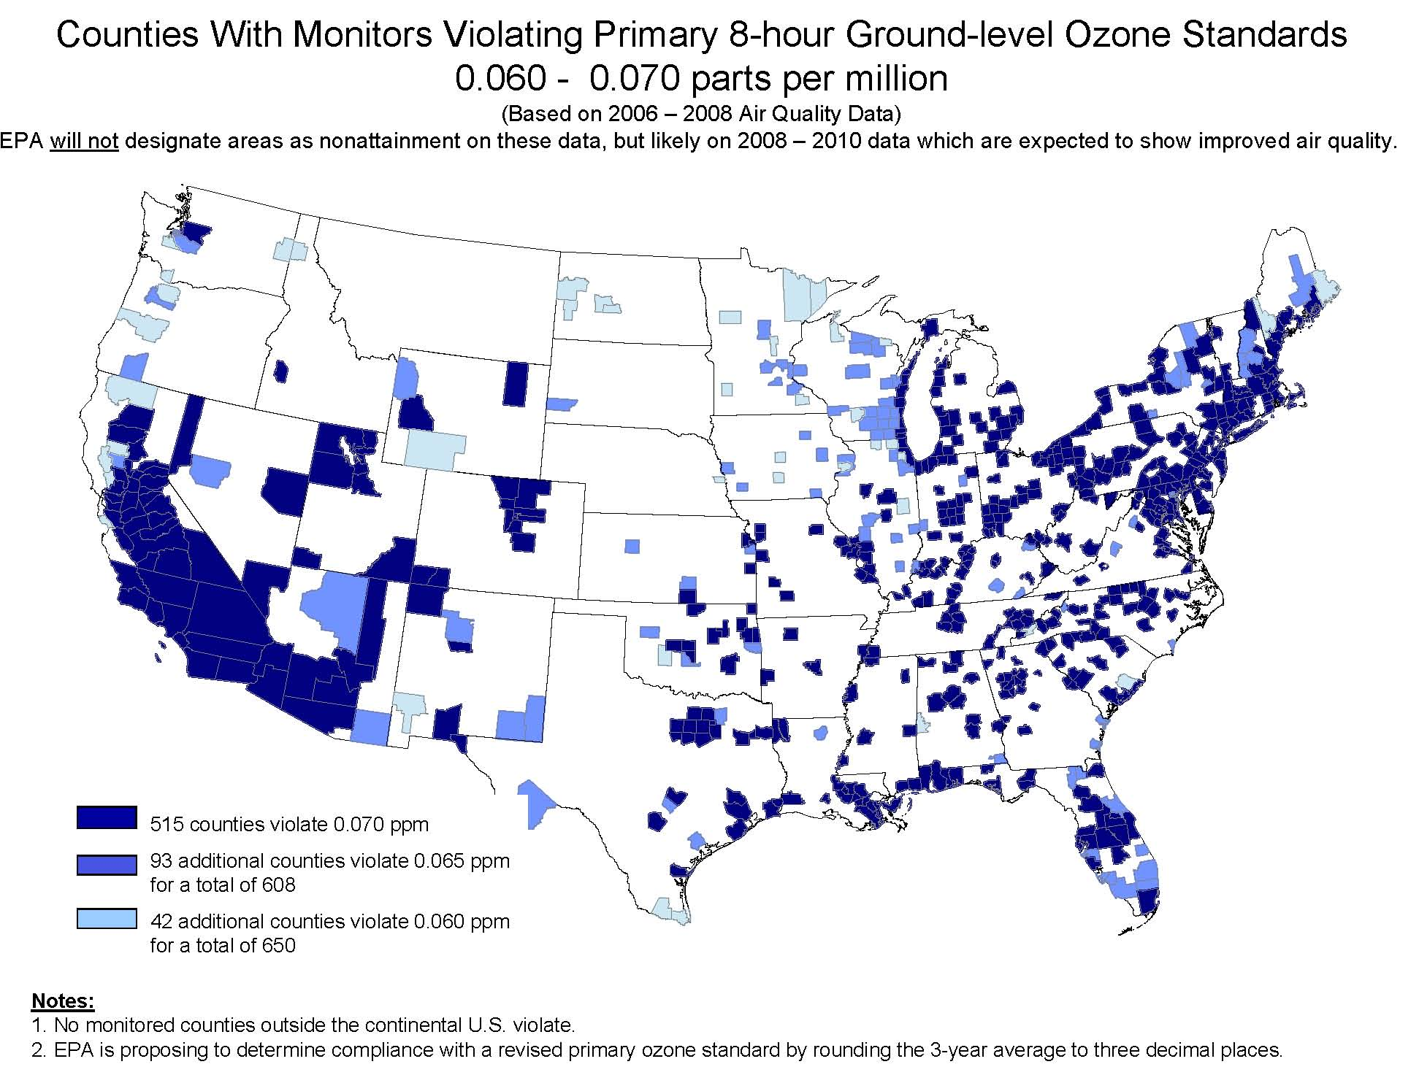
TEMPO science overview
As air quality standards become more stringent, more of the US may exceed the standards.
New and transient pollution sources (e.g., vehicular traffic, oil & gas development, trans-boundary pollution) will become more important but are very difficult to monitor from ground networks.
Air quality, climate change, and energy policies must increasingly be considered together.
TEMPO measurements will provide data to help solve these national challenges.
Counties Violating Ground-level Ozone Standards
TEMPO Science Questions
What are the temporal and spatial variations of emissions of gases and aerosols important for air quality and climate?
How do physical, chemical, and dynamical processes determine tropospheric composition and air quality over scales ranging from urban to continental, diurnally to seasonally?
How does air pollution drive climate forcing and how does climate change affect air quality on a continental scale?
How can observations from space improve air quality forecasts and assessments?
How does intercontinental transport affect air quality?
How do episodic events, such as wild fires, dust outbreaks, and volcanic eruptions, affect atmospheric composition and air quality?

Slide 4
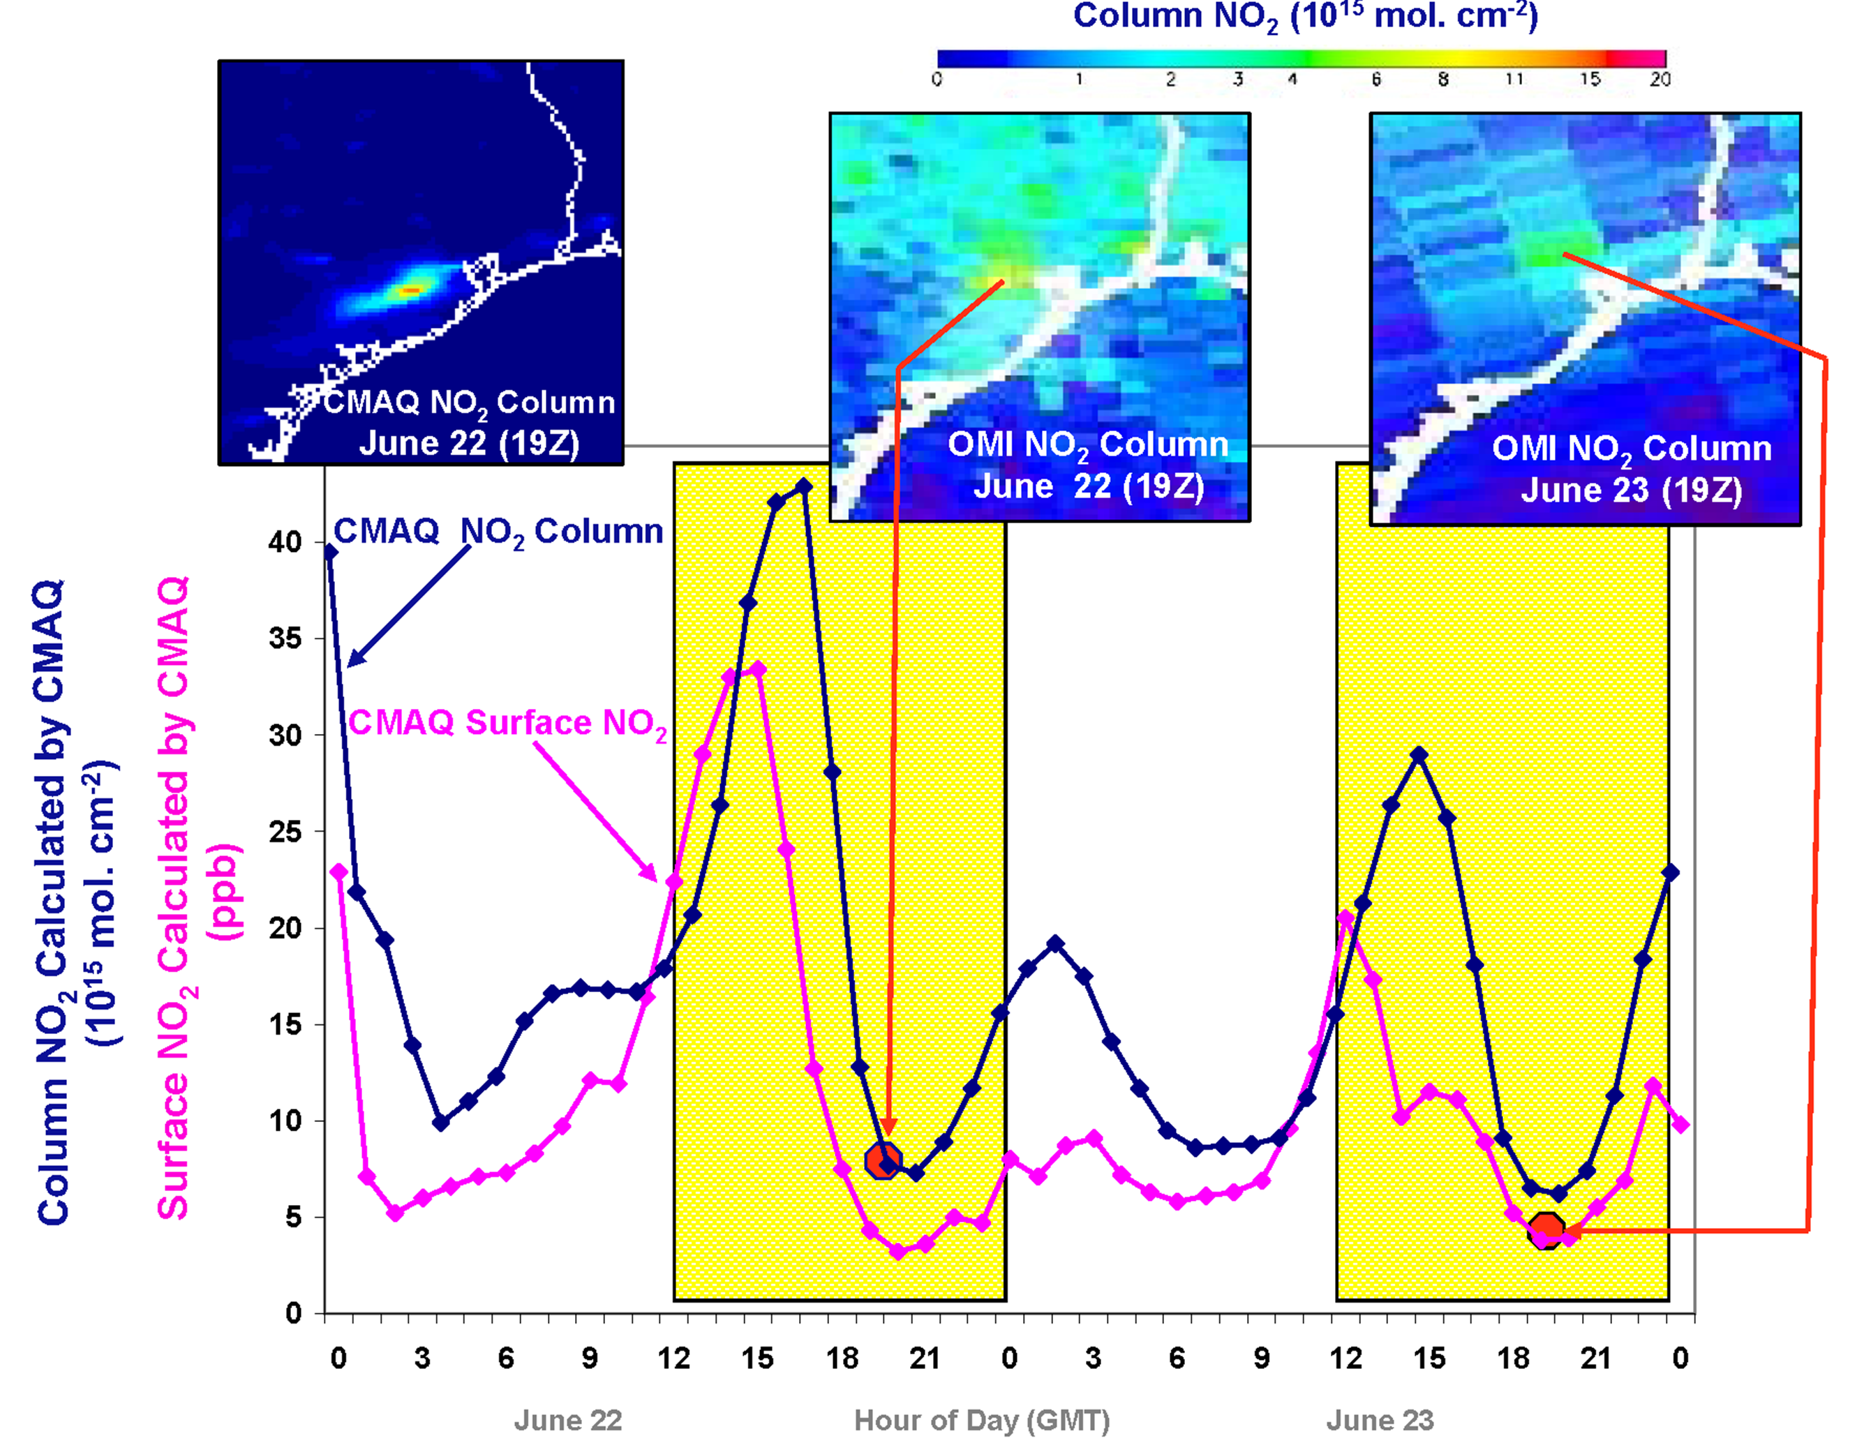
Why geostationary? High temporal and spatial resolution
Hourly NO₂ surface concentration and integrated column calculated by CMAQ air quality model: Houston, TX, June 22-23, 2005
June 22
Hour of Day (UTC)
June 23
LEO observations provide limited information on rapidly varying emissions, chemistry, & transport
GEO will provide observations at temporal and spatial scales highly relevant to air quality processes

Slide 5
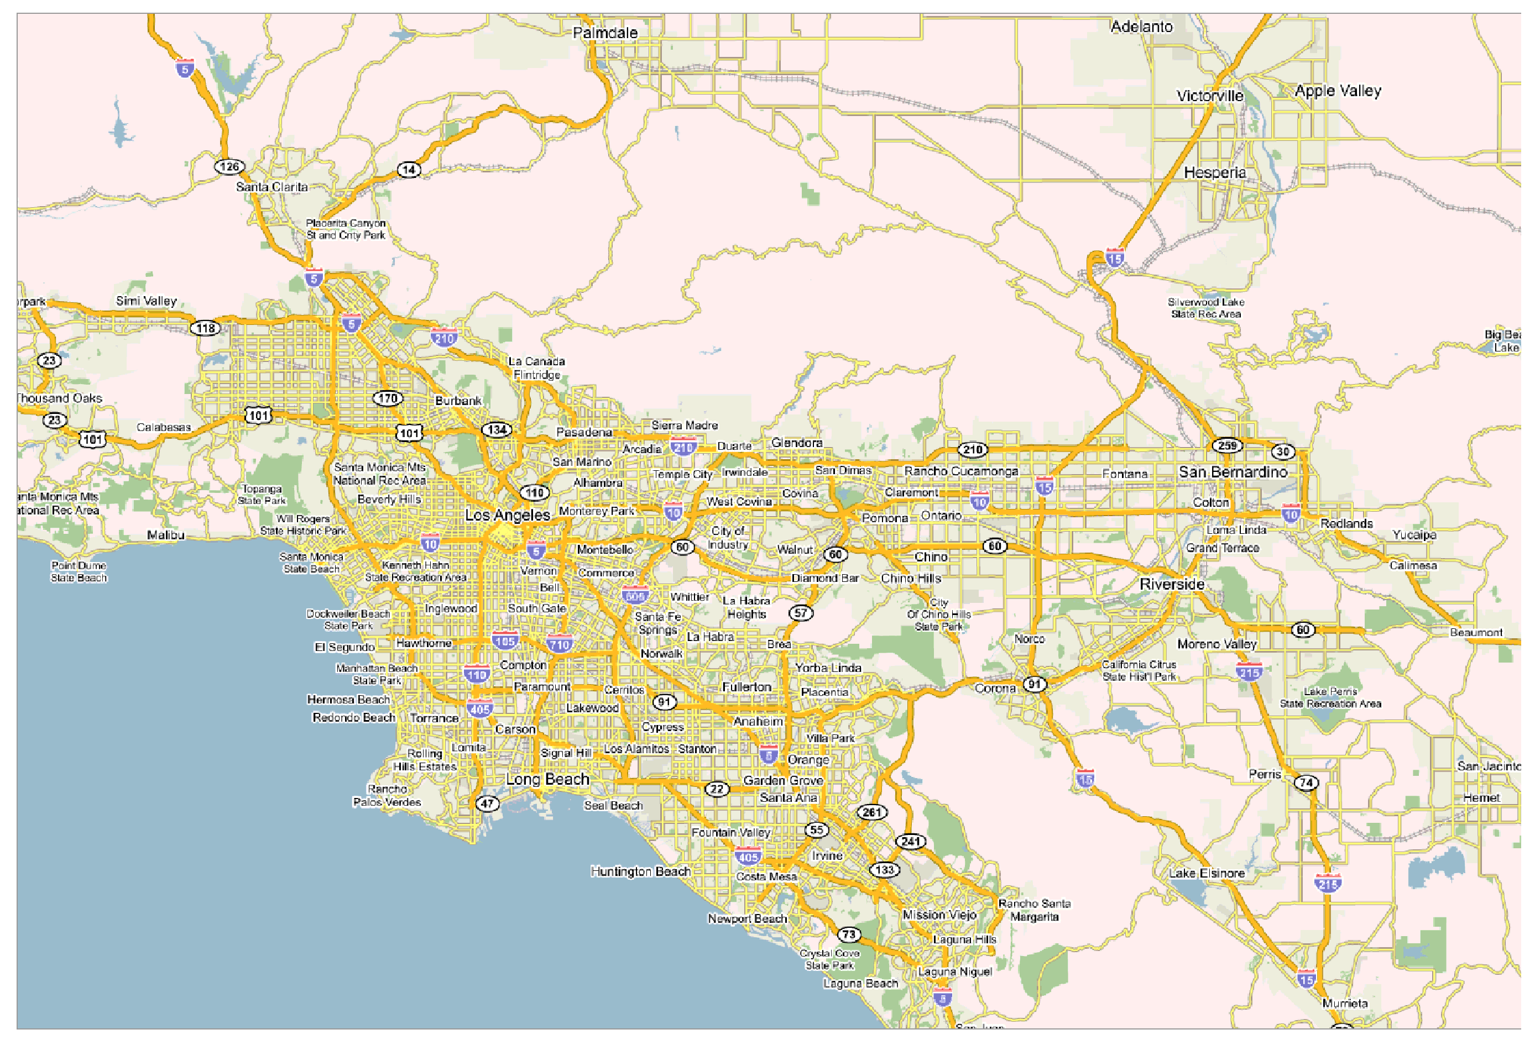
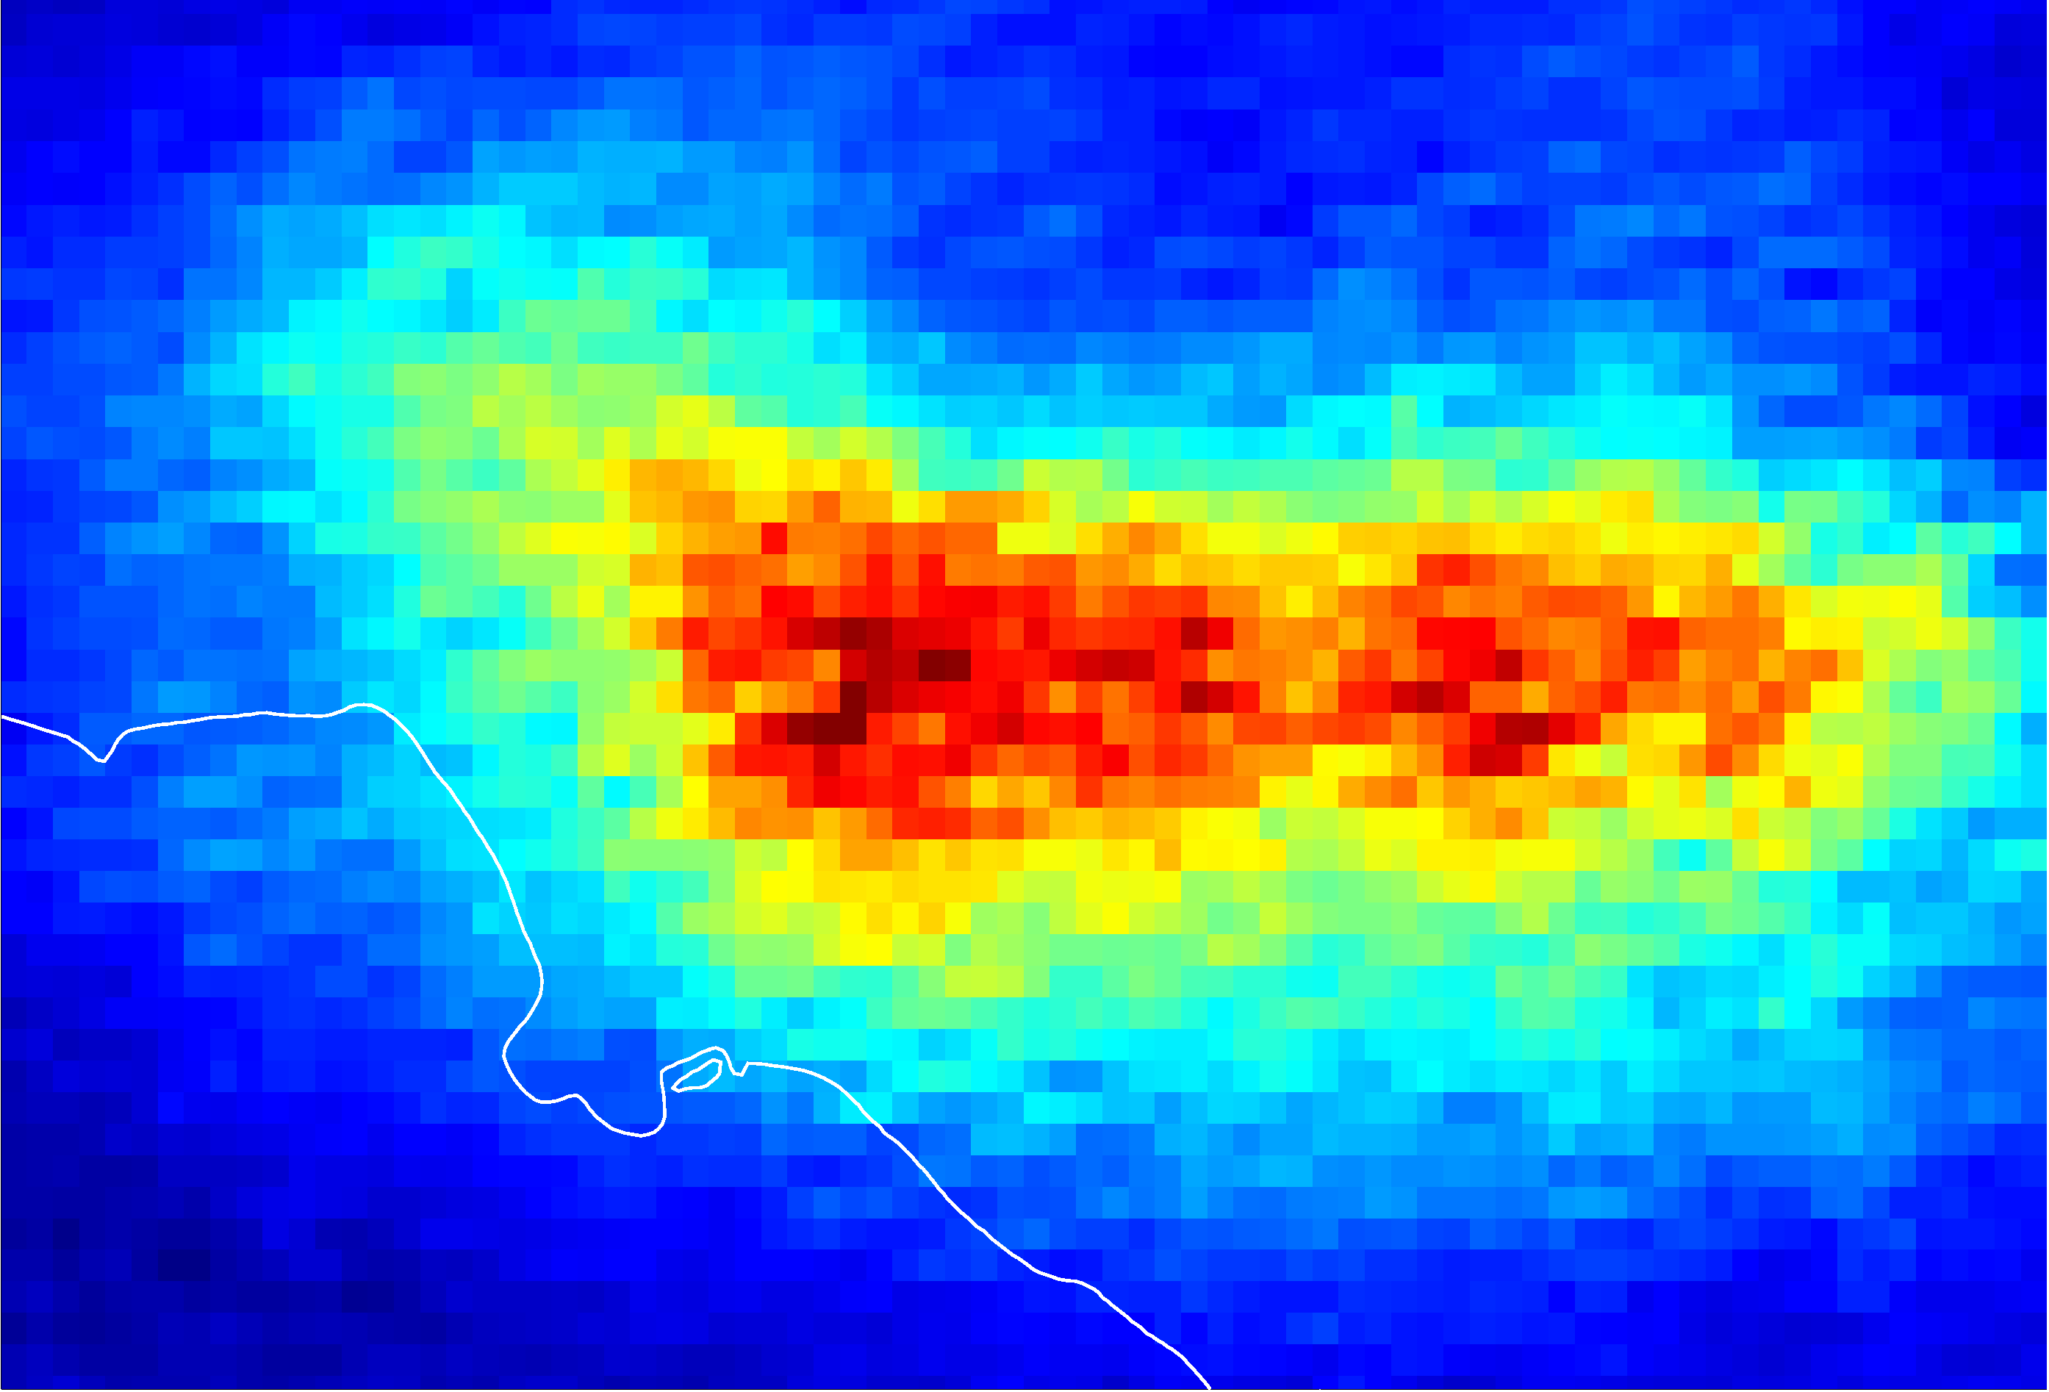
NO₂ over Los Angeles
Courtesy T. Kurosu

Slide 6
TEMPO science measurements
Violations of US National Ambient Air Quality Standards are primarily related to ozone (O₃) and particulate matter (aerosol)
  O₃ adversely impacts health and agriculture and is a greenhouse gas
  Aerosol adversely impacts health, reduces visibility, and influences climate
  Nitrogen dioxide (NO₂) and sulfur dioxide (SO₂) are also regulated
TEMPO measures O₃, key proxies for O₃ precursors (H₂CO and C₂H₂O₂ for hydrocarbons and NO₂ for nitrogen oxides), SO₂, and aerosol
O₃
O₂
STRATOSPHERE
TROPOSPHERE
By simultaneously measuring O₃ and the precursors from which it is produced, TEMPO provides understanding of all key phases of air quality: emissions, photochemistry, and long range transport
NO₂
H₂CO
OH
O₃
OH
O₃
NO₂
VOC
H₂O
CO
OH
NO
SO₂
Aerosol
  O₃ is created in the troposphere by photochemical cycles dependent on hydrocarbons and nitrogen oxides

Slide 7
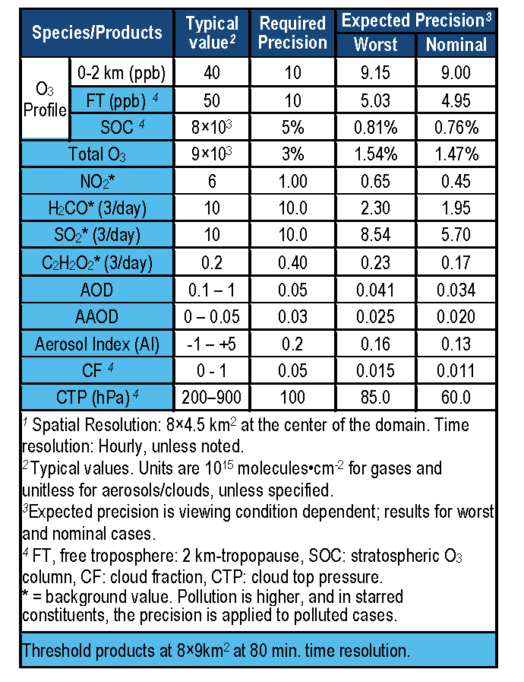
TEMPO baseline products
TEMPO has a minimally-redundant measurement set for air quality.

Slide 8
TEMPO instrument concept
Measurement technique
  Imaging grating spectrometer measuring solar backscattered Earth radiance
  Spectral band & resolution: 290-490 + 540-740 nm @ 0.6 nm FWHM, 0.2 nm sampling
  2 2-D, 2k×1k, detectors image the full spectral range for each geospatial scene
Field of Regard (FOR) and duty cycle
  Mexico City/Yucatan Peninsula to the Canadian tar/oil sands, Atlantic to Pacific
  Instrument slit aligned N/S and swept across the FOR in the E/W direction, producing a radiance map of Greater North America in one hour
Spatial resolution
  2.1 km N/S × 4.7 km E/W native pixel resolution (9.8 km²)
  Co-add/cloud clear as needed for specific data products
Standard data products and sampling rates
  Most sampled hourly, including eXceL O₃ (troposphere, PBL) for selected areas
  H₂CO, C₂H₂O₂, SO₂ sampled hourly (average results for ≥ 3/day if needed)
  Nominal spatial resolution 8.4 km N/S × 4.7 km E/W at center of domain (can often measure 2.1 km N/S × 4.7 km E/W)
  Measurement requirements met up to 50º for SO₂, 70º SZA for other products

Slide 9
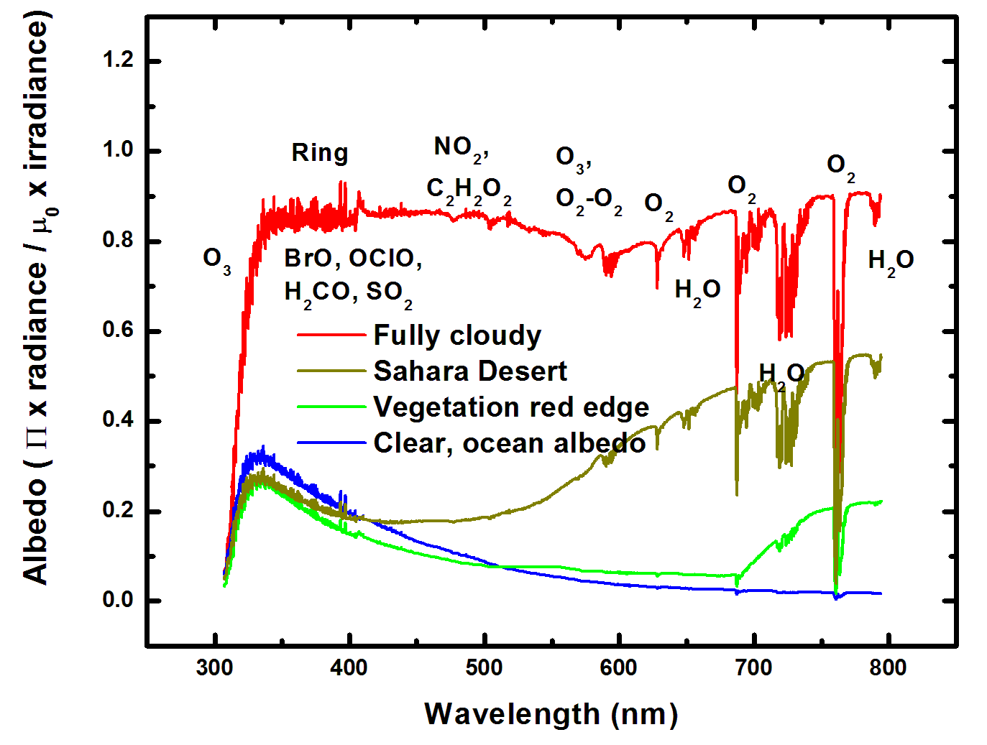
Typical TEMPO-range spectra (from ESA GOME-1)

Slide 10
TEMPO mission concept
Geostationary orbit, operating on a commercial telecom satellite
  NASA will arrange launch and hosting services (per Earth Venture Instrument scope)
    90-110º W preferred, 75-137º W acceptable
    Specifying satellite environment, accommodation
  Hourly measurement and telemetry duty cycle for at least ≤70º SZA
    Plan to measure up to 20 hours/day
TEMPO is low risk with significant space heritage
  All proposed TEMPO measurements have been made from low Earth orbit satellite instruments to the required precisions
  All TEMPO launch algorithms are implementations of currently operational algorithms
    NASA TOMS-type O₃
    SO₂, NO₂, H₂CO, C₂H₂O₂ from fitting with AMF-weighted cross sections
    Absorbing Aerosol Index, UV aerosol, Rotational Raman scattering cloud
    eXceL profile/tropospheric/PBL O₃ for selected geographic targets
Example higher-level products: Near-real-time pollution/AQ indices, UV index
TEMPO research products will greatly extend science and applications
  Example research products: eXceL profile O₃ for broad regions; BrO from AMF-normalized cross sections; height-resolved SO₂; additional cloud/aerosol products; vegetation products

Slide 11
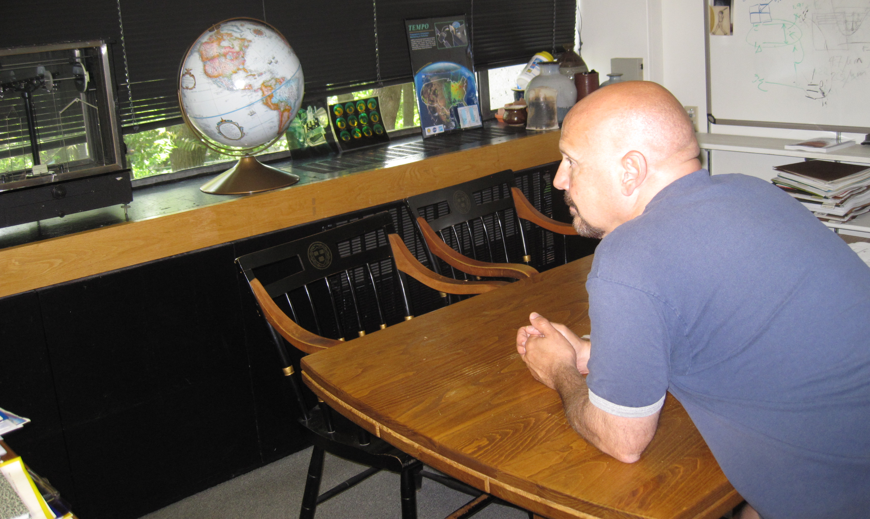
The view from GEO

Slide 12
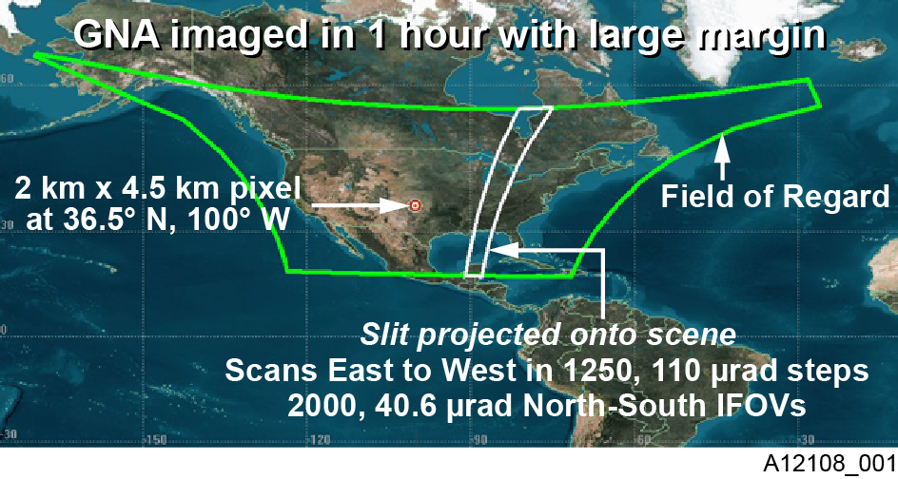
TEMPO footprint, ground sample distance and field of regard
2.1 km × 4.7
__________
Each 2.1 km × 4.7 km pixel is a 2K element spectrum from 290-740 nm
GEO platform selected by NASA for viewing Greater North America

Slide 13
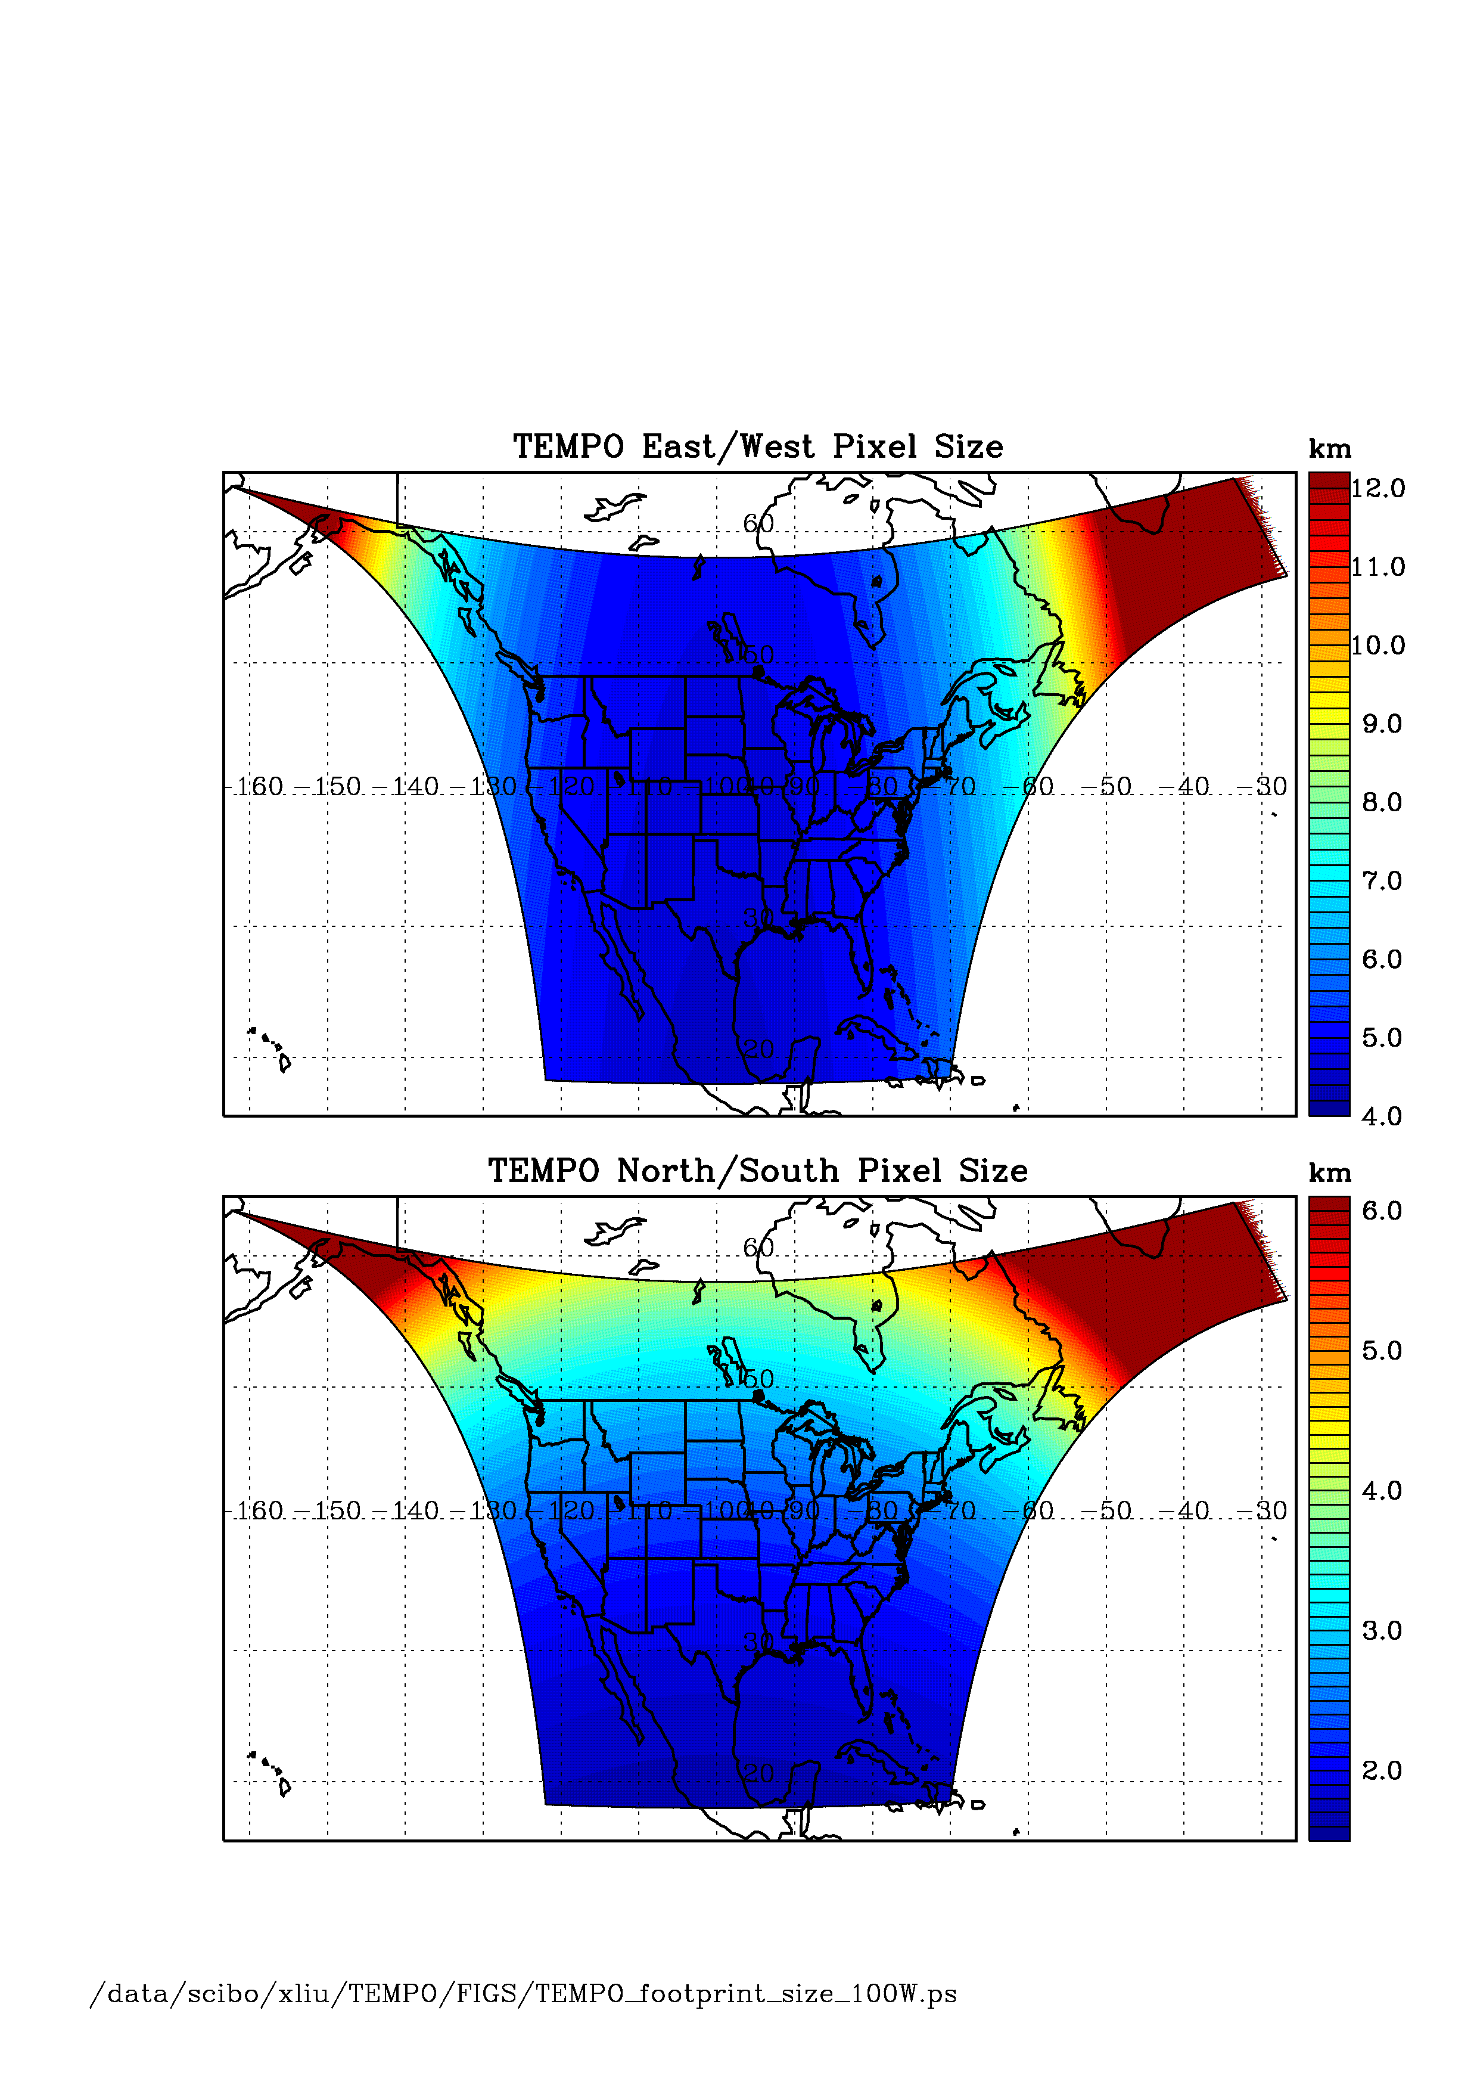
TEMPO footprint (GEO at 100º W)
Location | N/S (km) | E/W (km) | GSA (km²)
36.5ºN, 100ºW | 2.11 | 4.65 | 9.8
Washington, DC | 2.37 | 5.36 | 11.9
Seattle | 2.99 | 5.46 | 14.9
Los Angeles | 2.09 | 5.04 | 10.2
Boston | 2.71 | 5.90 | 14.1
Miami | 1.83 | 5.04 | 9.0
Mexico City | 1.65 | 4.54 | 7.5
Canadian tar sands | 3.94 | 5.05 | 19.2
Assumes 2000 N/S pixels
For GEO at 80ºW, pixel size at 36.5ºN, 100ºW is 2.2 km × 5.2 km.

Slide 14
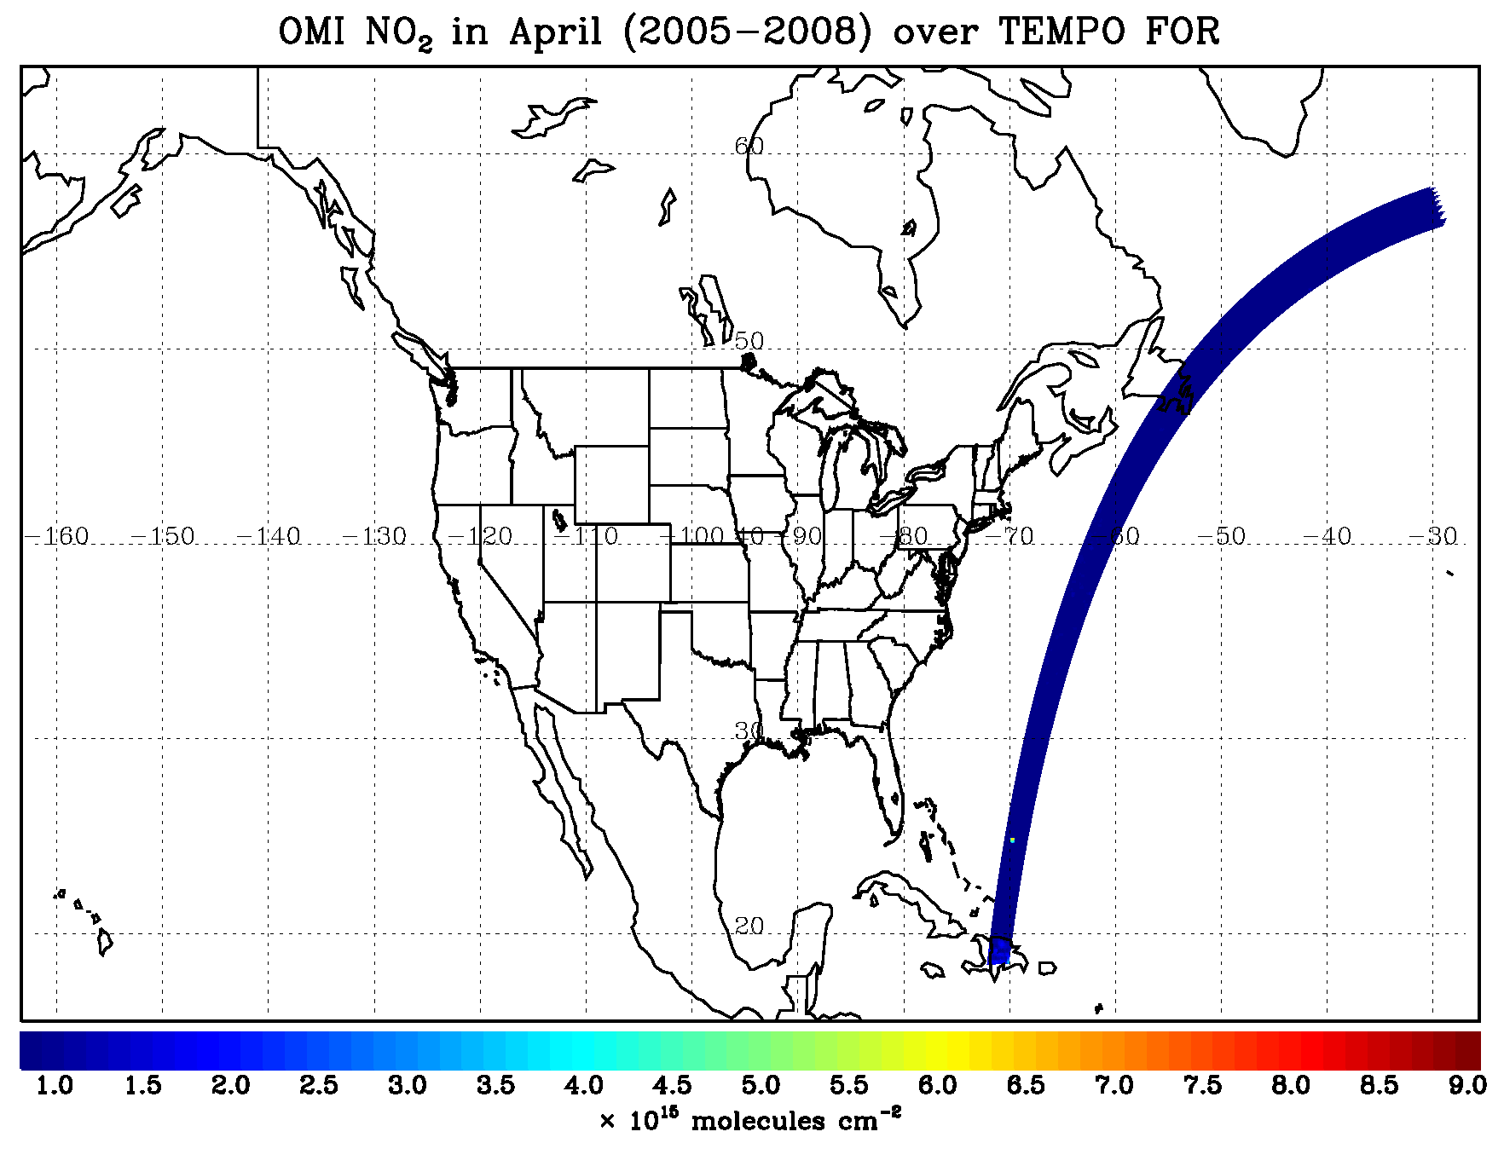
TEMPO hourly NO₂ sweep

Slide 15
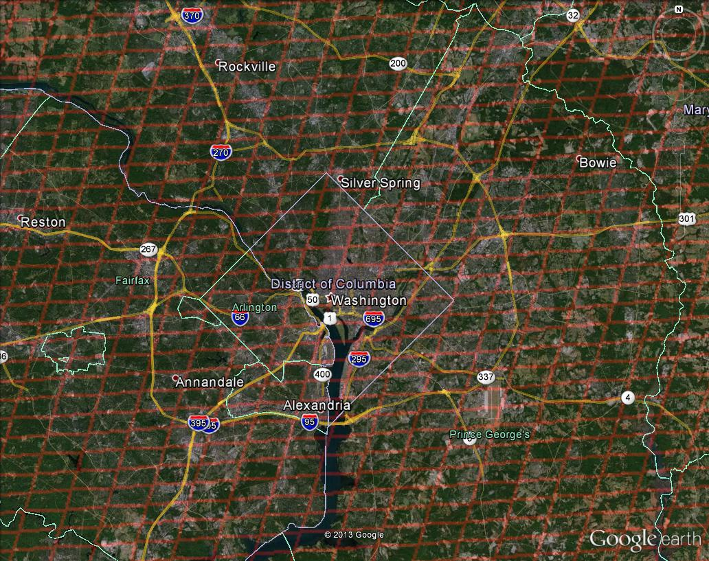
Washington, DC coverage
Hourly!

Slide 16
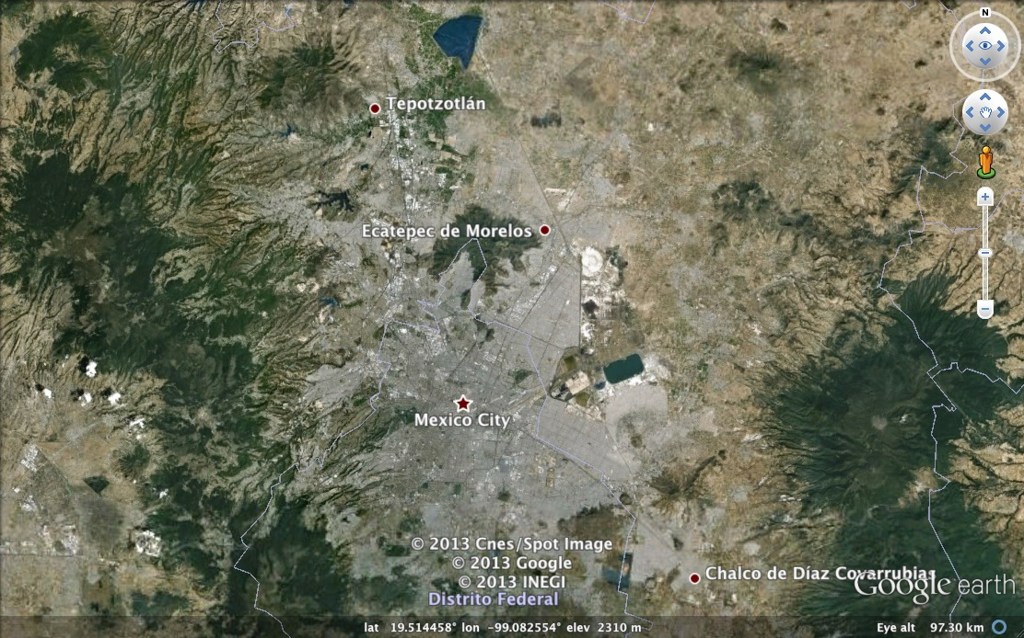

Mexico City coverage
¡Cada hora!

Slide 17
Measurement requirements
Species | Required precision | Sensitivity driver
Trop O₃ | 10 ppbv | Hourly for SZA ≤ 70º
Free trop O₃ | 10 ppbv | Hourly for SZA ≤ 70º
0-2 km O₃ | 10 ppbv | Hourly for SZA ≤ 70º
Total O₃ | 3% | Hourly for SZA ≤ 70º
NO₂ | 1.0×10¹⁵ | Hourly for SZA ≤ 70º
H₂CO | 1.0×10¹⁶ 1.73×10¹⁶ | 3/day for SZA ≤ 70º or Hourly for SZA ≤ 70º
SO₂ | 1.0×10¹⁶ 1.73×10¹⁶ | 3/day for SZA ≤ 50º or Hourly for SZA ≤ 50º
C₂H₂O₂ | 4.0×10¹⁴ 6.98×10¹⁴ | 3/day for SZA ≤ 70º or Hourly for SZA ≤ 70º
AOD | 0.10 | Hourly for SZA ≤ 70º
Spatial Resolution: ~8.84×5.11 km² or better at the center of the field of regard
Aerosol: requires smaller native pixels for cloud clearing.
NO₂, H₂CO, C₂H₂O₂, SO₂ are in vertical column densities (VCDs; molecules cm⁻²)
TEMPO STM: from GEO-CAPE STM with modifications:
  H₂CO, SO₂, C₂H₂O₂: scale precision from 3 times/day to hourly
  SZA req. for H₂CO & C₂H₂O₂ is changed to 70º. Still 50º for SO₂.
STM measurement requirements → Instrument requirements.

Slide 18
Refinement of instrument
SNR requirements
Sensitivity studies quantify variation of trace gas performance with respect to variables including SZA, time, location, cloudiness, aerosol loading, terrain height, etc.
Synthetic dataset developed from state-of-the-art (GEOS-Chem) model fields
  Hourly over TEMPO field of regard for 12 days (1 day/month) up to SZA 80° → ~90000 simulations
  O₃, NO₂, H₂CO, SO₂, C₂H₂O₂, H₂O, BrO, OClO, O₂, O₄
  6 types of aerosols, water/ice clouds, pixel independent approximation
  Koelemeijer GOME surface albedo database with linear interpolation
  Actual viewing geometry for a geostationary satellite (e.g., 100°W)
RTM Calculation and Sensitivity Calculation
  270-800 nm at 0.6 nm FWHM, 0.2 nm sampling
  Include additional weighting functions with respect to AOD, ASSA, COD, cloud fraction
  State vector includes AOD, ASSA, COD, cloud fraction additionally
  TEMPO SNR model: account for optical transmission and grating efficiency, including shot, dark current, RTN, readout, quantization, smear, CTE noise terms

Slide 19
SNR requirements and instrument performance
The current TEMPO design meets SNR requirements for nominal radiances with >20% EOL margin.
Species | Spectral range (nm) | Nominal radiance phot s⁻¹ cm⁻² nm⁻¹ sr⁻¹ | Req’d. SNR | Actual SNR | EOL margin
O₃ | 290-300 | 6.74×10¹⁰ | 48.2 | 64.2 | 33.3%
O₃ | 300-345 | 7.07×10¹² | 1134 | 1512 | 33.3%
O₃ | 540-650 | 1.19×10¹³ | 1327 | 1769 | 33.3%
SO₂ | 305-345 | 7.93×10¹² | 1399 | 1683 | 20.3%
H₂CO | 327-356 | 1.25×10¹³ | 763 | 2277 | 198%
Cloud | 346-354 | 1.26×10¹³ | 1200 | 2265 | 88.8%*
AOD | 354-388 | 1.25×10¹³ | 1414 | 2213 | 56.5%**
NO₂ | 423-451 | 1.65×10¹³ | 963 | 2609 | 171%
C₂H₂O₂ | 420-465 | 1.74×10¹³ | 1897 | 2629 | 38.6%
Vegetation | 700-740 | 1.36×10¹³ |  | 923
* SNR of 600 is needed at native resolution of ~2.2×5.1 km²
** SNR of 1000 is needed at native resolution using OMI UV aerosol algorithm (354+388 nm)

Slide 20
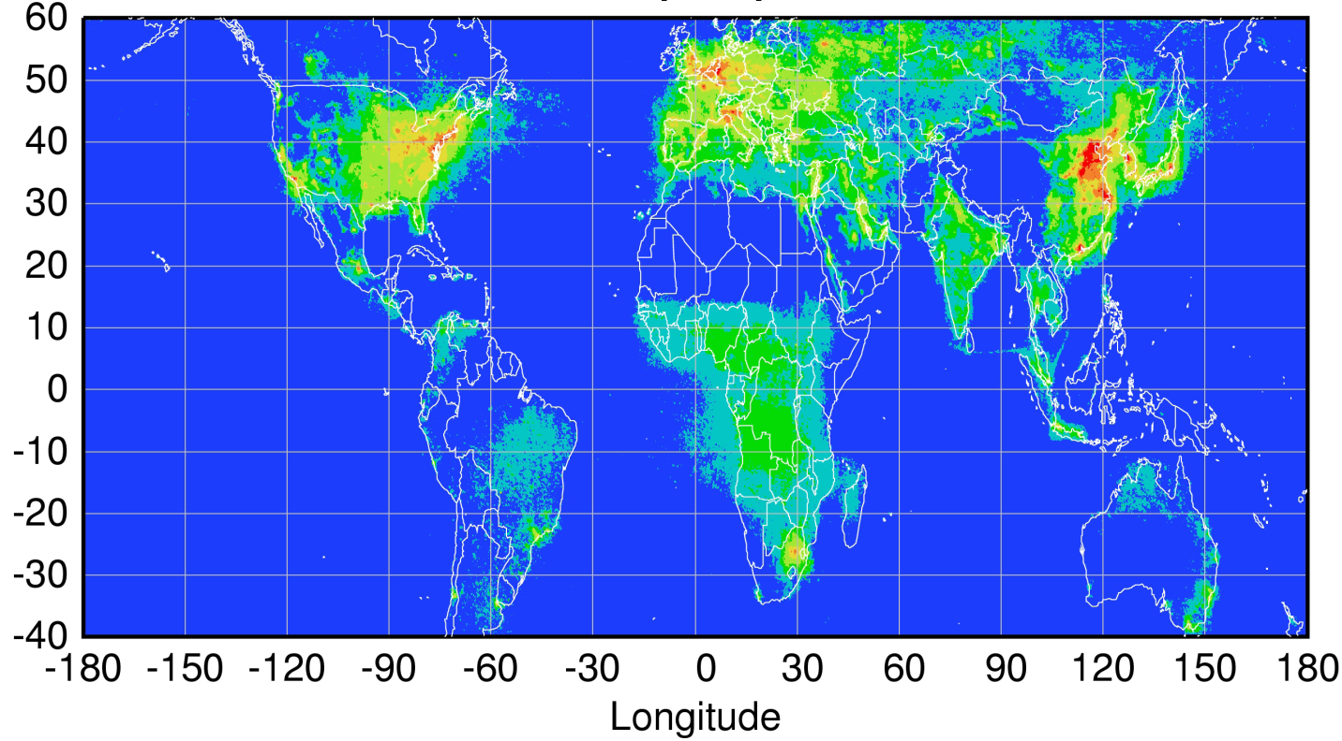
Global pollution monitoring constellation (2018-2020)
Sentinel-4
(hourly)
TEMPO
(hourly)
GEMS
(hourly)
Sentinel-5P
(once per day)
Courtesy Jhoon Kim,
Andreas Richter
Policy-relevant science and environmental services enabled by common observations
Improved emissions, at common confidence levels, over industrialized Northern Hemisphere
Improved air quality forecasts and assimilation systems
Improved assessment, e.g., observations to support United Nations Convention on Long Range Transboundary Air Pollution

Slide 21
Science summary
The TEMPO mission addresses NASA’s Strategic Plan:
  Strategic Goal 2: Expand scientific understanding of the Earth and the universe in which we live
    Advance Earth system science to meet the challenges of climate and environmental change
The science objectives of the mission lead to specific mission, measurement, and instrument requirements
The existing TEMPO mission meets these Level 1 requirements
Have defined Baseline and Threshold science requirements
The project science team, instrument team, mission team and PI are working closely together to have a successful mission.

Slide 22




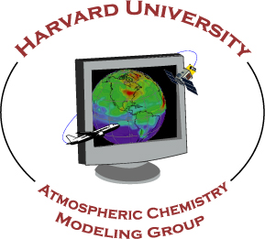





The End!

Slide 23
Backups

Slide 24
Process to determine and verify instrument requirements
Instrument Design
Verify
RTM & Ret. Sens. vs. SNR and FWHM
RTM & Ret. Sens.
Initialize
Refine
Measurement Requirements
(STM, ISD)
Retrieval Performance

Slide 25
Gas retrievals:
Requirements and sensitivities
TEMPO baseline measurement requirements
Methodology of sensitivity studies
Initial determination of instrument SNR requirements
Trace gas retrieval performance and refinement of SNR requirements

Slide 26
Retrieval sensitivity studies
Perform radiative transfer model (RTM) simulations with VLIDORT: Radiances and weighting functions
Estimate retrieval errors for both O₃ profile and other trace gas VCDs using the optimal estimation formulation, accounting for interferences but ignoring spectroscopic errors
  Measurement: spectral resolution, spectral interval
  Measurement error: assumed or from instrument SNR model
  State vector: target, interfering gases, Ring, surface albedo (up to 4th order)
  A priori error: climatological for O₃, unconstrained for other trace gas VCDs, consistent with current algorithms
  Retrieval errors: use solution errors (smoothing + precision)
  Can calculate errors due to other parameters (e.g., radiance errors, polarization sensitivity, surface albedo, cloud, aerosol, surface pressure) for determining retrieval error budgets and calibration requirements.
Same as NLLS for VCDs (unconstrained)

Slide 27
Initial determination of
SNR requirements
Molecule | O₃ | SO₂ | NO₂ | H₂CO | C₂H₂O₂
Fit Windows (nm) | 290-345 540-650 | 305-330 305-345 | 423-451 | 327-356 | 433-465 420-465
Use 1 “tough” atmospheric profile under highly ideal conditions
  GSFC NY12 from K. Pickering for July
  Clear-sky, no aerosols, 0.03 surface albedo at all wavelengths
Define worst viewing scenarios (different for different trace gases)
  O₃, SO₂: SZA 50°, VZA 66.2° (Northwest corner, 130°W, 50°N)
  NO₂: SZA 70°, VZA 17.6° (95°W, 15°N)
  H₂CO, C₂H₂O₂: SZA 50°, VZA 17.6° (95°W, 15°N)
Perform high-resolution RTM calculations: convolved to various spectral resolution and sampled at different spectral intervals.
Perform retrieval sensitivity studies: retrieval errors vs. various SNRs (shot noise only, SNR ~ SQRT(I)) and spectral resolutions

Slide 28
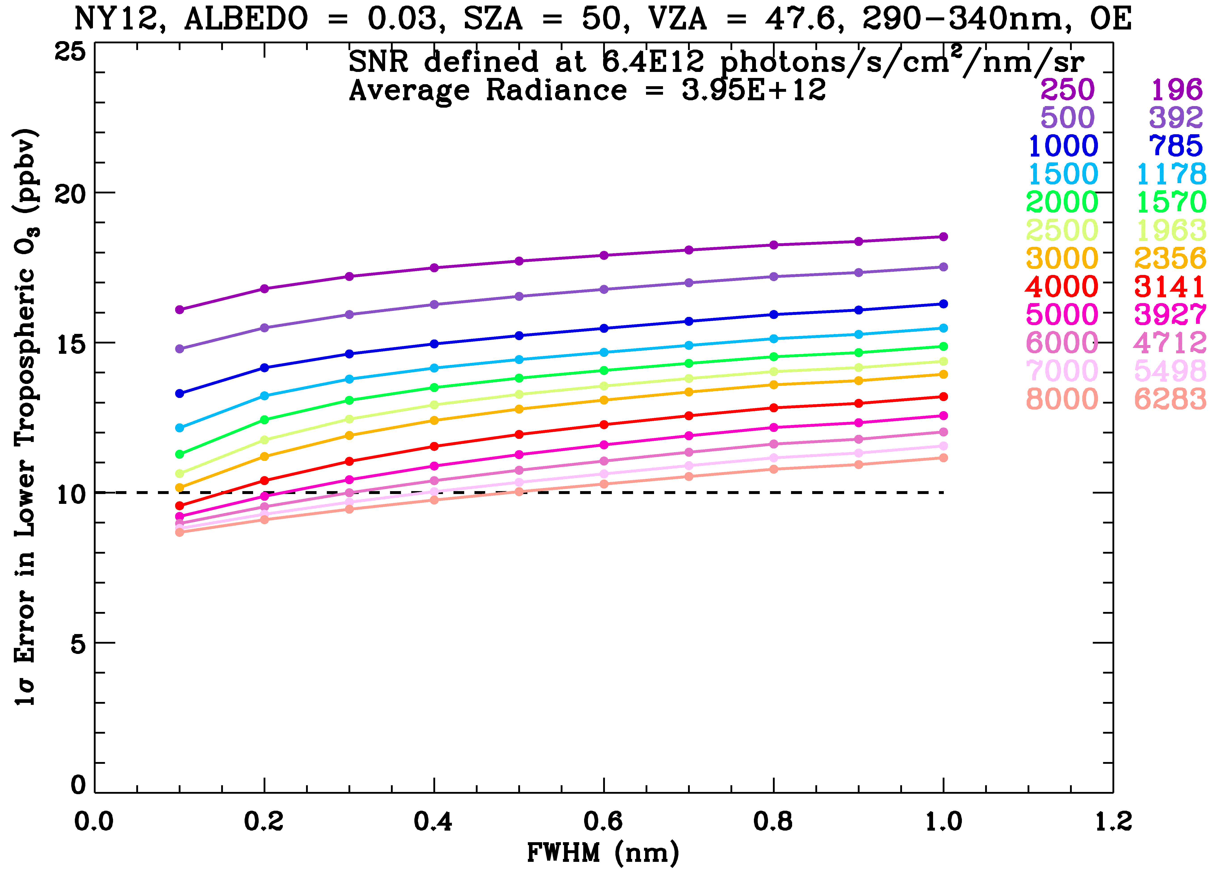
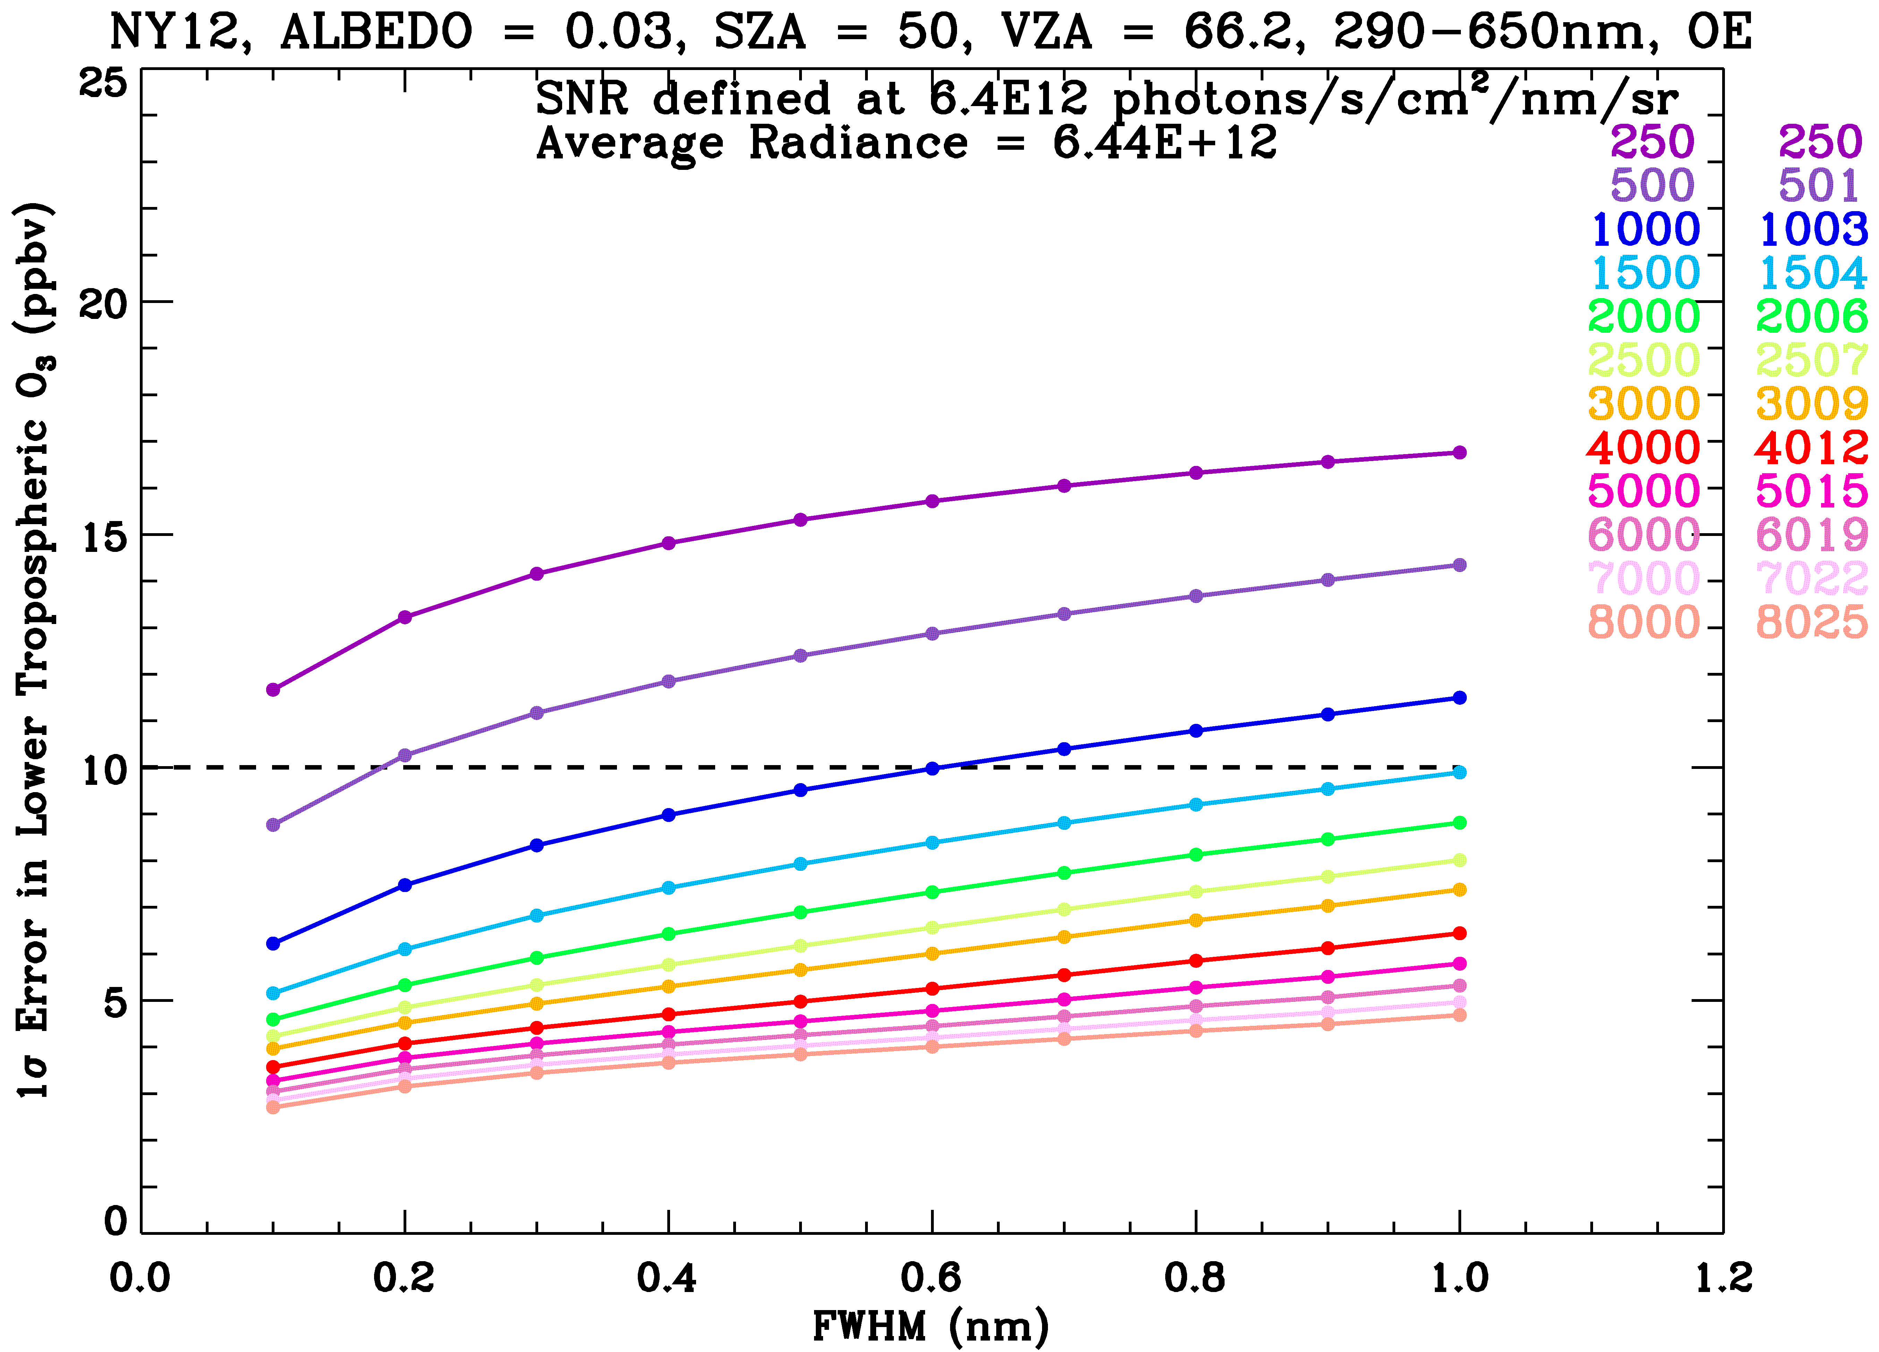
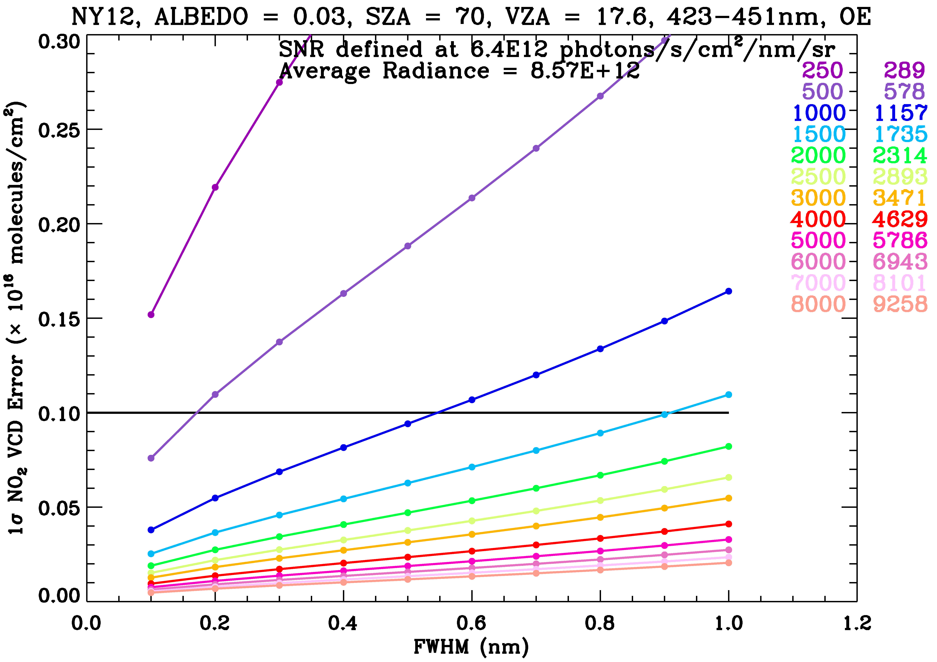
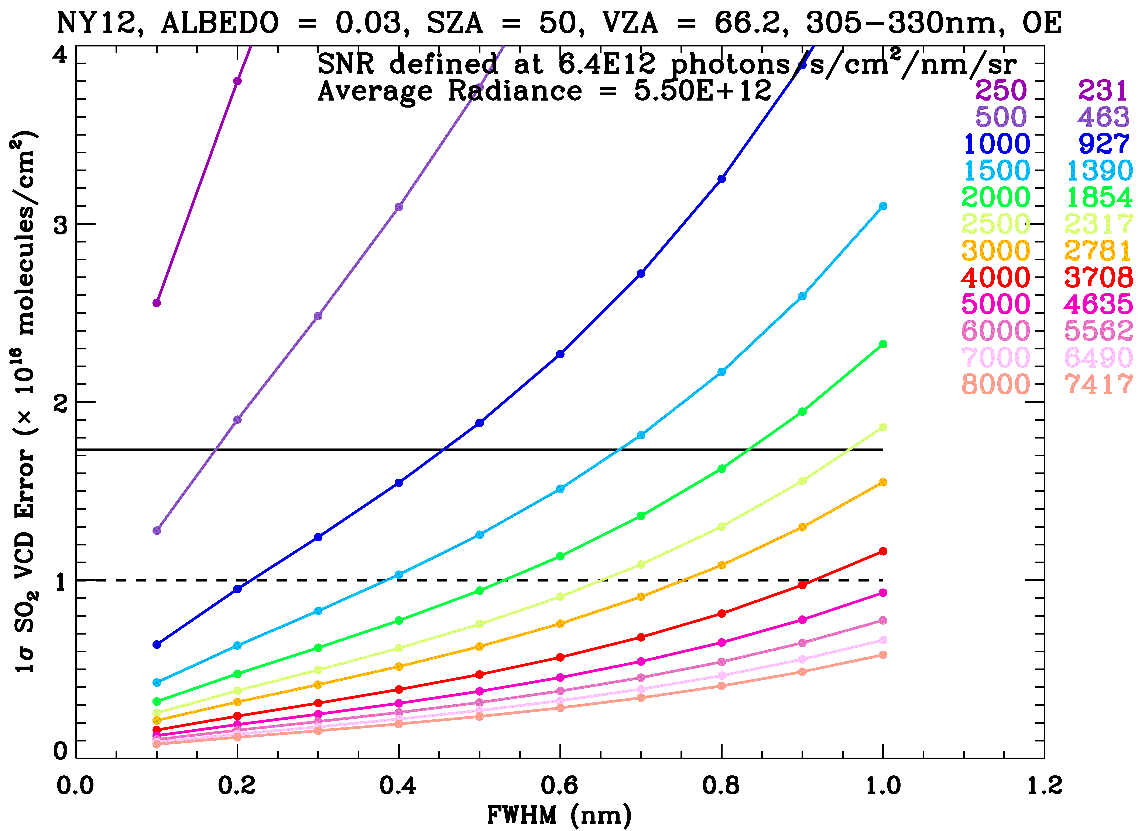
Initial determination of
SNR requirements
0-2 km O₃, UV
0-2 km O₃, UV+Vis
SO₂
NO₂

Slide 29
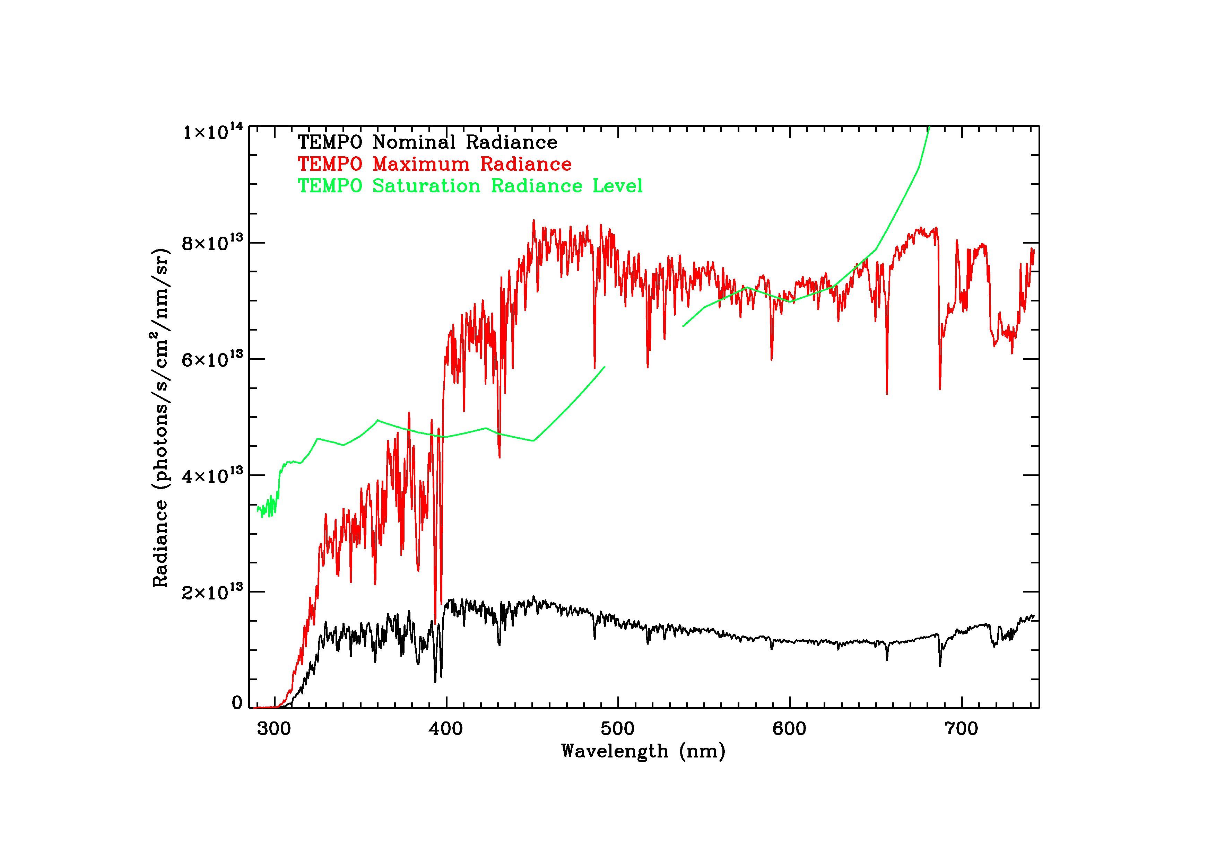
Determination of nominal and maximum radiances
Nominal and maximum radiances are often needed for instrument design to determine the radiance and saturation level and to estimate SNR
Nominal: mean clear (f_{c} < 0.05) over land
Maximum: maximum at each wavelength of all simulations
Saturation req.: No saturation at 50% of max radiance

Slide 30
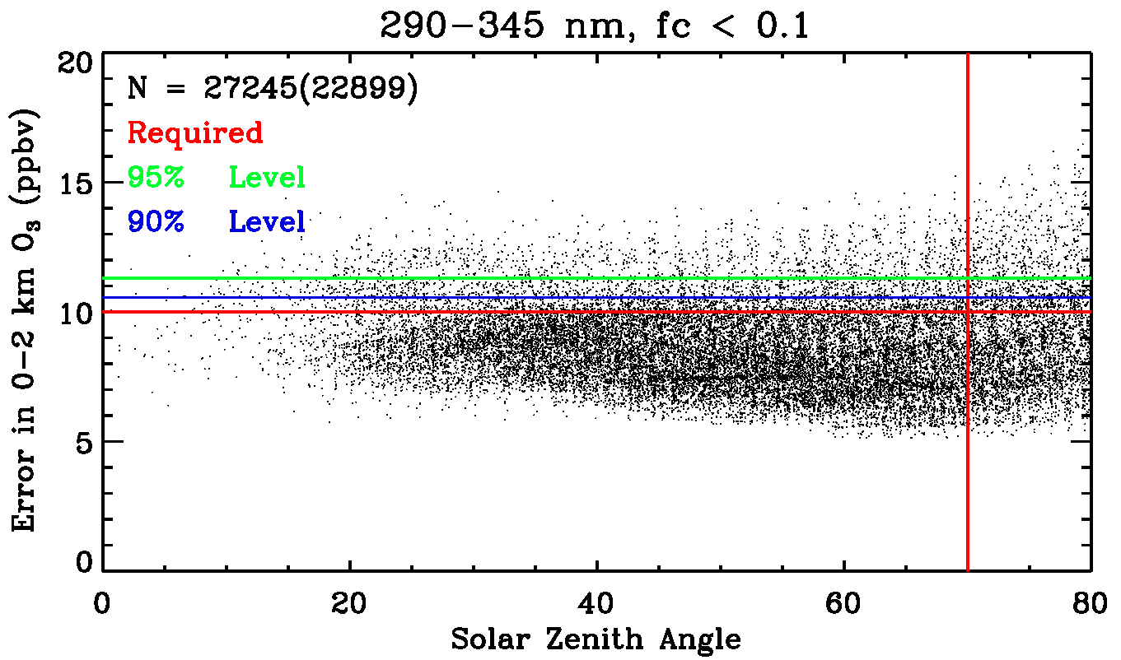
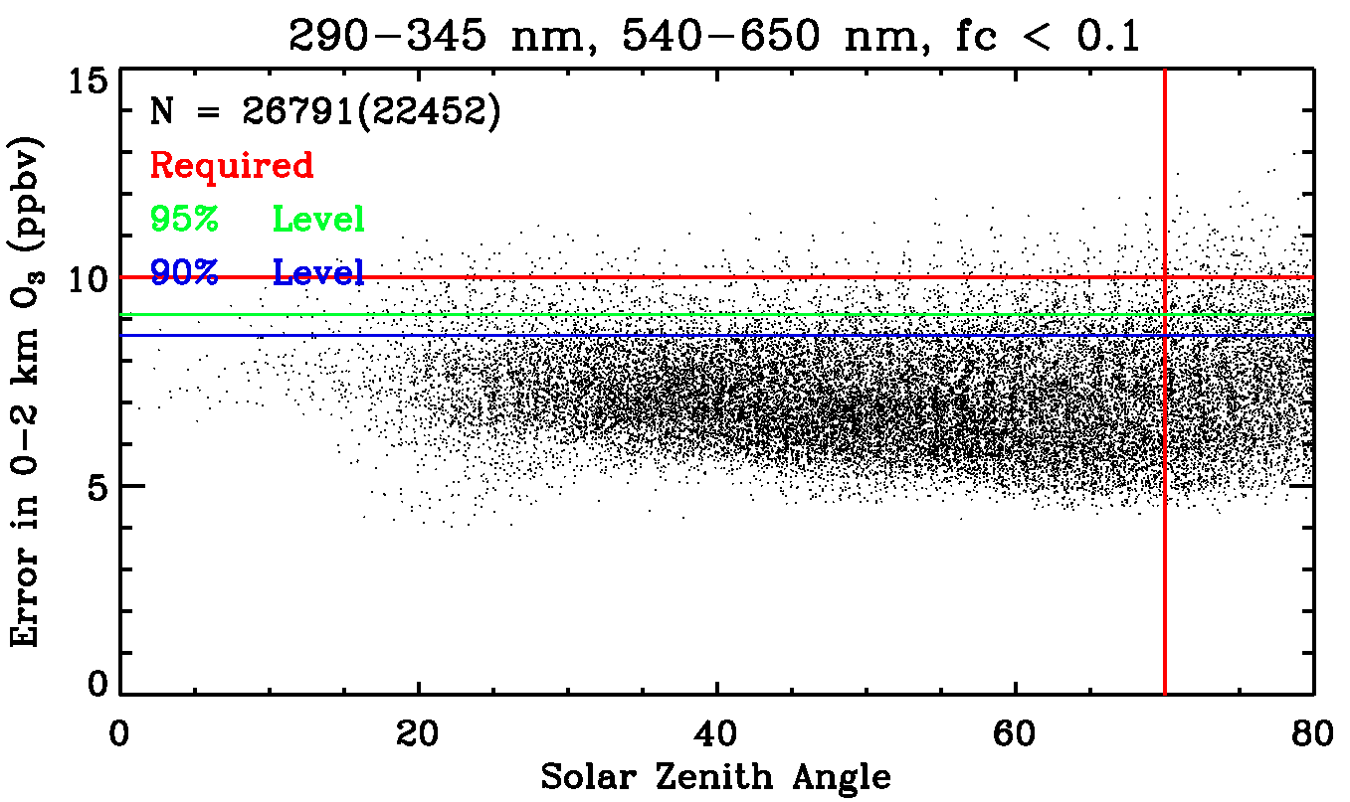
O₃ (0-2 km) retrieval performance
(cloud fraction < 0.1)
For O₃, measuring 0-2 km ozone to better than 10 ppbv is the driving requirement.
Not every retrieval can meet the requirement, define “requirement met” using a threshold: e.g., 90%, 95%
95% level: performance level (e.g., in error) for 95% of the cases
Use 95% except for SO₂ which is 90%
UV
UV+Vis
SZA requirement

Slide 31
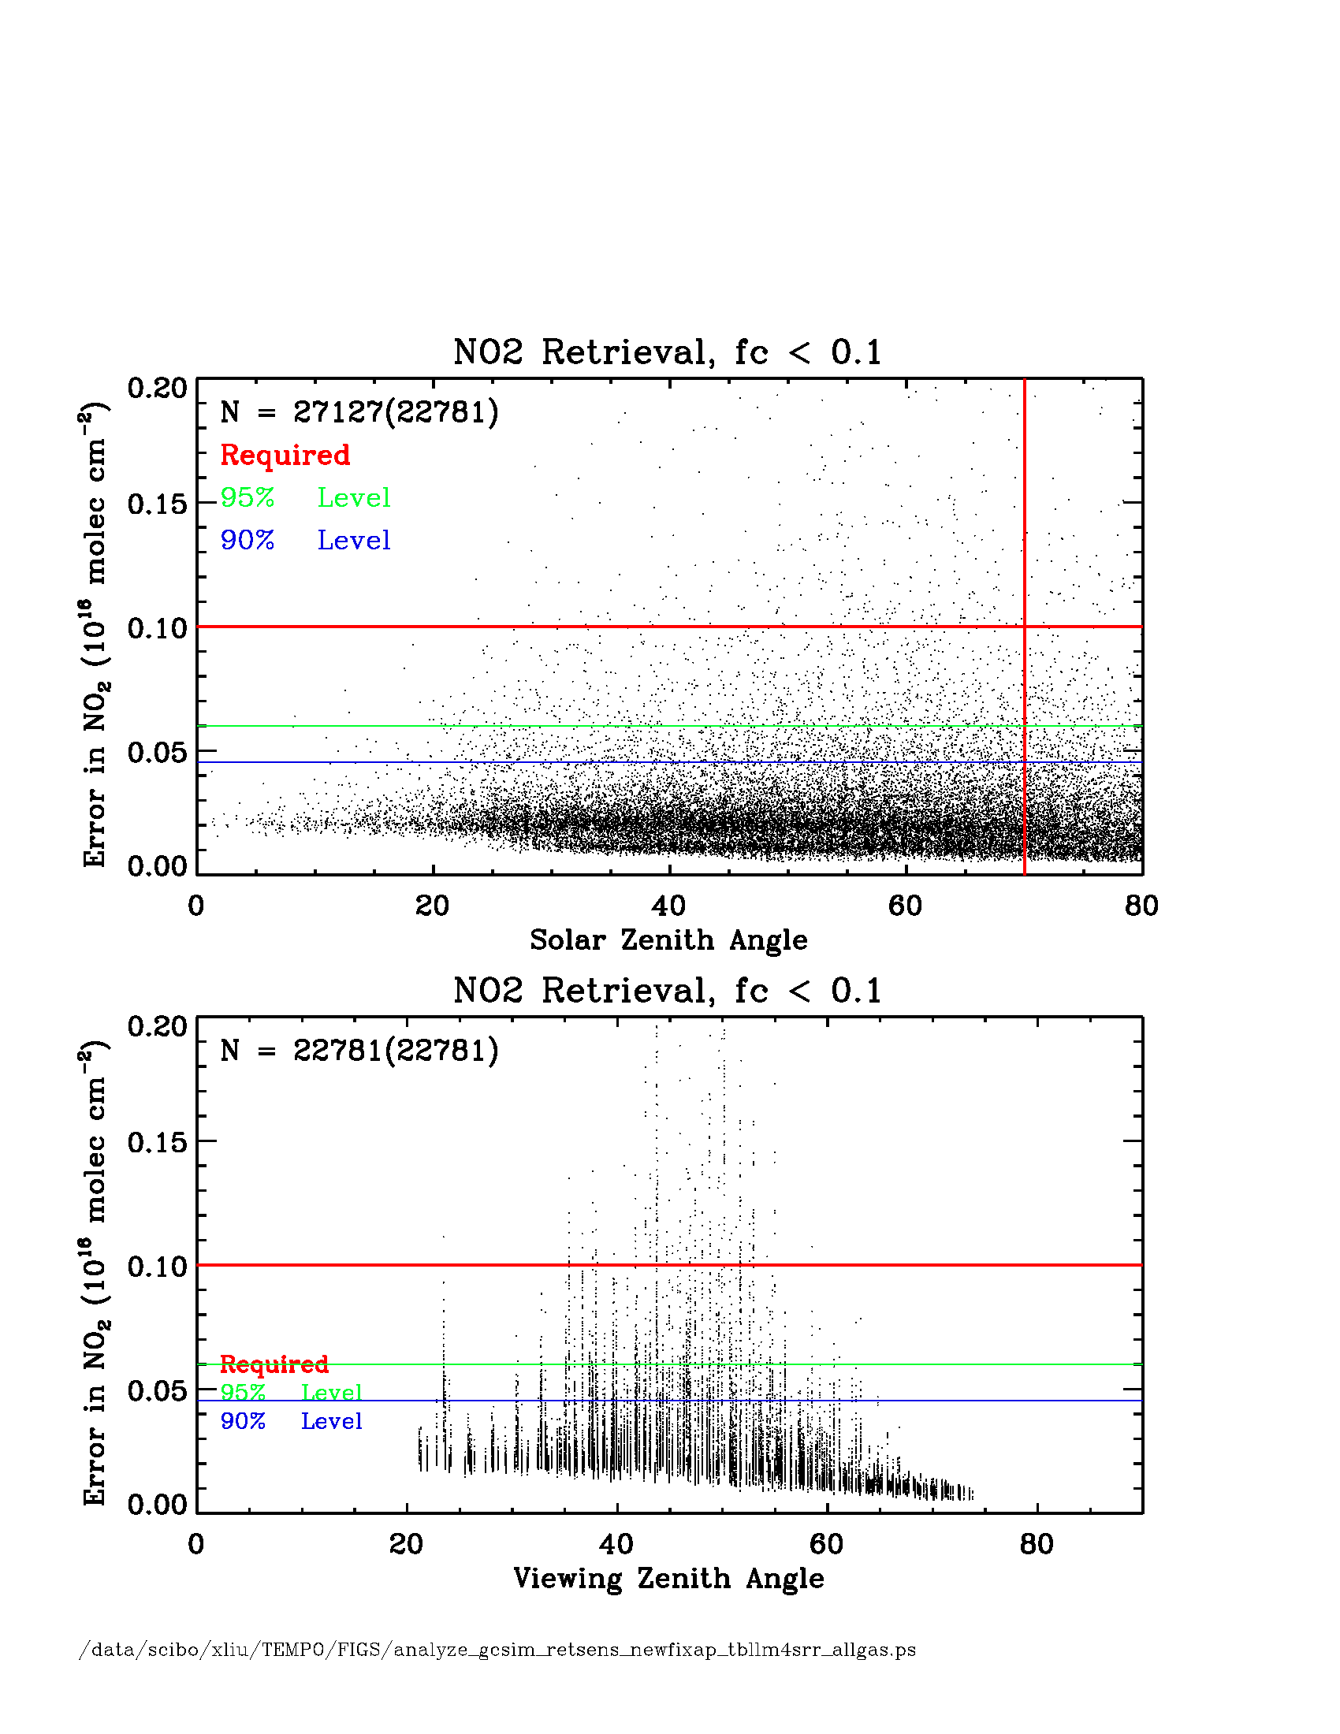
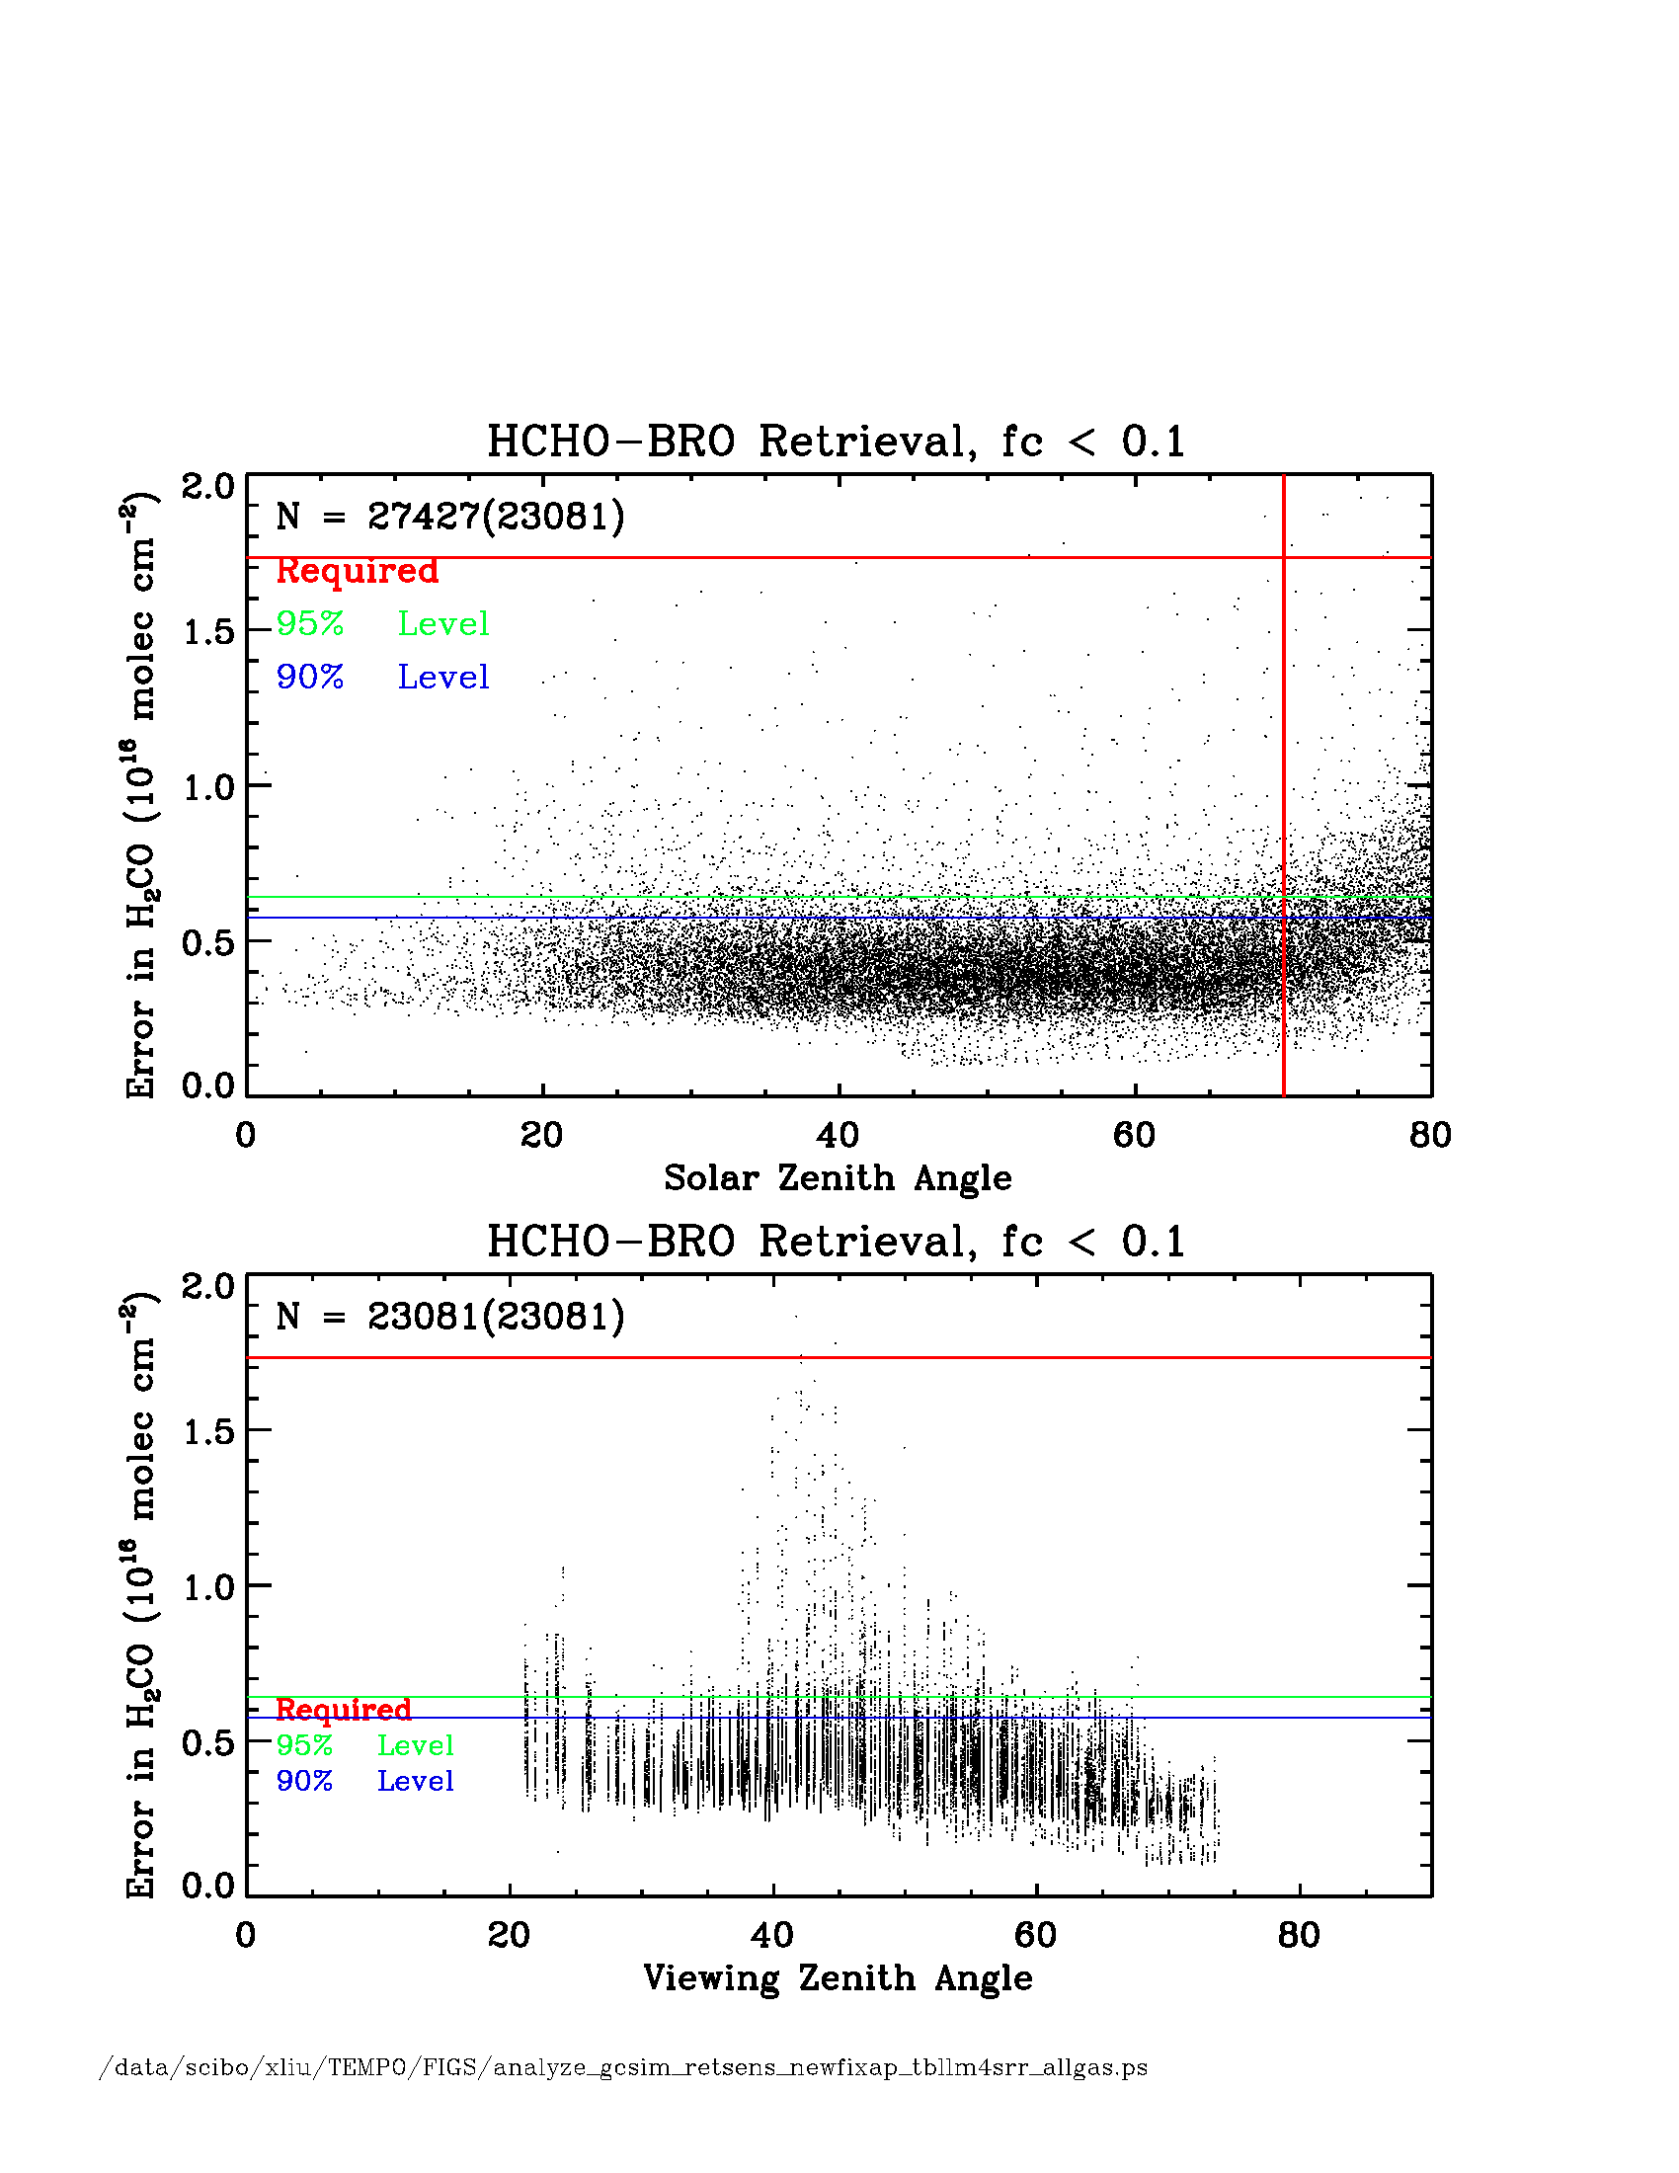
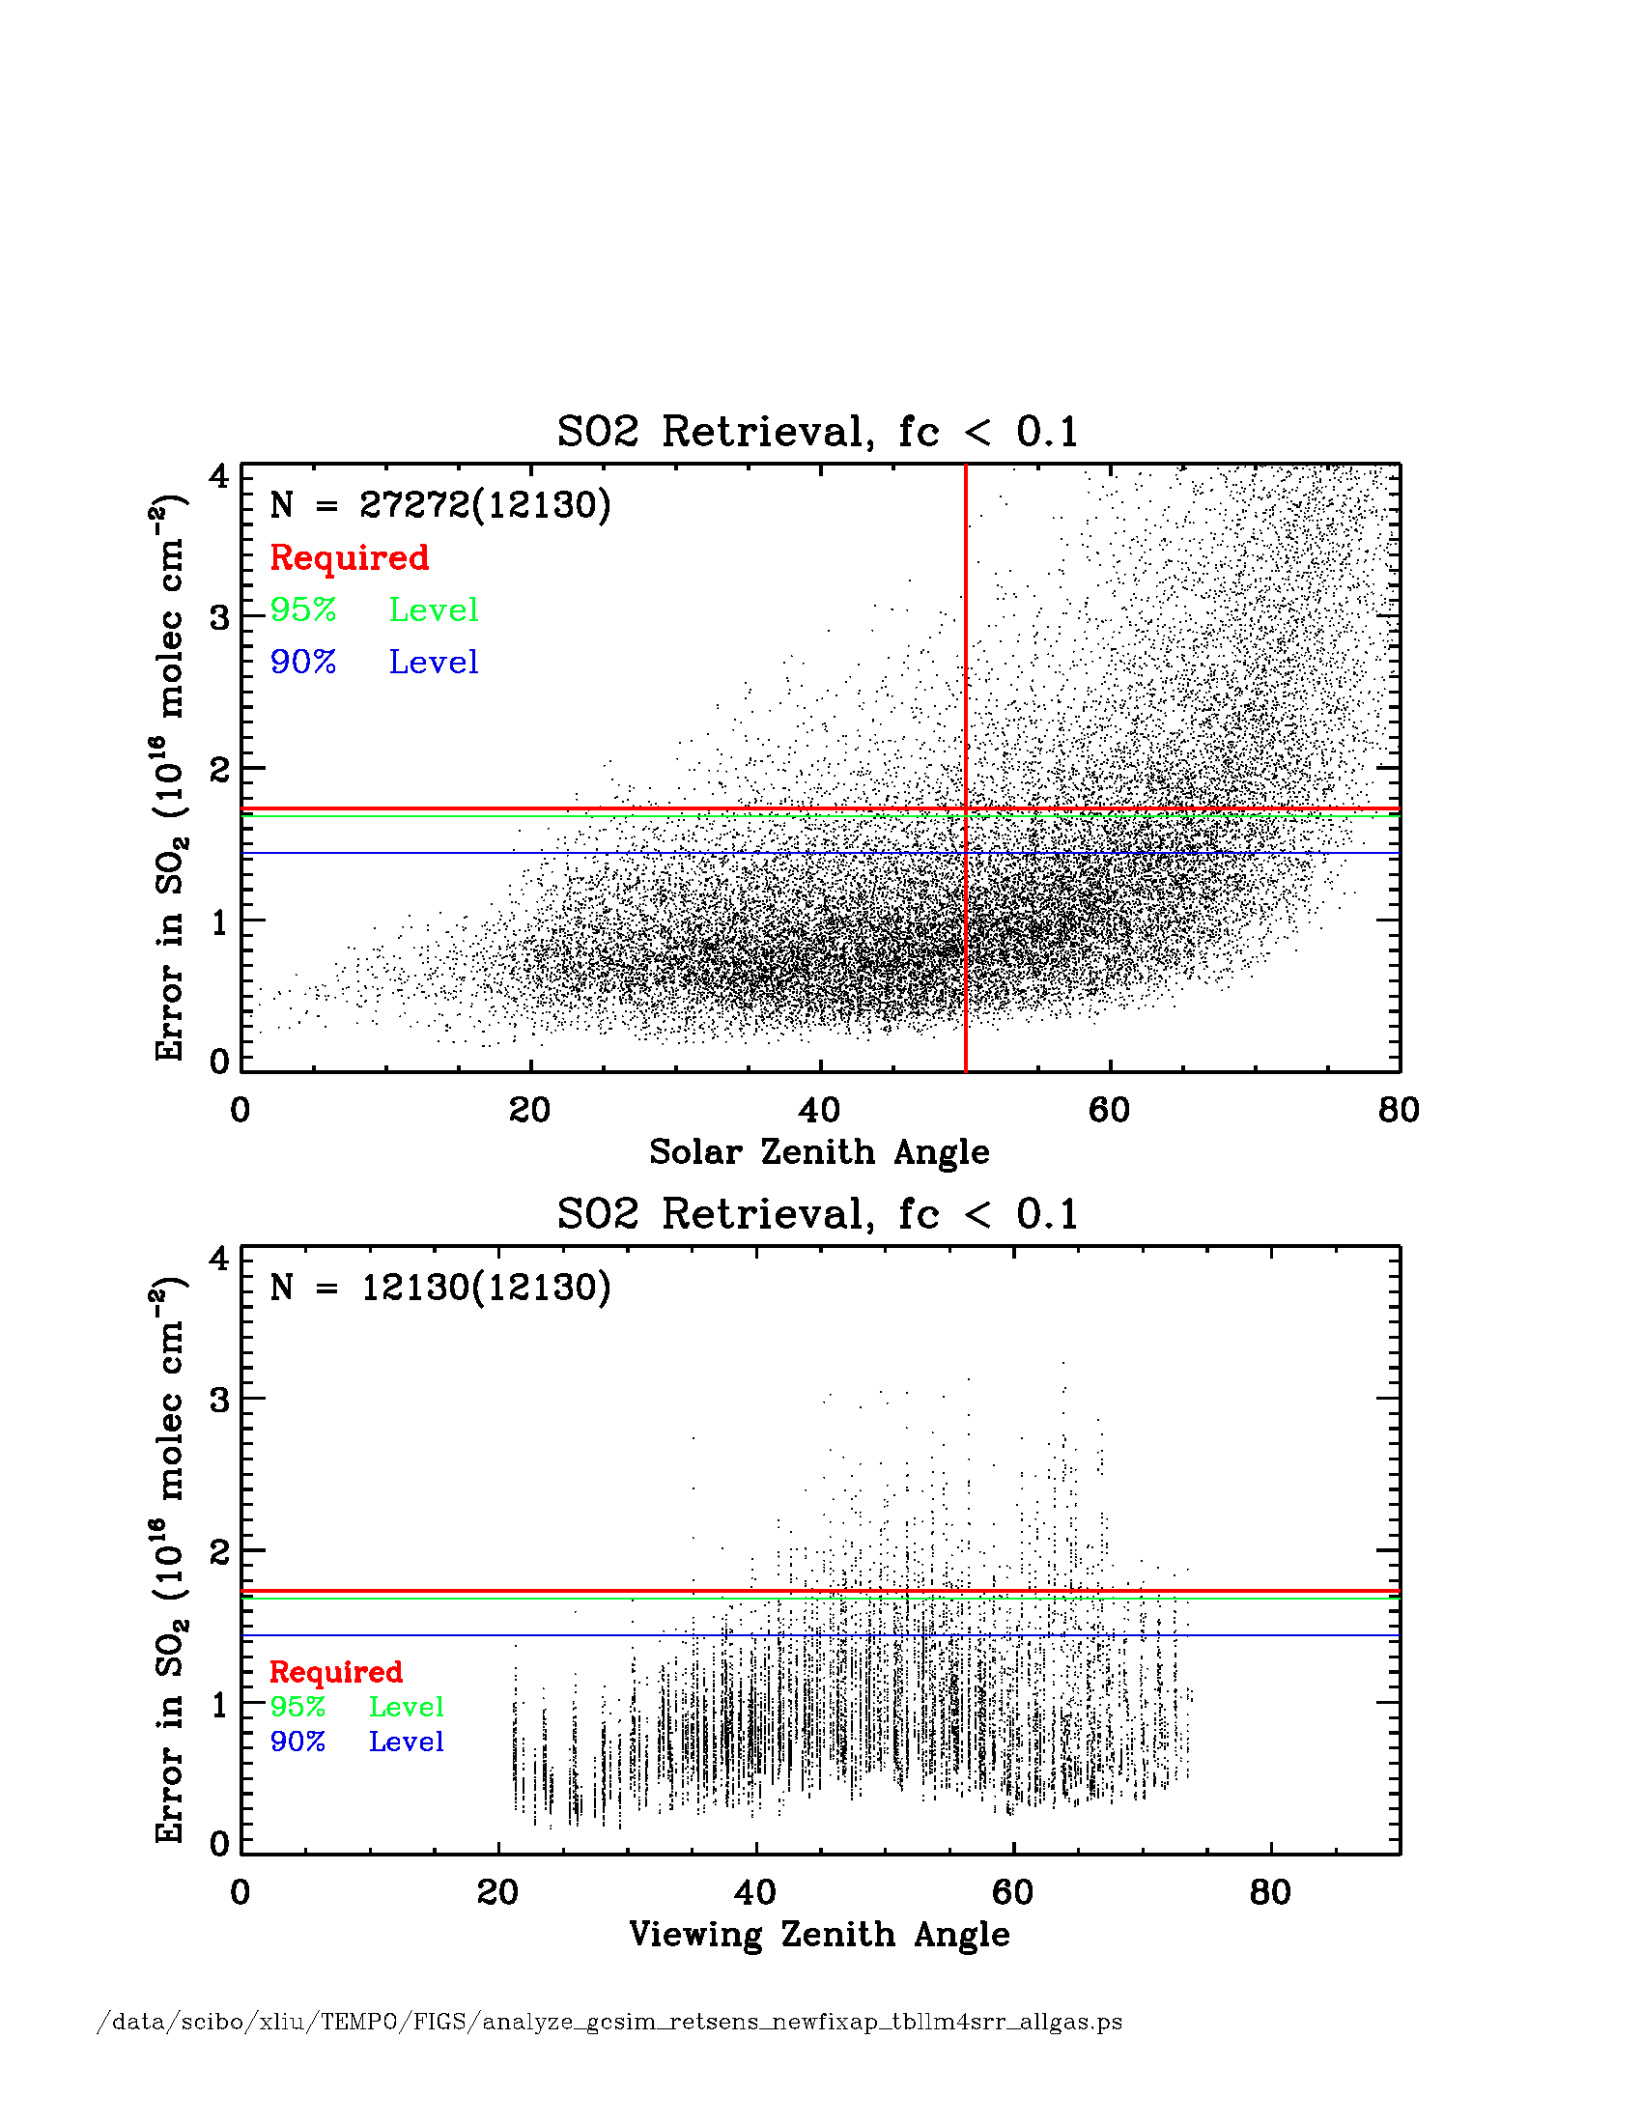
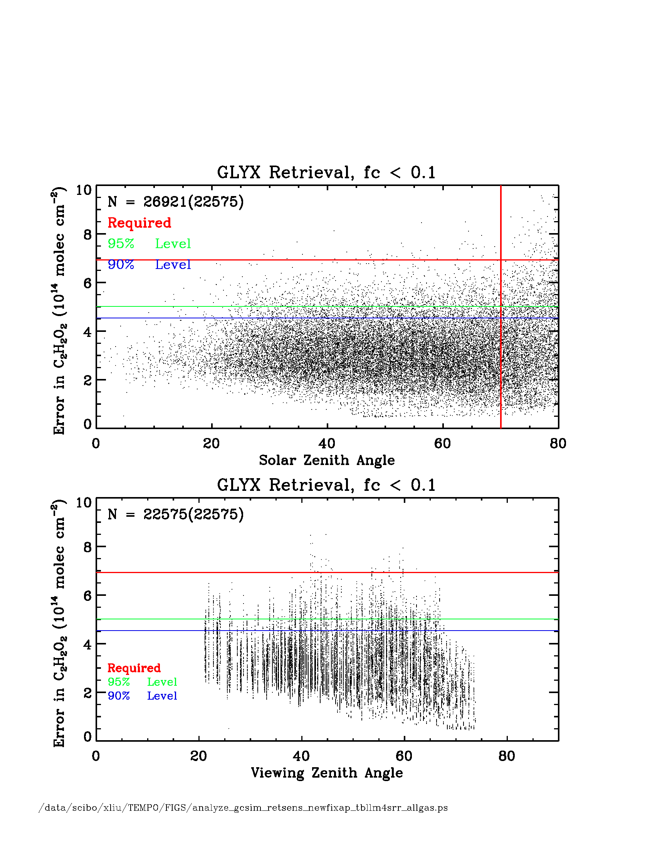
Trace gas retrieval performance
(cloud fraction < 0.1)
NO₂
H₂CO
SO₂
C₂H₂O₂
NO₂ meets reqs. at native spatial res. for SZA up to 80°
H₂CO meet requirements hourly for SZA up to 80°
SO₂ is the driver

Slide 32
Trace gas retrieval performance
(cloud fraction < 0.1)
Species | Required precision | Meet reqs (%) | 95% | 90%
Trop O₃ | 10 ppbv | 99.75 | 8.97 | 8.44
Free trop O₃ | 10 ppbv | 87.42 | 10.96 | 10.30
0-2 km O₃ | 10 ppbv | 82.84 | 11.30 | 10.56
Total O₃ | 3% | 100.0 | 1.01 | 0.91
Trop O₃ (UV+Vis) | 10 ppbv | 100.0 | 6.29 | 5.92
Free trop O₃ (UV+Vis) | 10 ppbv | 99.70 | 8.41 | 7.92
0-2 km O₃ (UV+Vis) | 10 ppbv | 98.74 | 9.10 | 8.61
Total O₃ (UV+Vis) | 3% | 100.0 | 0.58 | 0.54
NO₂ | 1.0×10¹⁵ | 98.51 | 6.00×10¹⁴ | 4.55×10¹⁴
H₂CO | 1.73×10¹⁶ | 99.98 | 6.41×10¹⁵ | 5.74×10¹⁵
SO₂ | 1.73×10¹⁶ | 95.62 | 1.68×10¹⁶ | 1.44×10¹⁶
C₂H₂O₂ | 6.93×10¹⁴ | 99.78 | 5.02×10¹⁴ | 4.54×10¹⁴

Slide 33
Refining SNR requirements
Select cases (~21) with retrieval errors closest to the threshold level (90% for SO₂, 95% for other species )
Adjust/scale SNR over the fitting window so that worst case error matches the requirement. The adjusted SNR is the required SNR.

Slide 34
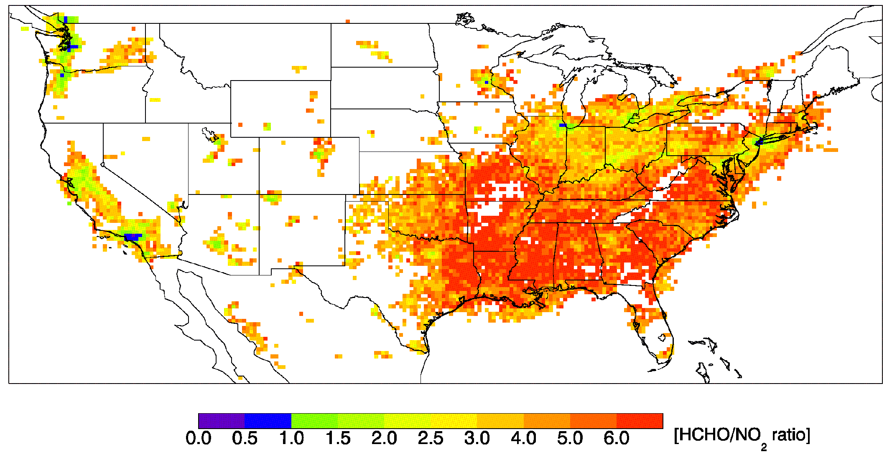
Satellite observations of ozone precursors:
Formation sensitivity of surface ozone
The OMI formaldehyde (HCHO) to nitrogen dioxide (NO₂) ratio for August 2005
Natural VOCs from trees are so high in the East that ozone production is primarily controlled by reducing NO_{x} emissions.
Ozone production is controlled by reducing VOC emissions in downtown LA.
Duncan et al., Atmospheric Environment, 2010
Reduce VOC Emissions
Transition
Reduce NO_{x} Emissions
Ratio indicates whether O₃ control strategies should focus on nitrogen oxide or hydrocarbon emissions.
Simultaneous measurements of O₃, NO₂ and HCHO allow distinction between local sources of O₃ and trans-boundary transport.
This view is a 1-month snapshot valid at the Aura overpass time (~1:30 in the afternoon) but the indicator varies widely throughout the day. Hourly geostationary observations will provide data needed for the next generation of control strategies.

Slide 35
TEMPO science measurements
Ozone (O₃) is created in the troposphere by photochemical cycles dependent upon concentrations of hydrocarbons and nitrogen oxides
By simultaneously measuring O₃ and the precursors from which it is produced, TEMPO provides understanding of all key phases of air quality: emissions, photochemistry, and long range transport
O₂
O₃
STRATOSPHERE
TEMPO measures O₃ and key proxies for its precursor hydrocarbons (H₂CO) and nitrogen oxides (NO₂)
TROPOSPHERE
NO₂
H₂CO
OH
O₃
OH
NO₂
CO
VOC
H₂O
OH
NO
11/12/13
35

Slide 36
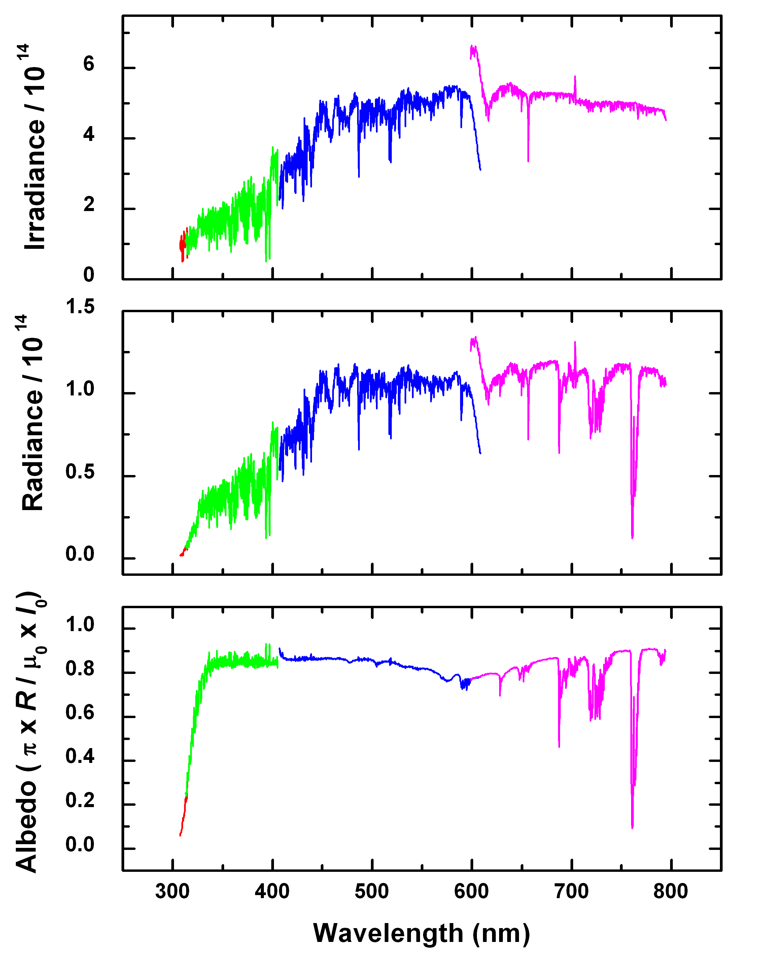
GOME-1 spectra
What do we measure?
GOME irradiance, radiance, and albedo spectrum for high-albedo (fully cloudy) ground pixel

Slide 37
TEMPO science questions
What are the temporal and spatial variations of emissions of gases and aerosols important for air quality and climate?
How do physical, chemical, and dynamical processes determine tropospheric composition and air quality over scales ranging from urban to continental, diurnally to seasonally?
How does air pollution drive climate forcing and how does climate change affect air quality on a continental scale?
How can observations from space improve air quality forecasts and assessments for societal benefit?
How does intercontinental transport affect air quality?
How do episodic events, such as wild fires, dust outbreaks, and volcanic eruptions, affect atmospheric composition and air quality?

Slide 38
TEMPO

