Slide 1
TEMPO Status
Kelly Chance
AQAST 7 meeting
June 17, 2014

Slide 2
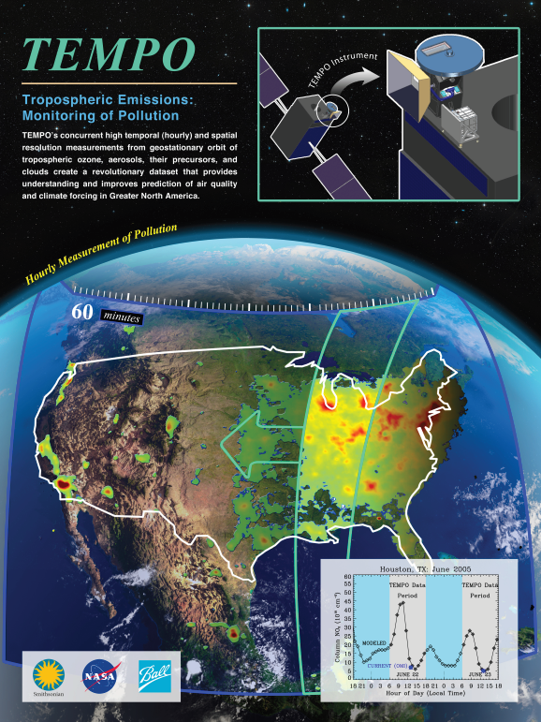
Hourly atmospheric pollution from geostationary Earth orbit
PI: Kelly Chance, Smithsonian Astrophysical Observatory
Instrument Development: Ball Aerospace
Project Management: NASA LaRC
Other Institutions: NASA GSFC, NOAA, EPA, NCAR, Harvard, UC Berkeley, St. Louis U, U Alabama Huntsville, U Nebraska, RT Solutions, Carr Astronautics
International collaboration: Korea, Europe, Canada, Mexico
Selected Nov. 2012 as NASA’s first Earth Venture Instrument
  Instrument delivery May 2017
  NASA will arrange hosting on commercial geostationary communications satellite with launch expected NET 11/2018
Provides hourly daylight observations to capture rapidly varying emissions & chemistry important for air quality
  UV/visible grating spectrometer to measure key elements in tropospheric ozone and aerosol pollution
  Exploits extensive measurement heritage from LEO missions
  Distinguishes boundary layer from free tropospheric & stratospheric ozone
Aligned with Earth Science Decadal Survey recommendations
  Makes many of the GEO-CAPE atmosphere measurements
  Responds to the phased implementation recommendation of GEO-CAPE mission design team
  North American component of an international constellation for air quality observations

Slide 3
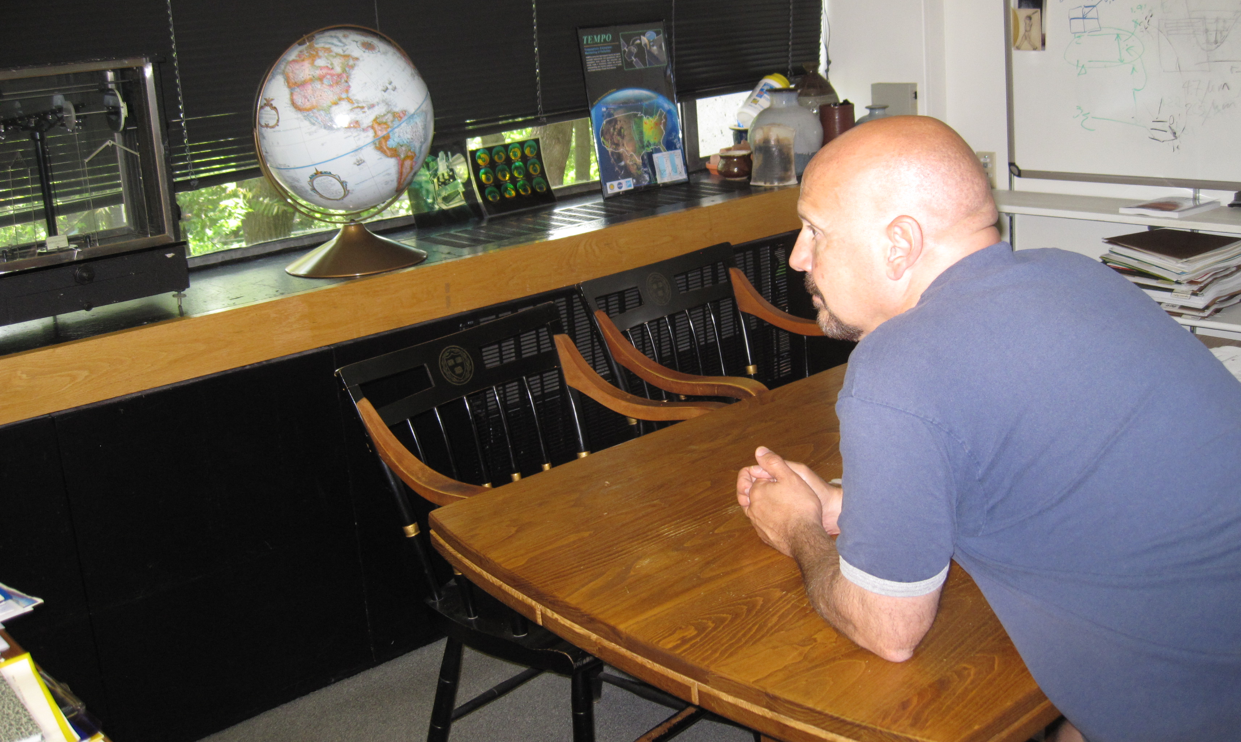
The view from GEO

Slide 4
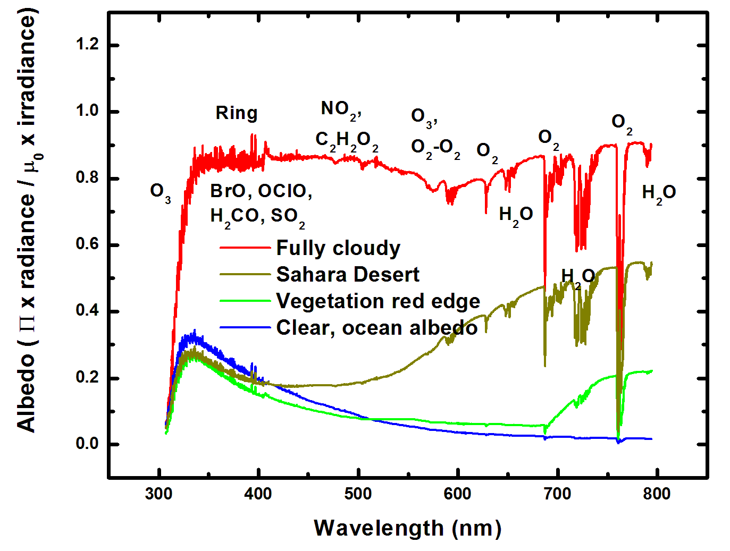
Typical TEMPO-range spectra (from ESA GOME-1)

Slide 5
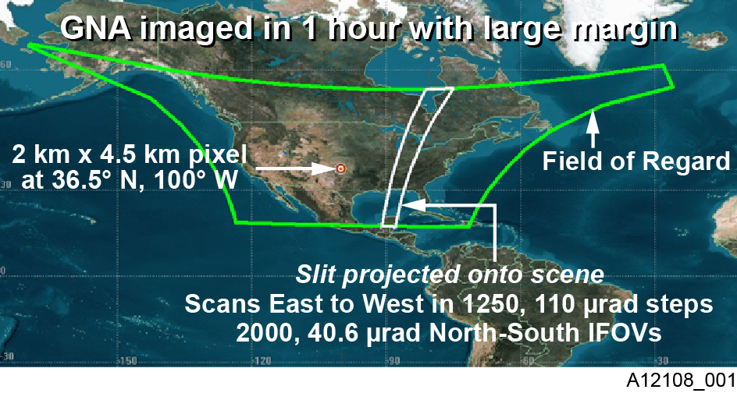
TEMPO footprint, ground sample distance and field of regard
2.1 km × 4.7
__________
Each 2.1 km × 4.7 km pixel is a 2K element spectrum from 290-740 nm
GEO platform selected by NASA for viewing Greater North America

Slide 6
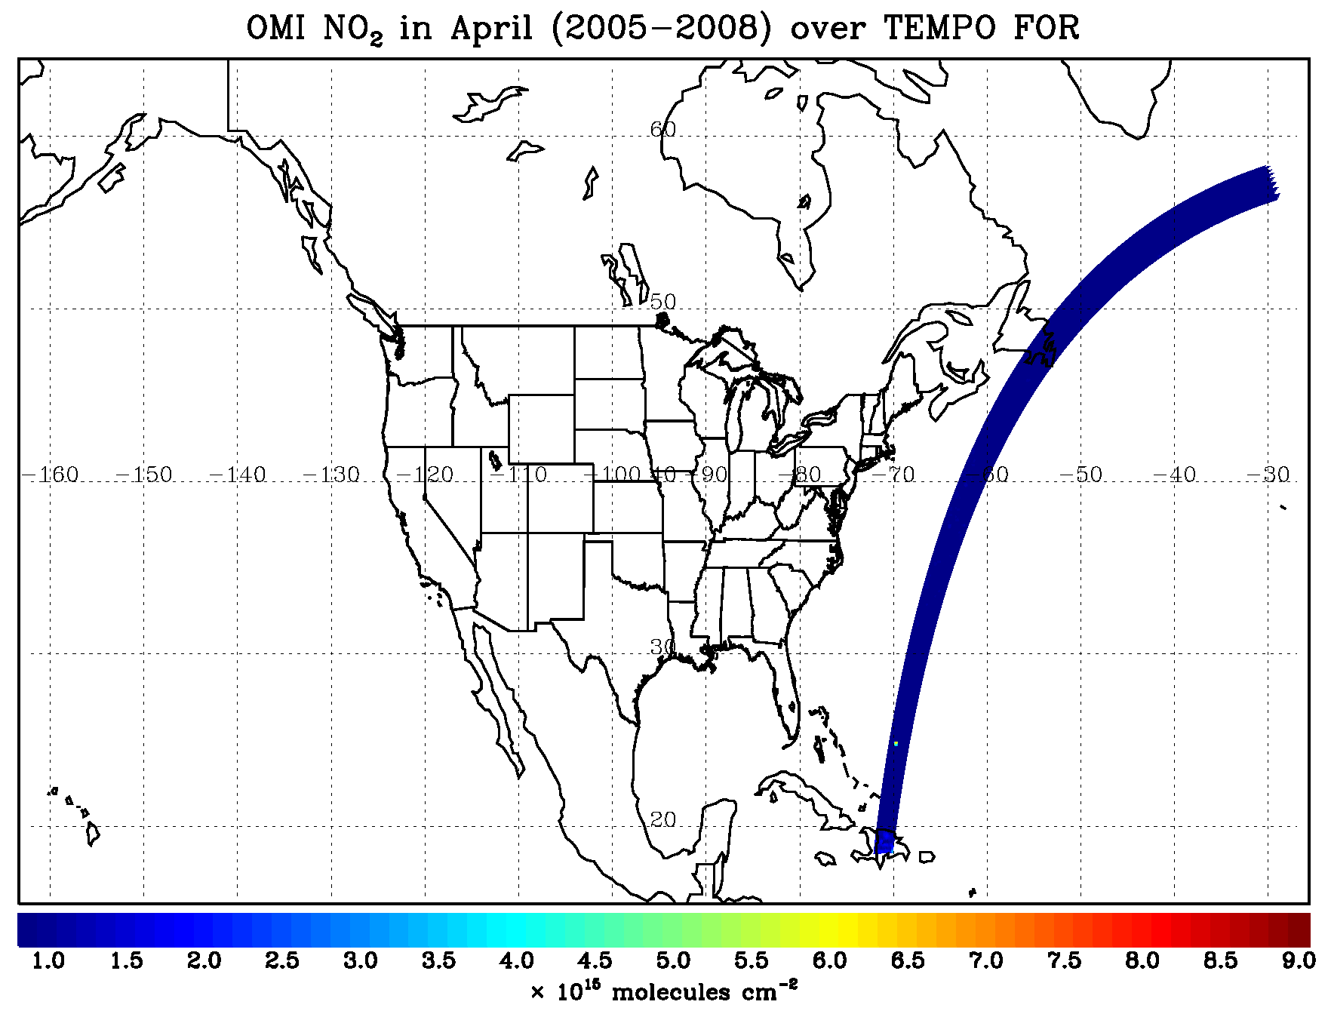
TEMPO hourly NO₂ sweep

Slide 7
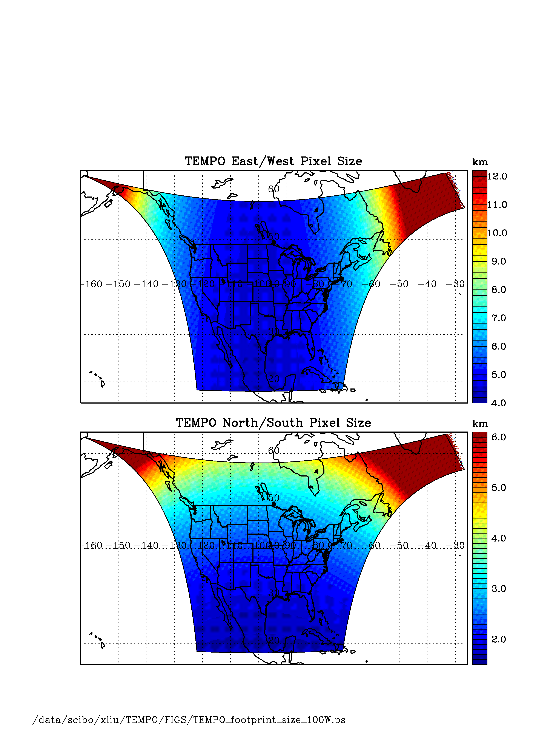
TEMPO footprint (GEO at 100º W)
Location | N/S (km) | E/W (km) | GSA (km²)
36.5ºN, 100ºW | 2.11 | 4.65 | 9.8
Washington, DC | 2.37 | 5.36 | 11.9
Seattle | 2.99 | 5.46 | 14.9
Los Angeles | 2.09 | 5.04 | 10.2
Boston | 2.71 | 5.90 | 14.1
Miami | 1.83 | 5.04 | 9.0
Mexico City | 1.65 | 4.54 | 7.5
Canadian tar sands | 3.94 | 5.05 | 19.2
Assumes 2000 N/S pixels
For GEO at 80ºW, pixel size at 36.5ºN, 100ºW is 2.2 km × 5.2 km.

Slide 8
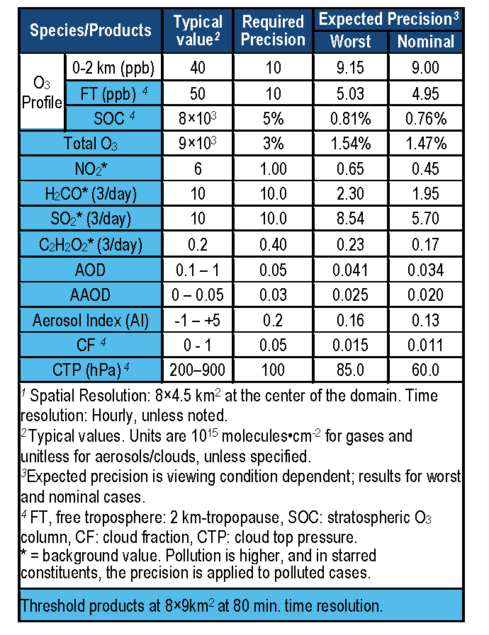
TEMPO baseline products
TEMPO has a minimally-redundant measurement set for air quality.
Near-real time products will allow for pollution alerts, chemical weather, app-based local air quality.

Slide 9
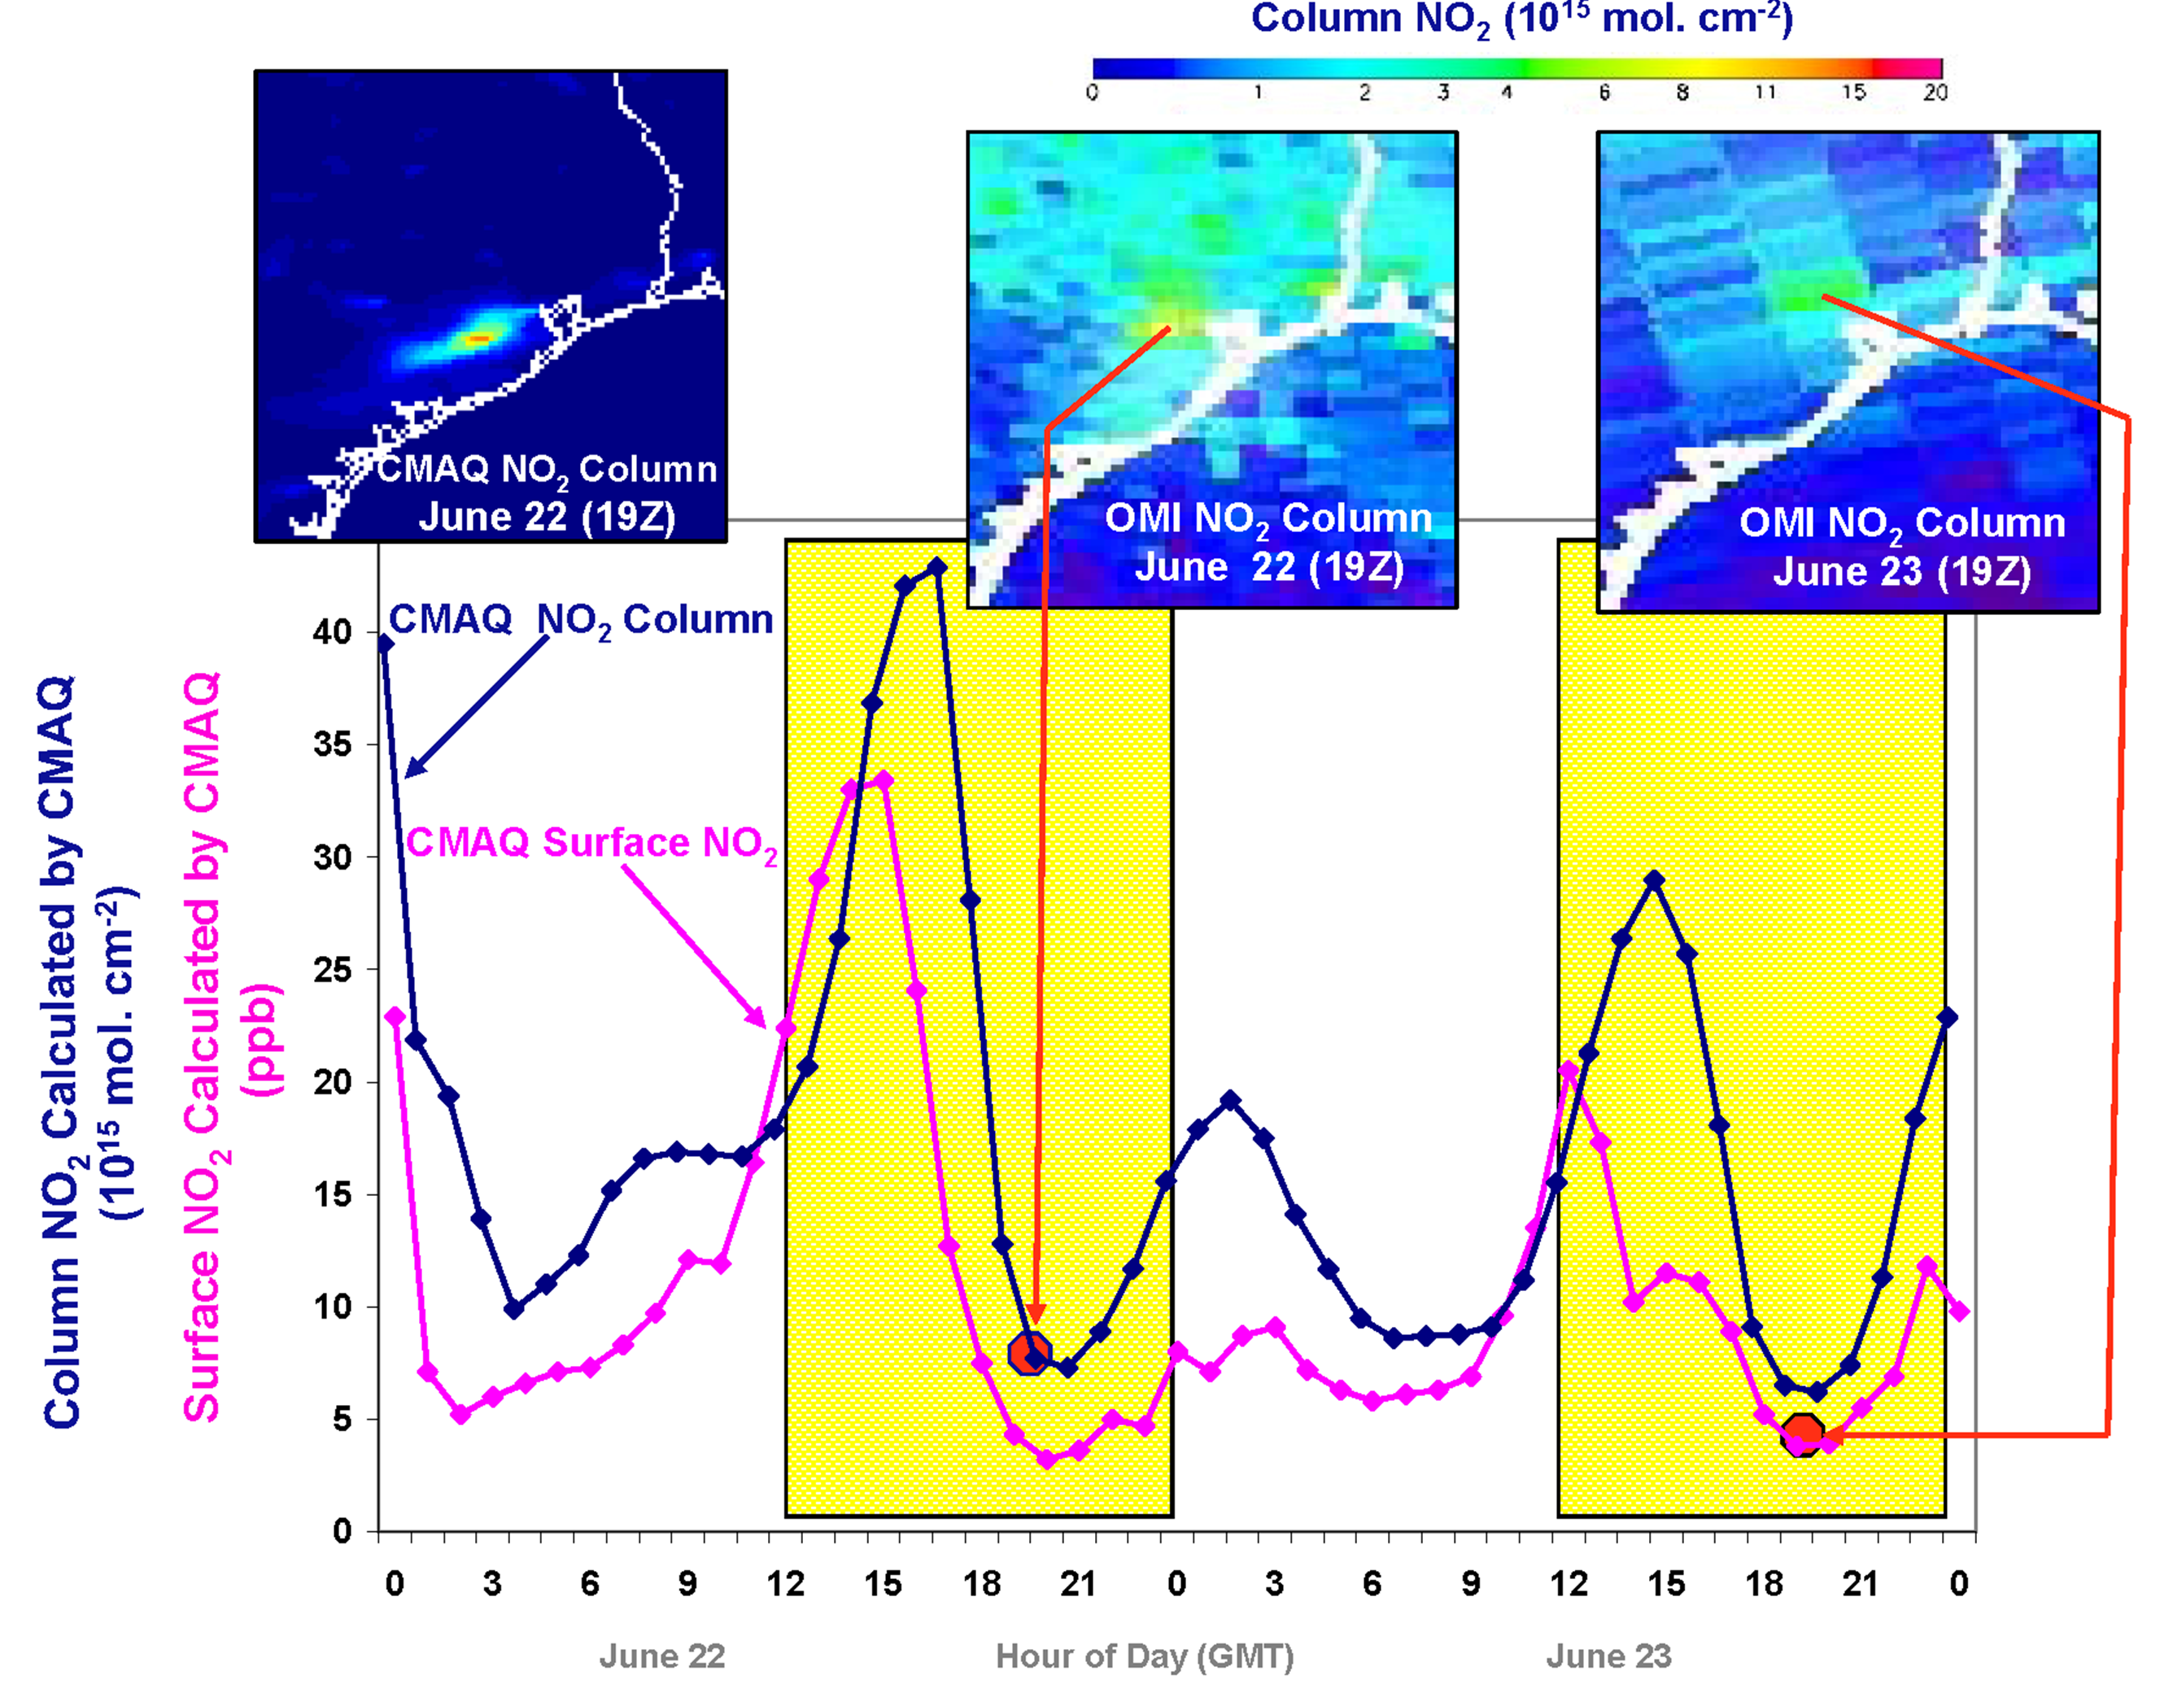
Why geostationary? High temporal and spatial resolution
Hourly NO₂ surface concentration and integrated column calculated by CMAQ air quality model: Houston, TX, June 22-23, 2005
June 22
Hour of Day (UTC)
June 23
LEO observations provide limited information on rapidly varying emissions, chemistry, & transport
GEO will provide observations at temporal and spatial scales highly relevant to air quality processes

Slide 10
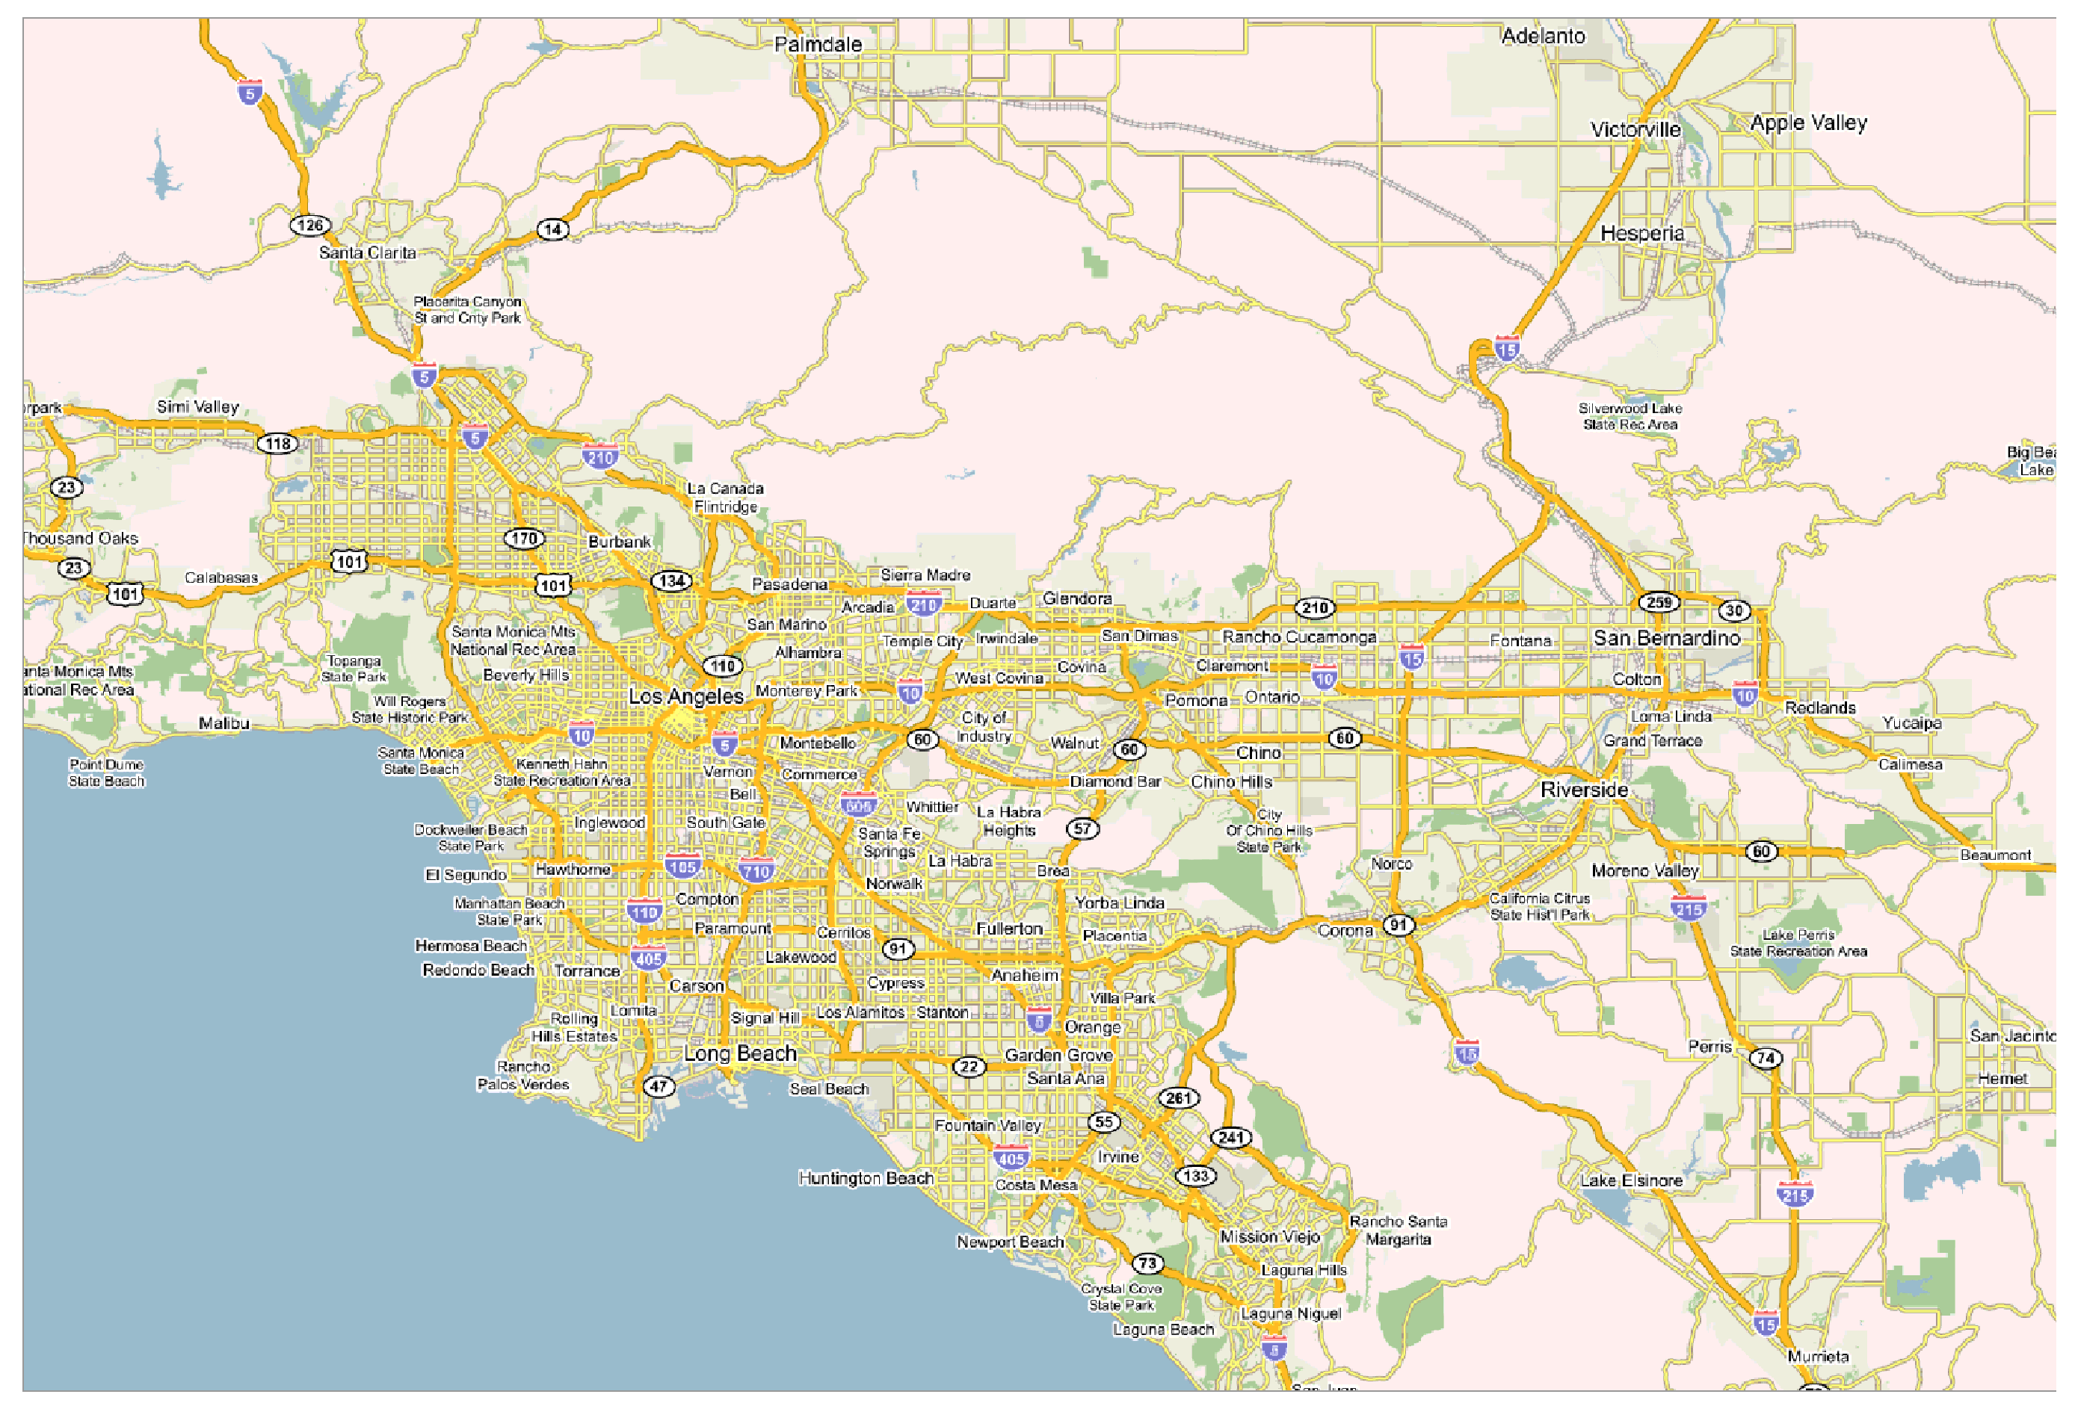
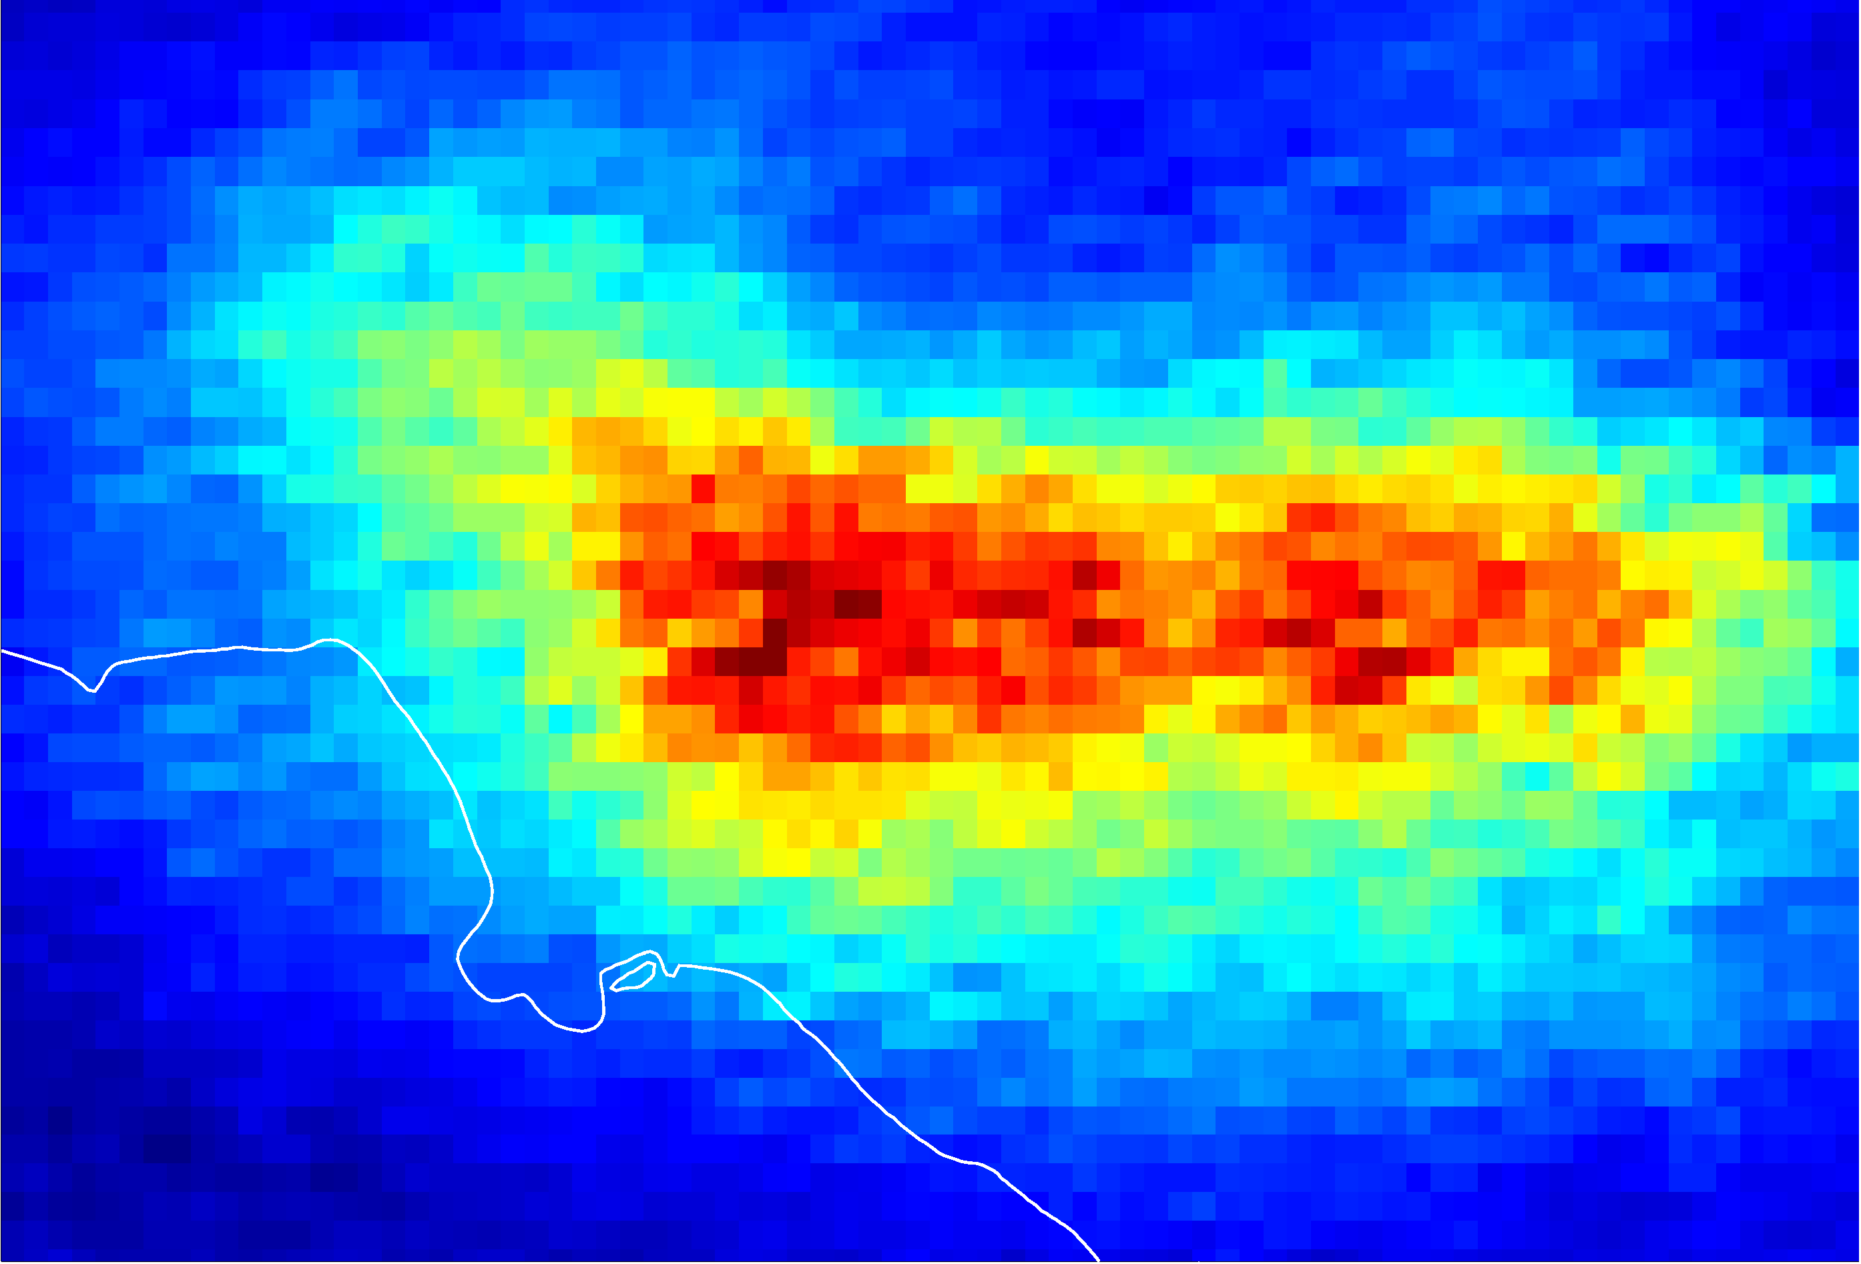
NO₂ over Los Angeles
Courtesy T. Kurosu

Slide 11
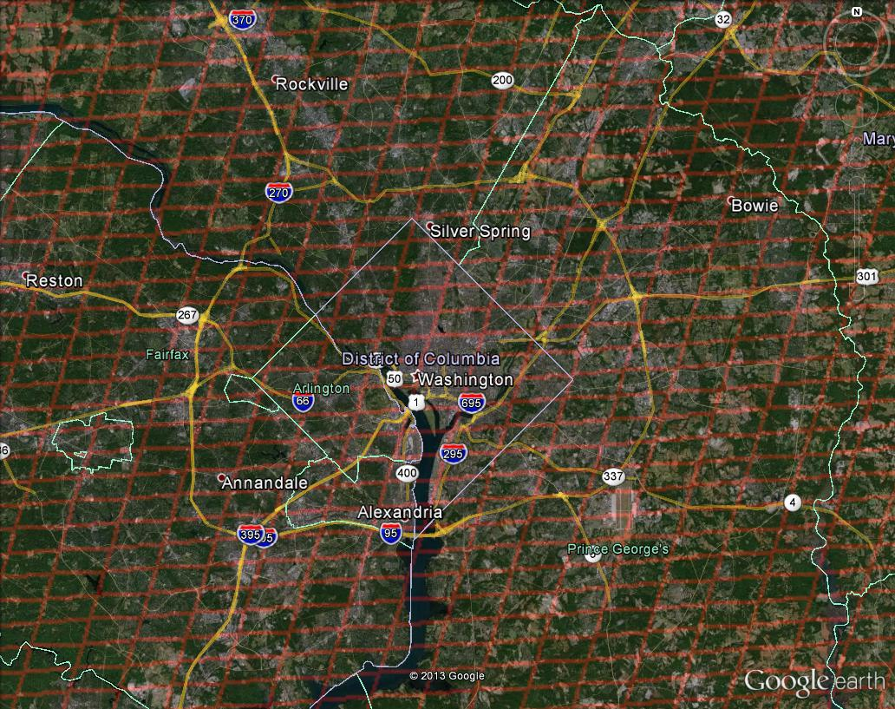
Washington, DC coverage
Hourly!

Slide 12
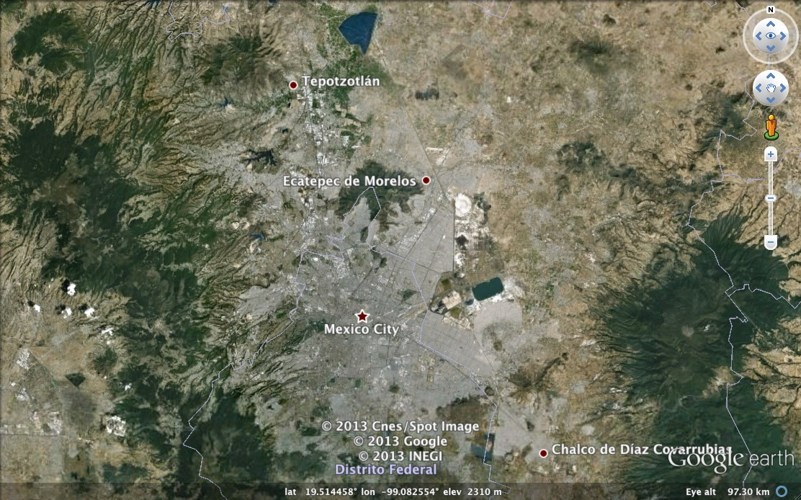

Mexico City coverage
¡Cada hora!

Slide 13
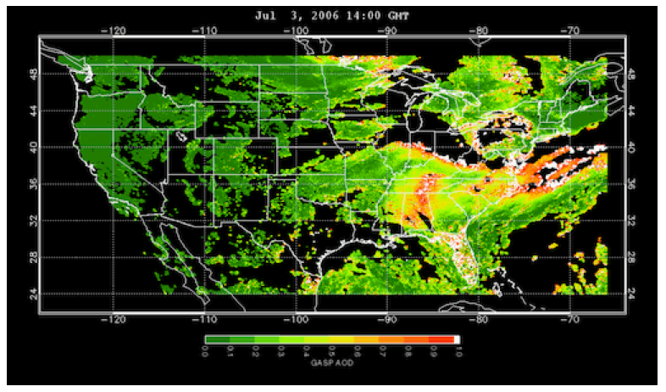
www.epa.gov/rsig
TEMPO will use the EPA’s Remote Sensing Information Gateway (RSIG) for subsetting, visualization, and product distribution – to make TEMPO YOUR instrument

Slide 14
TEMPO Summary
TEMPO is a pathfinder for NASA
  The first mission under the stringently cost-capped Earth Venture Instrument program
  First use of a competitively selected commercial host satellite
Currently on-schedule and on-budget
  Passed System Requirements Review and Mission Definition Review in November 2013
  Passed KDP-B April 2014, now in Phase B
  Most technical issues solved at the preliminary design level, following technical interchange meeting at Ball, April 2014
  PDR scheduled for late July 2014
Commercial satellite host selection and Instrument CDR summer 2015
  TEMPO operating longitude and launch date are not known until after host selection
Instrument delivery 05/2017 for launch no earlier than 11/2018

Slide 15







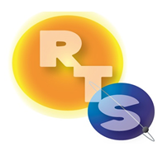


The End!

Slide 16
Backups

Slide 17
Baseline and threshold
data products
Species/Products | Required Precision | Temporal Revisit
0-2 km O₃ Selected Scenes, Baseline only | 10 ppbv | 2 hour
Tropospheric O₃ | 10 ppbv | 1 hour
Total O₃ | 3% | 1 hour
Tropospheric NO₂ | 1.0 × 10¹⁵ molecules cm⁻² | 1 hour
Tropospheric H₂CO | 1.0 × 10¹⁶ molecules cm⁻² | 3 hour
*Tropospheric SO₂ | 1.0 × 10¹⁶ molecules cm⁻² | 3 hour
*Tropospheric C₂H₂O₂ | 4.0 × 10¹⁴ molecules cm⁻² | 3 hour
*Aerosol Optical Depth | 0.10 | 1 hour
*Implementation of SO₂, C₂H₂O₂, and aerosol algorithms is deferred until after successful instrument PDR
Likely ~October 2015
No impact on instrument design capability
All products still ready for launch once approved
Minimal set of products sufficient for constraining air quality
Field of Regard (FOR) is Greater North America, depending on host satellite selected:
  At least 19°N to 57.5°N near 100°W
  At least 67°W to 125°W near 42°N
Data products at urban-regional spatial scales
  Baseline ≤ 60 km² at center of FOR
  Capability for retrieval at native pixel resolution (approx. 2.1 km x 4.7 km) when SNR allows
Geolocation uncertainty of less than 4 km
Temporal scales to resolve diurnal changes in pollutant distributions
Mission duration, subject to instrument availability
  Baseline 20 months
  Threshold 12 months

Slide 18
TEMPO Science
Traceability Matrix

Slide 19
TEMPO science team
Team Member | Institution | Role | Responsibility
K. Chance | SAO | PI | Overall science development; Level 1b, H₂CO, C₂H₂O₂
X. Liu | SAO | Deputy PI | Science development, data processing; O₃ profile, tropospheric O₃
J. Al-Saadi | LaRC | Deputy PS | Project science development
J. Carr | Carr Astronautics | Co-I | INR Modeling and algorithm
M. Chin | GSFC | Co-I | Aerosol science
R. Cohen | U.C. Berkeley | Co-I | NO₂ validation, atmospheric chemistry modeling, process studies
D. Edwards | NCAR | Co-I | VOC science, synergy with carbon monoxide measurements
J. Fishman | St. Louis U. | Co-I | AQ impact on agriculture and the biosphere
D. Flittner | LaRC | Project Scientist | Overall project development; STM; instrument cal./char.
J. Herman | UMBC | Co-I | Validation (PANDORA measurements)
D. Jacob | Harvard | Co-I | Science requirements, atmospheric modeling, process studies
S. Janz | GSFC | Co-I | Instrument calibration and characterization
J. Joiner | GSFC | Co-I | Cloud, total O₃, TOA shortwave flux research product
N. Krotkov | GSFC | Co-I | NO₂, SO₂, UVB
M. Newchurch | U. Alabama Huntsville | Co-I | Validation (O₃ sondes, O₃ lidar)
R.B. Pierce | NOAA/NESDIS | Co-I | AQ modeling, data assimilation
R. Spurr | RT Solutions, Inc. | Co-I | Radiative transfer modeling for algorithm development
R. Suleiman | SAO | Co-I, Data Mgr. | Managing science data processing, BrO, H₂O, and L3 products
J. Szykman | EPA | Co-I | AIRNow AQI development, validation (PANDORA measurements)
O. Torres | GSFC | Co-I | UV aerosol product, AI
J. Wang | U. Nebraska | Co-I | Synergy w/GOES-R ABI, aerosol research products
J. Leitch | Ball Aerospace | Collaborator | Aircraft validation, instrument calibration and characterization
D. Neil | LaRC | Collaborator | GEO-CAPE mission design team member
R. Martin | Dalhousie U. | Collaborator | Atmospheric modeling, air mass factors, AQI development
Chris McLinden | Environment Canada | Collaborator | Canadian air quality coordination
Michel Grutter de la Mora | UNAM, Mexico | Collaborator | Mexican air quality coordination
J. Kim | Yonsei U. | Collaborators, Science Advisory Panel | Korean GEMS, CEOS constellation of GEO pollution monitoring
C.T. McElroy | York U. Canada |  | CSA PHEOS, CEOS constellation of GEO pollution monitoring
B. Veihelmann | ESA |  | ESA Sentinel-4, CEOS constellation of GEO pollution monitoring

Slide 20
Meeting emphasis
TEMPO science studies during and after commissioning
Fluorescence
Lightning NO_{x}
Soil NO_{x}
NO/NO₂ at high dawn and dusk time resolution
Forest fires at high time resolution
Subsampling and spatial resolution
••••

Slide 21
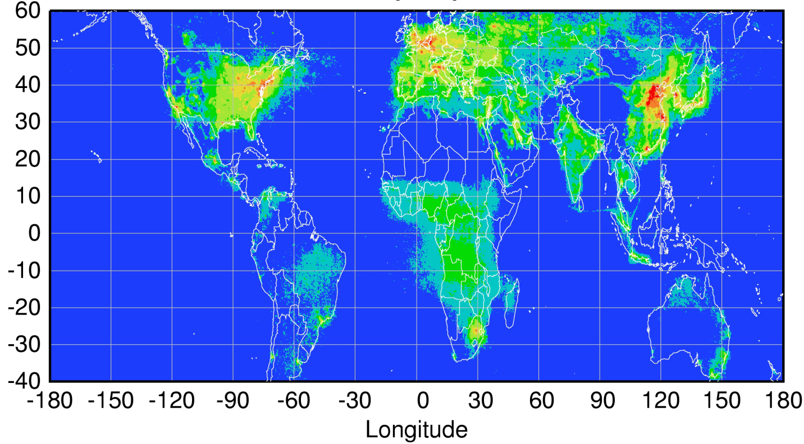
Global pollution monitoring constellation (2018-2020)
Sentinel-4
(hourly)
TEMPO
(hourly)
GEMS
(hourly)
Sentinel-5P
(once per day)
Courtesy Jhoon Kim,
Andreas Richter
Policy-relevant science and environmental services enabled by common observations
Improved emissions, at common confidence levels, over industrialized Northern Hemisphere
Improved air quality forecasts and assimilation systems
Improved assessment, e.g., observations to support United Nations Convention on Long Range Transboundary Air Pollution

Slide 22
Baseline and Threshold
Data Products
Species/Products | Required Precision | Temporal Revisit
0-2 km O₃ (Selected Scenes) Baseline only | 10 ppbv | 2 hour
Tropospheric O₃ | 10 ppbv | 1 hour
Total O₃ | 3% | 1 hour
Tropospheric NO₂ | 1.0 × 10¹⁵ molecules cm⁻² | 1 hour
Tropospheric H₂CO | 1.0 × 10¹⁶ molecules cm⁻² | 3 hour
Tropospheric SO₂ | 1.0 × 10¹⁶ molecules cm⁻² | 3 hour
Tropospheric C₂H₂O₂ | 4.0 × 10¹⁴ molecules cm⁻² | 3 hour
Aerosol Optical Depth | 0.10 | 1 hour
PLRA Table 1
Minimal set of products sufficient for constraining air quality
Across Greater North America (GNA): 18°N to 58°N near 100°W, 67°W to 125°W near 42°N
Data products at urban-regional spatial scales
  Baseline ≤ 60 km² at center of Field Of Regard (FOR)
  Threshold ≤ 300 km² at center of FOR
Temporal scales to resolve diurnal changes in pollutant distributions
Collected in cloud-free scenes
Geolocation uncertainty of less than 4 km
Mission duration, subject to instrument availability
  Baseline 20 months
  Threshold 12 months

Slide 23
Data Product Definitions and Details
Data Product | Description | Time beyond on-orbit checkout to deliver initial data | Maximum data latency after first release for ≥ 80% of all products†
Level 0 | Reconstructed, Unprocessed Instrument Data | 2 months | Within 2 hours of receipt at SAO
Level 1b | Calibrated, Geolocated Radiances | 4 months | Within 3 hours of Level 0 and ancillary data receipt at SAO
Level 2 | Derived Geophysical Data Products | 6 months | Within 24 hours of production of Level 1 at SAO
Level 3 | Derived Gridded Geophysical Data Products | 6 months | 1 month after completion of data accumulation required for individual geophysical products
All original observation data and standard science data products listed here, along with the scientific source code for algorithm software, coefficients, and ancillary data used to generate these products, shall be delivered to the designated NASA SMD/ESD-assigned DAAC within six months of completion of the prime mission. Data products are publicly distributed during the mission.
†80% of the products, not 80% of the product types, will be produced within this latency time.

Slide 24
TEMPO

