Slide 1
Implementation of Tropospheric Emissions: Monitoring of
Pollution (TEMPO)
Raid M. Suleiman, Kelly Chance,
Xiong Liu
Harvard-Smithsonian Center for
Astrophysics
David Flittner, Jay Al-Saadi,
NASA LaRC
Scott Janz, NASA GSFC
11th Conference of the Arab Union for
Astronomy and Space Sciences (AUASS),
University of Sharjah (8-11 December 2014)

Slide 2
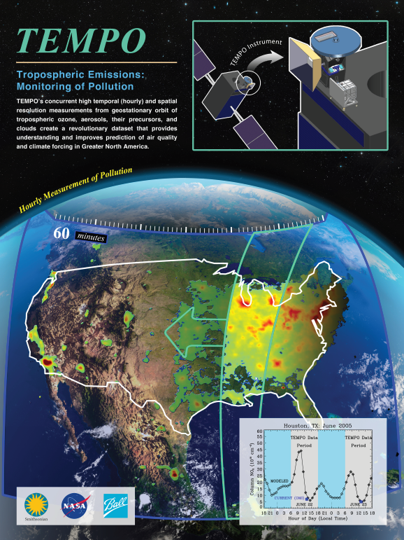
Hourly atmospheric pollution from geostationary Earth orbit
PI: Kelly Chance, Smithsonian Astrophysical Observatory
Instrument Development: Ball Aerospace
Project Management: NASA LaRC
Other Institutions: NASA GSFC, NOAA, EPA, NCAR, Harvard, UC Berkeley, St. Louis U, U Alabama Huntsville, U Nebraska, RT Solutions, Carr Astronautics
International collaboration: Korea, Europe, Canada, Mexico
Selected Nov. 2012 as NASA’s first Earth Venture Instrument
  Instrument delivery May 2017
  NASA will arrange hosting on commercial geostationary communications satellite with launch expected NET 11/2018
Provides hourly daylight observations to capture rapidly varying emissions & chemistry important for air quality
  UV/visible grating spectrometer to measure key elements in tropospheric ozone and aerosol pollution
  Exploits extensive measurement heritage from LEO missions
  Distinguishes boundary layer from free tropospheric & stratospheric ozone
Aligned with Earth Science Decadal Survey recommendations
  Makes many of the GEO-CAPE atmosphere measurements
  Responds to the phased implementation recommendation of GEO-CAPE mission design team
  North American component of an international constellation for air quality observations
Notes:
NET = not earlier than

Slide 3
TEMPO Instrument Project
Detailed Organization Structure
TEMPO Instrument
Principal Investigator: Kelly Chance
Deputy Principal Investigator: Xiong Liu
Program Administrator: Joseph Webber
Investigation Advisory Panel
SAO: Roger Brissenden, LaRC: Steve Jurczyk, Ball: Mark Bergeland
Science Advisory Panel
Geo Constellation/CEOS
Science Team
Project Management
Project Manager: Wendy Pennington
Project Scientist: David Flittner
Deputy PS: Jay Al-Saadi
Deputy PM: Craig Jones, COR
Deputy PP&C: Don Shick
Management Support
Schedules: Bonnie Lahiff
Configuration Manager: Donna Lewis
Communications: Jonathan Behun/Katie Bethea
Systems Engineering
Project CE: David Rosenbaum
SE: Mark Andraschko
Safety & Mission Assurance
Mission Assurance Manager: Jose Caraballo
Instrument
PM Dennis Nicks
Chief SE: Laura Hale
Instrument Performance: Brian Baker
Ground
Systems
Raid M. Suleiman
Instrument Operations
Raid M. Suleiman
Science Data Processing System
Kelly Chance
Notes:
CEOS = Committee on Earth Observation Satellites

Slide 4
TEMPO science team
Team Member | Institution | Role | Responsibility
K. Chance | SAO | PI | Overall science development; Level 1b, H₂CO, C₂H₂O₂
X. Liu | SAO | Deputy PI | Science development, data processing; O₃ profile, tropospheric O₃
J. Al-Saadi | LaRC | Deputy PS | Project science development
J. Carr | Carr Astronautics | Co-I | INR Modeling and algorithm
M. Chin | GSFC | Co-I | Aerosol science
R. Cohen | U.C. Berkeley | Co-I | NO₂ validation, atmospheric chemistry modeling, process studies
D. Edwards | NCAR | Co-I | VOC science, synergy with carbon monoxide measurements
J. Fishman | St. Louis U. | Co-I | AQ impact on agriculture and the biosphere
D. Flittner | LaRC | Project Scientist | Overall project development; STM; instrument cal./char.
J. Herman | UMBC | Co-I | Validation (PANDORA measurements)
D. Jacob | Harvard | Co-I | Science requirements, atmospheric modeling, process studies
S. Janz | GSFC | Co-I | Instrument calibration and characterization
J. Joiner | GSFC | Co-I | Cloud, total O₃, TOA shortwave flux research product
N. Krotkov | GSFC | Co-I | NO₂, SO₂, UVB
M. Newchurch | U. Alabama Huntsville | Co-I | Validation (O₃ sondes, O₃ lidar)
R.B. Pierce | NOAA/NESDIS | Co-I | AQ modeling, data assimilation
R. Spurr | RT Solutions, Inc. | Co-I | Radiative transfer modeling for algorithm development
R. Suleiman | SAO | Co-I, Data Mgr. | Managing science data processing, BrO, H₂O, and L3 products
J. Szykman | EPA | Co-I | AIRNow AQI development, validation (PANDORA measurements)
O. Torres | GSFC | Co-I | UV aerosol product, AI
J. Wang | U. Nebraska | Co-I | Synergy w/GOES-R ABI, aerosol research products
J. Leitch | Ball Aerospace | Collaborator | Aircraft validation, instrument calibration and characterization
D. Neil | LaRC | Collaborator | GEO-CAPE mission design team member
R. Martin | Dalhousie U. | Collaborator | Atmospheric modeling, air mass factors, AQI development
Chris McLinden | Environment Canada | Collaborator | Canadian air quality coordination
Michel Grutter de la Mora | UNAM, Mexico | Collaborator | Mexican air quality coordination
J. Kim | Yonsei U. | Collaborators, Science Advisory Panel | Korean GEMS, CEOS constellation of GEO pollution monitoring
C.T. McElroy | York U. Canada |  | CSA PHEOS, CEOS constellation of GEO pollution monitoring
B. Veihelmann | ESA |  | ESA Sentinel-4, CEOS constellation of GEO pollution monitoring

Slide 5
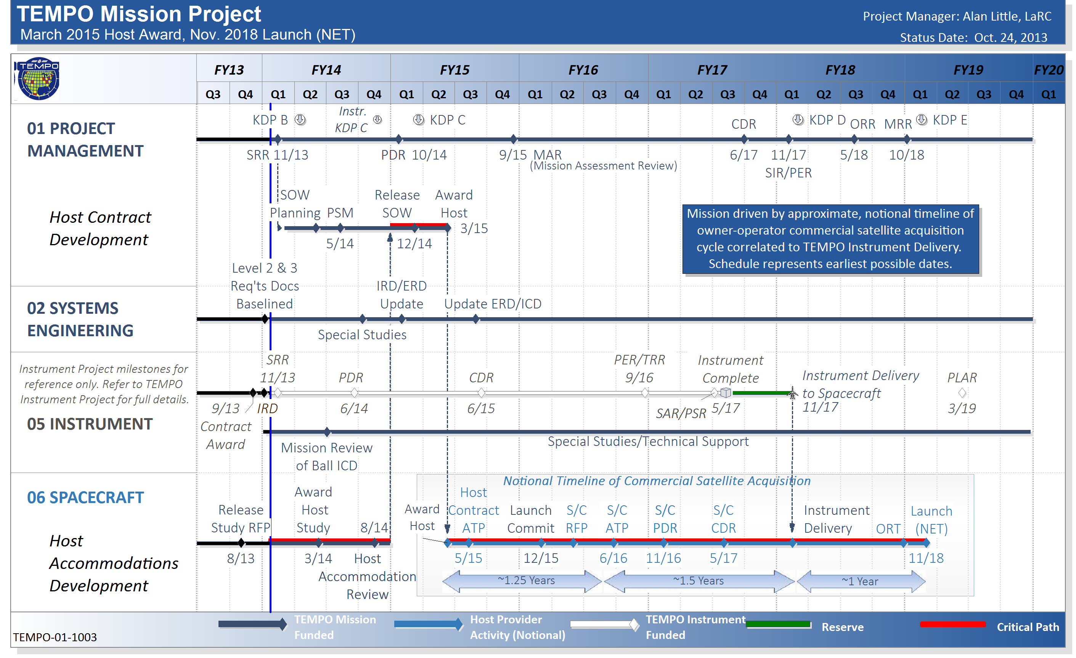
TEMPO Mission Project
Integrated Master Schedule
Notes:
Host Award 3/15 --- Contract by May 2015
PDR late July 2014
CDR June 2015
Instrument Complete May 2017
Instrument delivery to S/C November 2017
Launch NET November 2018

Slide 6
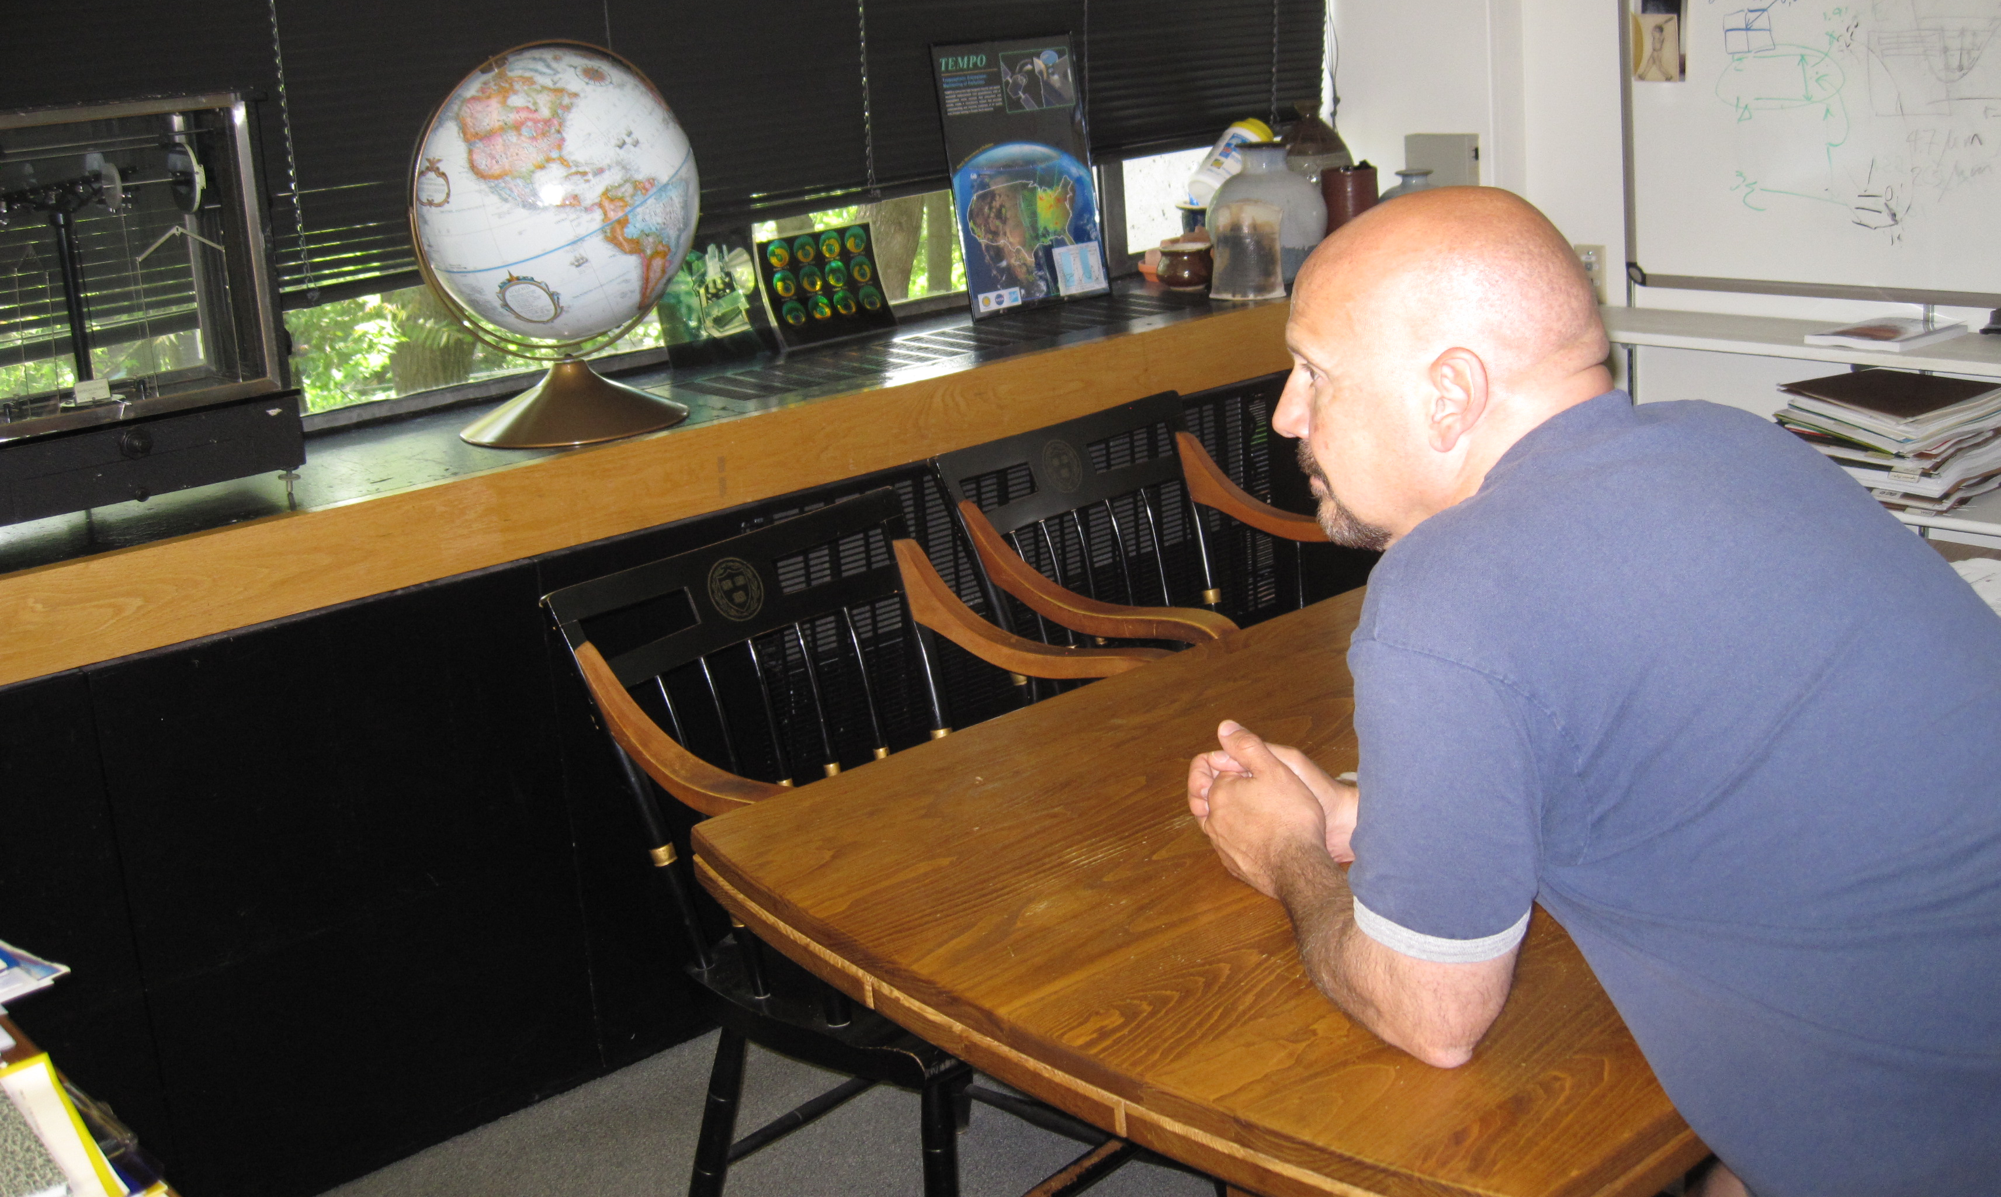
The view from GEO
Notes:
This Joe our division administrator and where he is is where the satellite would be in GEO
We will be about 36000 KM away from Earth

Slide 7
TEMPO instrument concept
Measurement technique
  Imaging grating spectrometer measuring solar backscattered Earth radiance
  Spectral band & resolution: 290-490 + 540-740 nm @ 0.6 nm FWHM, 0.2 nm sampling
  2 2-D, 2k×1k, detectors image the full spectral range for each geospatial scene
Field of Regard (FOR) and duty cycle
  Mexico City/Yucatan Peninsula to the Canadian tar/oil sands, Atlantic to Pacific
  Instrument slit aligned N/S and swept across the FOR in the E/W direction, producing a radiance map of Greater North America in one hour
Spatial resolution
  2.1 km N/S × 4.7 km E/W native pixel resolution (9.8 km²)
  Co-add/cloud clear as needed for specific data products
Standard data products and sampling rates
  Most sampled hourly, including eXceL O₃ (troposphere, PBL) for selected areas
  H₂CO, C₂H₂O₂, SO₂ sampled hourly (average results for ≥ 3/day if needed)
  Nominal spatial resolution 8.4 km N/S × 4.7 km E/W at center of domain (can often measure 2.1 km N/S × 4.7 km E/W)
  Measurement requirements met up to 50º for SO₂, 70º SZA for other products

Slide 8
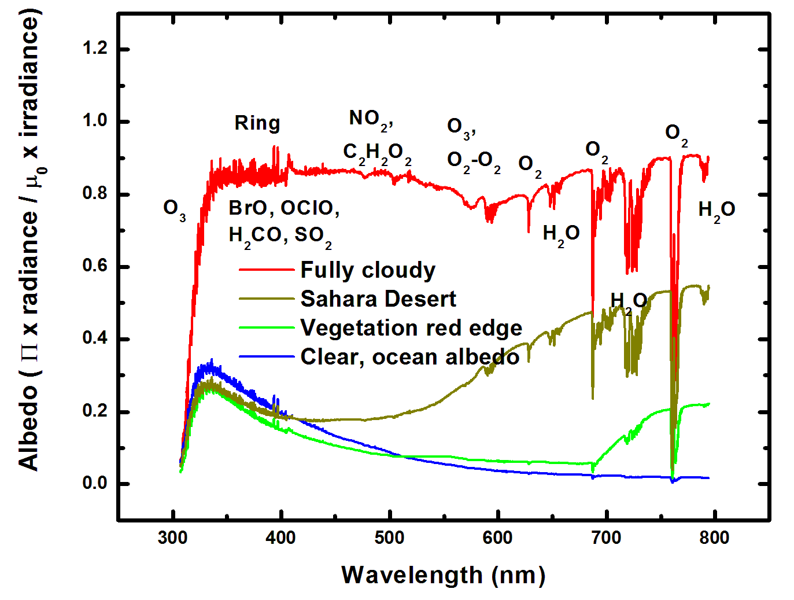
Typical TEMPO-range spectra (from ESA GOME-1)
Notes:
This an example of TEMPO spectra for selected surfaces. This is from GOME-1
The dashed lines present the TEMPO two detectors
We can see some of the products that TEMPO will measure including the vegetation red edge

Slide 9
TEMPO mission concept
Geostationary orbit, operating on a commercial telecom satellite
  NASA will arrange launch and hosting services (per Earth Venture Instrument scope)
    90-110º W preferred, 75-137º W acceptable
    Specifying satellite environment, accommodation
  Hourly measurement and telemetry duty cycle for at least ≤70º SZA
    Plan to measure up to 20 hours/day
TEMPO is low risk with significant space heritage
  All proposed TEMPO measurements have been made from low Earth orbit satellite instruments to the required precisions
  All TEMPO launch algorithms are implementations of currently operational algorithms
    NASA TOMS-type O₃
    SO₂, NO₂, H₂CO, C₂H₂O₂ from fitting with AMF-weighted cross sections
    Absorbing Aerosol Index, UV aerosol, Rotational Raman scattering cloud
    eXceL profile/tropospheric/PBL O₃ for selected geographic targets
Example higher-level products: Near-real-time pollution/AQ indices, UV index
TEMPO research products will greatly extend science and applications
  Example research products: eXceL profile O₃ for broad regions; BrO from AMF-normalized cross sections; height-resolved SO₂; additional cloud/aerosol products; vegetation products

Slide 10
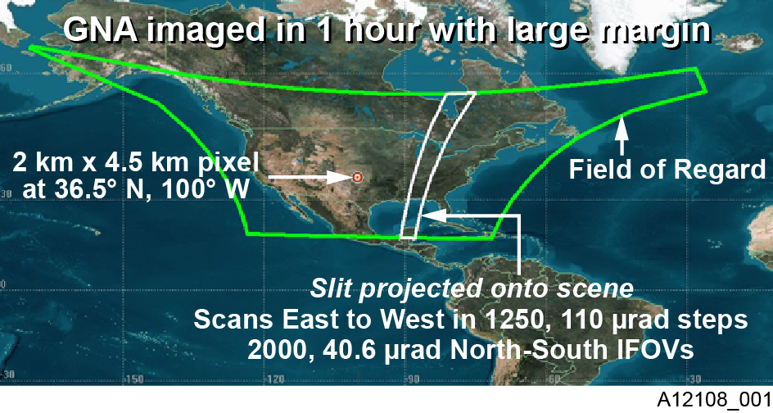
TEMPO footprint, ground sample distance and field of regard
2.1 km × 4.7
__________
Each 2.1 km × 4.7 km pixel is a 2K element spectrum from 290-740 nm
GEO platform selected by NASA for viewing Greater North America
Notes:
E – W of 1250 steps
and 2000 N-S that is 2.5 million spectra every hour

Slide 11
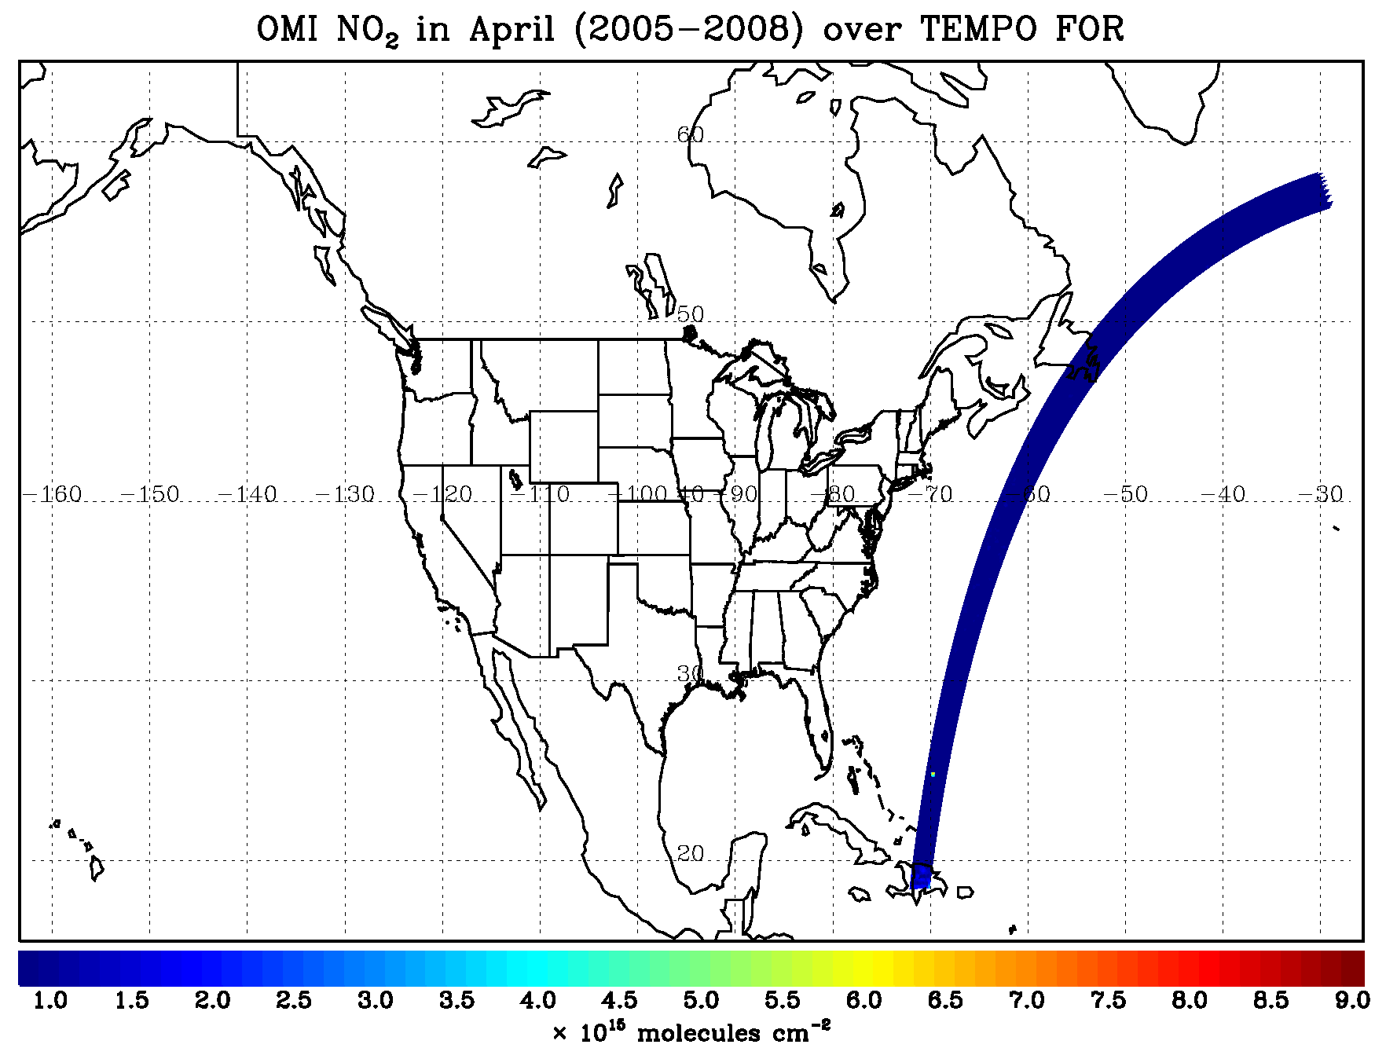
TEMPO hourly NO₂ sweep
Notes:
This is an example of TEMPO hourly scans showing the FOR

Slide 12
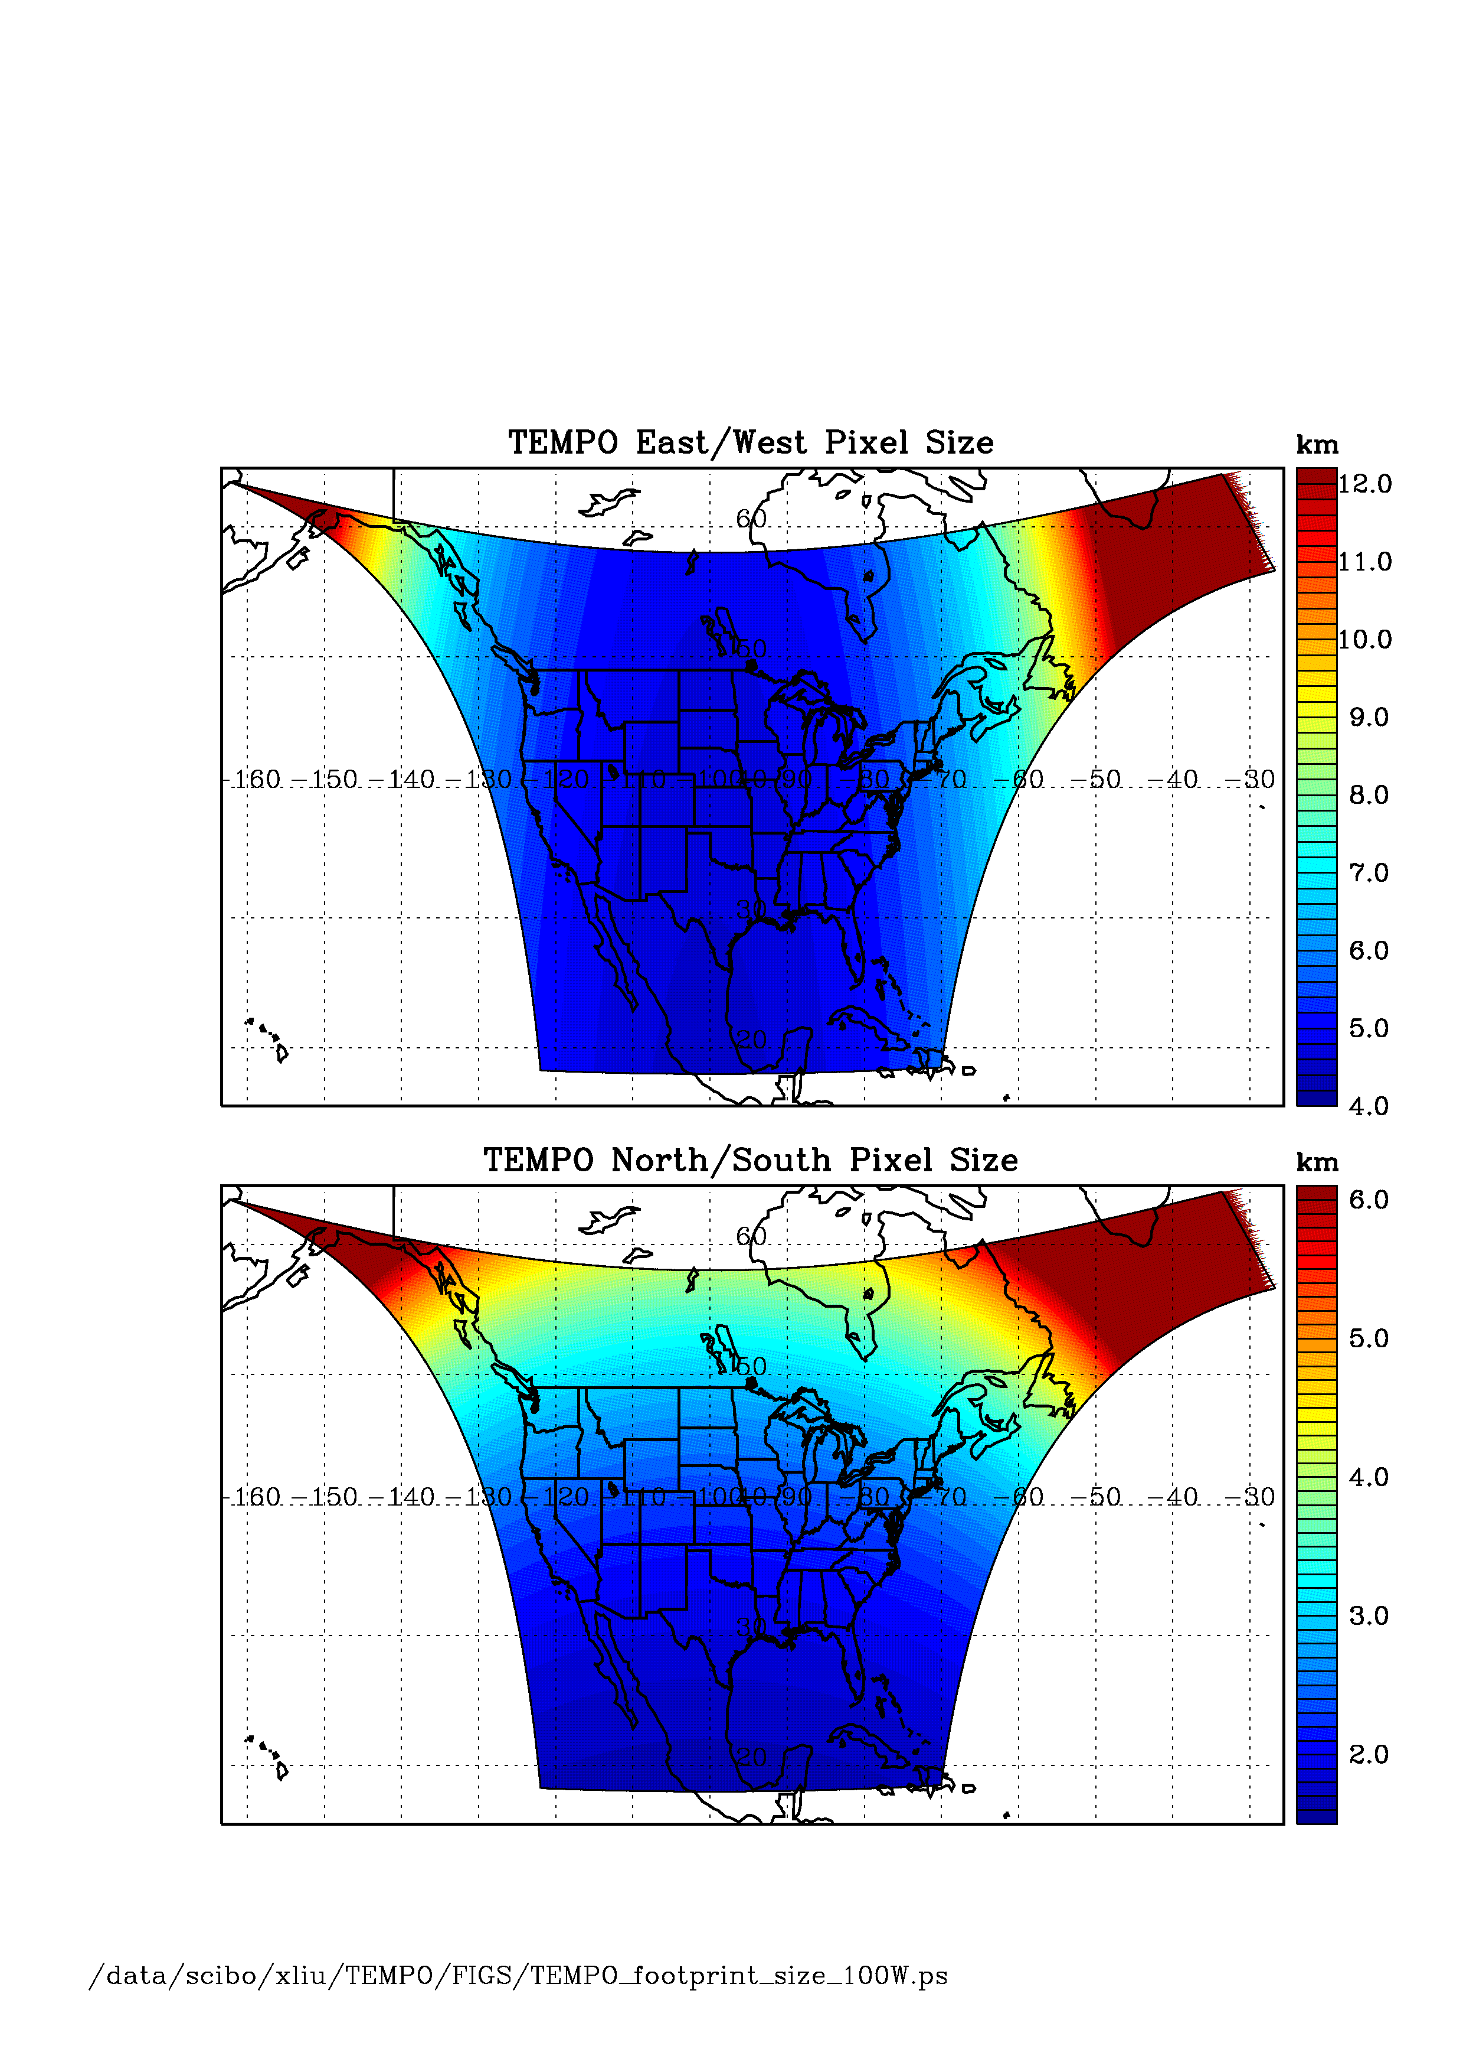
TEMPO footprint (GEO at 100º W)
Location | N/S (km) | E/W (km) | GSA (km²)
36.5ºN, 100ºW | 2.11 | 4.65 | 9.8
Washington, DC | 2.37 | 5.36 | 11.9
Seattle | 2.99 | 5.46 | 14.9
Los Angeles | 2.09 | 5.04 | 10.2
Boston | 2.71 | 5.90 | 14.1
Miami | 1.83 | 5.04 | 9.0
Mexico City | 1.65 | 4.54 | 7.5
Canadian tar sands | 3.94 | 5.05 | 19.2
Assumes 2000 N/S pixels
For GEO at 80ºW, pixel size at 36.5ºN, 100ºW is 2.2 km × 5.2 km.
Notes:
Assuming we are at 100 degree WEST
then TEMPO spatial footprint for different locations within the FOR are shown here
GSA = Ground Sample Area

Slide 13
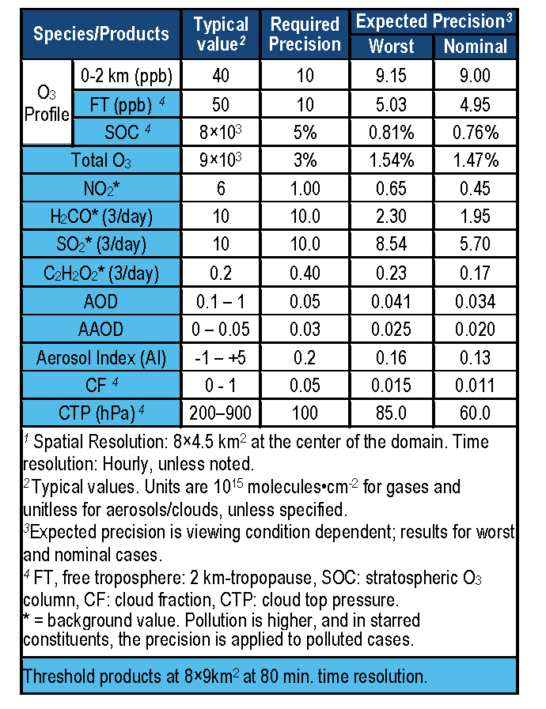
TEMPO baseline products
TEMPO has a minimally-redundant measurement set for air quality.
Near-real time products will allow for pollution alerts, chemical weather, app-based local air quality.
Notes:
This is a list of the baseline products that was mentioned briefly before
The baseline data products include surface ozone FREE TROPOSHERE TOTAL OZONE H2CO SO2 C2H2O@
SOC = stratospheric ozone column
AOD = Aerosol optical depth
AAOD = Aerosol absorption optical depth
AI = Aerosol index
CF = cloud fraction
CTP = cloud top pressure

Slide 14
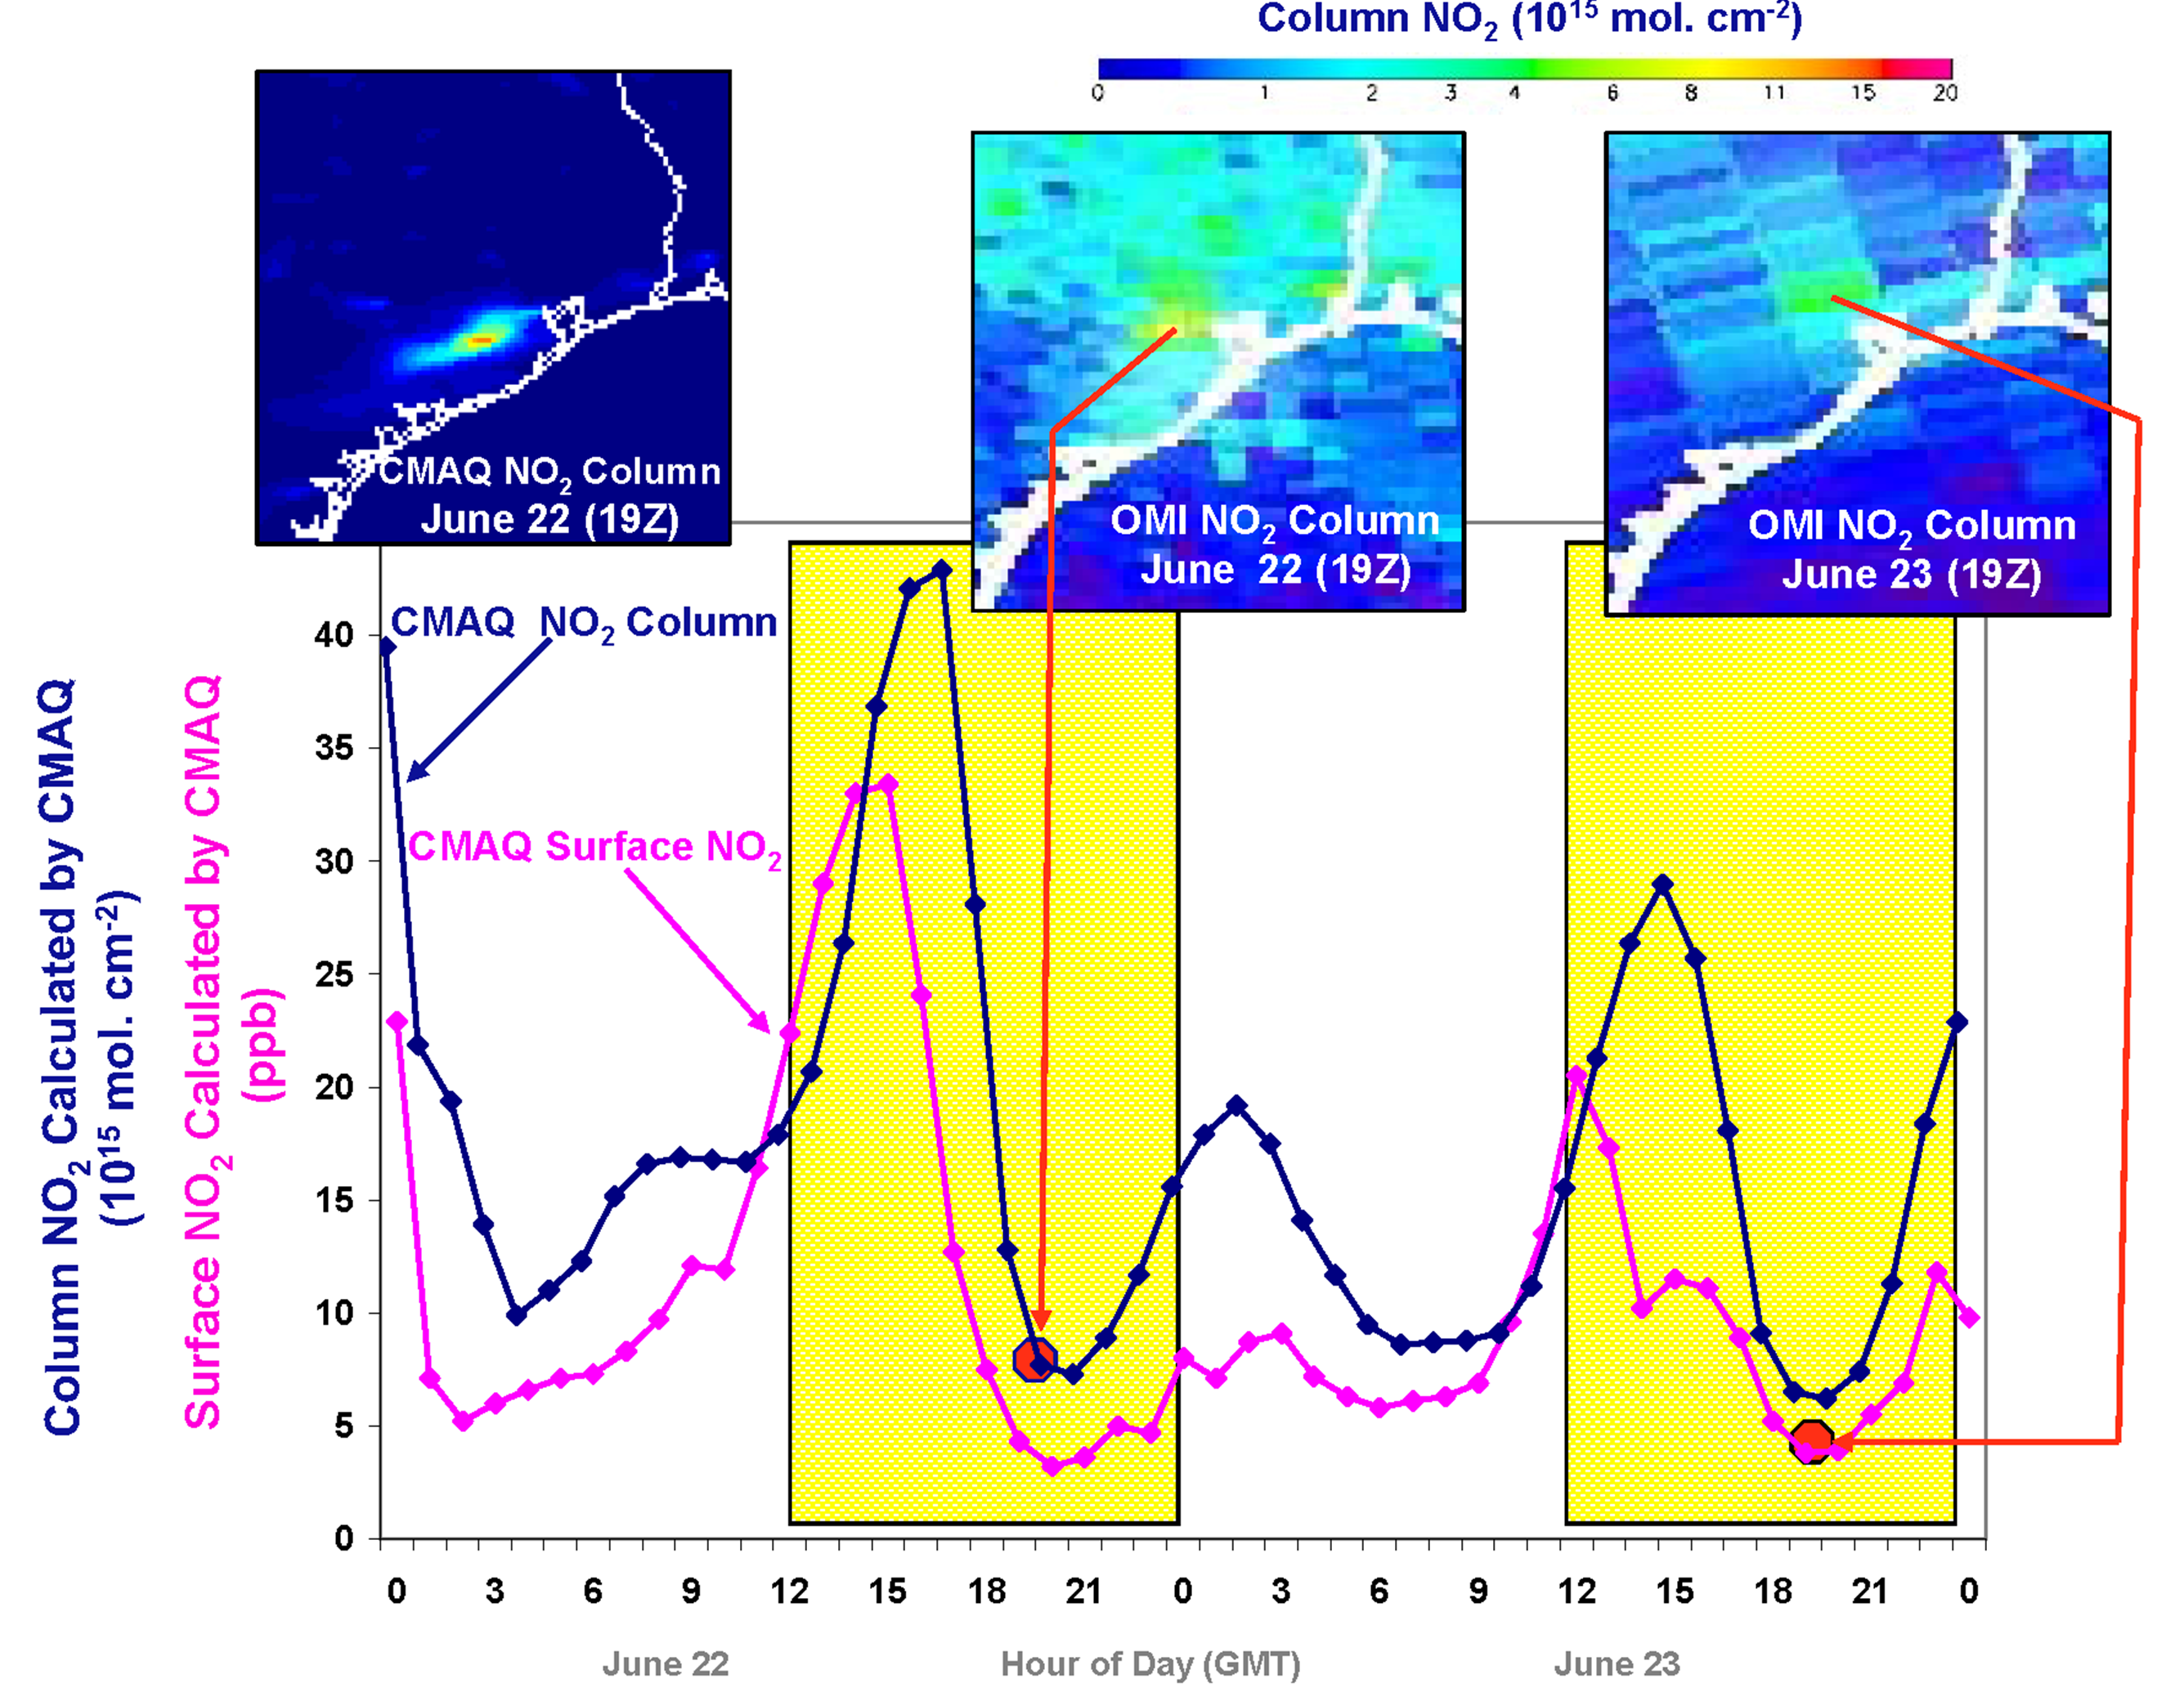
Why geostationary? High temporal and spatial resolution
Hourly NO₂ surface concentration and integrated column calculated by CMAQ air quality model: Houston, TX, June 22-23, 2005
June 22
Hour of Day (UTC)
June 23
LEO observations provide limited information on rapidly varying emissions, chemistry, & transport
GEO will provide observations at temporal and spatial scales highly relevant to air quality processes
Notes:
Community Multi-scale Air Quality (CMAQ) model output
We see model output for June 22 and 23 of 2005 and one OMI measurement for each one the the two days.
Based on the CMAQ simulations there is a strong diurnal variations. These variations cannot cannot be resolved with OMI where one 1 point is measurement at the daily minimum. TEMPO on the other hand will be able to resolves these diurnal variations.

Slide 15
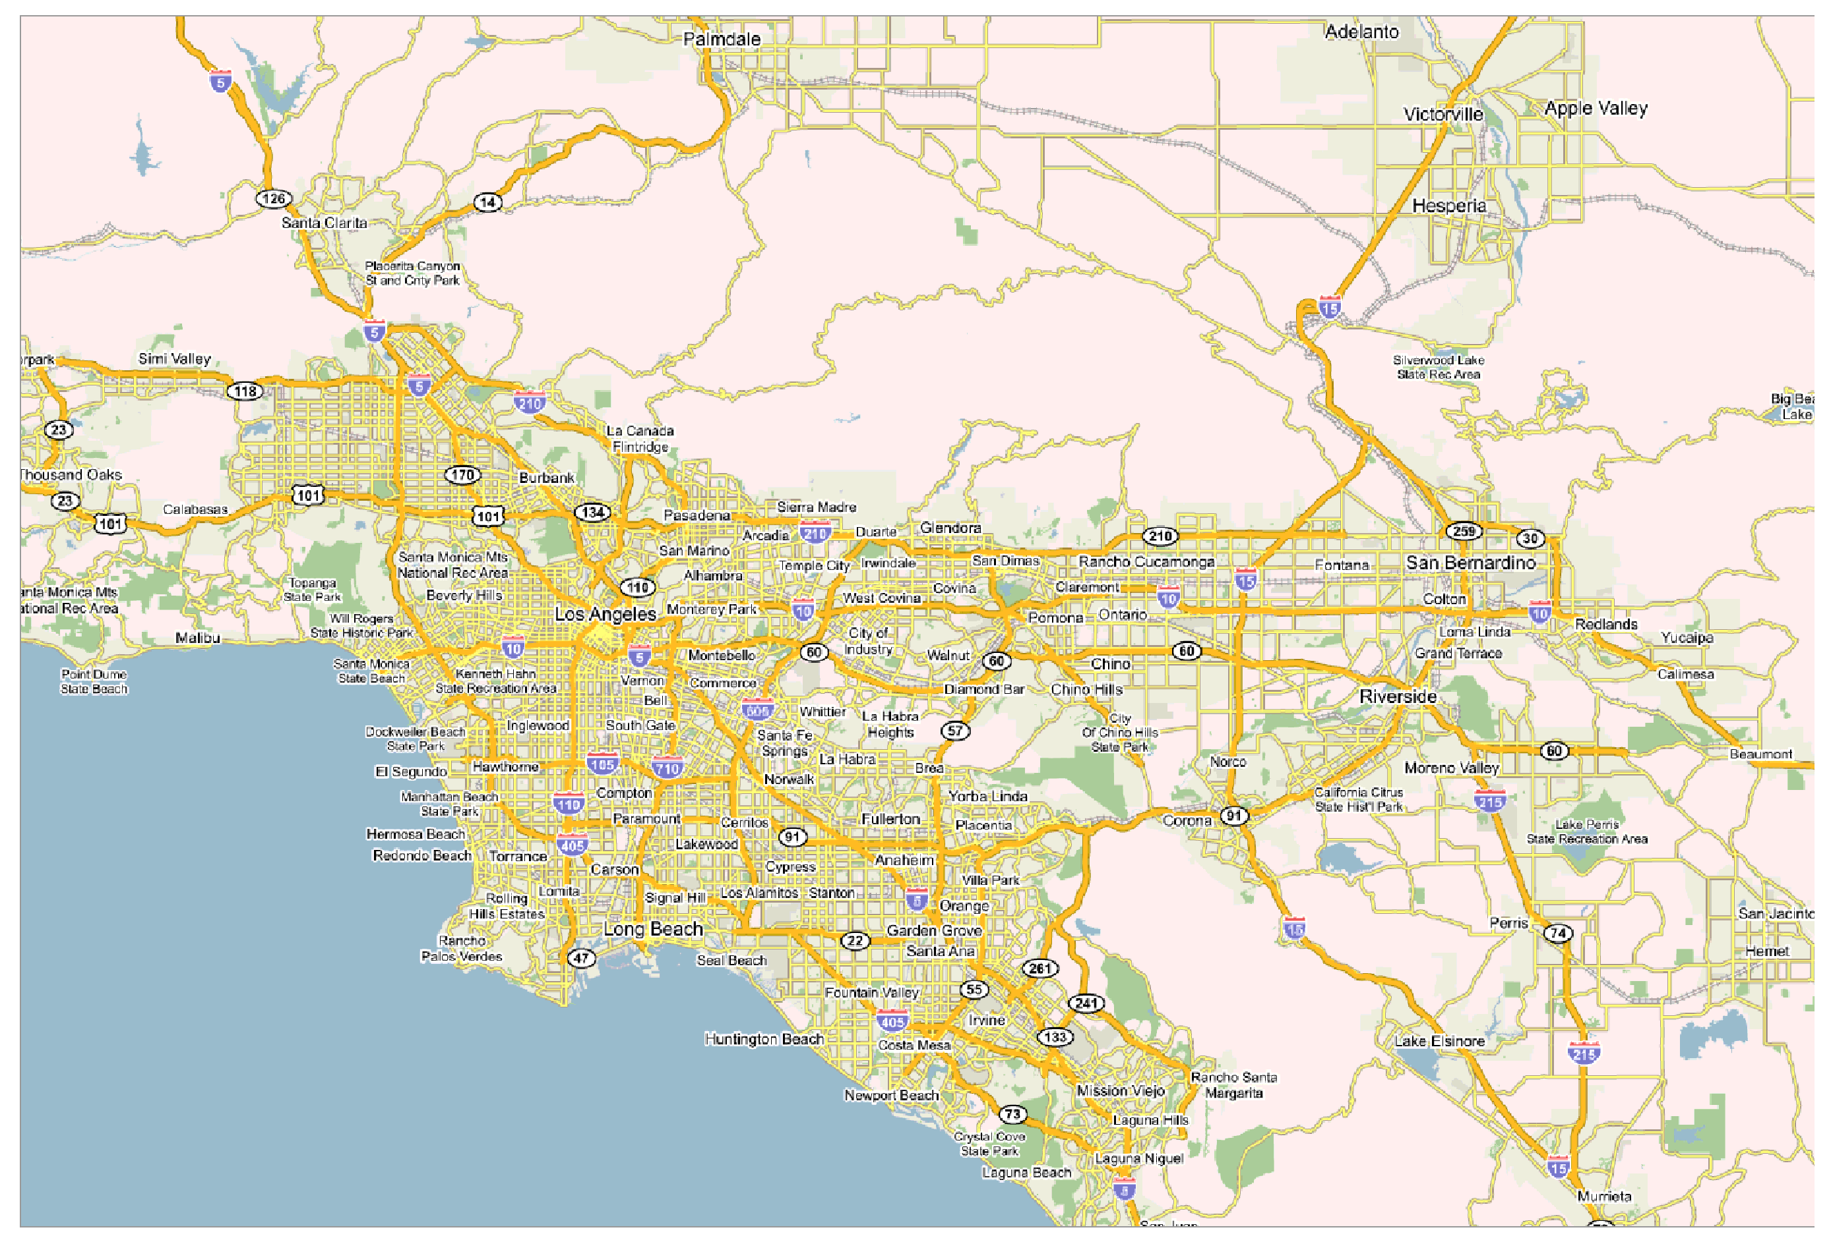
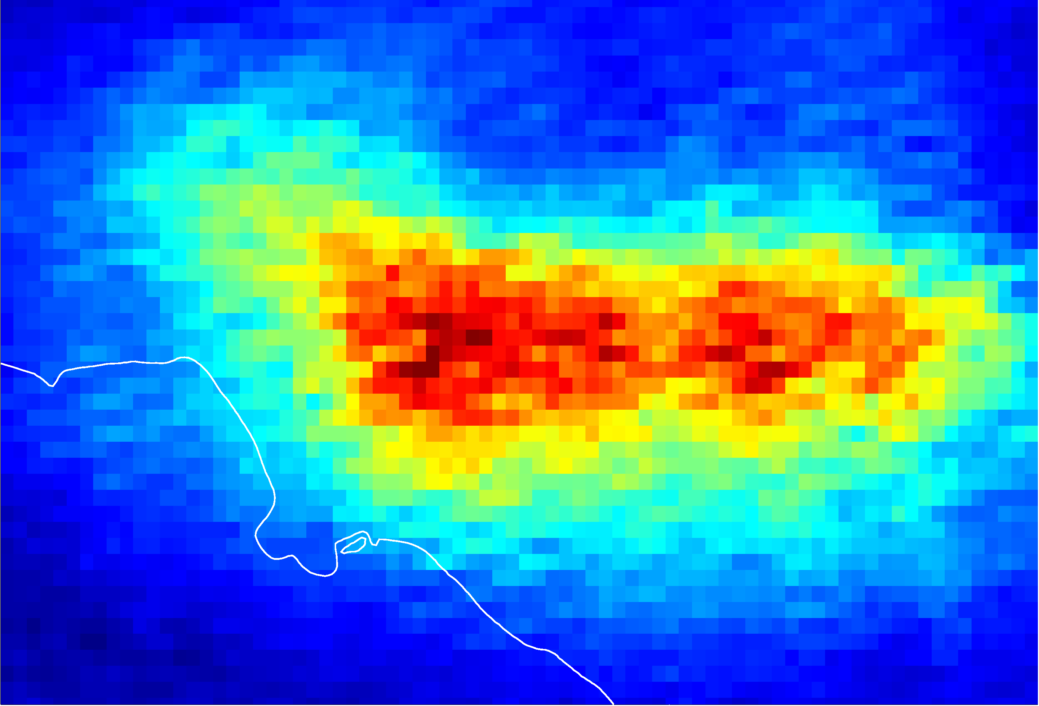
NO₂ over Los Angeles
Courtesy T. Kurosu
Notes:
This is based on OMI NO2 observations where months worth of data were combined to produce this image. TEMPO will be able to produce such a map within 1 hour.

Slide 16
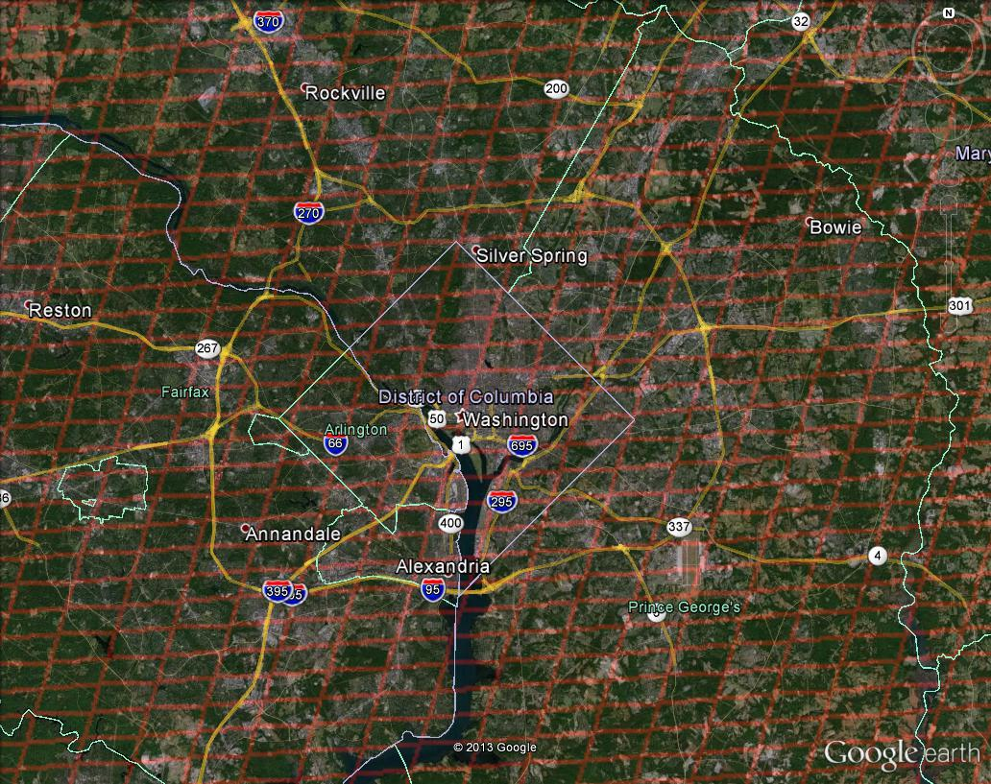
Washington, DC coverage
Hourly!
Notes:
The box represents the TEMPO spatial footprint over DC. TEMPO will observe DC at this resolution every hour

Slide 17
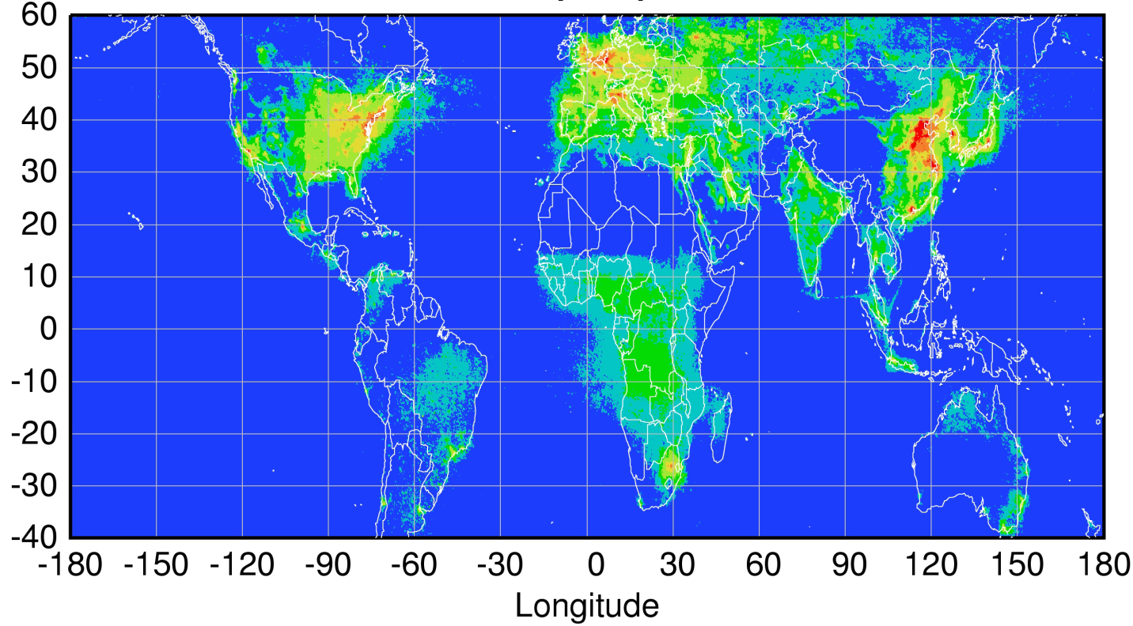
Global pollution monitoring constellation (2018-2020)
Sentinel-4
(hourly)
TEMPO
(hourly)
GEMS
(hourly)
Sentinel-5P
(once per day)
Courtesy Jhoon Kim,
Andreas Richter
Policy-relevant science and environmental services enabled by common observations
Improved emissions, at common confidence levels, over industrialized Northern Hemisphere
Improved air quality forecasts and assimilation systems
Improved assessment, e.g., observations to support United Nations Convention on Long Range Transboundary Air Pollution

Slide 18
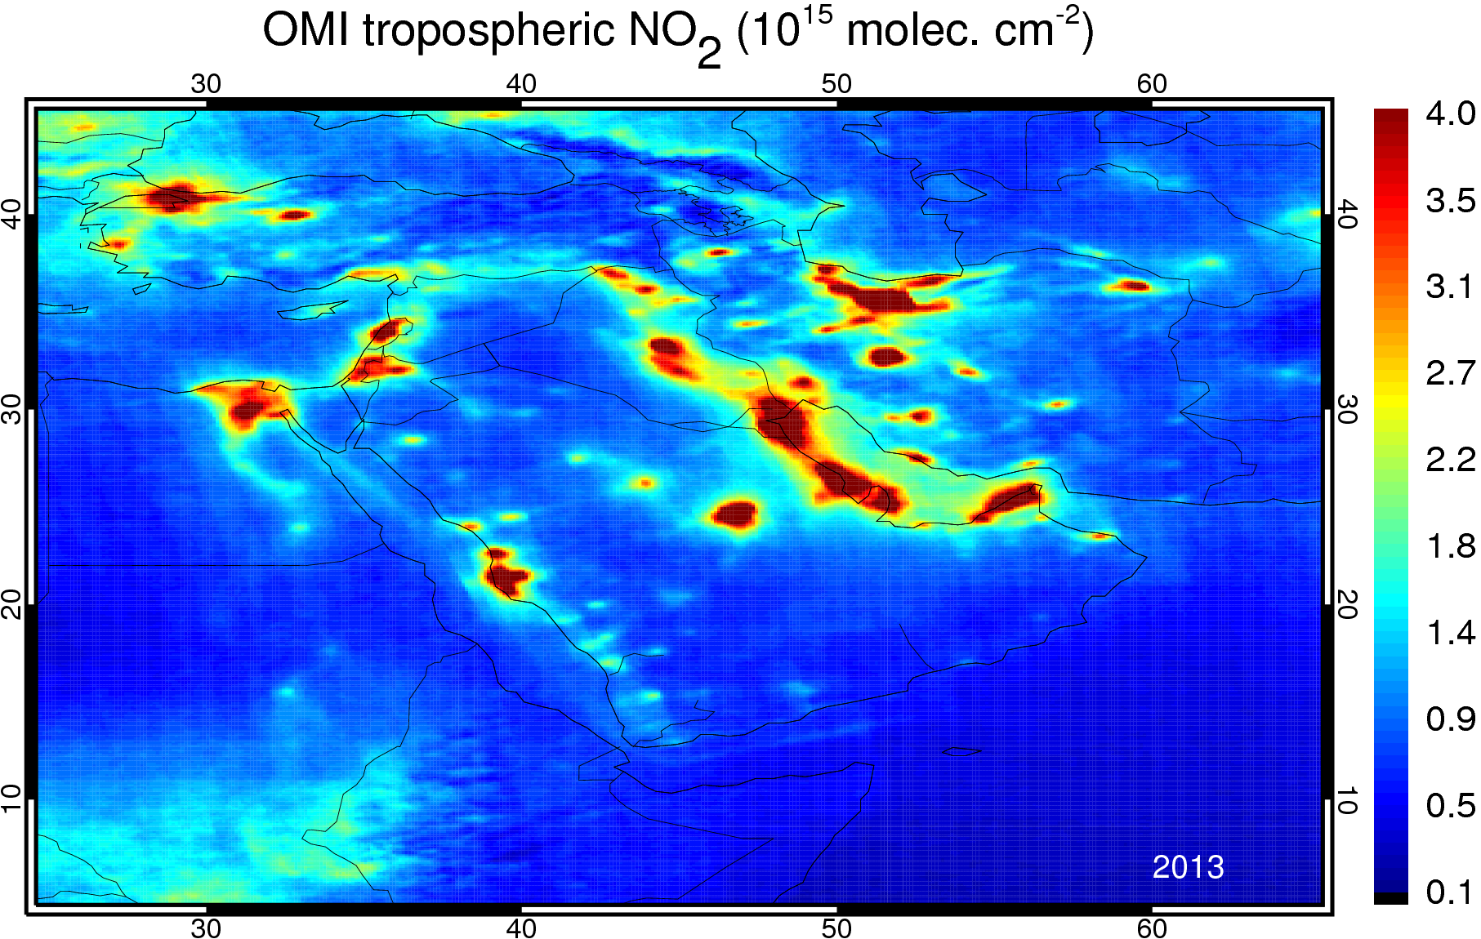
Over Middle East
Notes:
EPA = Environmental Protection Agency
Remote Sensing Information Gateway (RSIG)
RSIG allows for quick and easy access to subsets of multi-terabyte, environmental datasets via an interactive, Web browser-based application.
RSIG also allows users to integrate their selected datasets into a unified visualization. The user can tap into a wide range of key environmental models and data, such as NASA's Moderate Resolution Imaging Spectroradiometer (MODIS), the Environmental Protection Agency's (EPA) Community Multi-scale Air Quality (CMAQ) model output, National Environmental Satellite, Data, and Information Service (NESDIS) biomass burning data, and ground station measurements from AIRNow and EPA's Air Quality System (AQS).
The image is based on new data from GOES-GASP Geostationary US-coverage satellite 4km Aerosol Optical Depth data. GOES-GASP

Slide 19
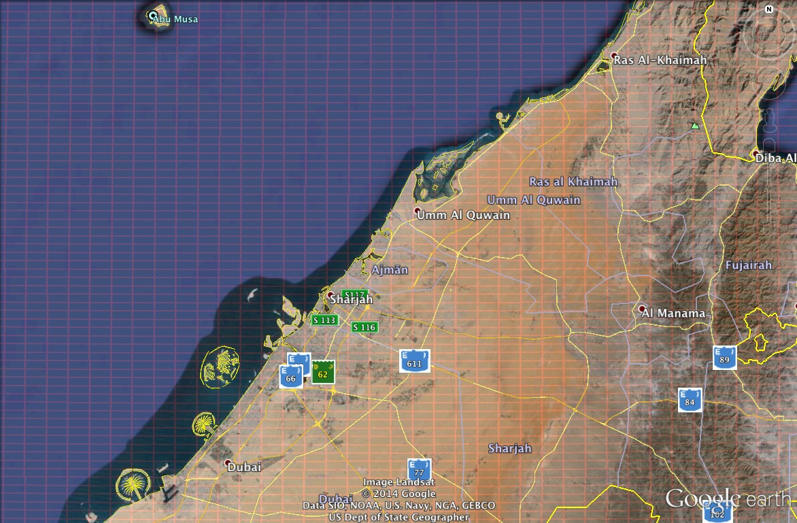
Sharjah coverage
كل ساعة!
Notes:
The box represents the TEMPO spatial footprint over Mexico City. TEMPO will observe Mexico City at this resolution every hour

Slide 20
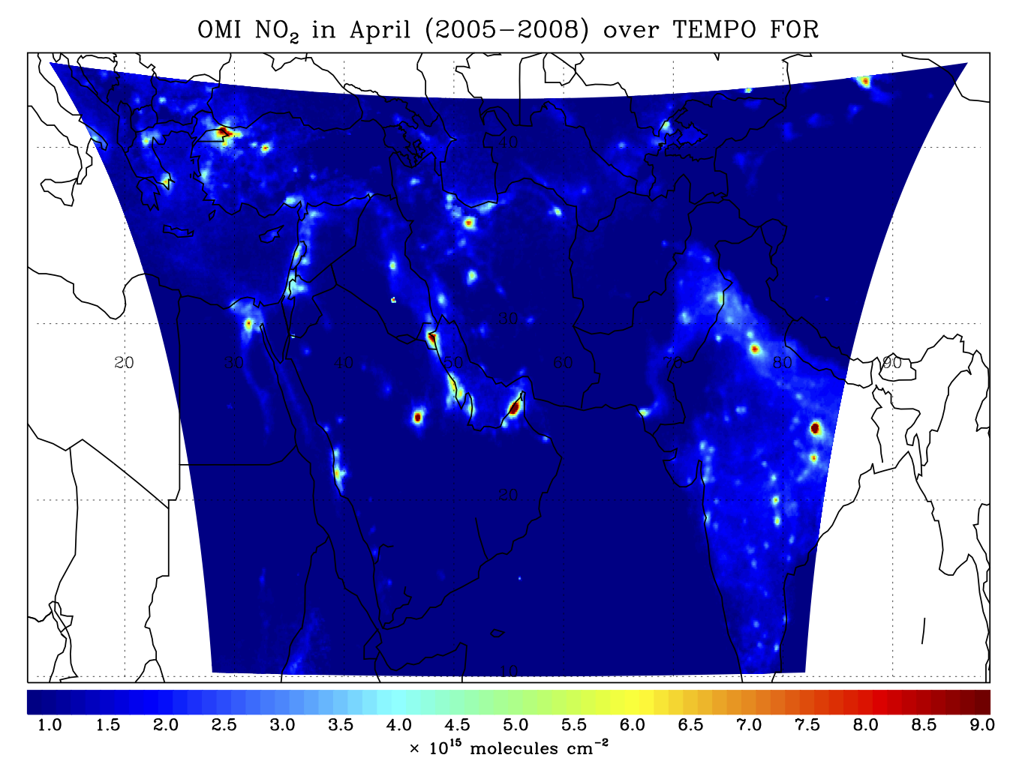
ME-TEMPO footprint, ground sample distance and field of regard
Notes:
E – W of 1250 steps
and 2000 N-S that is 2.5 million spectra every hour

Slide 21
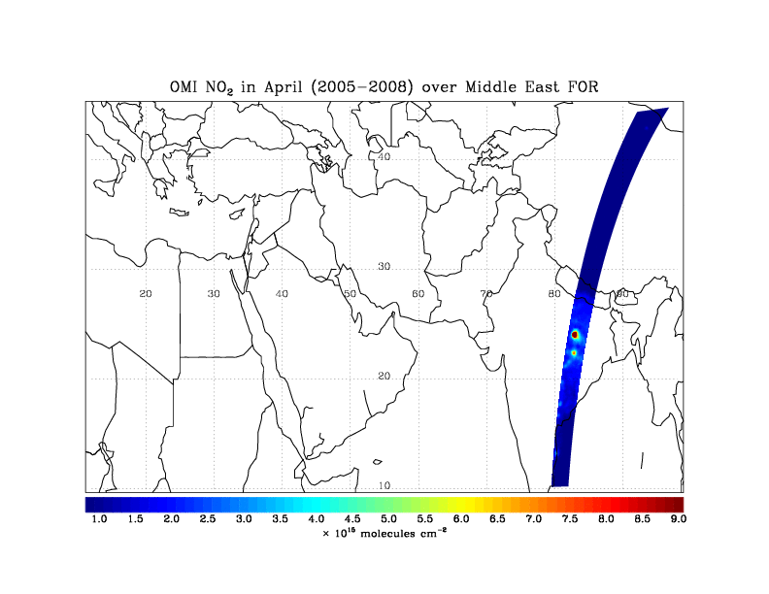
ME-TEMPO hourly NO₂ sweep
Notes:
This is an example of TEMPO hourly scans showing the FOR

Slide 22
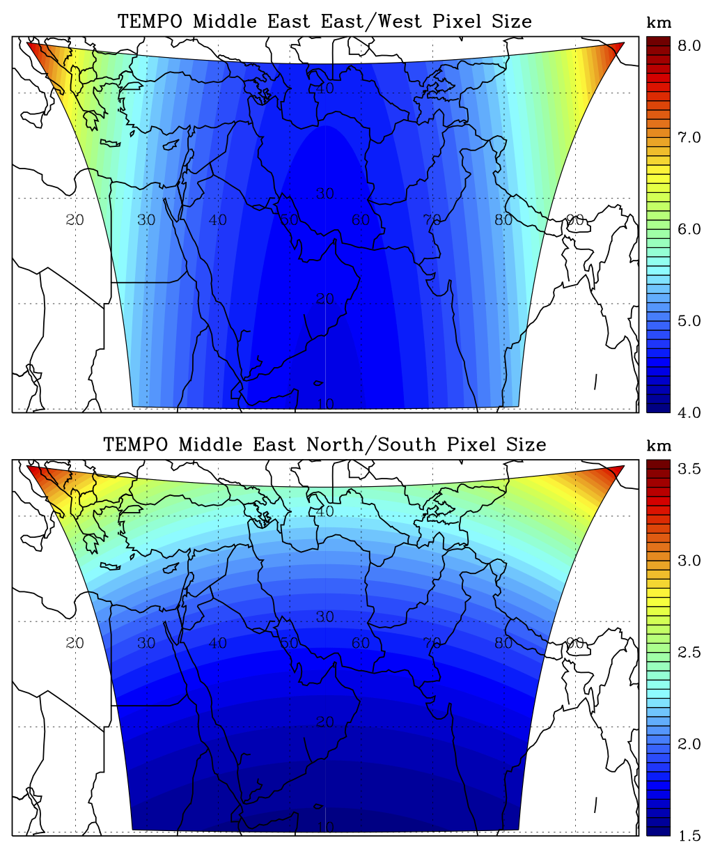
ME-TEMPO footprint (GEO at 55º E)
Location | N/S (km) | E/W (km) | GSA (km²)
25ºN, 55ºE | 4.52 | 1.74 | 7.87
Mecca | 4.52 | 1.75 | 7.91
Sharjah | 4.77 | 1.69 | 7.87
Riyadh | 4.60 | 1.74 | 10.2
Jerusalem | 5.05 | 1.99 | 9.73
Cairo | 5.26 | 1.97 | 9.90
Istanbul | 5.57 | 2.52 | 12.77
New Delhi | 5.15 | 1.91 | 9.48
Assumes 2000 N/S pixels
Notes:
Assuming we are at 55 degree EAST
then ME-TEMPO spatial footprint for different locations within the FOR are shown here
GSA = Ground Sample Area
location lon lat E/W size N/S size E/WxN/S GSA (Ground Sample Area)
Center of FOR 55.00 25.00 4.52 1.74 7.87 7.87
Sharjah 55.39 25.36 4.52 1.75 7.91 7.91
Mecca 39.82 21.42 4.77 1.69 8.08 8.01
Riyadh 46.72 24.63 4.60 1.74 8.01 7.98
Dubai 55.33 24.95 4.52 1.74 7.87 7.87
Muscat 58.54 23.61 4.53 1.71 7.76 7.75
Tehran 51.42 35.70 4.61 2.06 9.50 9.49
Cairo 31.23 30.05 5.26 1.97 10.36 9.90
Jerusalem 35.22 31.78 5.05 1.99 10.07 9.73
Baghdad 44.42 33.33 4.71 1.99 9.39 9.29
Ankara 32.86 39.93 5.27 2.39 12.61 11.82
Istanbul 28.95 41.01 5.57 2.52 14.05 12.77
New Delhi 77.21 28.61 5.15 1.91 9.82 9.48

Slide 23
Global pollution monitoring constellation (2018-2020)
Sentinel-4
(hourly)
ME-TEMPO
(hourly)
TEMPO
(hourly)
GEMS
(hourly)
Sentinel-5P
(once per day)
Courtesy Jhoon Kim,
Andreas Richter
Policy-relevant science and environmental services enabled by common observations
Improved emissions, at common confidence levels, over industrialized Northern Hemisphere
Improved air quality forecasts and assimilation systems
Improved assessment, e.g., observations to support United Nations Convention on Long Range Transboundary Air Pollution

Slide 24
TEMPO Summary
TEMPO is a pathfinder for NASA
  The first mission under the stringently cost-capped Earth Venture Instrument program
  First use of a competitively selected commercial host satellite
Currently on-schedule and on-budget
  Passed System Requirements Review and Mission Definition Review in November 2013
  Passed KDP-B April 2014, now in Phase B/C
  Most technical issues solved at the preliminary design level, following technical interchange meeting at Ball, April 2014
  Passed PDR on July 31, 2014
  KDP-C has not been scheduled yet (September 30, 2014)
Commercial satellite host selection and Instrument CDR summer 2015
  TEMPO operating longitude and launch date are not known until after host selection
Instrument delivery 05/2017 for launch no earlier than 11/2018

Slide 25







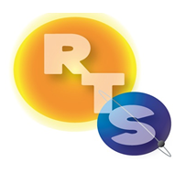


The End!

