Slide 1
Tropospheric Emissions:
Monitoring of Pollution
Overview
Kelly Chance, Xiong Liu,
Raid M. Suleiman,
Smithsonian Astrophysical
Observatory
David Flittner, Jay Al-Saadi,
NASA LaRC
Scott Janz, NASA GSFC
Atmospheric Composition
Constellation Meeting 11
April 29, 2015

Slide 2
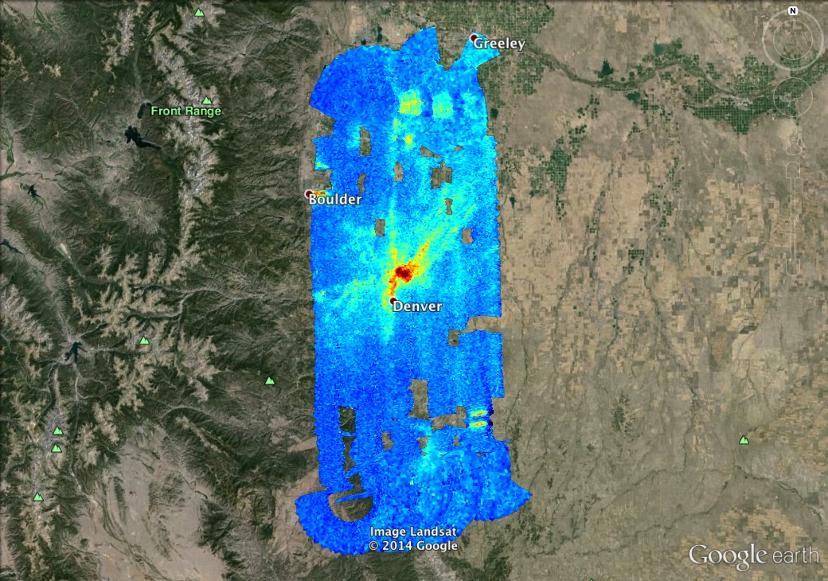

TEMPO measurements will capture the diurnal cycle of pollutant emissions
GeoTASO NO₂ Slant Column, 02 August 2014 Morning
Co-added to approx.
500m x 450m
Morning vs. Afternoon
Preliminary data,
C. Nowlan, SAO

Slide 3
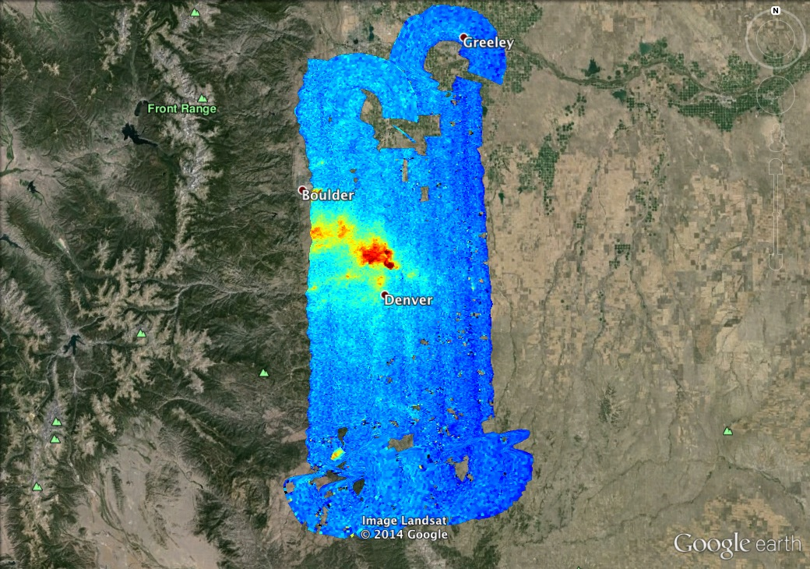
TEMPO measurements will capture the diurnal cycle of pollutant emissions
GeoTASO NO₂ Slant Column, 02 August 2014 Afternoon
Co-added to approx.
500m x 450m
Morning vs. Afternoon
Preliminary data,
C. Nowlan, SAO

Slide 4
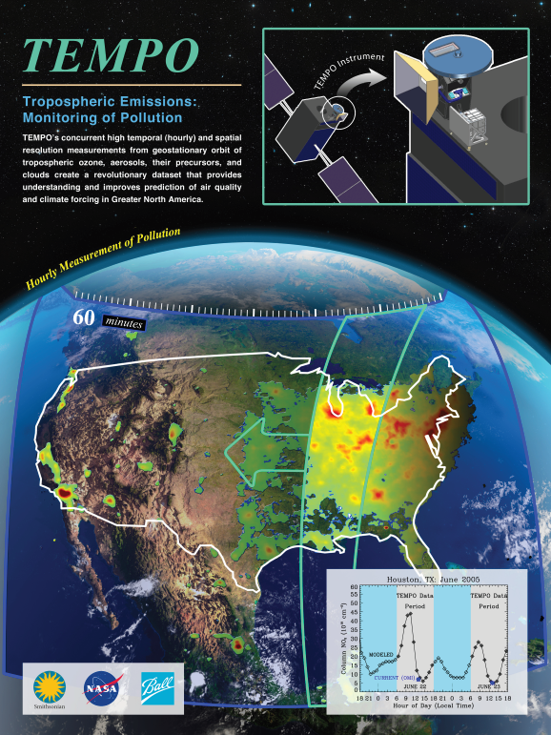
Hourly atmospheric pollution from geostationary Earth orbit
PI: Kelly Chance, Smithsonian Astrophysical Observatory
Instrument Development: Ball Aerospace
Project Management: NASA LaRC
Other Institutions: NASA GSFC, NOAA, EPA, NCAR, Harvard, UC Berkeley, St. Louis U, U Alabama Huntsville, U Nebraska, RT Solutions, Carr Astronautics
International collaboration: Korea, U.K., ESA, Canada, Mexico
Selected Nov. 2012 as NASA’s first Earth Venture Instrument
  Instrument being implemented, delivery May 2017
  NASA will arrange hosting on commercial geostationary communications satellite with launch expected NET 11/2018
Provides hourly daylight observations to capture rapidly varying emissions & chemistry important for air quality
  UV/visible grating spectrometer to measure key elements in tropospheric ozone and aerosol pollution
  Exploits extensive measurement heritage from LEO missions
  Distinguishes boundary layer from free tropospheric & stratospheric ozone
Aligned with Earth Science Decadal Survey recommendations
  Makes many of the GEO-CAPE atmosphere measurements
  Responds to the phased implementation recommendation of GEO-CAPE mission design team
  North American component of an international constellation for air quality observations

Slide 5
TEMPO instrument project detailed organization structure
TEMPO Instrument
Principal Investigator: Kelly Chance
Deputy Principal Investigator: Xiong Liu
Program Administrator: Joseph Webber
Investigation Advisory Panel
SAO, LaRC, Ball Senior Management
Science Advisory Panel
Geo Constellation/CEOS
Science Team
Project Management
Project Manager: Wendy Pennington
Project Scientist: David Flittner
Deputy Project Scientist: Jay Al-Saadi
Deputy PM: Craig Jones, COR
Deputy PP&C: Don Shick
Management Support
Schedules: Barbara Guilmette
Configuration Manager: Donna Lewis
Communications: Jonathan Behun/Katie Bethea
Systems Engineering
Project CE: David Rosenbaum
SE: Mark Andraschko
Safety & Mission Assurance
Mission Assurance Manager: Jose Caraballo
Instrument
PM Dennis Nicks
Chief SE: Laura Hale
Instrument Performance: Brian Baker
Ground
Systems
Raid M. Suleiman
Instrument Operations
John E. Davis
Science Data Processing System
John Houck

Slide 6
TEMPO Science Team, U.S.
Team Member | Institution | Role | Responsibility
K. Chance | SAO | PI | Overall science development; Level 1b, H₂CO, C₂H₂O₂
X. Liu | SAO | Deputy PI | Science development, data processing; O₃ profile, tropospheric O₃
J. Al-Saadi | LaRC | Deputy PS | Project science development
J. Carr | Carr Astronautics | Co-I | INR Modeling and algorithm
M. Chin | GSFC | Co-I | Aerosol science
R. Cohen | U.C. Berkeley | Co-I | NO₂ validation, atmospheric chemistry modeling, process studies
D. Edwards | NCAR | Co-I | VOC science, synergy with carbon monoxide measurements
J. Fishman | St. Louis U. | Co-I | AQ impact on agriculture and the biosphere
D. Flittner | LaRC | Project Scientist | Overall project development; STM; instrument cal./char.
J. Herman | UMBC | Co-I | Validation (PANDORA measurements)
D. Jacob | Harvard | Co-I | Science requirements, atmospheric modeling, process studies
S. Janz | GSFC | Co-I | Instrument calibration and characterization
J. Joiner | GSFC | Co-I | Cloud, total O₃, TOA shortwave flux research product
N. Krotkov | GSFC | Co-I | NO₂, SO₂, UVB
M. Newchurch | U. Alabama Huntsville | Co-I | Validation (O₃ sondes, O₃ lidar)
R.B. Pierce | NOAA/NESDIS | Co-I | AQ modeling, data assimilation
R. Spurr | RT Solutions, Inc. | Co-I | Radiative transfer modeling for algorithm development
R. Suleiman | SAO | Co-I, Data Mgr. | Managing science data processing, BrO, H₂O, and L3 products
J. Szykman | EPA | Co-I | AIRNow AQI development, validation (PANDORA measurements)
O. Torres | GSFC | Co-I | UV aerosol product, AI
J. Wang | U. Nebraska | Co-I | Synergy w/GOES-R ABI, aerosol research products
J. Leitch | Ball Aerospace | Collaborator | Aircraft validation, instrument calibration and characterization
D. Neil | LaRC | Collaborator | GEO-CAPE mission design team member

Slide 7
TEMPO Science Team, non-U.S.
Team Member | Institution | Role | Responsibility
R. Martin | Dalhousie U. | Collaborator | Atmospheric modeling, air mass factors, AQI development
Chris McLinden | Environment Canada | Collaborator | Canadian air quality coordination
Michel Grutter de la Mora | UNAM, Mexico | Collaborator | Mexican air quality coordination
Gabriel Vazquez | UNAM, Mexico | Collaborator | Mexican air quality, algorithm physics
Amparo Martinez | INECC, Mexico | Collaborator | Mexican environmental pollution and health
J. Victor Hugo Paramo Figeuroa | INECC, Mexico | Collaborator | Mexican environmental pollution and health
Brian Kerridge | Rutherford Appleton Laboratory, UK | Collaborator | Ozone profiling studies, algorithm development
Paul Palmer | Edinburgh U., UK | Collaborator | Atmospheric modeling, process studies
J. Kim | Yonsei U. | Collaborators, Science Advisory Panel | Korean GEMS, CEOS constellation of GEO pollution monitoring
C.T. McElroy | York U. Canada |  | CSA PHEOS, CEOS constellation of GEO pollution monitoring
B. Veihelmann | ESA |  | ESA Sentinel-4, CEOS constellation of GEO pollution monitoring

Slide 8
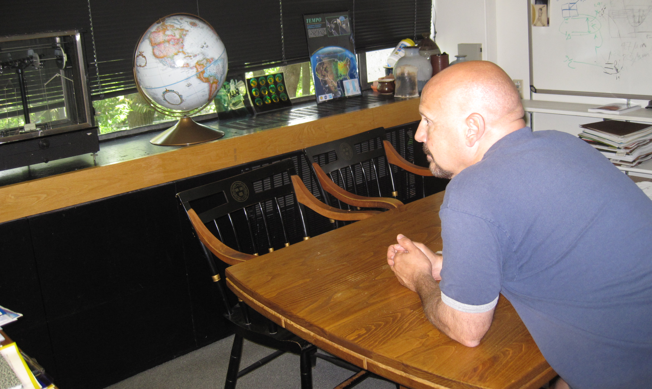
The view from GEO

Slide 9
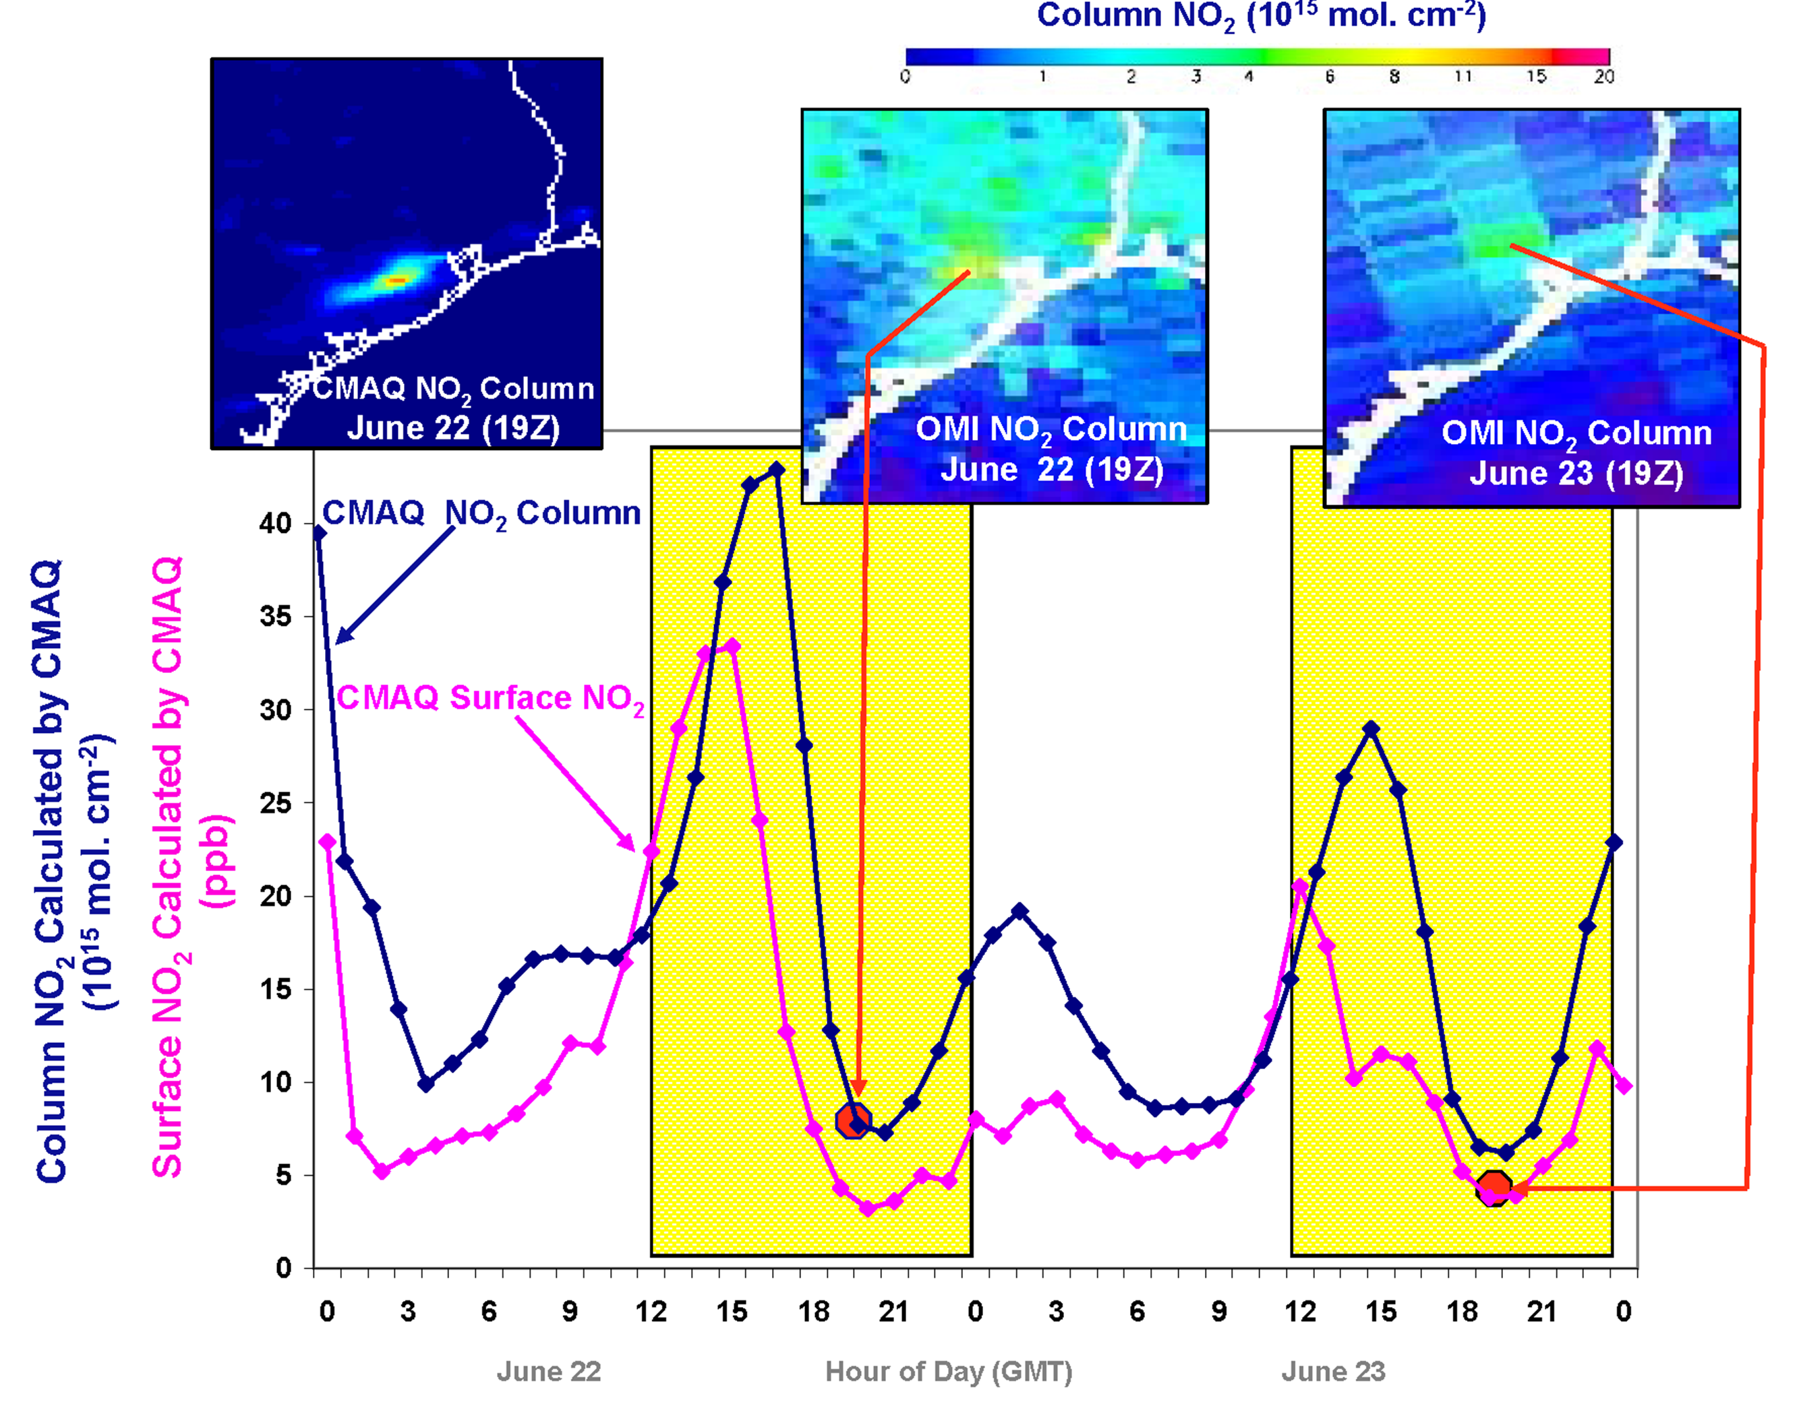
Why geostationary? High temporal and spatial resolution
Hourly NO₂ surface concentration and integrated column calculated by CMAQ air quality model: Houston, TX, June 22-23, 2005
June 22
Hour of Day (UTC)
June 23
LEO observations provide limited information on rapidly varying emissions, chemistry, & transport
GEO will provide observations at temporal and spatial scales highly relevant to air quality processes

Slide 10
TEMPO science traceability matrix

Slide 11
Baseline and threshold data products
Species/Products | Required Precision | Temporal Revisit
0-2 km O₃ (Selected Scenes) Baseline only | 10 ppbv | 2 hour
Tropospheric O₃ | 10 ppbv | 1 hour
Total O₃ | 3% | 1 hour
Tropospheric NO₂ | 1.0 × 10¹⁵ molecules cm⁻² | 1 hour
Tropospheric H₂CO | 1.0 × 10¹⁶ molecules cm⁻² | 3 hour
Tropospheric SO₂ | 1.0 × 10¹⁶ molecules cm⁻² | 3 hour
Tropospheric C₂H₂O₂ | 4.0 × 10¹⁴ molecules cm⁻² | 3 hour
Aerosol Optical Depth | 0.10 | 1 hour
Minimal set of products sufficient for constraining air quality
Across Greater North America (GNA): 18°N to 58°N near 100°W, 67°W to 125°W near 42°N
Data products at urban-regional spatial scales
  Baseline ≤ 60 km² at center of Field Of Regard (FOR)
  Threshold ≤ 300 km² at center of FOR
Temporal scales to resolve diurnal changes in pollutant distributions
Collected in cloud-free scenes
Geolocation uncertainty of less than 4 km
Mission duration, subject to instrument availability
  Baseline 20 months
  Threshold 12 months

Slide 12
TEMPO instrument concept
Measurement technique
  Imaging grating spectrometer measuring solar backscattered Earth radiance
  Spectral band & resolution: 290-490 + 540-740 nm @ 0.6 nm FWHM, 0.2 nm sampling
  2 2-D, 2k×1k, detectors image the full spectral range for each geospatial scene
Field of Regard (FOR) and duty cycle
  Mexico City/Yucatan Peninsula to the Canadian tar/oil sands, Atlantic to Pacific
  Instrument slit aligned N/S and swept across the FOR in the E/W direction, producing a radiance map of Greater North America in one hour
Spatial resolution
  2.1 km N/S × 4.7 km E/W native pixel resolution (9.8 km²)
  Co-add/cloud clear as needed for specific data products
Standard data products and sampling rates
  Most sampled hourly, including eXceL O₃ (troposphere, PBL) for selected areas
  H₂CO, C₂H₂O₂, SO₂ sampled hourly (average results for ≥ 3/day if needed)
  Nominal spatial resolution 8.4 km N/S × 4.7 km E/W at center of domain (can often measure 2.1 km N/S × 4.7 km E/W)
  Measurement requirements met up to 50º for SO₂, 70º SZA for other products

Slide 13
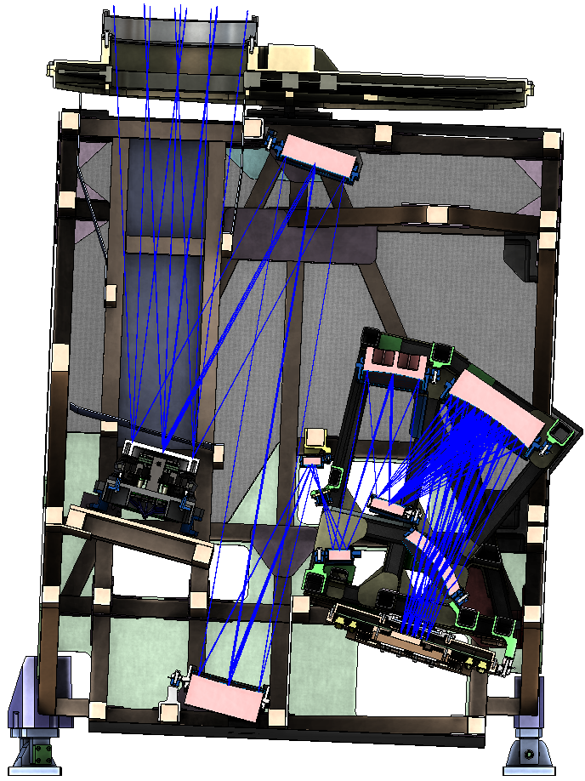
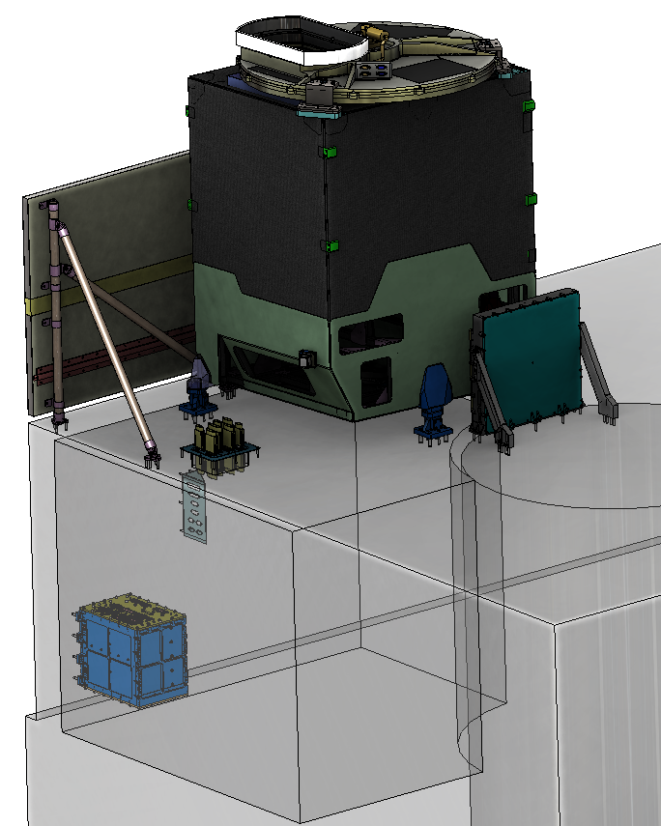

Instrument layout
Calibration Mechanism Assembly
Telescope Assembly
Scan Mechanism Assembly
Spectrometer Assembly
Radiator Assembly
Focal Plane Electronics
Focal Plane
Assembly
Instrument
Control Electronics
Instrument Support
Assembly
Notes:
Most of final drawings done; detectors in-house; grating ordered; optical bench ordered

Slide 14
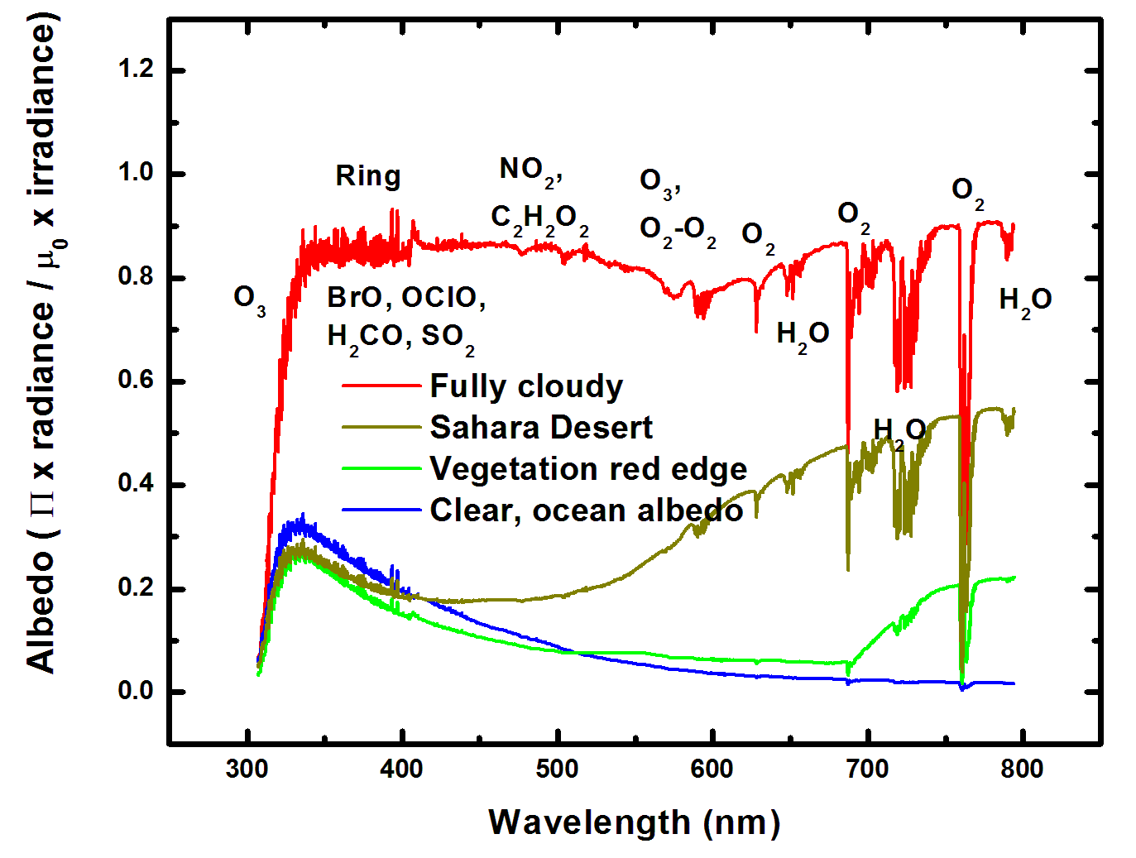
Typical TEMPO-range spectra (from ESA GOME-1)

Slide 15
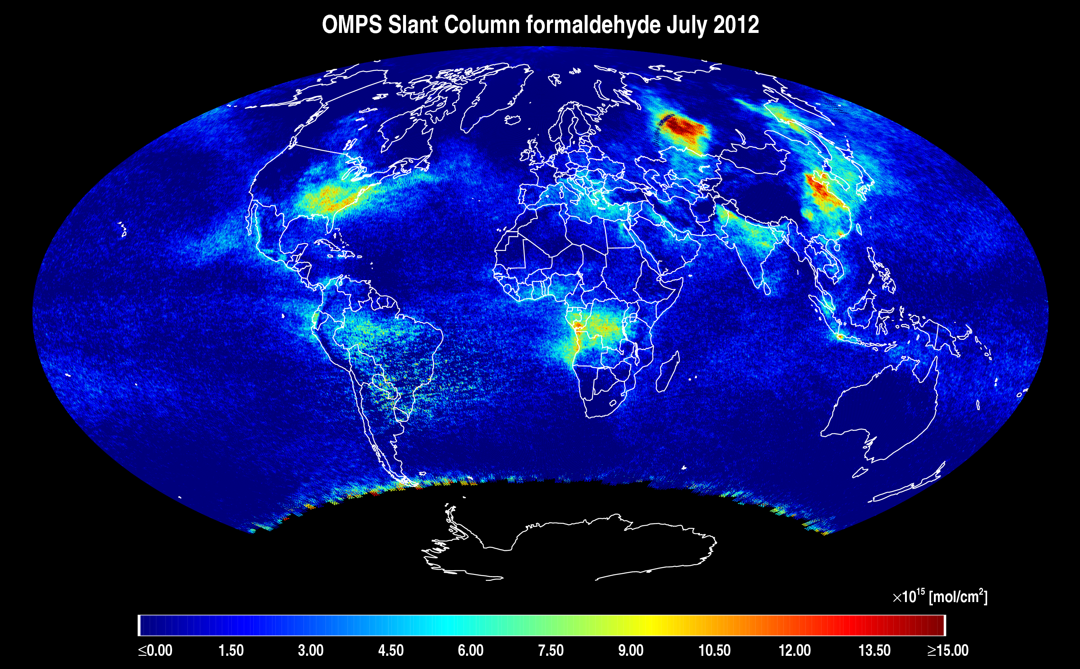
Algorithm testing: OMPS H₂CO
OMPS slant column H₂CO monthly average for July 2012. Because of higher SNR, the OMPS precisions are substantially higher than those from OMI.

Slide 16
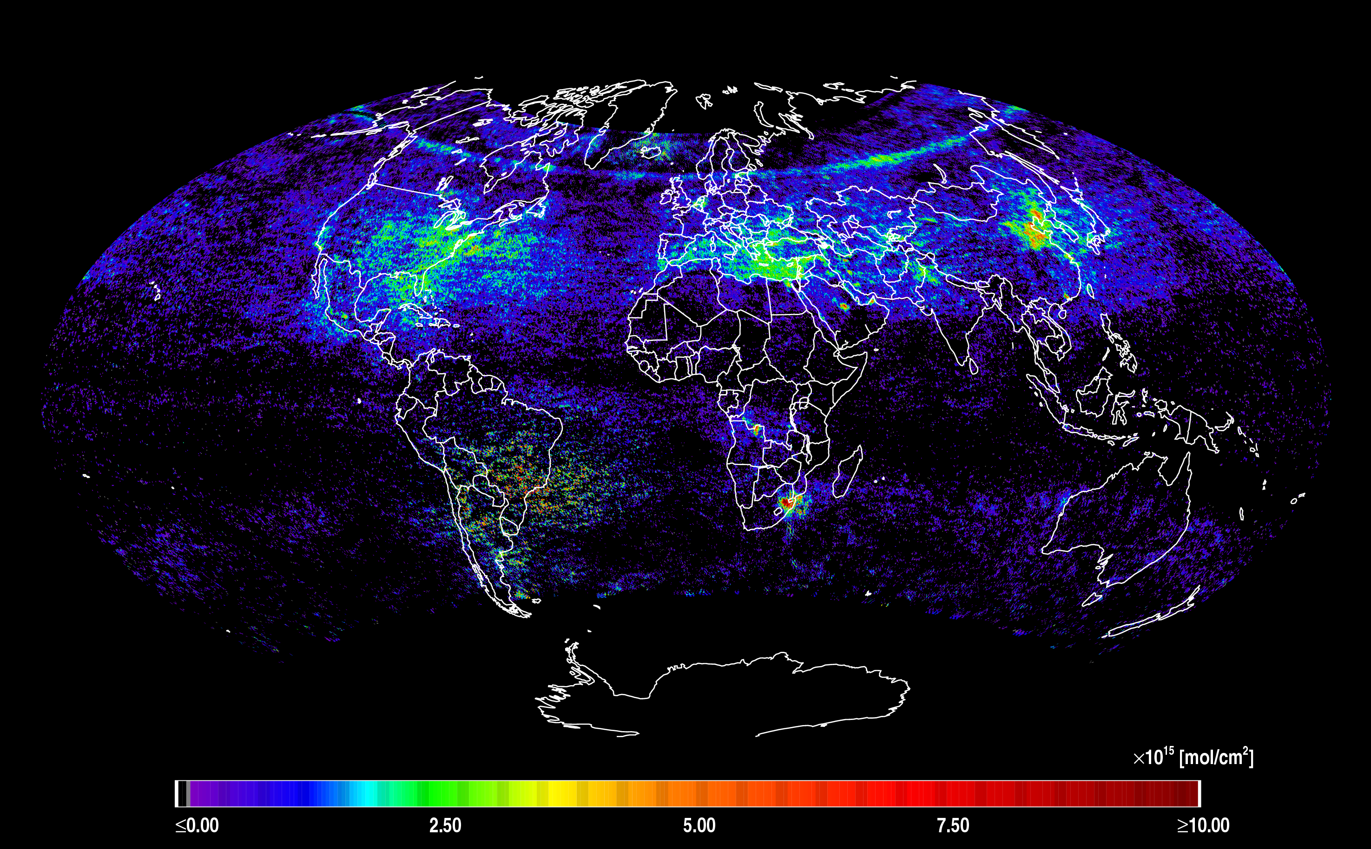
Algorithm testing: OMPS NO₂
OMPS tropospheric slant column NO₂ for July 2-7, 2012. Much optimization remains to improve fitting and remove artifacts but the data are nearly of sufficient quality for scientific studies. The SAA is readily visible.

Slide 17
TEMPO mission concept
Geostationary orbit, operating on a commercial telecom satellite
  NASA will arrange launch and hosting services (per Earth Venture Instrument scope)
    80-115º W acceptable latitude
    Specifying satellite environment, accommodation
  Hourly measurement and telemetry duty cycle for at least ≤70º SZA
    Hope to measure up to 20 hours/day
TEMPO is low risk with significant space heritage
  All proposed TEMPO measurements have been made from low Earth orbit satellite instruments to the required precisions
  All TEMPO launch algorithms are implementations of currently operational algorithms
    NASA TOMS-type O₃
    SO₂, NO₂, H₂CO, C₂H₂O₂ from fitting with AMF-weighted cross sections
    Absorbing Aerosol Index, UV aerosol, Rotational Raman scattering cloud
    eXceL profile/tropospheric/PBL O₃ for selected geographic targets
Example higher-level products: Near-real-time pollution/AQ indices, UV index
TEMPO research products will greatly extend science and applications
  Example research products: eXceL profile O₃ for broad regions; BrO from AMF-normalized cross sections; height-resolved SO₂; additional cloud/aerosol products; vegetation products

Slide 18
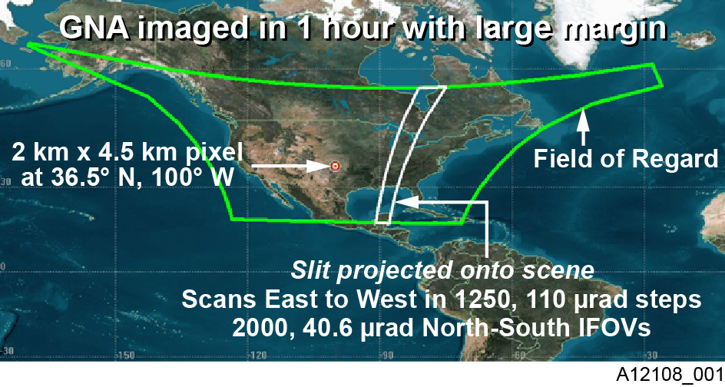
TEMPO footprint, ground sample distance and field of regard
2.1 km × 4.7
__________
Each 2.1 km × 4.7 km pixel is a 2K element spectrum from 290-740 nm
GEO platform selected by NASA for viewing Greater North America

Slide 19
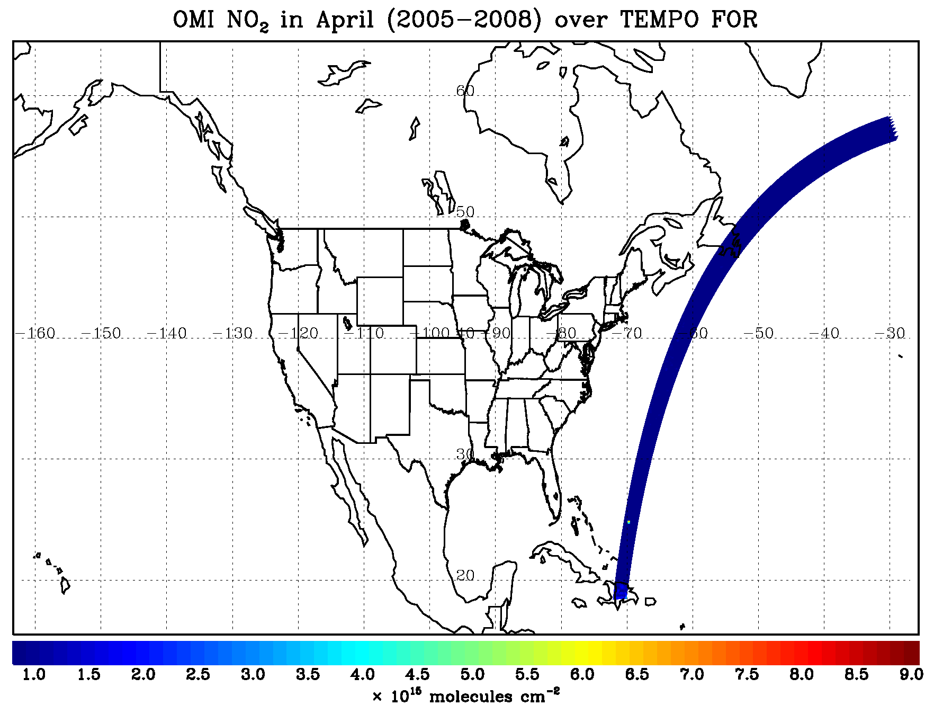
TEMPO hourly NO₂ sweep

Slide 20
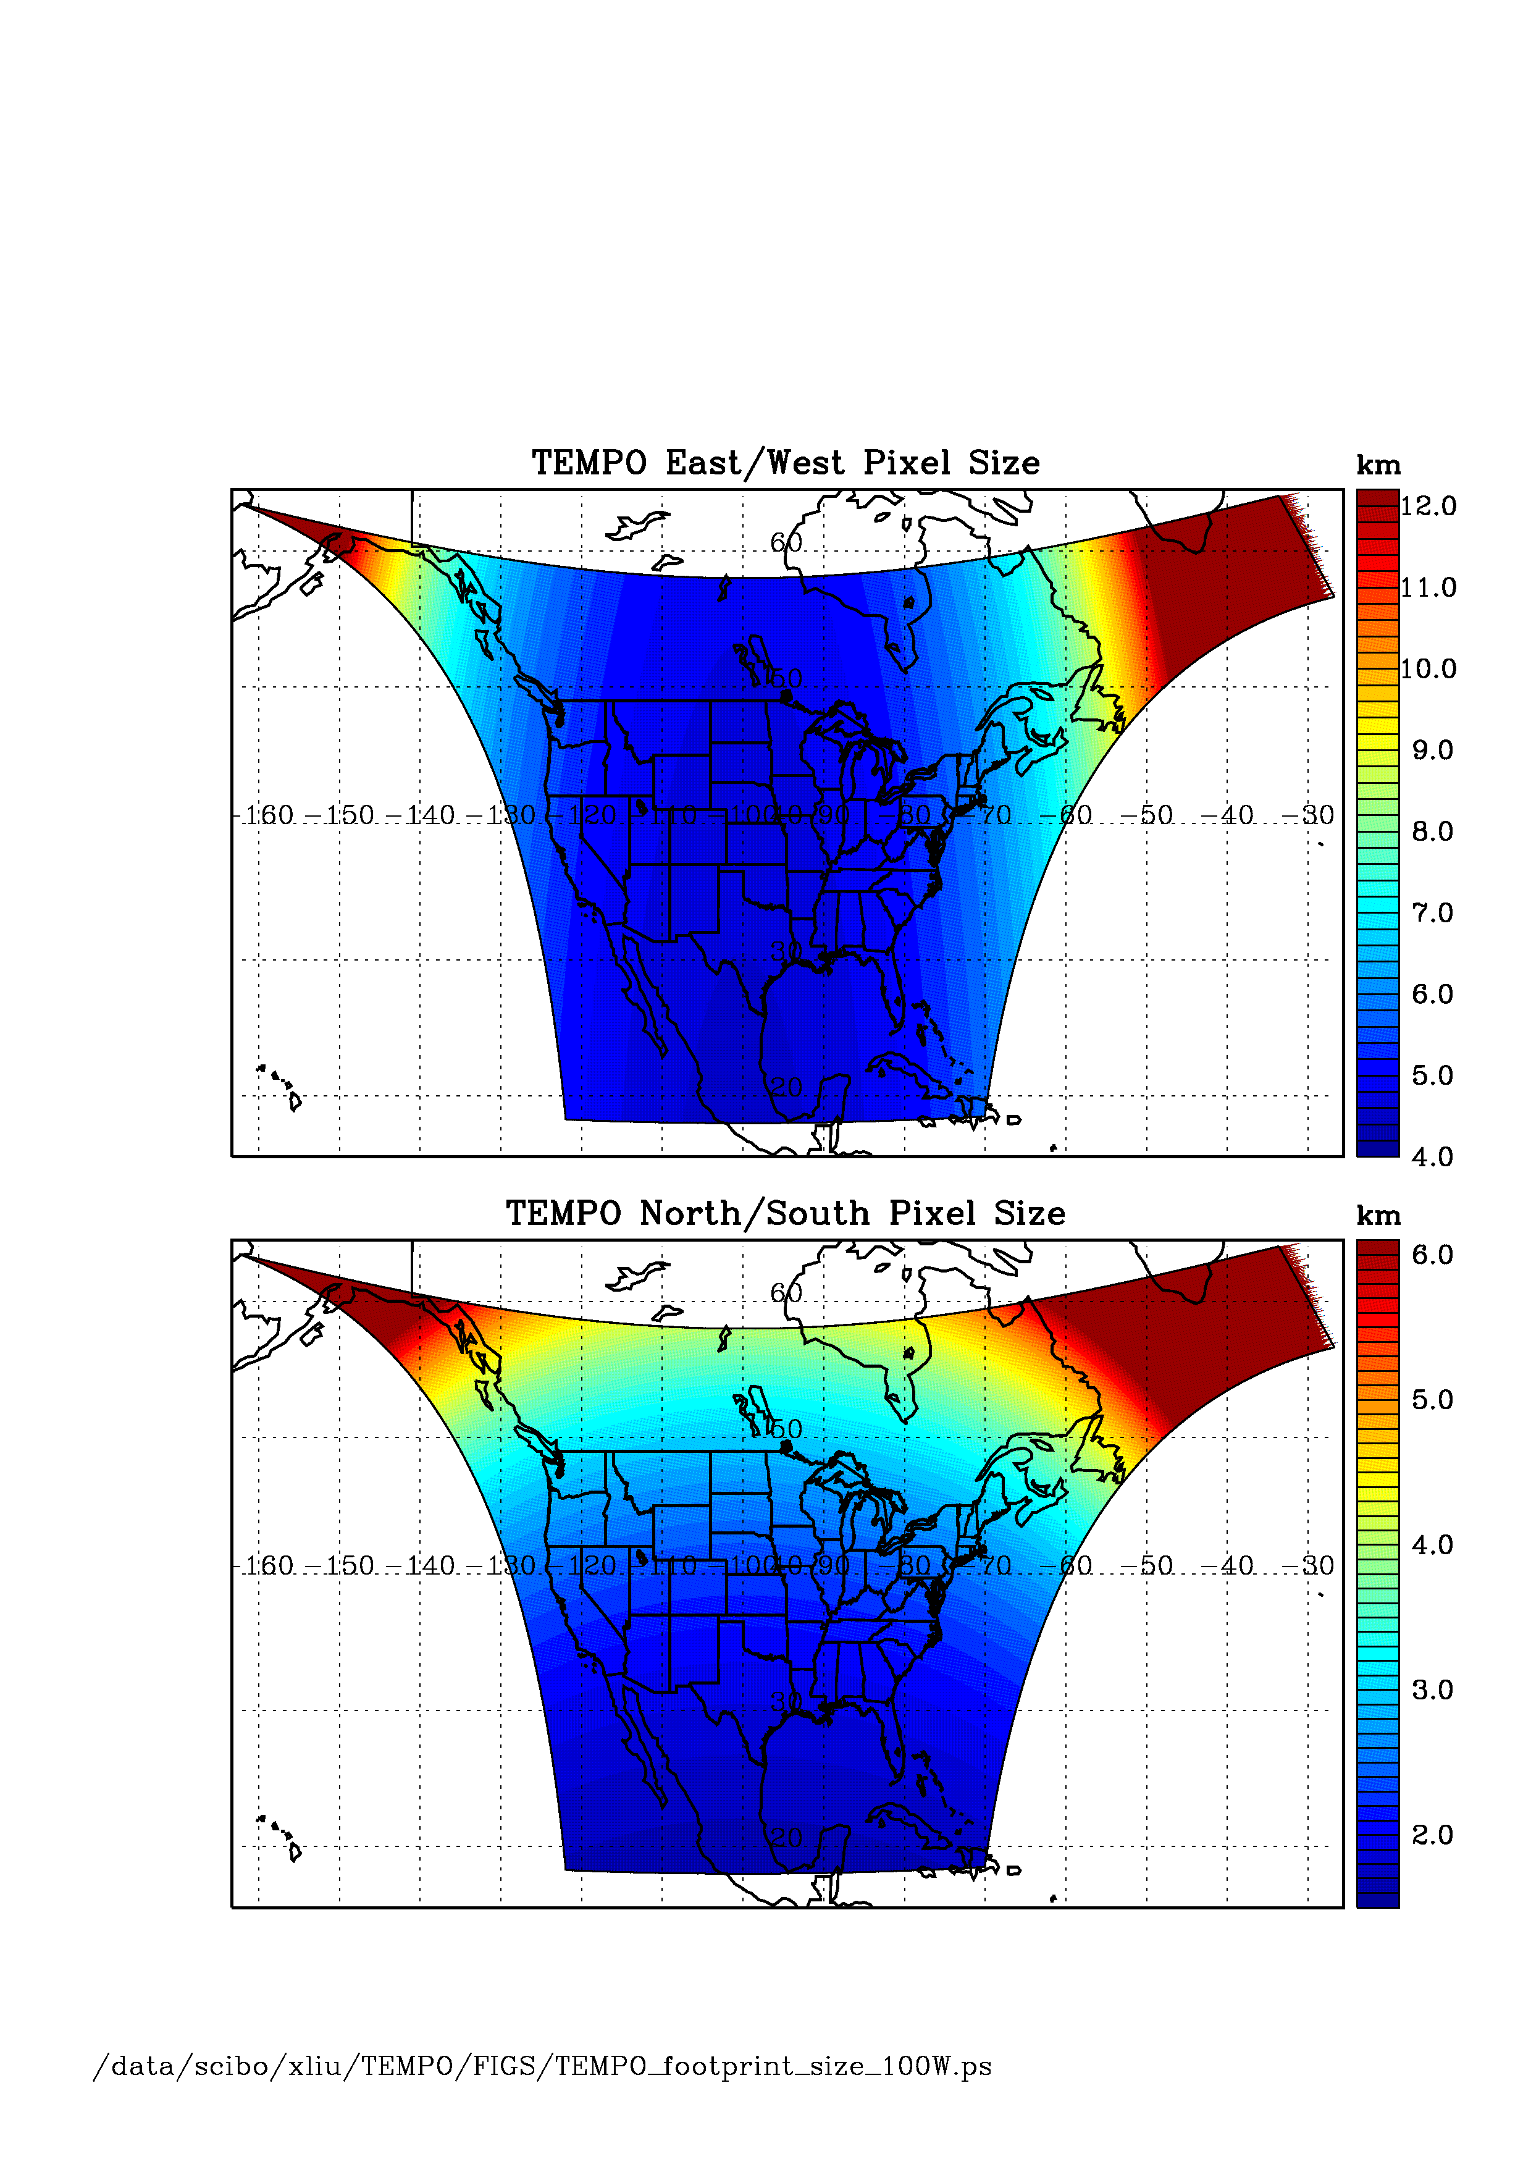
TEMPO footprint (GEO at 100º W)
Location | N/S (km) | E/W (km) | GSA (km²)
36.5ºN, 100ºW | 2.11 | 4.65 | 9.8
Washington, DC | 2.37 | 5.36 | 11.9
Seattle | 2.99 | 5.46 | 14.9
Los Angeles | 2.09 | 5.04 | 10.2
Boston | 2.71 | 5.90 | 14.1
Miami | 1.83 | 5.04 | 9.0
Mexico City | 1.65 | 4.54 | 7.5
Canadian tar sands | 3.94 | 5.05 | 19.2
Assumes 2000 N/S pixels
For GEO at 80ºW, pixel size at 36.5ºN, 100ºW is 2.2 km × 5.2 km.

Slide 21
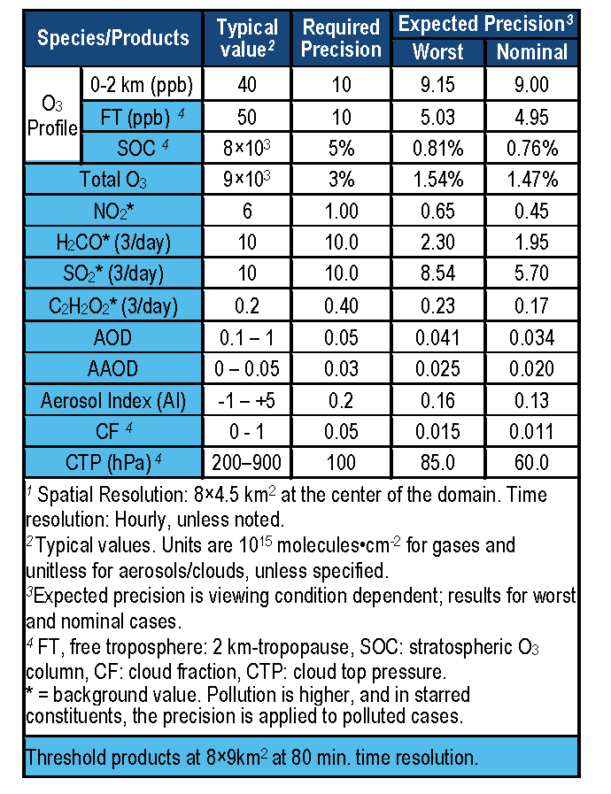
TEMPO baseline products
TEMPO has a minimally-redundant measurement set for air quality.
Near-real time products will allow for pollution alerts, chemical weather, app-based local air quality.
Revised PLRA has O₃, NO₂, H₂CO as baseline

Slide 22
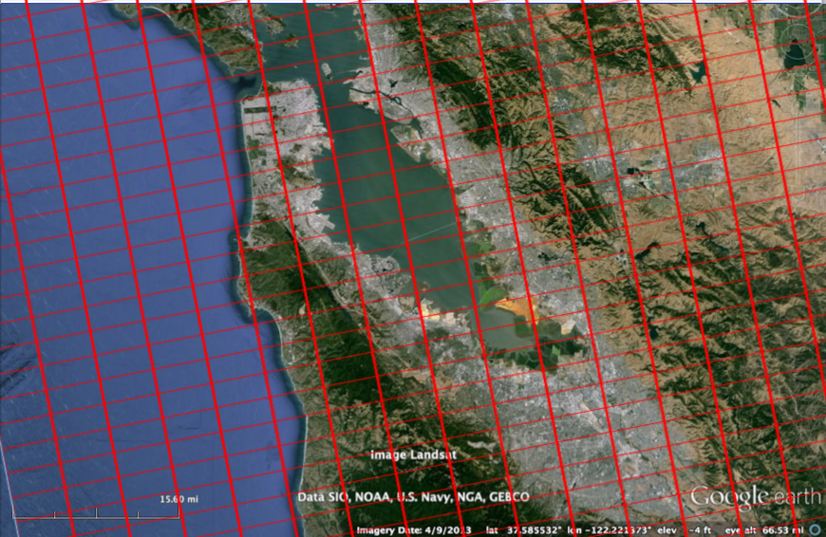
Bay Area coverage
Every hour!

Slide 23
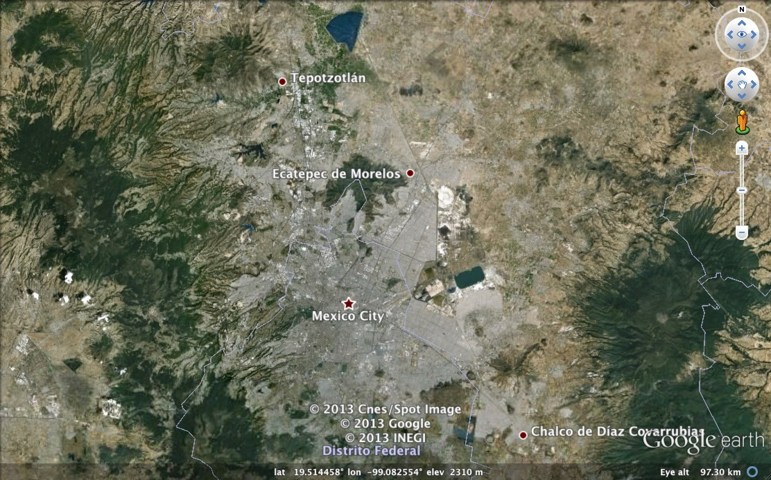

Mexico City coverage
¡Cada hora!

Slide 24
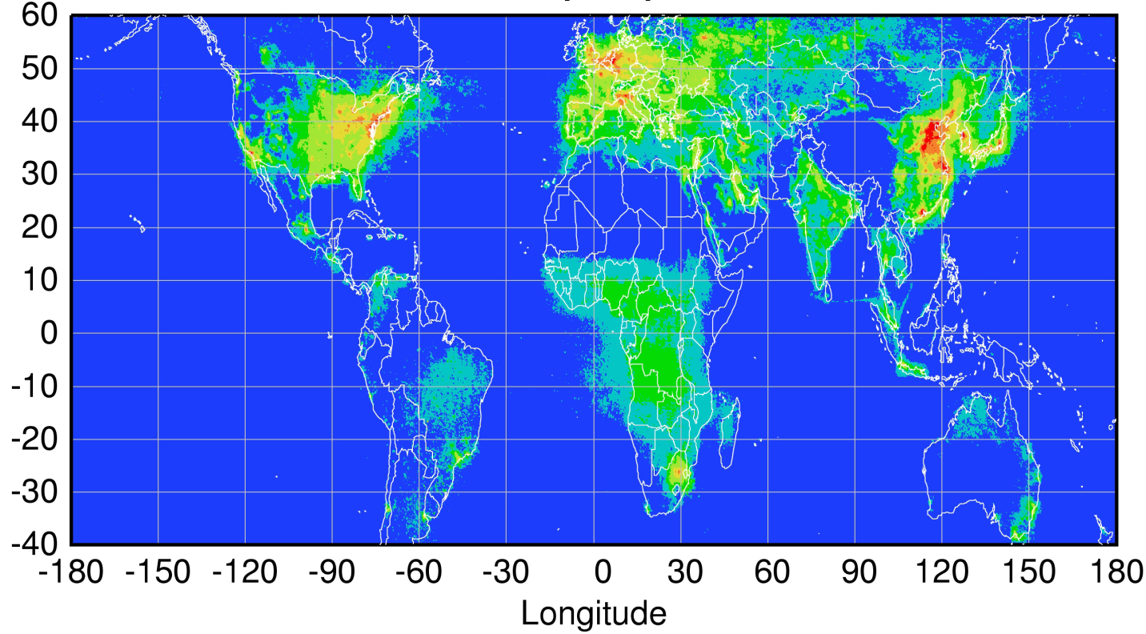
Global pollution monitoring constellation
Sentinel-4
(hourly)
TEMPO
(hourly)
GEMS
(hourly)
80-115°W
0°
2021+ launch
128.2°E
2019 launch
Sentinel-5P
(once per day)
Courtesy Jhoon Kim,
Andreas Richter
Policy-relevant science and environmental services enabled by common observations
Improved emissions, at common confidence levels, over industrialized Northern Hemisphere
Improved air quality forecasts and assimilation systems
Improved assessment, e.g., observations to support United Nations Convention on Long Range Transboundary Air Pollution

Slide 25
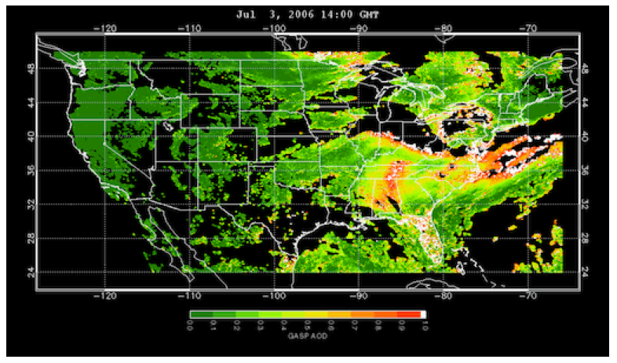
www.epa.gov/rsig
TEMPO will use the EPA’s Remote Sensing Information Gateway (RSIG) for subsetting, visualization, and product distribution – to make TEMPO YOUR instrument

Slide 26
TEMPO summary
Currently on-schedule and on-budget
  Passed System Requirements Review and Mission Definition Review in November 2013
  Passed KDP-B April 2014
  Most technical issues solved at the preliminary design level, following technical interchange meeting at Ball, April 2014
  Passed PDR on July 31, 2014
  In Phase C: KDP-C April 10, 2015!
  Detectors in-house, grating and optical bench ordered
  Ground systems development at SAO on schedule
Instrument CDR summer 2015, select satellite host 2017+
  TEMPO operating longitude and launch date are not known until after host selection
Instrument delivery 05/2017 for launch 11/2018 or later

Slide 27






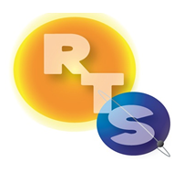


The end!

Slide 28
Backups

Slide 29
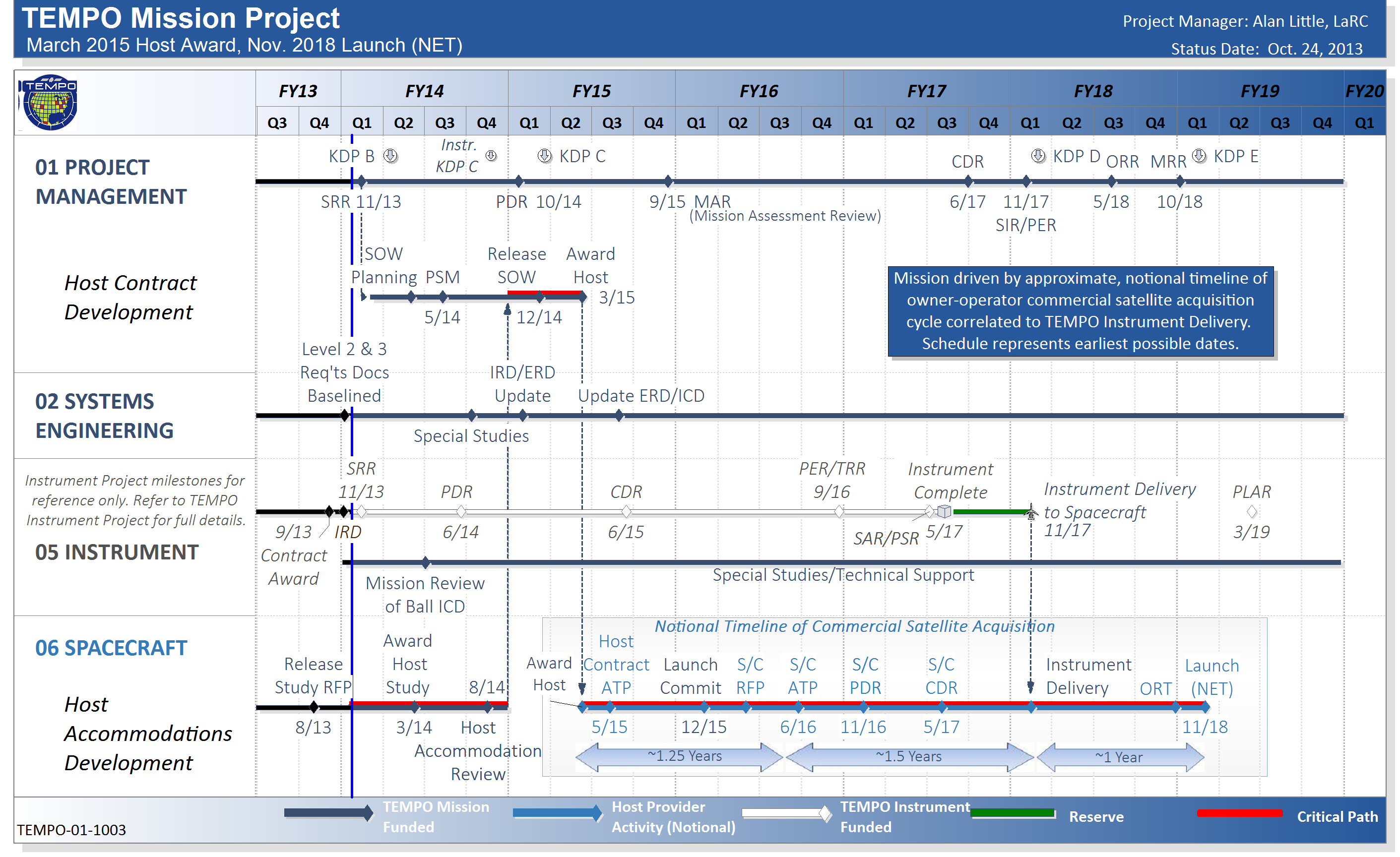
TEMPO mission project integrated master schedule

Slide 30
Data product definitions and details
Data Product | Description | Time beyond on-orbit checkout to deliver initial data | Maximum data latency after first release for ≥ 80% of all products†
Level 0 | Reconstructed, Unprocessed Instrument Data | 2 months | Within 2 hours of receipt at SAO
Level 1b | Calibrated, Geolocated Radiances | 4 months | Within 3 hours of Level 0 and ancillary data receipt at SAO
Level 2 | Derived Geophysical Data Products | 6 months | Within 24 hours of production of Level 1 at SAO
Level 3 | Derived Gridded Geophysical Data Products | 6 months | 1 month after completion of data accumulation required for individual geophysical products
All original observation data and standard science data products listed here, along with the scientific source code for algorithm software, coefficients, and ancillary data used to generate these products, shall be delivered to the designated NASA SMD/ESD-assigned DAAC within six months of completion of the prime mission. Data products are publicly distributed during the mission.
†80% of the products, not 80% of the product types, will be produced within this latency time.

Slide 31
Instrument progress since KDP-B
TIM @ Ball in April plus follow-on studies:
S/N now meets reqs. with high margin (engineering & retrieval studies)
Wavelength stability accepted, will use cross-correlation algorithm solution
Polarization sensitivity modeled to be acceptable with high margin
Field of regard (instrument plus mission jitter budget) resolved by changing acceptable range, still including Mexico City, Canadian oil sands
N/S modulation transfer function (MTF) issue resolved by analysis
  May reduce MTF requirements to threshold near slit edge, beyond CONUS
Stray light modeled to be well within acceptable levels
  Stray light instrument specifications now accepted
  Stray light knowledge and levels are nominal for this type of instrument (GOME, SCIA, OMI, OMPS)
  Normal stray light correction is in 0-1 algorithm, as planned. Low risk of additional resources being required
  Developing details of verification/characterization/calibration/testing is normal planned engineering work
  The TEMPO instrument design is capable of meeting Baseline Level 1 science requirements

Slide 32


Table 1. UV/Visible/IR Satellite Array Spectrometers
UV/Visible/IR satellite
array spectrometers
Instrument
Wavelength
(nm)
Viewing
Geometry
Gases
Launch
Year
GOME (GOME-2)
240-790
Nadir
O₃, NO₂, BrO, OClO, SO₂, HCHO, H₂O
1995 (2006, 2012)
OSIRIS/ODIN
280-800
Limb
O₃, NO₂, BrO, OClO, SO₂, HCHO, H₂O
2001
SAGE III
280-1040
occultation
(limb)
O₃, NO₂, BrO, OClO, H₂O
2001
GOMOS/Envisat
250-952
stellar
occultation
O₃, NO₂, H₂O, NO₃
2002
SCIAMACHY/Envisat
240-2380
nadir/limb/
occultation
O₃, NO₂, BrO, OClO, SO₂, HCHO, CHO-CHO, H₂O, NO₃, N₂O, CH₄, CO, CO₂
2002
MAESTRO/ACE
285-1030
occultation
O₃, NO₂, BrO, OClO, SO₂, HCHO, H₂O
2003
OMI/AURA
270-500
nadir
O₃, NO₂, BrO, OClO, SO₂, HCHO, CHO-CHO
2004
OPUS/GCOM
306-420
nadir
O₃, NO₂, BrO, OClO, SO₂, HCHO
2006
OMPS/NPOESS
250-1000
nadir/limb
O₃, NO₂, BrO, OClO, SO₂, HCHO, H₂O
2011

