Slide 1
The Impact of Masers in Modern Astrophysics
by
James Moran
Harvard-Smithsonian Center for Astrophysics
Lo Memorial Lecture
Xinjiang Astronomical Observatory
September 19, 2018

Slide 2

Kwok-Yung (Fred) Lo
1947 - 2016

Slide 3

Jan Lo and Susan Moran, January 1983, Pasadena
Born in the year of the Dragon

Slide 4
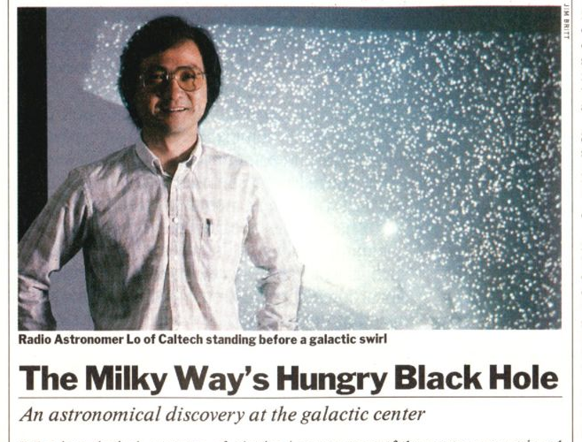
Time Magazine, June 3, 1985
Based on the article: On the Size of the Galactic Centre Compact Radio Source:
Diameter < 20AU, by Lo, Backer, Ekers, Kellermann, Reid and Moran,
Nature, 314, 124, May 9, 1985

Slide 5
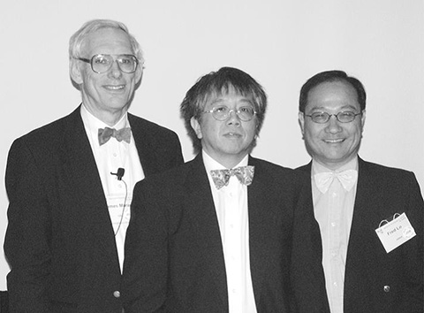
SMA Press Conference 2002
Jim Moran Paul Ho Fred Lo

Slide 6
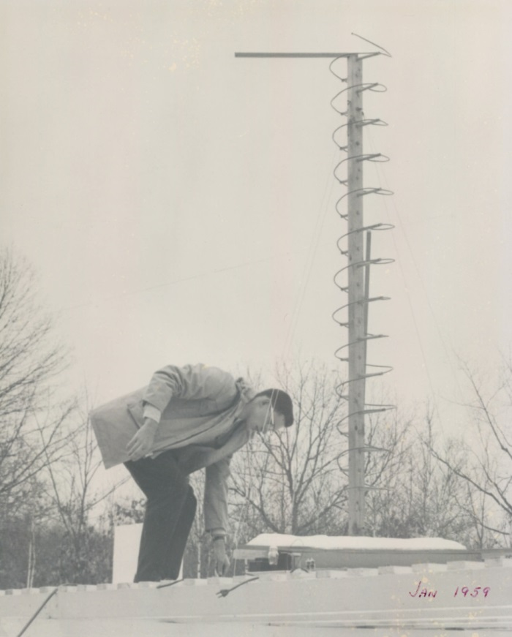
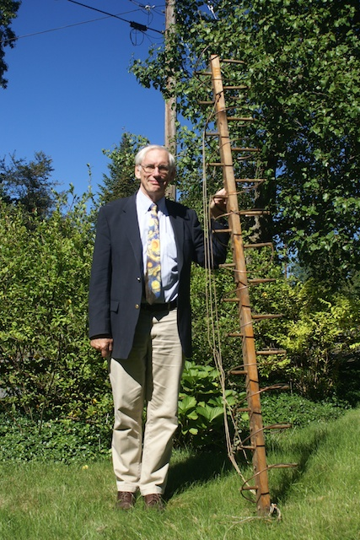
My First Attempt at Radio Astronomy
January 1959, with 400-MHz antenna
July 2013, with remains of 400-MHz antenna

Slide 7
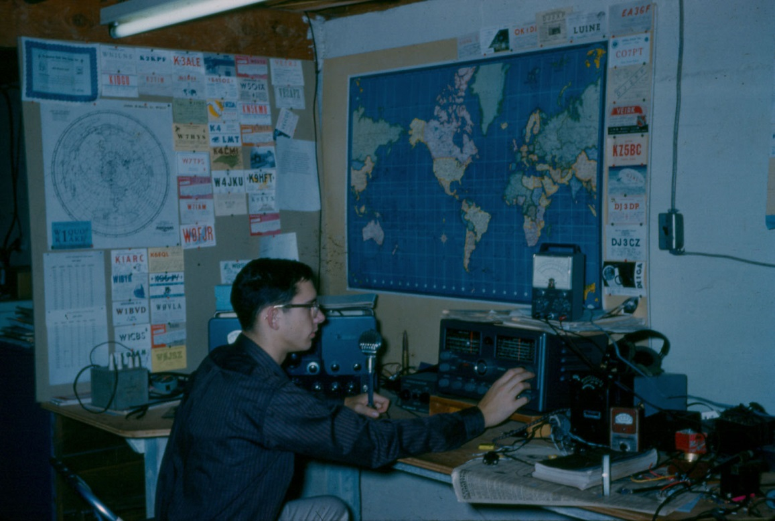
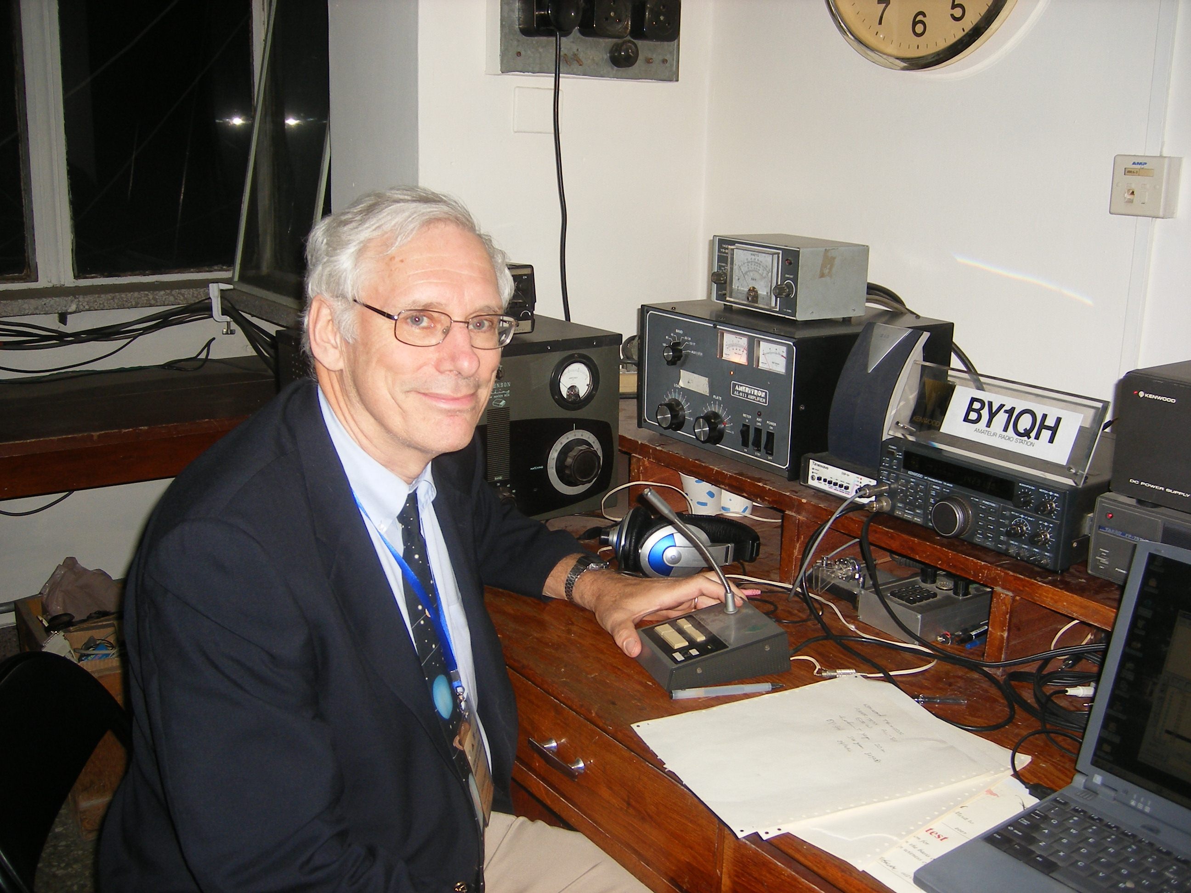
Jim Moran (K1AKE), Then and Now
1958
Leominster,
Mass USA
2008
Tsinghua University,
Beijing, PRC

Slide 8
Today’s Talk
Short introduction to the physics of masers
Discovery that masers trace dynamical motions
How do interferometers work?
The maser accretion disk in NGC4258
”One of Nature’s Most Beautiful Creations”
Extreme resolution observations with Radioastron
Measuring the Hubble constant

Slide 9
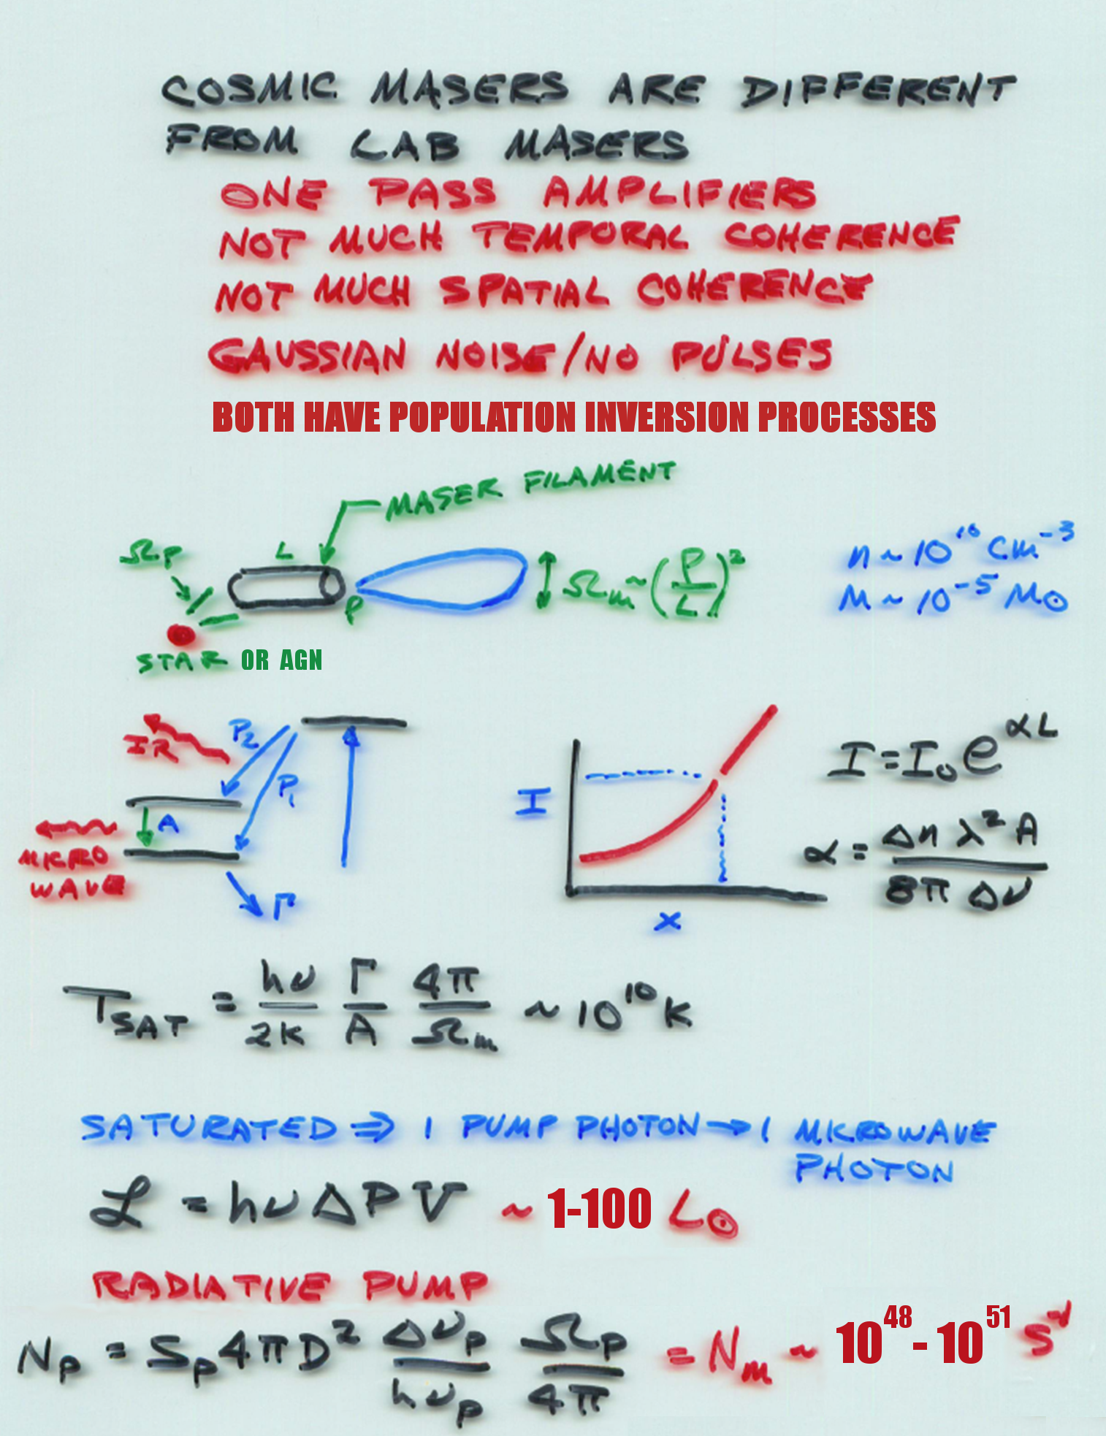
Cosmic Maser are Different from Lab Masers
One pass amplifiers
Little temporal coherence
Little spatial coherence
Gaussian noise – no noise pulses
Both have population inversion processes and high amplification

Slide 10
I Should Have Followed Up on That . . .
PHYSICAL PROCESSES IN GASEOUS NEBULAE
ABSORPTION AND EMISSION OF RADIATION
DONALD H. MENZEL
Ap.J. 1937, 85, 330
The total radiation, absorbed in the transition n’– n, including the effect of the “stimulated emissions,” which must be counted as negative absorptions, is easily found to be . . . .
….. complicated equation …..
Outside of thermodynamic equilibrium, the condition may conceivably arise when the value of the integral [above] turns out to be negative. The physical significance of such a result is that energy is emitted rather than absorbed. This energy must be distinguished, however, from that arising in random emissions. The process merely puts energy back into the original beam, as if the atmosphere had a negative opacity. This extreme will probably never occur in practice.

Slide 11
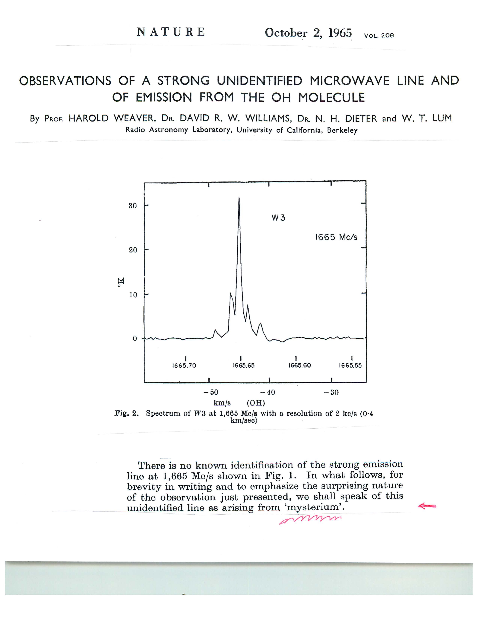

Slide 12
How Does an Interferometer Work ?
point source extended source
𝜆/D
FT
V(u,v) ⇄ I(x,y)

Slide 13
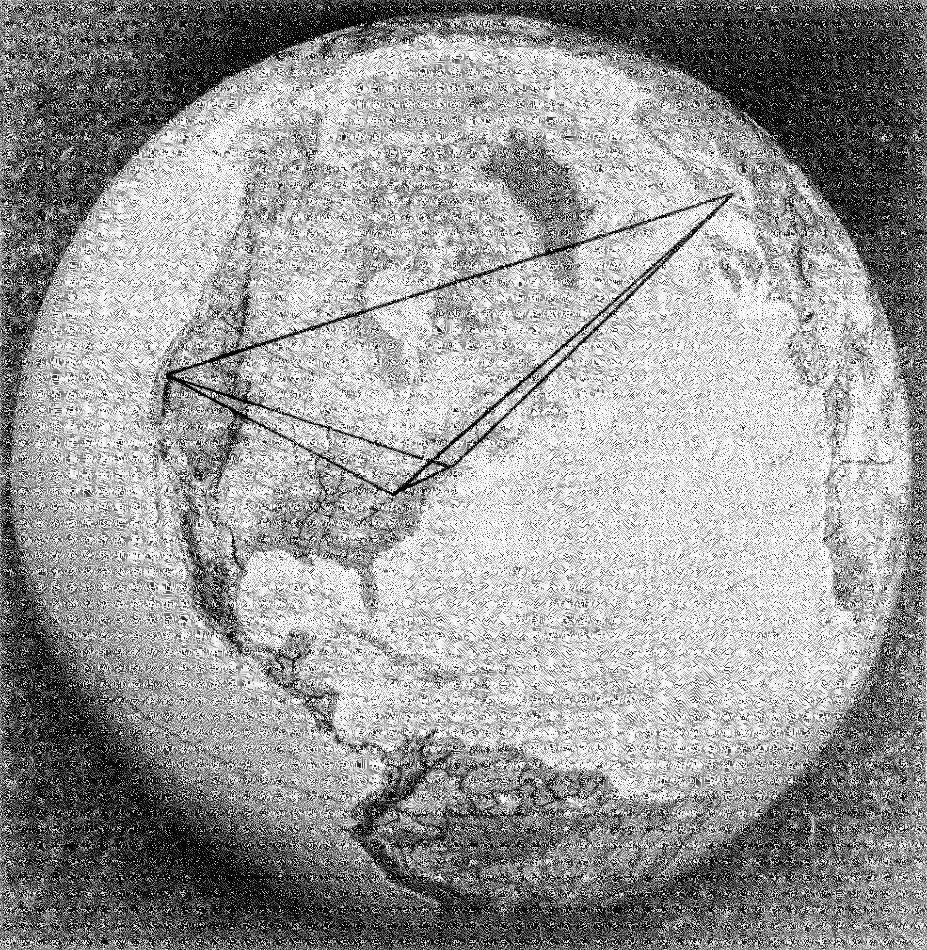
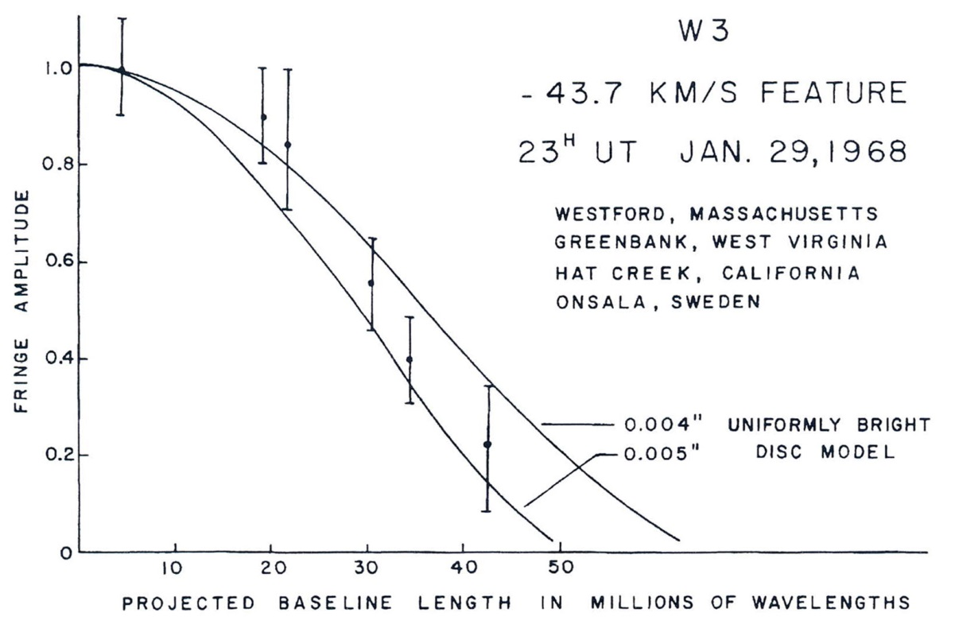
First Resolution of a Maser “Spot” (1968)

Slide 14
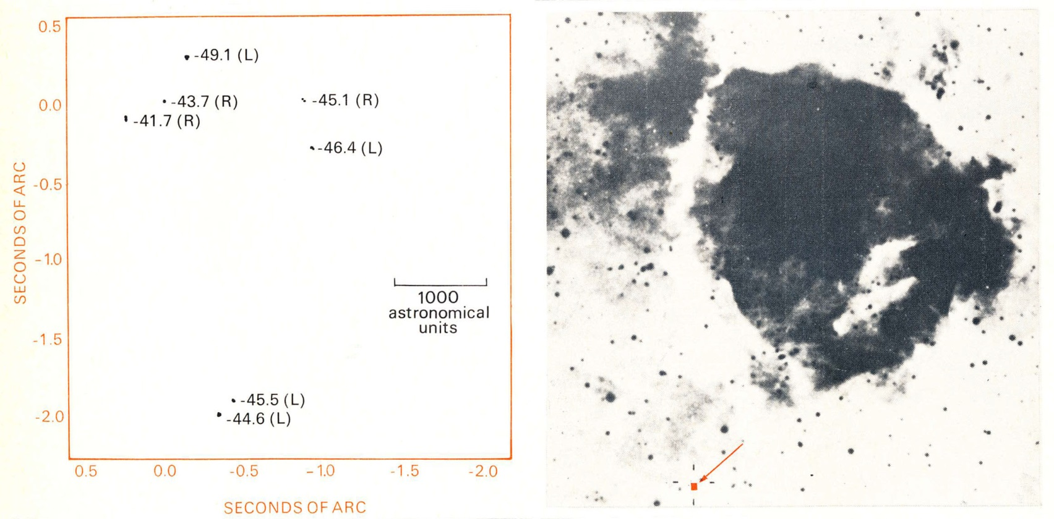
Palomar Sky Survey Image
of W3 HII Region
VLBI Image of W3 Maser

Slide 15
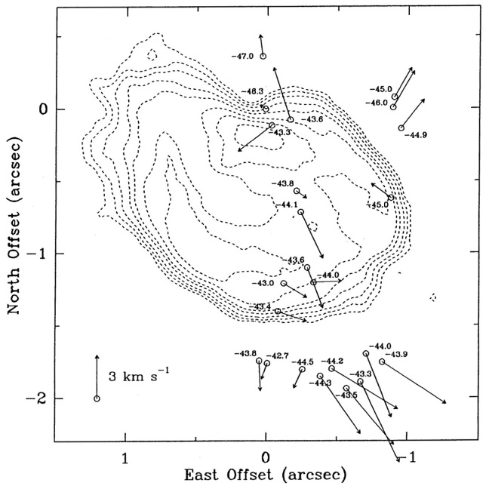
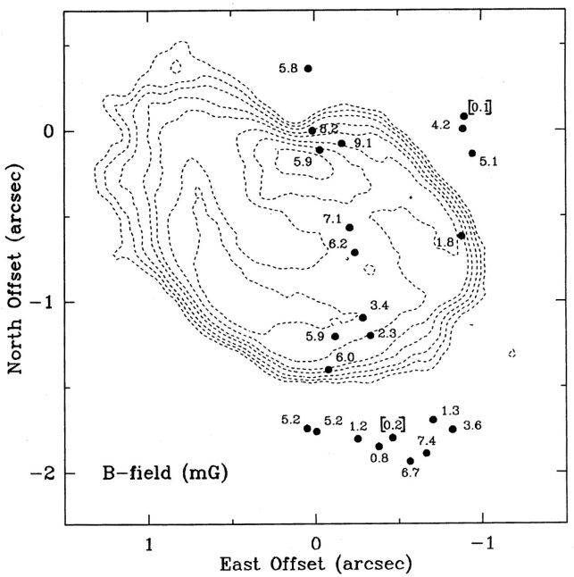
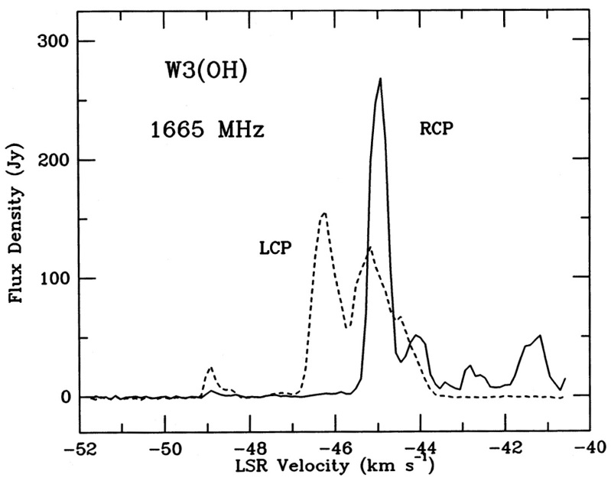
Proper Motions (left) and Magnetic Field Strength (right)
in W3 OH Maser (1986) with US VLBI Network (NUG)
Contours
Trace
UCUII
Region
W3(OH)

Slide 16
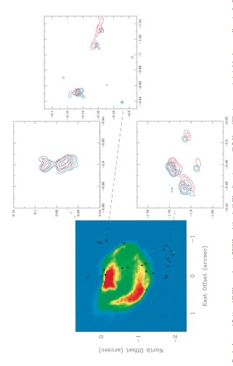
Motions of OH Masers in W3(OH): 1978-1986
20 mas
Bloemhof, Reid, and Moran, 1996, Ap.J.(Lett.) 467, L117

Slide 17
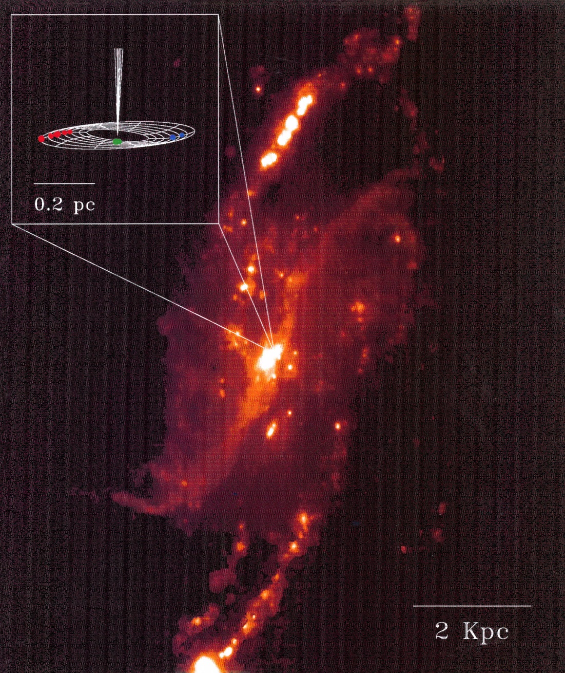
NGC4258 (M106)

Slide 18
Water Vapor Maser Discoveries in NGC4258
6₁₆ – 5₂₃ transition
λ = 1.35 cm
Claussen, Heiligman & Lo
Nature 1982
OVRO, 1024 channel spectrometer
S(Jy)
500 700
V (km s⁻¹)
NRO, 16,384 channel spectrometer
Nakai, Inoue & Miyoshi, Nature 1993
Blue high velocity
Systemic
Red high velocity

Slide 19
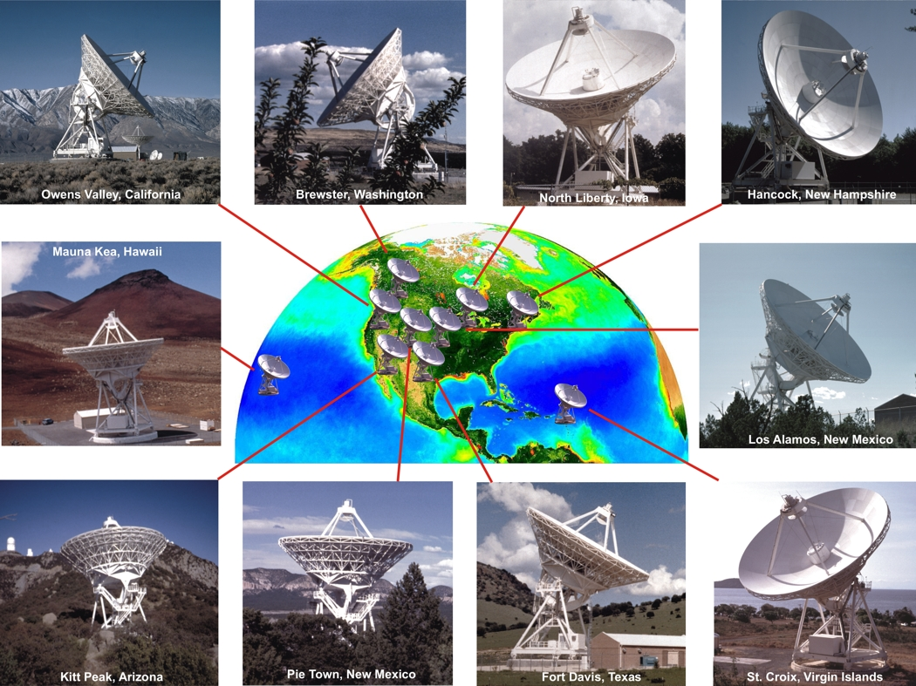
The NRAO Very Long Baseline Array (1994+)
Maximum Baseline = 8000 km, Resolution = 200 microarcseconds at 1.3 cm wavelength

Slide 20
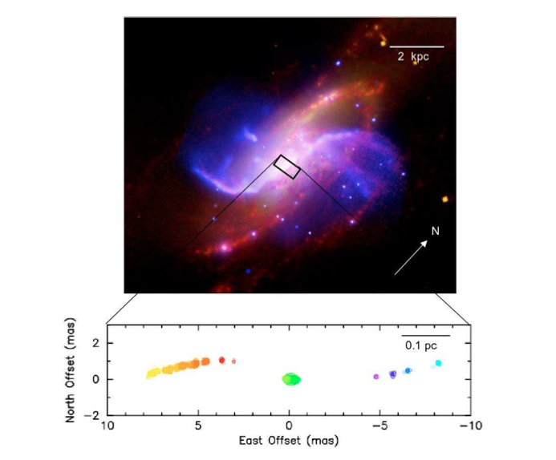
Water Masers in NGC4258
Myoshi et at, 1995, Nature; Herrnstein et al, 2005, Humphreys, et al., 2013

Slide 21
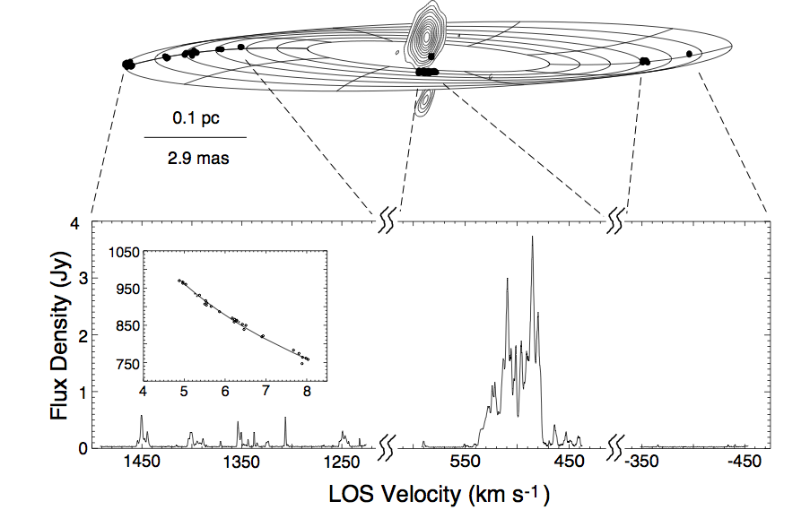
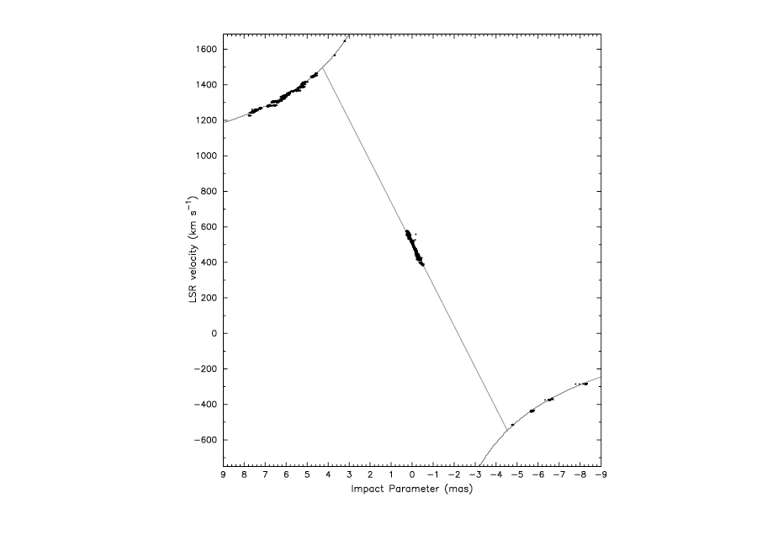
Maser Spot Distribution in NGC4258
Line of Sight Accelerations
(top) systemic features
(bottom) red high velocity
Velocity (km/s)
1998.8 2000
time (year)
11199
Systemic feature velocity drift
originally discovered by Haschick,
Baan & Peng, ApJ 1994
Impact parameter (mas)

Slide 22

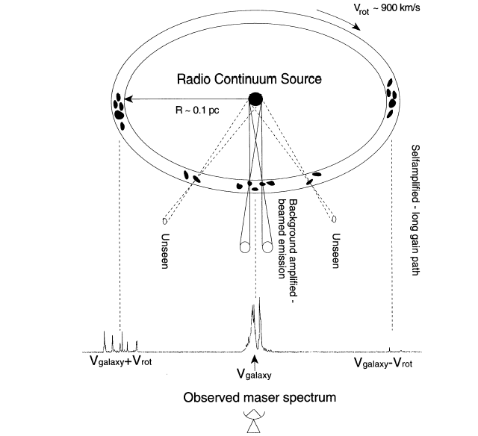


Cartoon of Accretion Disk Megamaser
Measuring Distance
Proper motions (8 μas/year)
Accelerations (9 km/s/year)
D = R/θ
a = V_{r}²/R
D = V_{r}²/aθ
D = 7.54 +/- 0.20 (3%) Mpc
Riess et al., 2016; Humphreys et al., 2013

Slide 23
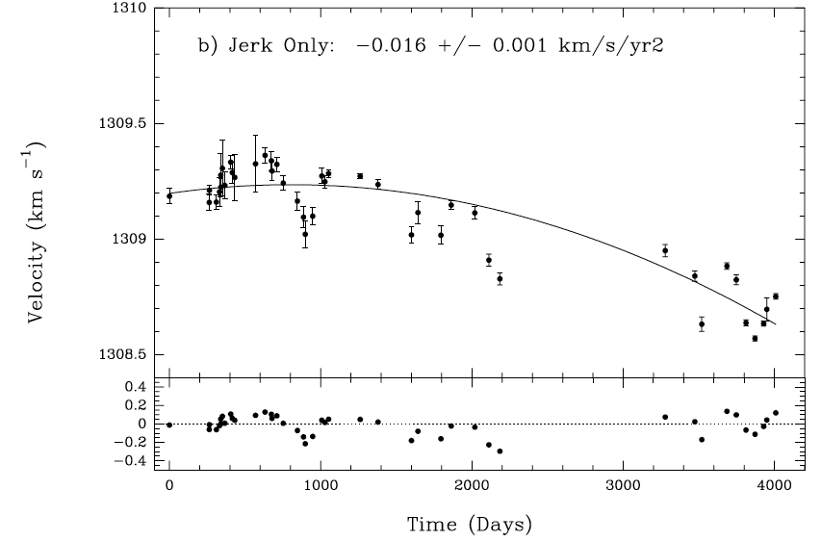
Acceleration of the “1306” kms⁻¹ Feature
Humphreys et al. 2013

Slide 24



Measurement of the Thickness of the Accretion
Disk in the Vicinity of the Systemic Features
Argon, et al., Ap.J., 659, 1040, 2007

Slide 25
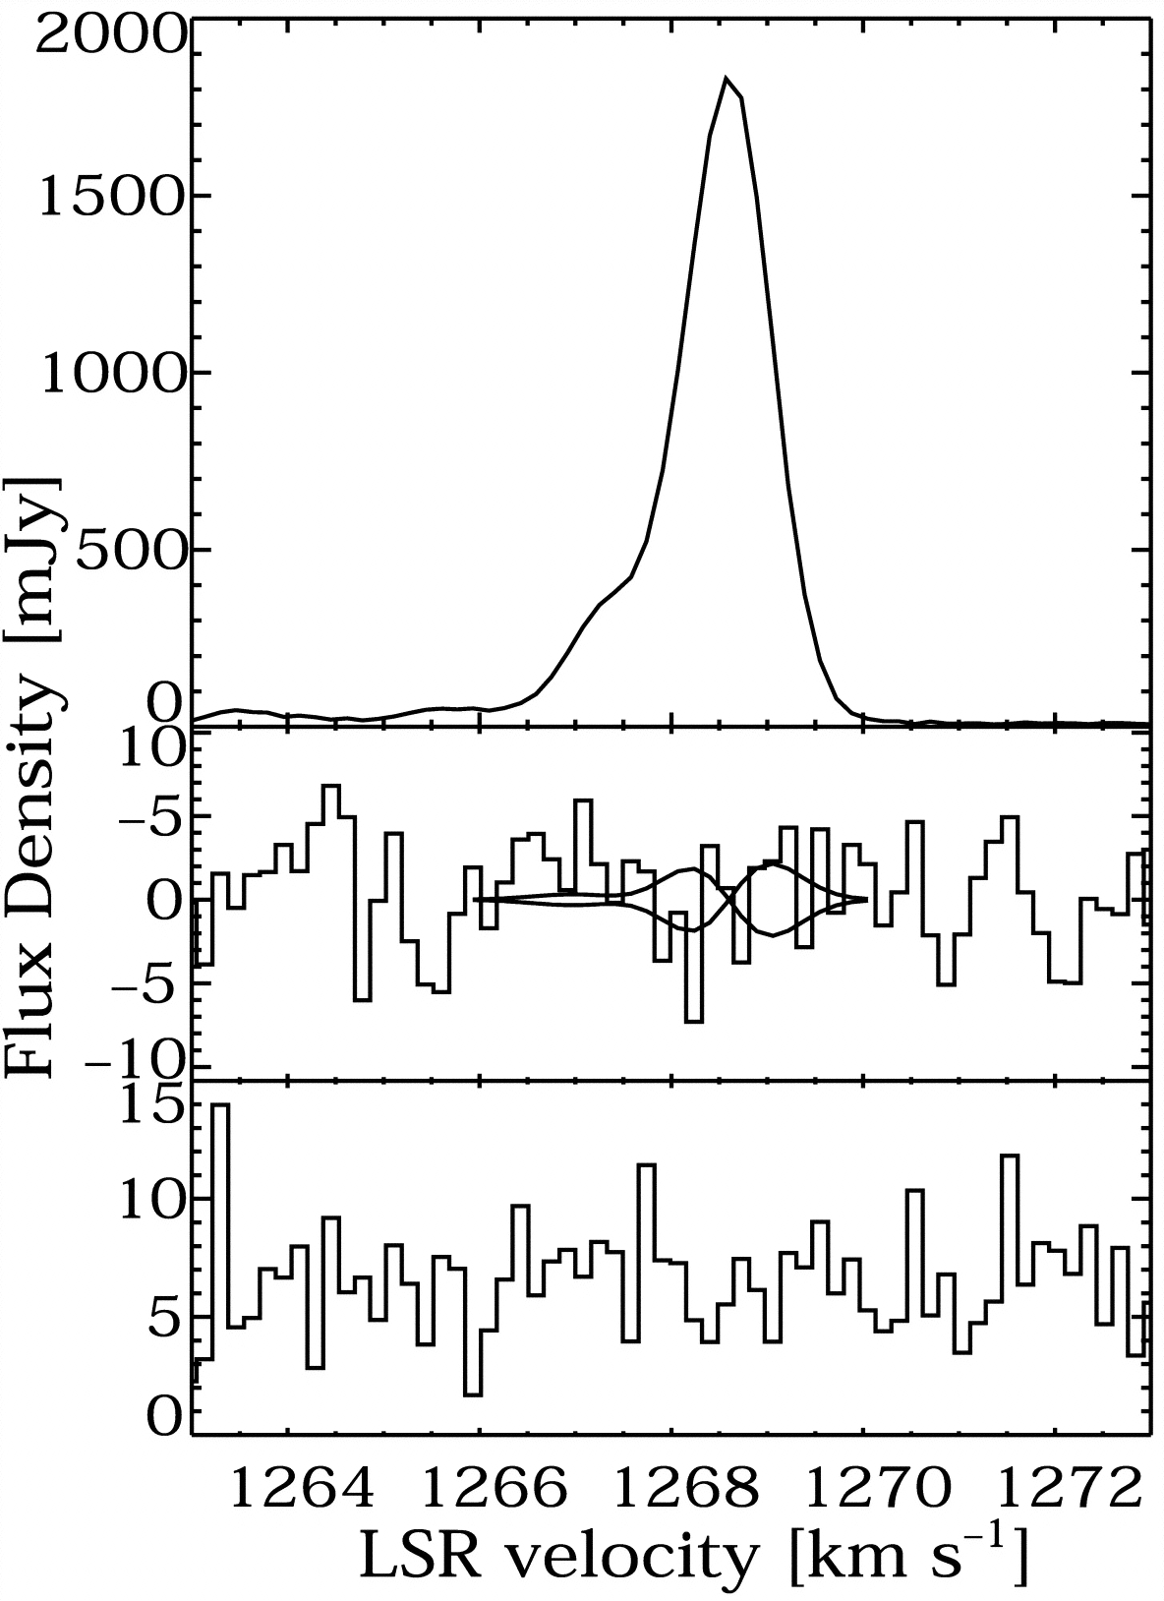
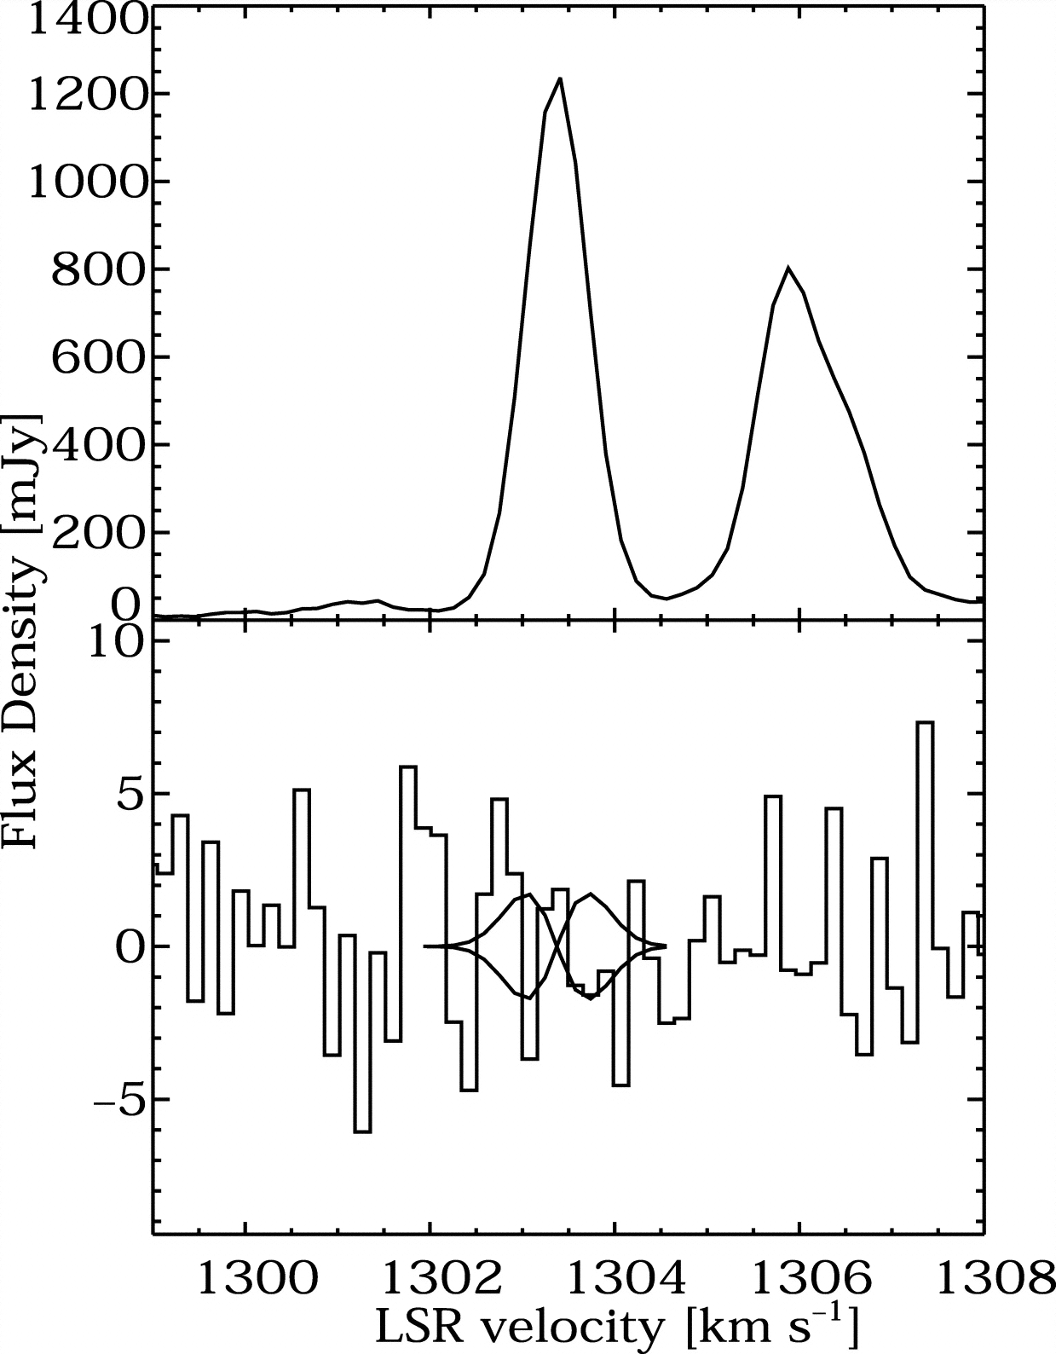
Search for Zeeman Splitting of Maser Features in NGC 4258 (B < 30 mG)
VLA Spectrum GBT Spectrum
Modjaz, Moran, Kondratko, & Greenhill, ApJ 2005

Slide 26
RadioAstron MegaMaser Team
Alexi Alakoz
Tao An (SHAO)
Willem Baan
Simon Ellingsen
Chris Henkel
Hiroshi Imai
Vladimir Kostenko
Ivan Litovchenko
Jim Moran
Andrej Sobolev
Alexander Tolmachev

Slide 27
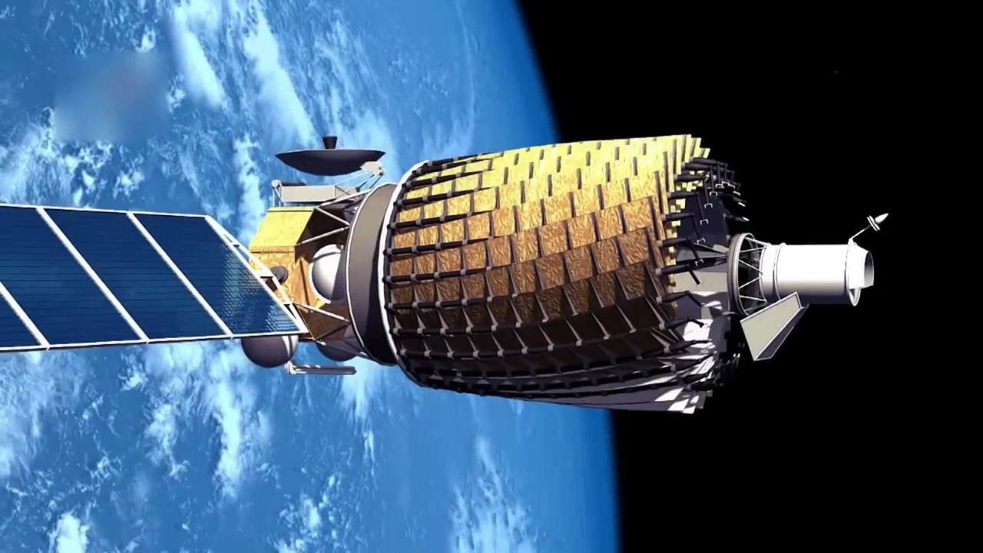
RadioAstron Satellite (launched 2011)

Slide 28
NGC4258 VLBI Observations
Stations: Radioastron, GBT
Observations: 18 December 2014 (fringe spacing = 110 μas (1.9 ED)
(fringes parallel to maser disk) duration 60 minutes
16 March 2016 (fringe spacing = 11 μas (19.5 ED)
(fringes perpendicular to maser disk) duration 74 minutes
Spectroscopy: Systemic features only (no high velocity)
resolution 7.8 kHz (0.1 km/s; smoothed to 0.3 km/s)

Slide 29
Observations of NGC4258 with Fringes
Parallel and Perpendicular to Accretion Disk
Fringe orientation
18 December 2014
parallel
Fringe orientation
16 March 2016
perpendicular
Systemic
velocity maser
in accretion disk

Slide 30
RadioAstron – GBT Visibility Spectrum of Systemic Velocity Group of Masers
18 December 2014 (110 μas parallel) 17 March 2016 (11 μas perpendicular)

Slide 31
Simulation Fringe Pattern (11 μas perpendicular)
of UNRESOLVED Maser Spots in NGC4258
50 3-km/s components at random positions
T_{B} ≥ 4 x 10¹⁵ K
Spots smaller than 3 μas (2 x 10 ¹⁵ cm)

Slide 32

Megamaser Cosmology Project (MCP)
Fred Lo, Founder
Jim Braatz, Principal Investigator
Mark Reid
Jim Condon
Christian Henkel
Jenny Greene
Dom Pesce
Feng Gao
Violetta Impellizzeri
Cheng-Yu Kuo
Anca Constantin
Lei Hao
Wei Zhao

Slide 33

NGC 4258
UGC 3789
NGC 6323
CGCG 074-064
NGC 6264
NGC 5765b
2 mas
0.2 pc

Slide 34
Hubble Constant Estimates from Maser
Cosmology Project (MCP)
Average of 5 galaxies 71 ± 4.0 (6%)
UGC 3789
NGC 6424
NGC 6323
NGC 5765b
CGCG 074-064
JM compilation from publications
(km⁻¹ s Mpc⁻¹)
UGC 3789 (49.6 +/- 5.1 Mpc) Reid et al., 2013 NGC 5765b (126 +/- 11 Mpc) Gao et al., 2016
NGC 6264 (137 +/- 19 Mpc) Kuo et al., 2013 CGCG 074-064 (83.9 +/- 7.4 Mpc) Pesce (thesis) 2018
NGC 6323 (107 +/- 42 Mpc) Kuo et al., 2015

Slide 35
Some Recent Hubble Constant Determinations
S-Z Effect (Bonamente, et al., 2006)
Gravitational Lensing (4) (Suyu, et al., 2018)
Hubble Key Project (Freedman, et al., 2012)
Cepheids + SN Ia (Riess, et al., 2018)
MCP (Braatz, et al., 2018)
Cepheids/NGC4258 (Riess et al., 2016/Humphreys, et al., 2013)
CMB/WMAP (Hinshaw, et al., 2013)
CMB/Planck Collaboration, 2018)
(km s⁻¹ Mpc⁻¹)

Slide 36
Summary
Maser trace the dynamics of stellar outflows and AGN accretion disks
NGC4258 is an ideal test bed for accretion dynamics
Some properties of the accretion disk
Accretion disk is very thin: h/R ~ 0.0002
Masers spots very small: < 3 𝛍as or 2 x 10¹⁵ cm
Distance is known extremely well: 7.5 +/- 0.2 Mpc
NGC4258 anchors the Cepheid distance scale
H_{o} = 71 +/- 4.0 km/s/Mpc (5 megamasers)

Slide 37
Kwok-Yung (Fred) Lo
1947 - 2016

Slide 39
The Impact of Masers in Modern Astrophysics
by
James Moran
Harvard-Smithsonian Center for Astrophysics
Lo Memorial Lecture
Shanghai Astronomical Observatory
September 12, 2018

Slide 40
The Impact of Masers in Modern Astrophysics
by
James Moran
Harvard-Smithsonian Center for Astrophysics
Lo Memorial Lecture
National Astronomical Observatory of China
September 17, 2018

Slide 41
The Impact of Masers in Modern Astrophysics
by
James Moran
Harvard-Smithsonian Center for Astrophysics
Lo Memorial Lecture
Kavli Institute for Astronomy and Astrophysics
at Peking University
September 18, 2018

