Slide 1
SO₂ Retrievals in the UV from Space
Caroline Nowlan
Atomic and Molecular Physics Division
Harvard-Smithsonian Center for Astrophysics
Collaborators: Kelly Chance, Xiong Liu, Thomas Kurosu, Chulkyu Lee, Randall Martin, Sajeev Philip

Slide 2
Nadir UV-Visible Retrievals at SAO
Instrument | Launch | Equatorial Overpass (Local Time) | Ground Pixel Size | Global Coverage
GOME-1 | 1996 | 10:30 AM | 40 x 320 km | 3 days
SCIAMACHY | 2002 | 10:00 AM | 30 x 60 km | 6 days
OMI | 2004 | 1:30 PM | 13 x 25 km to 42 x 162 km | daily
GOME-2 | 2006 | 9:30 AM | 40 x 80 km | 1.5 days
Upcoming:
OMPS, GOME-2 B, UVAS, GEO-Cape, …

Slide 3
Remote Sounding: Inverse Problem
We have y (spectral data) with errors ε
We want x (atmospheric parameters)
Requirements for inversion
Forward model (F)
Retrieval algorithm

Slide 4
Beer-Lambert Law and Optical Depth
Length L
I₀
I
τ = optical depth
= absorption cross-section (cm²/molecule)
n = density (molecules/cm³)
L = length of path (cm)

Slide 5
GOME-2 Spectra, Channel 2

Slide 6
Effective Optical Depth

Slide 7
Spectral Fitting in UV-visible-NIR
Molecules
Ozone, NO₂, HCHO, SO₂, H₂O, O₂, O₂-O₂, IO, CHO-CHO, BrO, OClO
Polynomials for background and scaling
Aerosols, calibration issues
Rotational Raman scattering
Instrument Considerations
Wavelength to detector pixel calibration
Slit function width (resolution)
Undersampling

Slide 8
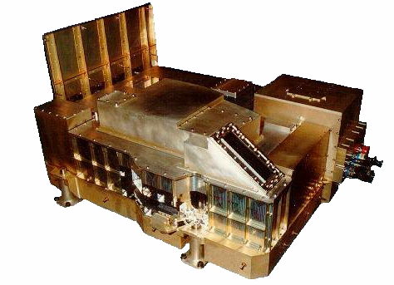
GOME-2
Global Ozone Monitoring Experiment
Metop-A satellite
Launched October 2006
Useful data since January/March 2007
4 channels, each with 1024-pixel photodiode array
240 – 314 nm
310 – 403 nm
397 – 604 nm
593 – 790 nm
Nadir-viewing
Nominal ground pixel = 80 x 40 km²

Slide 9
SO₂
Anthropogenic sources (≈70 %)
Fossil fuel burning
Smelting
Natural sources (≈30 %)
Dimethyl sulfide from oceans
Volcanoes
Biomass burning
Effects on
Climate from sulfate aerosol formation
Regional or global in case of volcanic stratospheric injection
Local pollution
Acid rain

Slide 10
SO₂ Retrievals from GOME-2
Two approaches to SO₂ retrievals:
Traditional two-step approach
Calculate:
1. Slant column density (using spectra) in viewing path
2. Air mass factor (using radiative transfer model and profiles)
Vertical column = Slant Column / AMF
Optimal Estimation
Implements full radiative transfer calculation and climatological profiles directly into one-step retrieval calculation
Much more time-consuming (~100 times longer)
Better consideration of wavelength effects, nonlinearity of AMF under heavy SO₂ loading, ozone interference

Slide 11
Optimal Estimation Approach
Nonlinear iterative retrieval
Δx = (K^{T} S_{ε}⁻¹ K + S_{a}⁻¹)⁻¹ [K^{T}S_{ε}⁻¹ Δy– S_{a}⁻¹(x – x_{a}) ]
x = current guess of retrieved parameter
S_{ε} = measurement error covariance matrix
K = weighting function matrix
x_{a} = a priori profile (climatology or from a model)
S_{a} = a priori error covariance matrix

Slide 12
Optimal Estimation Algorithm
Based on ozone profile retrieval developed for
GOME (Liu et al., 2005)
OMI (Liu et al., 2010)
Full radiative transfer calculation using including trace gas profiles
Wavelength window: 312 – 330 nm
Simultaneous fit of
SO₂ vertical column
Ozone profile at 24 levels
BrO, HCHO, NO₂ vertical columns
Rotational Raman scattering
Effective surface albedo
Effective cloud fraction
Wavelength shift

Slide 13
SO₂ A Priori Information
Need SO₂ a priori profile information
Anthropogenic SO₂
GEOS-Chem model
(Lee et al., 2009)
Volcanic SO₂
Gaussian plume with FWHM=0.5 km
z
volcanic
anthropogenic
SO₂ mixing ratio

Slide 14
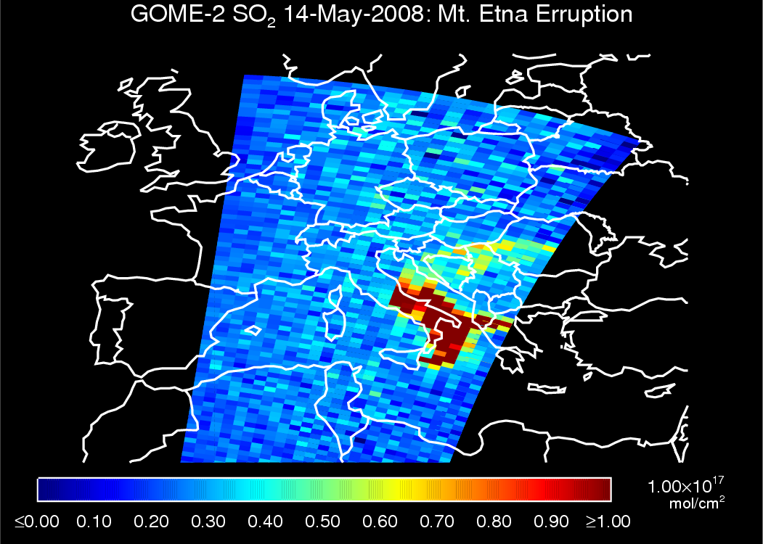

Slide 15
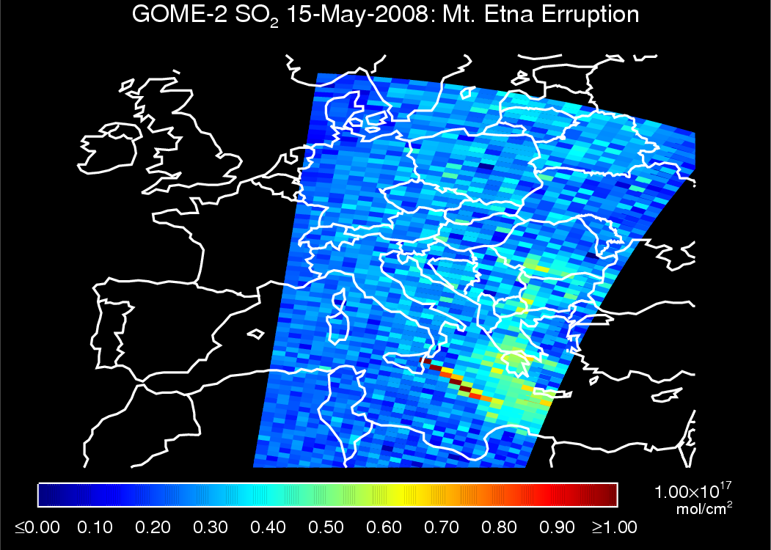

Slide 16
Spectral Fits
1 Dobson Unit (DU) =
2.69 molecules/cm²

Slide 17
SO₂ Profiles and Averaging Kernels

Slide 18
Global SO₂ from GOME-2: 2007
Cloud fraction < 0.2, Solar Zenith Angle < 70°, no ice or snow-covered pixels

Slide 19
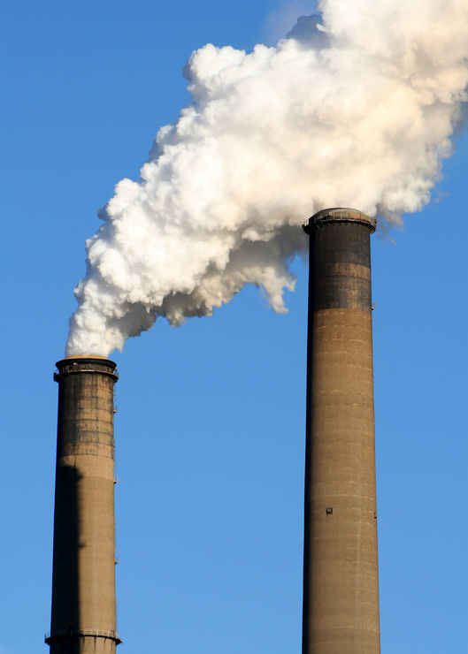
Anthropogenic SO₂

Slide 20
North American Surface Networks
EPA (Environmental Protection Agency)
AQS (Air Quality System)
Various sites: background, urban, industrial…
Hourly measurements
CASTNET (Clear Air Status and Trends Network)
Background sites
Weekly averages
Environment Canada
NAPS (National Air Pollution Surveillance)
Sites usually in populated areas
Hourly measurements
Comparisons: 40 km and 1 hour, use N > 100 coincidences

Slide 21
North American Surface SO₂: 2008

Slide 22
North American Surface SO₂: 2008
Excellent correlation with CASTNET, but ~2.5 overestimation
Diurnal variability in mixing layer depth + boundary layer chemistry? (Lee et al., 2010)
AQS/NAPS: More difficulty distinguishing localized SO₂ sources

Slide 23
Surface SO₂ from Nested Model

Slide 24
GOME-2 vs. EANET Surface SO₂: 2007
R = 0.65

Slide 25
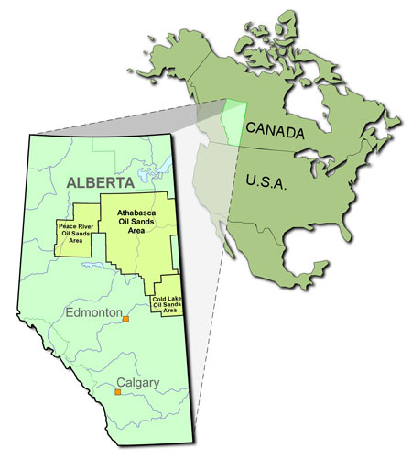
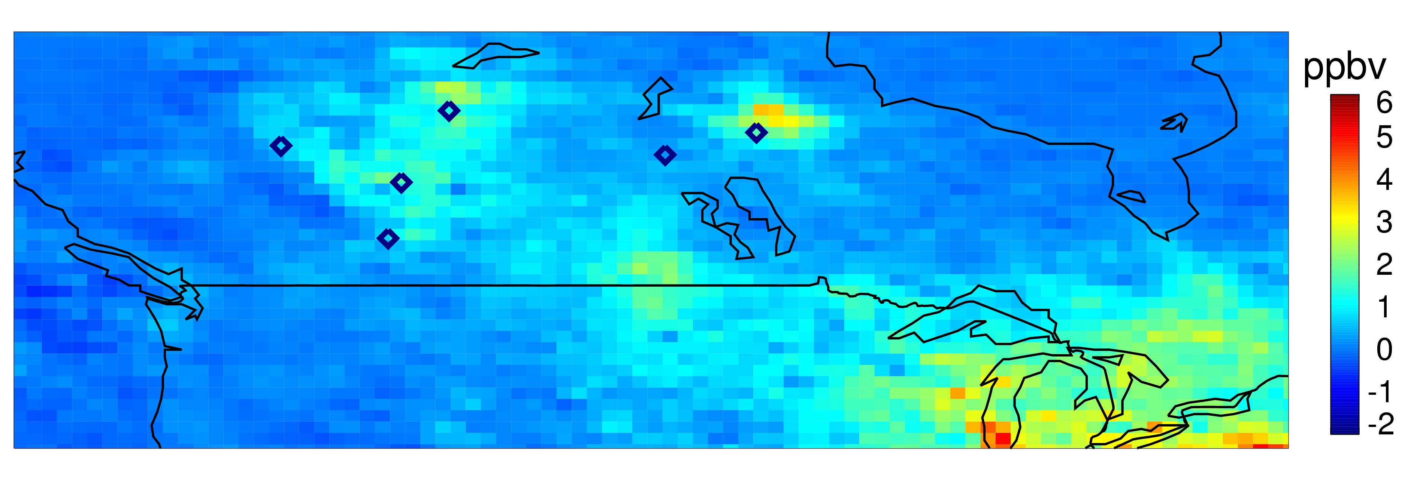
Canadian SO₂ Pollution
Top single emitters (2009):
Hudson Bay Mining and Smelting Flin Flon, Manitoba (144 kT)
Vale Inco Thompson, Manitoba (143 kT)
Syncrude Canada Mildred Lake, Alberta (81 kT)
2007
Grande Prairie
Ft. McMurray
Thompson
Flin Flon
Edmonton
Calgary

Slide 26
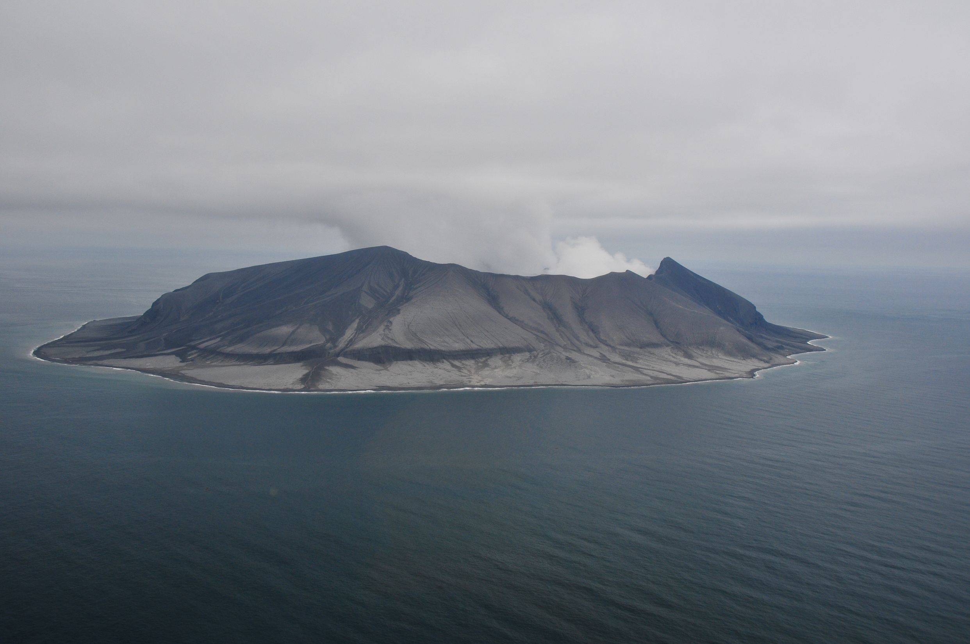
Volcanic SO₂
Mount Kasatochi, Alaska
Courtesy: AVO/USGS (Chris Waythomas)

Slide 27
SO₂ Altitude Weighting Functions

Slide 28
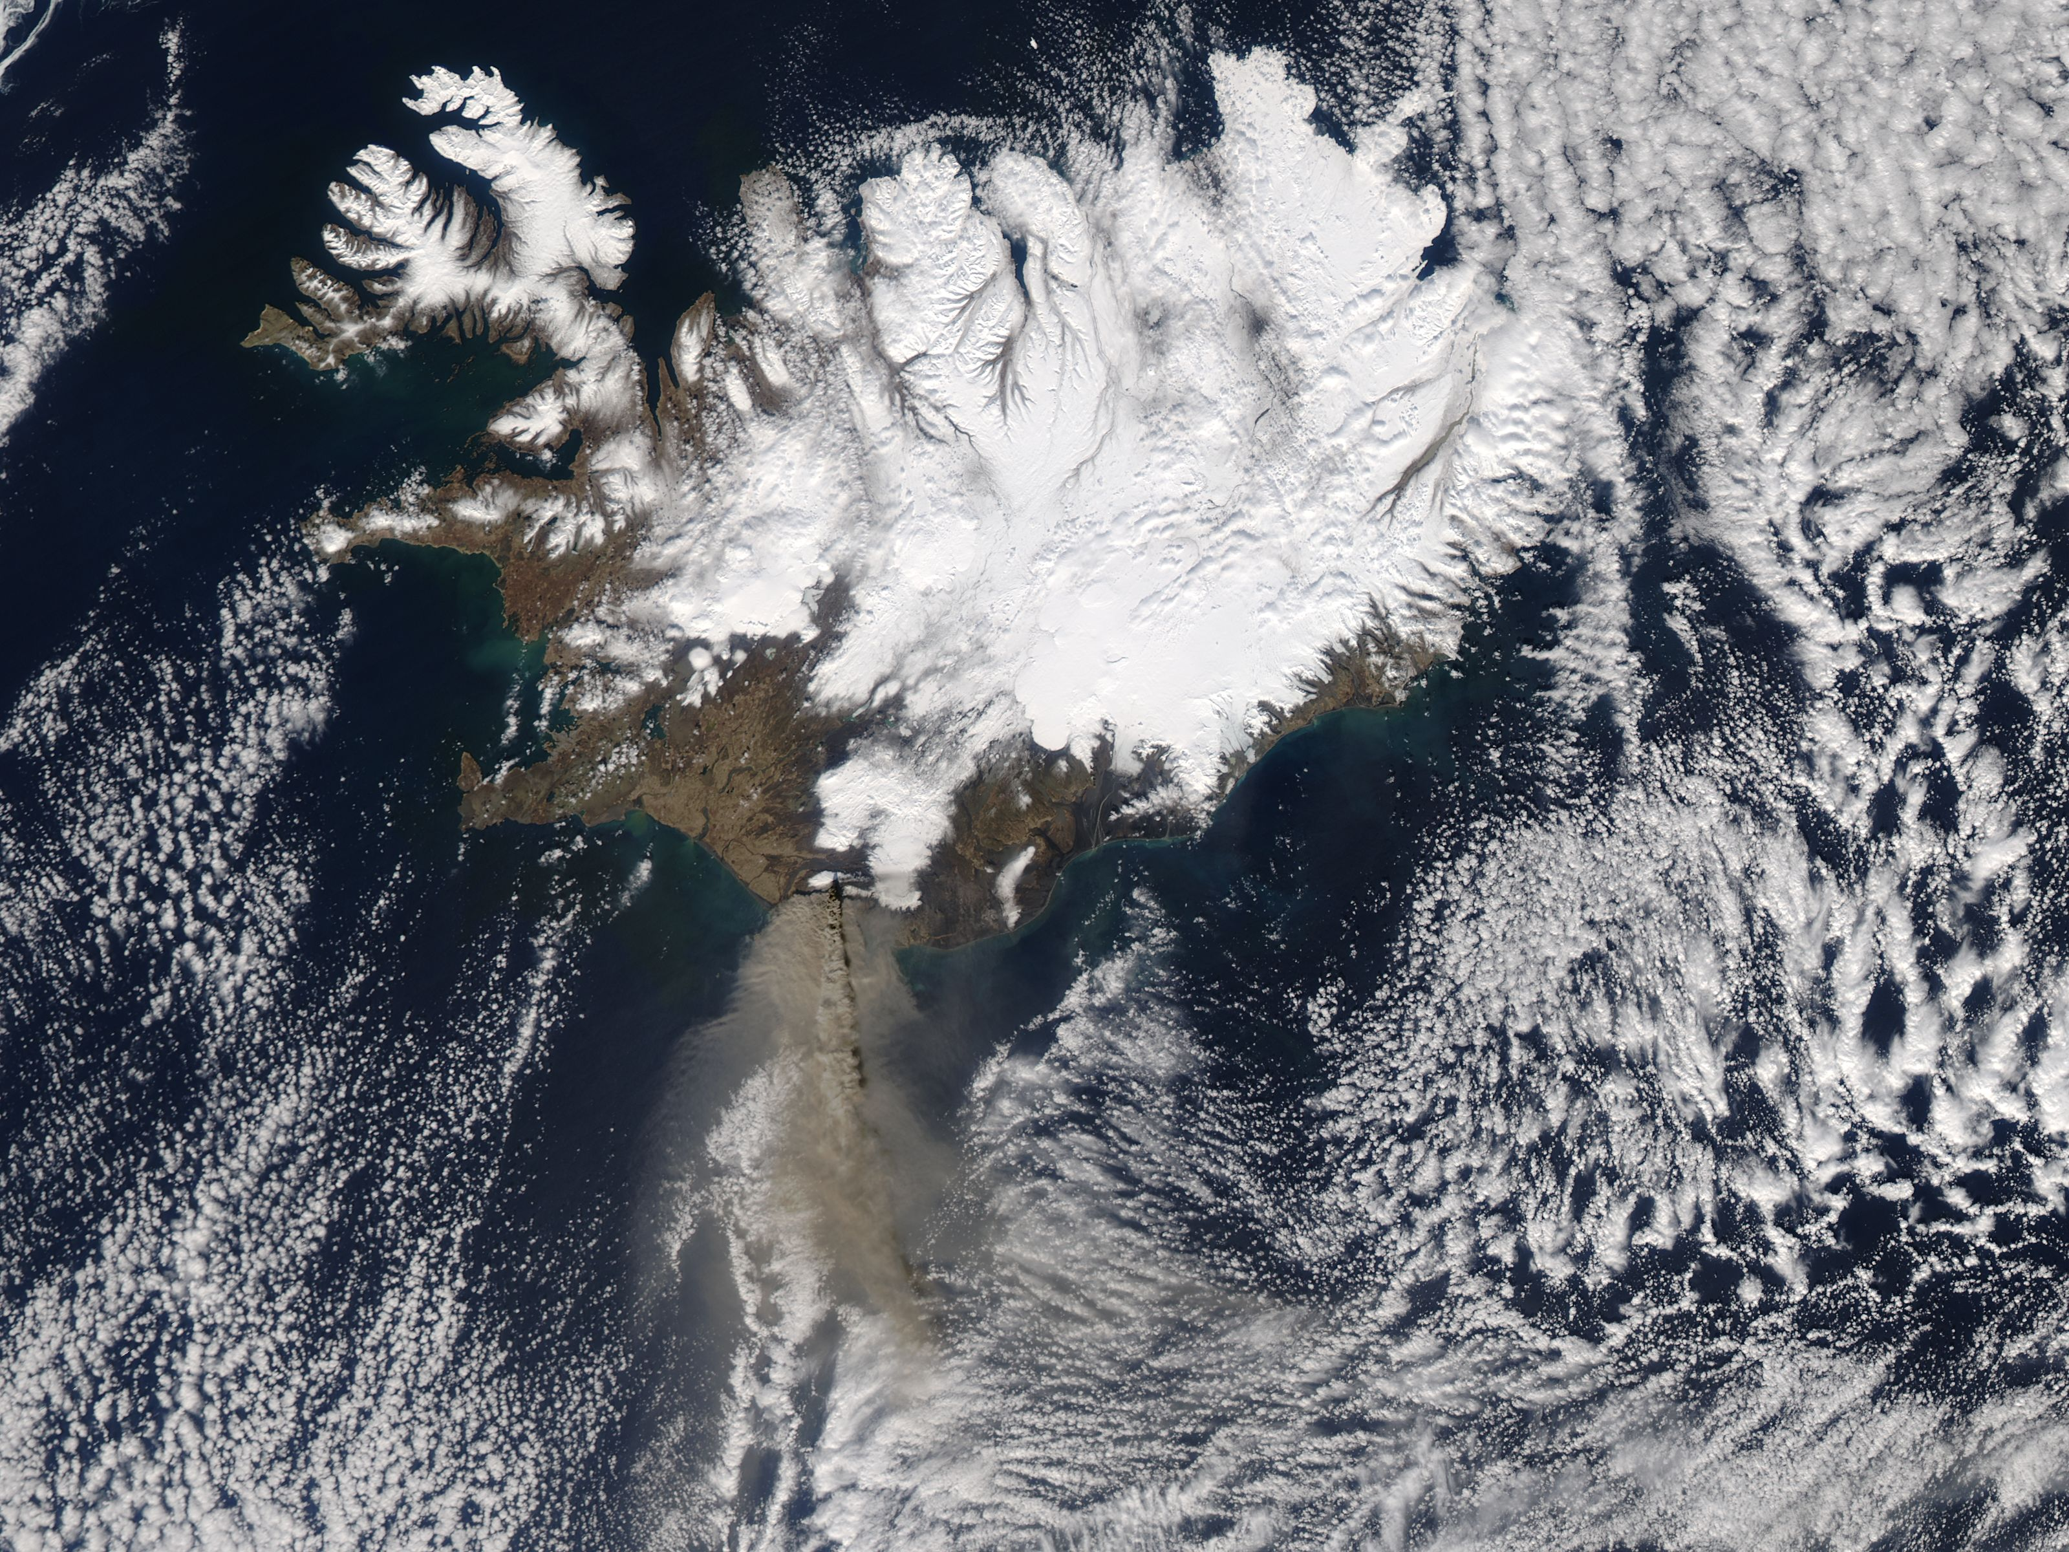
Eyjafjallajökull
MODIS
April 17, 2010

Slide 29
Eyjafjallajökull, Iceland May 5th, 2010
A priori SO₂ altitude = 5 km
Uncertainty = 5 km
Altitudes shown for SO₂ vertical column > 1 DU

Slide 30
GOME-2 and OMI SO₂
Mt. Kasatochi, Alaska
9 August 2008
A priori SO₂ altitude = 10 km
Uncertainty = 2 km

Slide 31
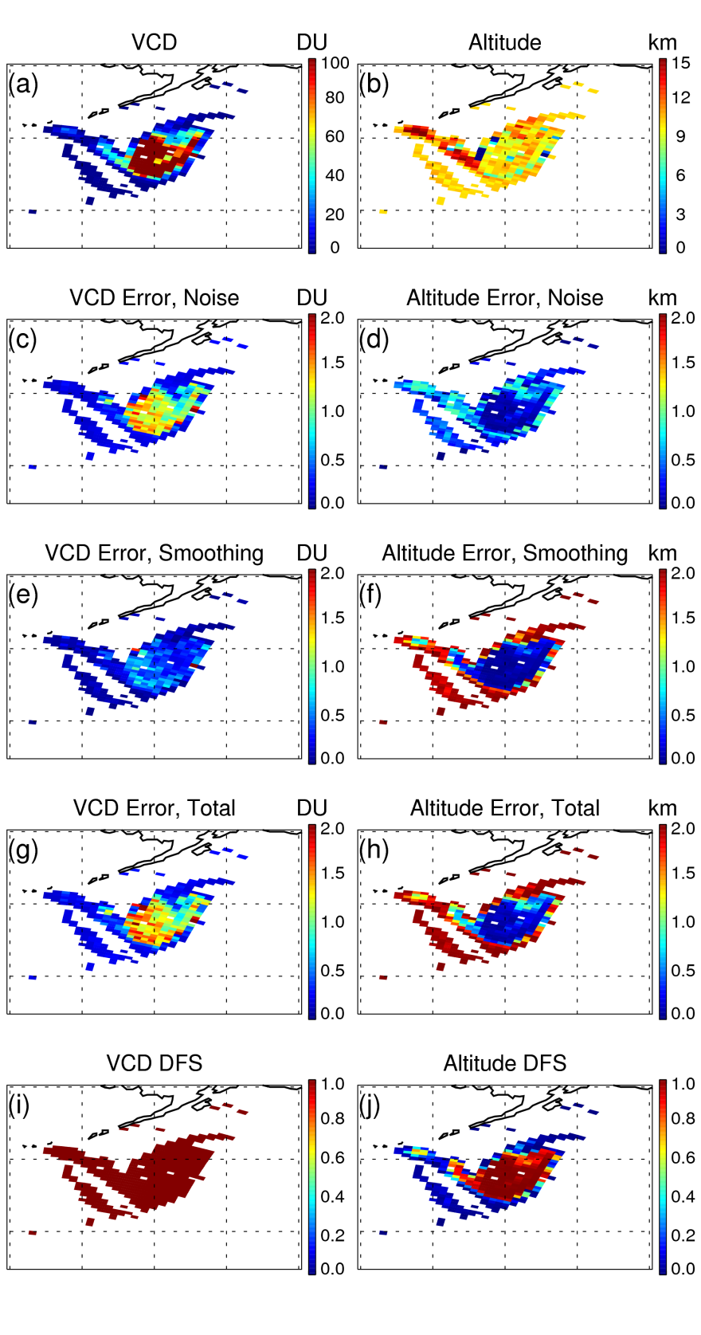
Can use altitude degrees of freedom for signal to look at how much altitude information really exists
DFS > 0.9 for SO₂ column > 30 DU

Slide 32
SO₂ Tonnage Comparisons Mt. Kasatochi, 9 August 2011
GOME-2 total SO₂ mass from these retrievals compares well with recent OMI and IASI retrievals
Instrument/Retrieval | Total Tonnage
GOME-2 (shown here) | 1.6 Tg (Nowlan et al., 2011)
OMI | 1.6 Tg (Yang et al., 2010)
IASI | 1.6 Tg (Karagulian et al., 2010)
GOME-2 (Bremen) | 2.5 Tg (Richter et al., 2009)
AIRS | 1.2 Tg (Prata et al., 2010)
FLEXPART in combination with satellite data | 1.7 Tg (Kristiansen et al., 2010)
9-Aug-2008 only
Entire eruption

Slide 33
Volcanic SO2 Altitude Uncertainties
Aerosols are significant uncertainty
Size, type, altitude
Non-homogeneous distribution of SO₂ in field-of-view (Yang et al., 2010), mostly at edges of plume

Slide 34
Altitude Retrievals: Anthropogenic Pollution

Slide 35
Summary
Main considerations in UV-Visible nadir sounding:
Molecules
Scattering, clouds and aerosols
Instrument calibration
Approaches:
Basic spectral fitting
Optimal estimation
Spectral fitting can be used to derive SO₂ vertical columns and in some cases, additional information about altitude
The future:
Geostationary orbit for temporal resolution
Better ground resolution

Slide 36
Summary
GOME-2 vertical columns used to infer surface SO₂ using GEOS-Chem
North American background SO₂ pattern very well represented, but ~2.5:1 overestimation of weekly averages
Point sources are more difficult to represent
Combining Channels 1 and 2 looks promising
Next steps:
Apply GOME-2 for top-down emissions inventories (Lee et al., 2011)
Comparisons with OMI and SCIAMACHY results
Finish 2007-2010 reprocessing with current algorithm
Dataset should be available in coming months!

Slide 37
Mt. Kasatochi BrO

