Slide 1
UV/VIS backscattered Sun light retrievals from space born platforms
G. Gonzalez Abad
With a lot of help from K. Chance, X. Liu, C. Miller and others

Slide 2
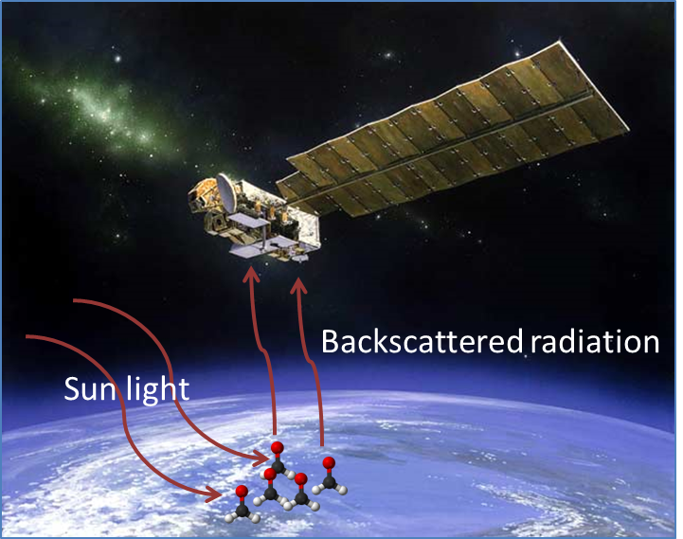

Slide 3
Overview
A bit of history on UV-VIS backscatter spectrometers
Past, present and future instruments (as far as I know)
TOMS vs. OMI
GOME vs. OMI
The GEO constellation
Slant column retrievals
The equations: BOAS
To have in mind (solar spectrum, cross sections, ring, undersampling, …)
Examples
Slant column to vertical column
Equations
Vertical columns: examples from OMI

Slide 4
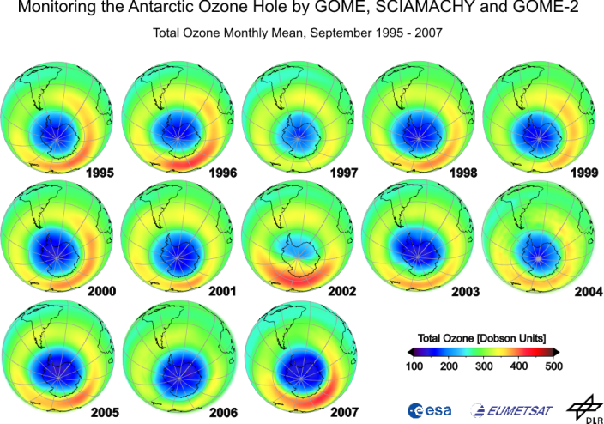
History: The DISCOVERY OF THE ozone hole fuelled the interest in the atmospheric chemistry and composition during the 1970s
USA
Europe

Slide 5
HISTORY & PRESENT: USA
Instrument | Satellite (Agency) | Period
BUV | Nimbus-4 (NASA) | 1970-1980
SBUV | Nimbus-7 (NASA) | 1978-1993
TOMS | Nimbus-7 (NASA) Meteor-3 (NASA) (Russian) Earth Probe (NASA) | 1978 1993 1996-2007
SBUV/2 | NOAA 9,10,11,13,14,17,16,18,19 (NOAA) | 1984 – present
OMI | AURA (NASA/KNMI) | 2004-present
OMPS | SUOMI-NPP (NOAA) | 2011-present

Slide 6
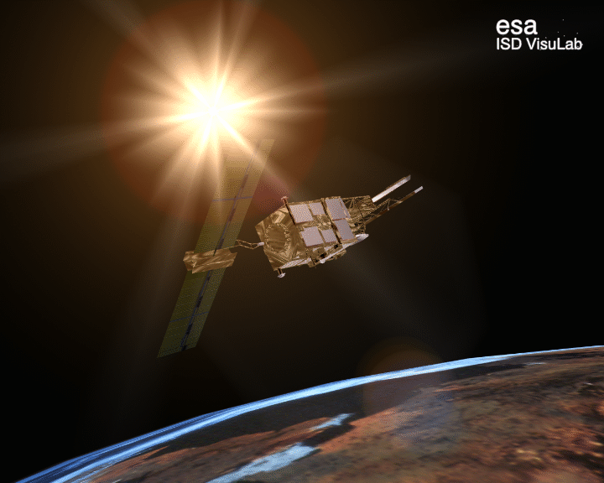
HISTORY & PRESENT: Europe & CHINA
Instrument | Satellite (Agency) | Period
GOME | ERS-2 (ESA) | 1995-2011
SCIAMACHY | ENVISAT (ESA) | 2002-2012
OMI | AURA (KNMI/NASA) | 2004-present
GOME2 | Metop-A (EUMETSAT) Metop-B (EUMETSAT) | 2006-present 2012-present
TOU/SBUS | FY-3A (NRSCC) FY-3B (NRSCC) FY-3C (NRSCC) | 2008-present

Slide 7
Future instruments
Instrument | Satellite (Agency) | Orbit
OMPS | JPSS1 (NOAA) JPSS2 (NOAA) | LEO LEO
TROPOMI | SENTINEL 5P (ESA) | LEO
GOME-2 | Metop-C (EUMETSAT) | LEO
UVAS | Seosat-Ingenio (CDTI) | LEO
UVN | SENTINEL 4 (ESA) | GEO
GEMS | MP-GEOSAT (KORA) | GEO
TEMPO | TBD (NASA/SMITHSONIAN) | GEO

Slide 8
Toms vs. omi
 | TOMS (Nimbus-7) | OMI
Spectral coverage | 312.5 nm 317.5 nm 331.3 nm 339.9 nm 360.0 nm 380.0 nm | UV1: 270-314 nm UV2: 306-380 nm VIS: 350-500 nm
Bandwidth, resolution | 1.1 nm | 0.63 – 0.45 nm
Ground pixel size (nadir) | 50 x 50 km² | 13 x 24 km²
Global coverage | Daily | Daily

Slide 9
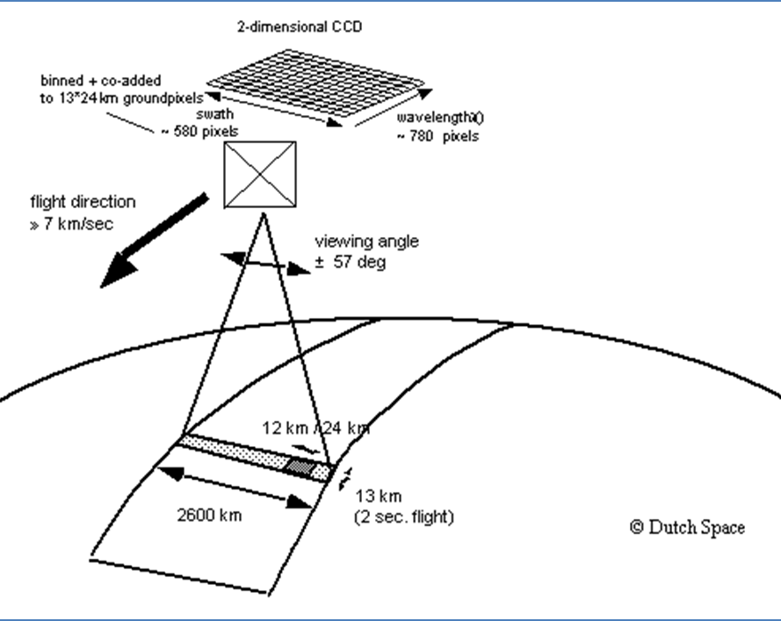
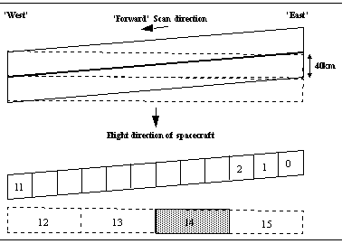
GOME vs. OMI
GOME
OMI
Photodiode detectors 1024 pixels
2D CCD detector

Slide 10
THE GEO CONSTELLATION
& Kelly Chance

Slide 11
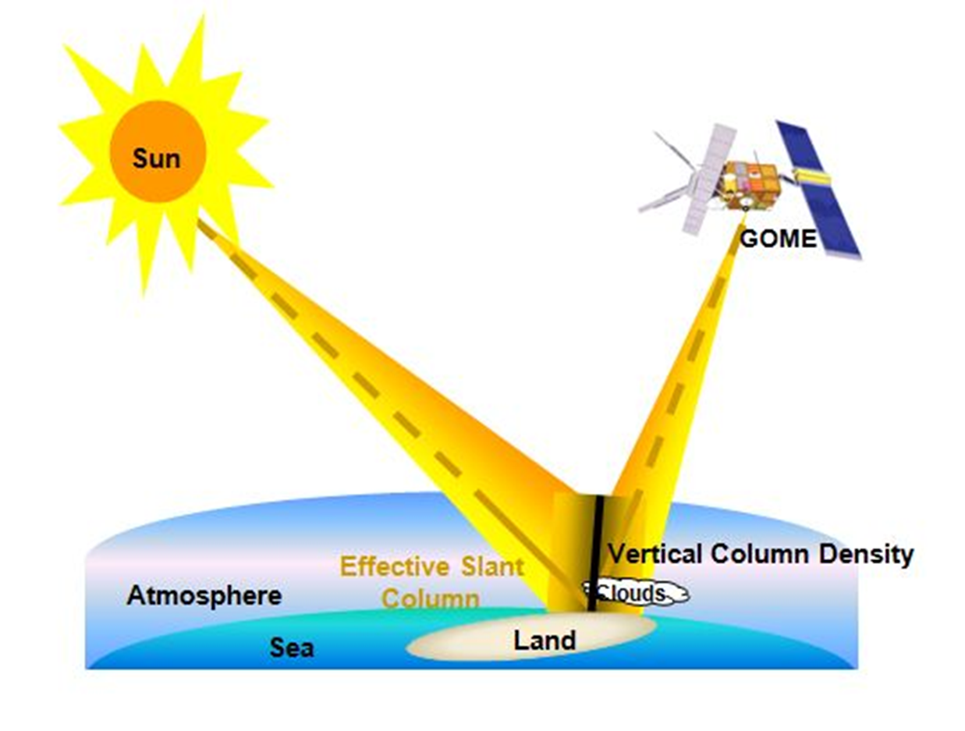
Slant column retrieval

Slide 12
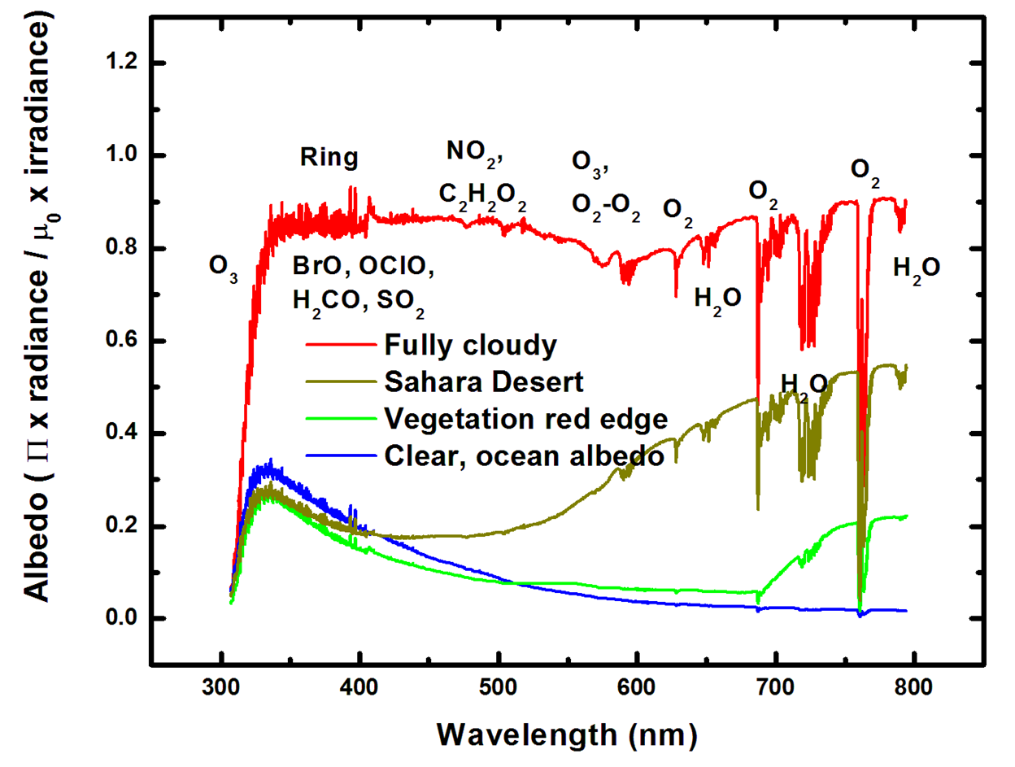
Slant column retrieval

Slide 13
SLANT COLUMN RETRIEVAL: BOAS
$$χ^{2}=\sum_{i}{{\left(y_{i}−f(λ_{i},β)\right)}^{2}}$$
$$I={\left[(aI_{o}+\sum_{i}{α_{i}X_{i})e^{−\sum_{j}{α_{j}X_{j}}}+\sum_{k}{α_{k}X_{k}}}\right]ScalPoly+BasePoly}_{}$$
$$ε=β−\hat{β}$$

Slide 14
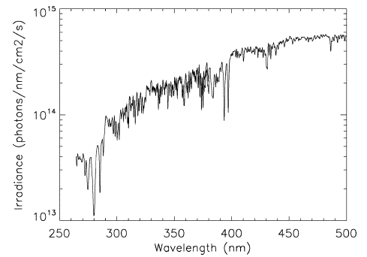
SLANT COLUMN RETRIEVAL: Irradiance
$$I={\left[(aI_{o}+\sum_{i}{α_{i}X_{i})e^{−\sum_{j}{α_{j}X_{j}}}+\sum_{k}{α_{k}X_{k}}}\right]ScalPoly+BasePoly}_{}$$
OMI irradiance, Dobber at al. 2006

Slide 15
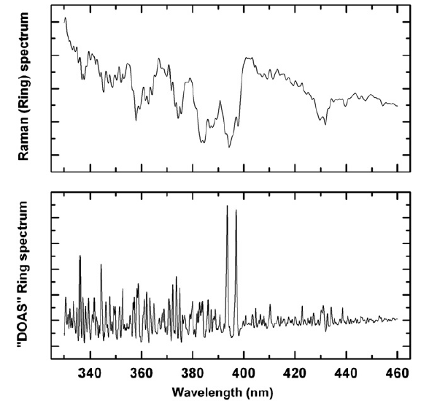
SLANT COLUMN RETRIEVAL: ring spectrum
$$I={\left[(aI_{o}+\sum_{i}{α_{i}X_{i})e^{−\sum_{j}{α_{j}X_{j}}}+\sum_{k}{α_{k}X_{k}}}\right]ScalPoly+BasePoly}_{}$$
Chance and Kurucz
2010

Slide 16
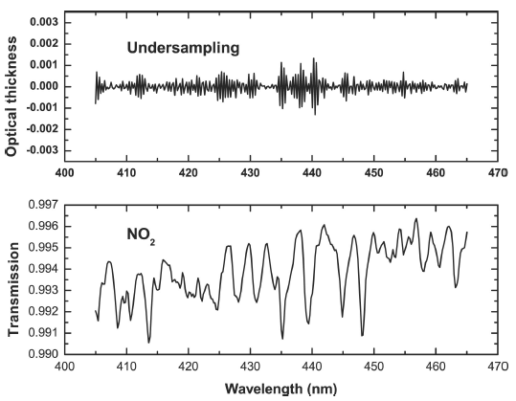
SLANT COLUMN RETRIEVAL: Undersampling
$$I={\left[(aI_{o}+\sum_{i}{α_{i}X_{i})e^{−\sum_{j}{α_{j}X_{j}}}+\sum_{k}{α_{k}X_{k}}}\right]ScalPoly+BasePoly}_{}$$
Chance et. Al, 2005

Slide 17
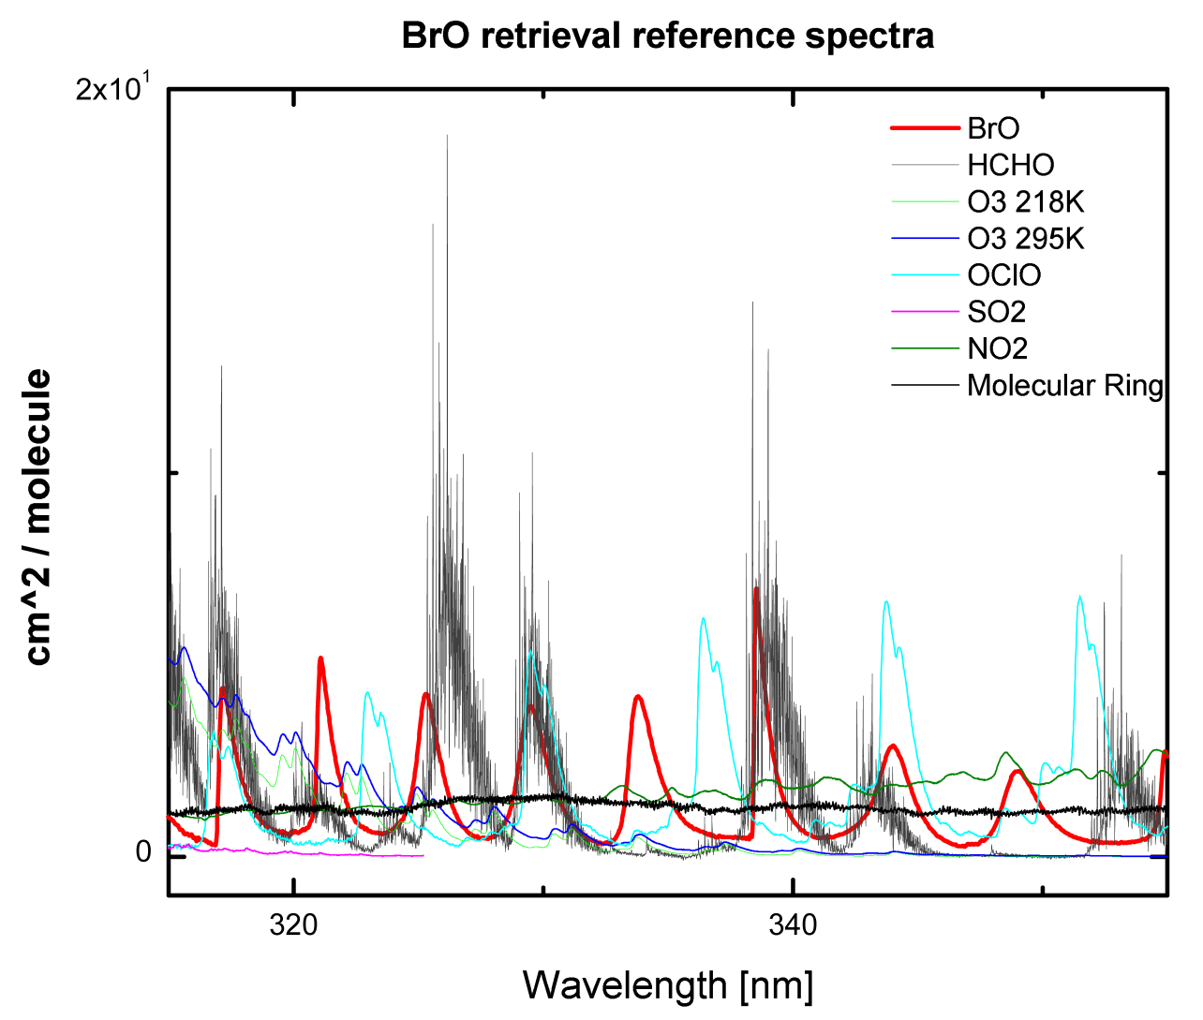
SLANT COLUMN RETRIEVAL: cross sections
$$I={\left[(aI_{o}+\sum_{i}{α_{i}X_{i})e^{−\sum_{j}{α_{j}X_{j}}}+\sum_{k}{α_{k}X_{k}}}\right]ScalPoly+BasePoly}_{}$$

Slide 18
SLANT COLUMN RETRIEVAL: common mode
$$I={\left[(aI_{o}+\sum_{i}{α_{i}X_{i})e^{−\sum_{j}{α_{j}X_{j}}}+\sum_{k}{α_{k}X_{k}}}\right]ScalPoly+BasePoly}_{}$$

Slide 19
SLANT COLUMN RETRIEVAL: optical depth
Courtesy: IUP-IFE, University of Bremen

Slide 20
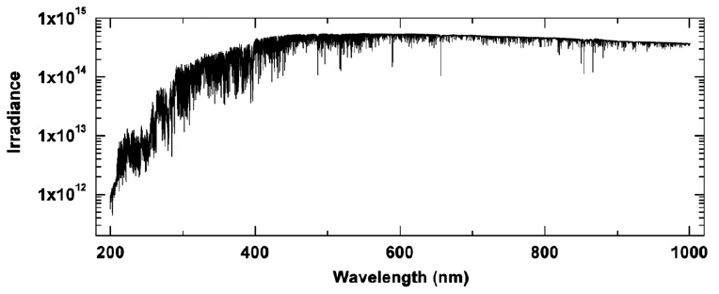
SLANT COLUMN RETRIEVAL: HIGH resolution solar spectrum
Chance & Kurucz, 2010

Slide 21
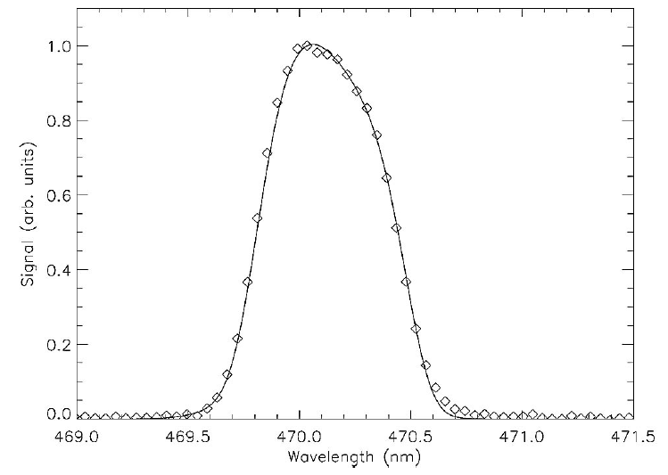
SLANT COLUMN RETRIEVAL: SLIT FUNCTION
Dirksen et al. 2006

Slide 22
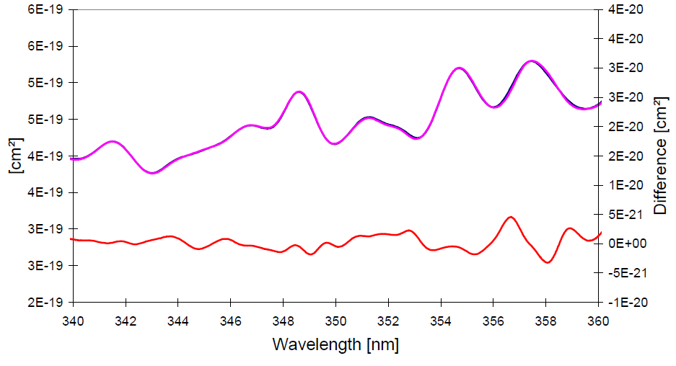
SLANT COLUMN RETRIEVAL: i₀ correction
Wagner, Chance et al.

Slide 23
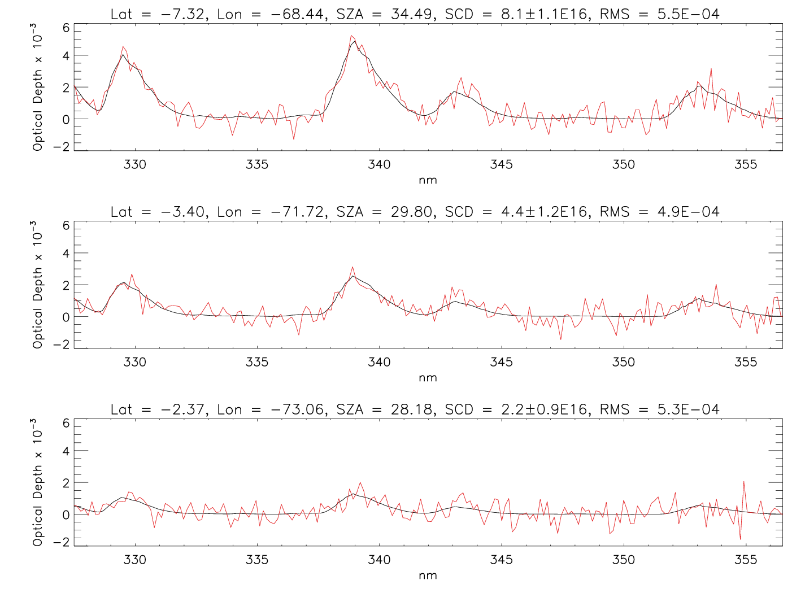
Slant column retrieval: OMI C₂HO

Slide 24
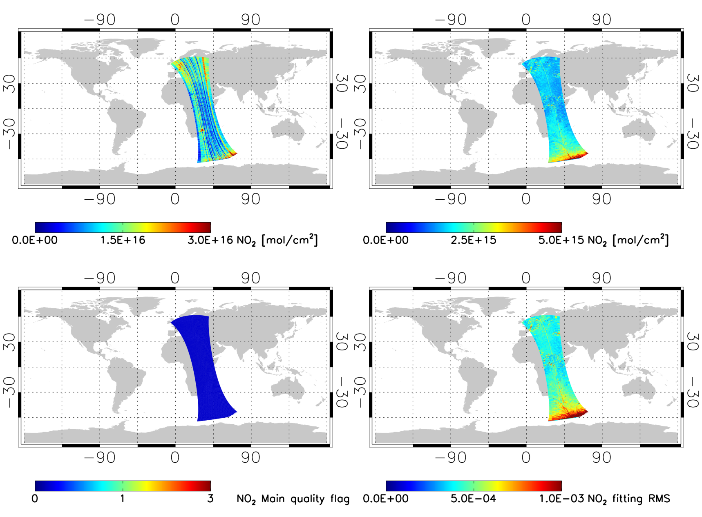
Slant column retrieval: OMPS NO₂

Slide 25
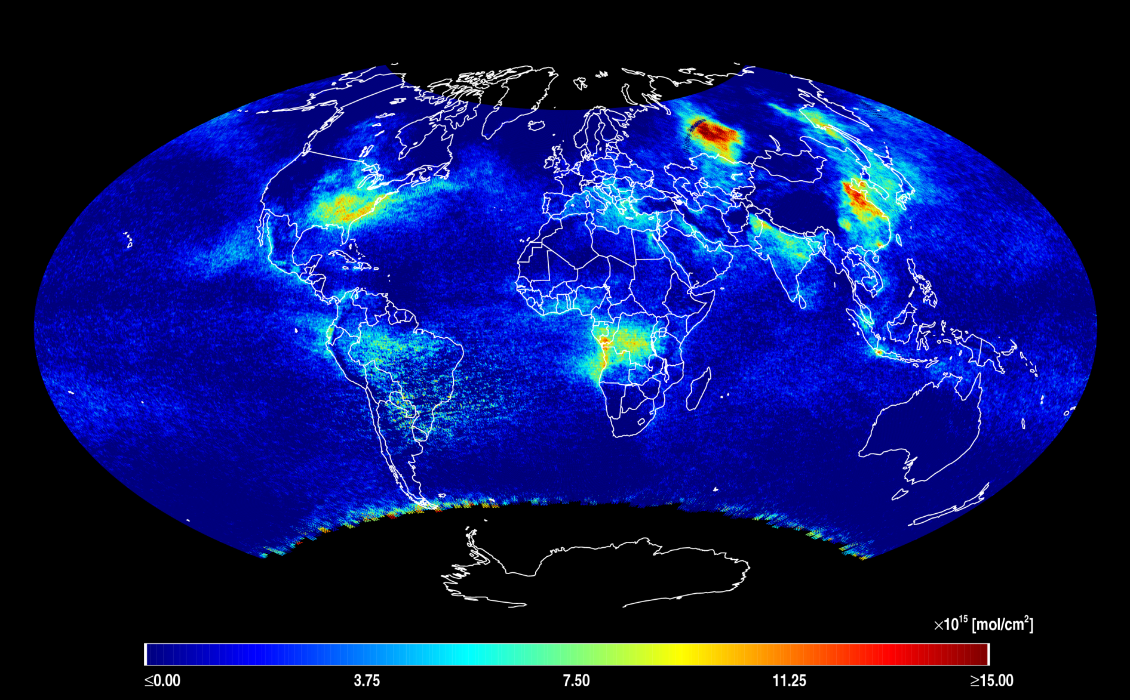
Slant column retrieval: OMPS C₂HO

Slide 26
Vertical column: equations
$$VCD=\frac{SCD}{AMF}$$
AMF (Air Mass Factor)

Slide 27
Vertical column: equations
$$AMF= \int_{atm}{w\left(z\right)S_{z}(z)dz}$$
w(z) Scattering weights from Vlidort
S_{x} (z) shape factors from a climatology for example GEOS-Chem

Slide 28
Vertical column: equations, Shape factors
$$S\left(z\right)=\frac{x_{a}(z)}{\int_{atm}{x_{a}\left(z\right)dz}}$$

Slide 29
Vertical column: EQUATIONS scattering weights
$$w\left(z\right)= \frac{∂I/∂z}{I \sum{x_{z}}}$$
Cloudy SZA: 28°
Clear SZA: 24°
Cloudy VZA: 16°
Clear VZA: 2.7°
Cloudy cloud fraction: 0.2
Clear cloud fractions: 0.01

Slide 30
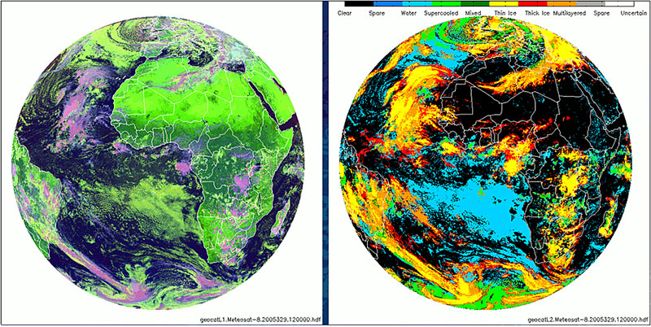
Vertical column: equations SINGEL PIXEL approximation
$$w\left(z\right)=\left(1−∅\right)w_{clear}\left(z,a_{s},h_{s}\right)+∅w_{cloud}(z,a_{c},h_{c})$$

Slide 31
Generic retrieval framework
Typical retrieval flow chart for a retrieval
L1 data
Read L1 data
Auxiliary data
Read auxiliary data
Wavelength calibration using high resolution solar spectrum
Compute I0 correction
Compute under sampling spectrum
Compute Ring spectrum
Compute Common mode spectrum
Direct fitting of slant columns
Look up tables and climatology for AMF calculation
Read look up tables & climatology
Compute AMFs
Compute vertical columns
Post processing (if needed)

Slide 32
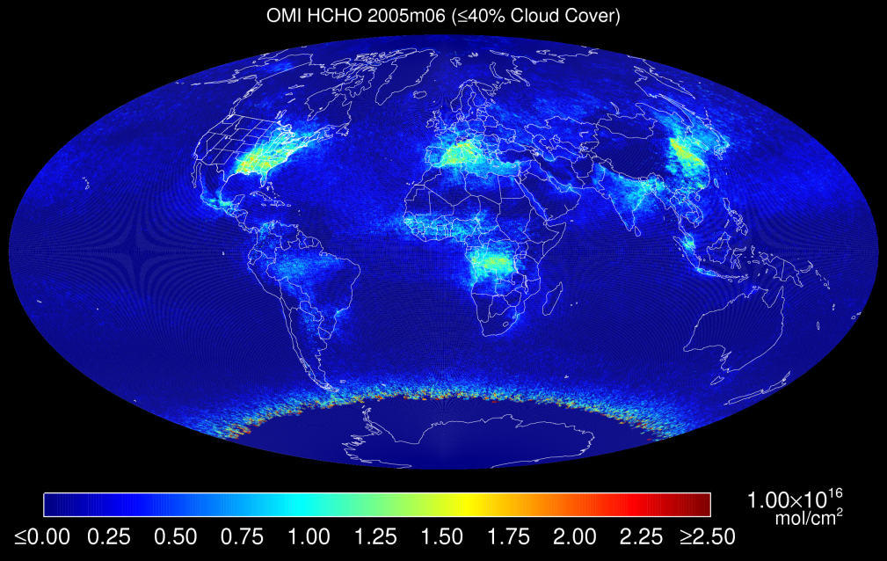
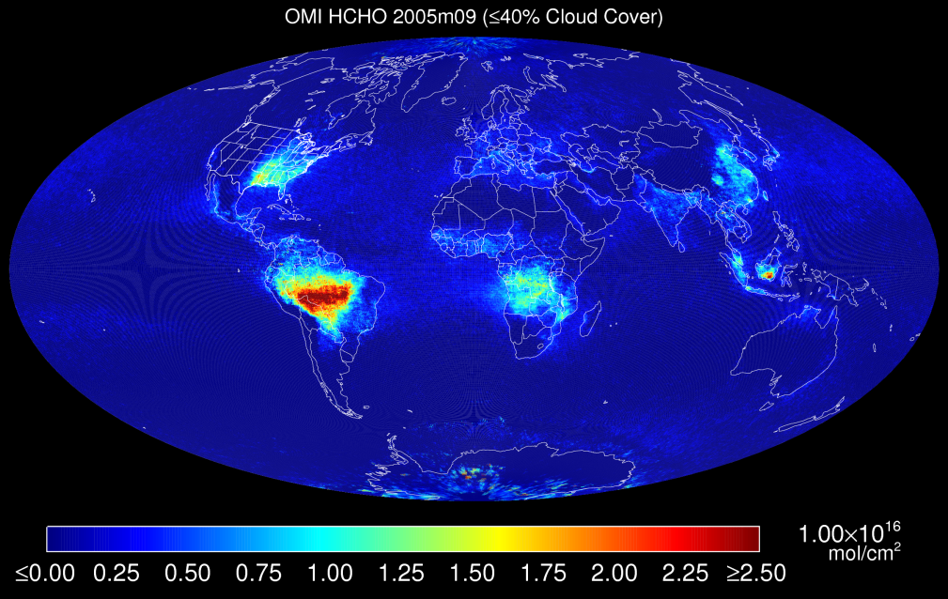
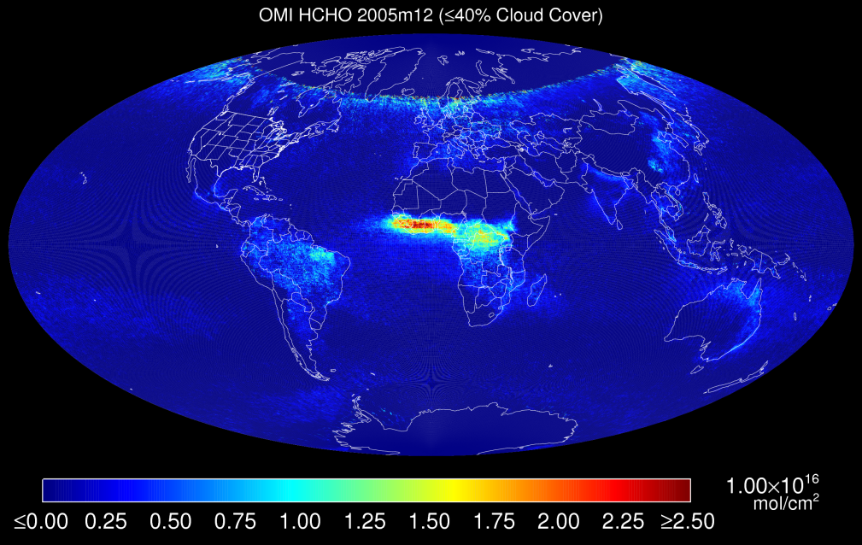
VERTICAL column retrieval: OMI C₂HO

Slide 33
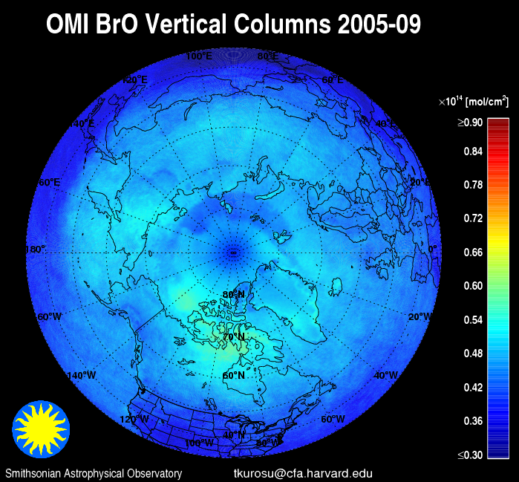
VERTICAL column retrieval: OMI Bro

Slide 34
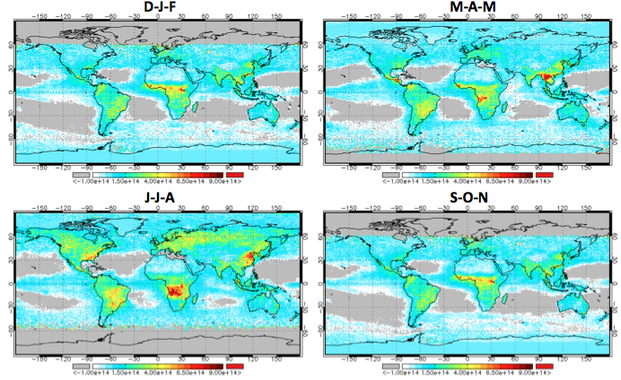
VERTICAL column retrieval: OMI C₂H₂O₂

Slide 35
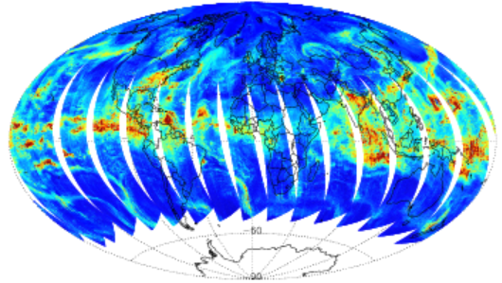
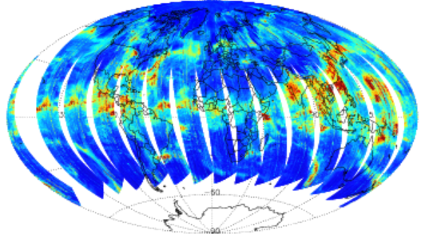
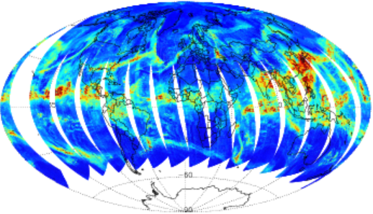
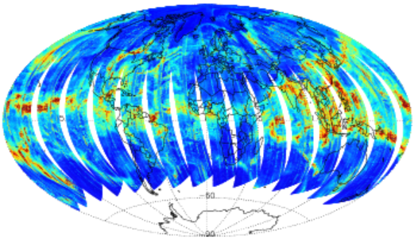
VERTICAL column retrieval: OMI H₂O
20050714
20110714
20070714
20130714

Slide 36
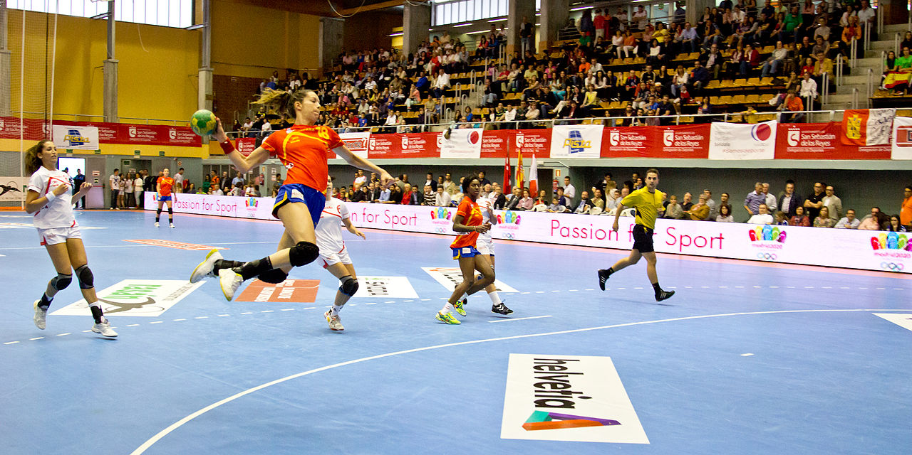
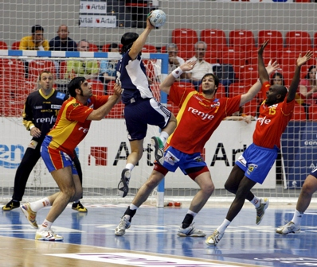
THE END
PLUS TEAM HANDBALL

Slide 37
OMI operational HCHO
Fitting window | 327.5 – 356.5 nm
Baseline polynomial | 3rd order
Scaling polynomial | 3rd order
Instrument slit function | Hyper-parameterization of pre-flight measurements
Wavelength calibration | Spectral shift (no squeeze)
Solar Reference Spectrum | Chance and Spurr, 1997
HCHO cross sections | Cantrell et al., 1990; 300K
O₃ cross sections | Macilet et al., 1995; 228K
NO₂ cross sections | Vandaele et al., 1998 220K
BrO cross sections | Wilmouth et al., 1999; 228K
Molecular Ring cross sections | Chance and Spurr, 1997
Sampling correction | Computed on-line
Residual common mode spectrum | Computed on-line

Slide 38
OMI CHOCHO
Fitting window | 431.5 – 469.5 nm
Baseline polynomial | 4th order
Scaling polynomial | 3rd order
Instrument slit function | Hyper-parameterization of pre-flight measurements
Wavelength calibration | Spectral shift (no squeeze)
Solar Reference Spectrum | Chance and Spurr, 1997
CHOCHO cross sections | Volkamer et al., 2005; 296K
O₃ cross sections | Macilet et al., 1995; 228K
NO₂ cross sections | Vandaele et al., 1998 220K
O₂-O₂ cross sections | Hermans BISA, 2006; 294K
H₂O cross sections | HITRAN 2008, 280K
Liquid H₂O cross sections | Pope and Fry, 1997
IO cross sections | Spietz et al., 2005; 298K
Vibrational Raman Spectrum | Chance and Spurr, 1997
Molecular Ring cross sections | Chance and Spurr, 1997
Sampling correction | Computed on-line
Residual common mode spectrum | Computed on-line

Slide 39
OMI operational BrO
Fitting window | 319.0 – 347.5 nm
Baseline polynomial | 4^{rh} order
Scaling polynomial | 4th order
Instrument slit function | Hyper-parameterization of pre-flight measurements
Wavelength calibration | Spectral shift (no squeeze)
Solar Reference Spectrum | Chance and Spurr, 1997
HCHO cross sections | Cantrell et al., 1990; 300K
O₃ cross sections | Macilet et al., 1995; 218K; 295K
NO₂ cross sections | Vandaele et al., 1998 220K
BrO cross sections | Wilmouth et al., 1999; 228K
O₂-O₂ cross sections | Hermans BISA, 2006; 294K
SO₂ cross sections | Hermans et al., 2009; 295K
OClO cross sections | Kromminga et al,. 2003; 213K
Molecular Ring cross sections | Chance and Spurr, 1997
Sampling correction | Computed on-line
Residual common mode spectrum | Computed on-line

Slide 40
OMI operational OClO
Fitting window | 358.5 – 392.0 nm
Baseline polynomial | 3rd order
Scaling polynomial | 3th order
Instrument slit function | Hyper-parameterization of pre-flight measurements
Wavelength calibration | Spectral shift (no squeeze)
Solar Reference Spectrum | Chance and Spurr, 1997
O₃ cross sections | Macilet et al., 1995; 228K
NO₂ cross sections | Vandaele et al., 1998 220K
BrO cross sections | Wilmouth et al., 1999; 228K
O₂-O₂ cross sections | Hermans BISA, 2006; 294K
OClO cross sections | Kromminga et al,. 2003; 213K
Molecular Ring cross sections | Chance and Spurr, 1997
Sampling correction | Computed on-line
Residual common mode spectrum | Computed on-line

Slide 41
GOME2 SO₂
Fitting window | 312.0 – 330.0 nm
Baseline polynomial | 3rd order
Scaling polynomial | 3rd order
Instrument slit function | Asymmetric Gaussian fitted online
Wavelength calibration | Spectral shift (no squeeze)
Solar Reference Spectrum | Chance and Spurr, 1997
SO₂ cross sections | Bogumil et al., 2003; 293K
HCHO cross sections | Meller and Moortgat et al., 2000; 298K
O₃ cross sections | Brion et al., 1993; 218K, 273K
NO₂ cross sections | Vandaele et al., 1998 220K
BrO cross sections | Wilmouth et al., 1999; 228K
Molecular Ring cross sections | Chance and Spurr, 1997
Sampling correction | Computed on-line
Residual common mode spectrum | Computed on-line

